Slide 1
Machine Learning in Genetic Disorder & Disorder Subclass Prediction
Date: 25-4-2024

Slide 2
Outline
Introduction, History & Context
What is Genomics
Data in Genomics
Phases and Goal of the model

Slide 3
Introduction
History and Context
By the end of the 21st century, the world's population may exceed 11 billion.
As per reports, because of the unsustainable increase in population the number of genetic disorders have increased.
Hereditary illnesses are becoming more common due to a lack of understanding about the need for genetic testing.
Often kids die because of these illnesses, thus genetic testing during pregnancy is critical.

Slide 4
What is Genomics?
Genomics is the branch of molecular biology concerned with the structure, function, evolution, and mapping of genomes.
The genome is the entire set of DNA instructions found in a cell.
Genomic data is used in the field of Bioinformatics for collection, storage and processing of living being genomes.
Genomic data processing requires a significant amount of data storage and high-performance hardware and software for statistical analysis.
Notes:
https://www.youtube.com/watch?v=mmgIClg0Y1k

Slide 5
Data in Genomics
There are around 3.16 billion base pairs present in each human cell.
These DNAs are spread across in total of 46 chromosomes in a single human cell.
Machine Learning helps the genomics field:
1. Description of large-scale genomic datasets. 2. Annotation of wide variety of genomics sequence elements. 3. Predicting the influence of genetic variation on DNA sequences. 4. Determine the likelihood of developing a particular disease and to determine genetic heredity.

Slide 6
ML and Prevention Strategies
CRISPR
technologies enable early detection of genetic abnormalities, which can help prospective parents make informed decisions and prepare for any necessary medical interventions that might improve the quality of life of the affected child.
Couples at risk of passing genetic disorders to their children to ensure that only embryos without these disorders are implanted.
CRISPR, is a technology that allows scientists to edit genes precisely and efficiently, enabling targeted modifications to DNA sequences in organisms. It relies mainly on ML-Driven Target Identification which improves the precision of CRISPR.
Notes:
https://www.youtube.com/watch?v=p5G5aMnExpI

Slide 7
In short, why is ML in genetics important?
ML contributes to
the Prevention,
Diagnosis & Treatment
of genetic disorders.

Slide 8
Example of Data
Paper: Machine learning applications in genetics and genomics
Supervised
Data with labels
example: 'gene' or 'not gene'
Unsupervised
Finds patterns in datasets without the use of labels
Semi-Supervised
Combines both approaches
these labels are used to predict other examples
Finds patterns in labeled and unlabeled data to predict labels
Notes:
Reference: https://www.nature.com/articles/nrg3920

Slide 9
Genetic Disorders: Leading Cause of Child Mortality
Studies supporting this claim
Congenital malformations, deformations and chromosomal abnormalities have been reported to be the leading causes of infant death in the United States for the past 50 years.
Many, but not all, of these are associated with genetic diseases.
Several of the other nine leading causes of infant mortality are also associated with genetic diseases: including low birth weight and prematurity, sudden infant death syndrome, newborn sepsis, diseases of the circulatory system and neonatal hemorrhage
Notes:
Paper of Reference:
Measurement of genetic diseases as a cause of mortality in infants receiving whole genome sequencing

Slide 10
Genetic Disorders: Leading Cause of Child Mortality
Studies supporting this claim
“This study shows that a test, the basic (sequencing) element of which is now available for $200, is likely to have dramatic benefits if deployed early in the clinical course.”
Notes:
Reference: https://www.sandiegouniontribune.com/news/health/story/2023-02-09/how-many-babies-die-from-genetic-diseases#:~:text=Because%20these%20conditions%20do%20not,deaths%20had%20a%20genetic%20cause.

Slide 11
Goal of this Project:
ML model using data of children’s genetic information (7-14)
We will build a model that successfully classifies the genetic disorder and disorder subclass based on the dataset provided.
Here are the steps:
Data Loading and Exploration
Data Pre-Processing
Feature Selection
Model Selection
Model Training
Model Evaluation
Optimization and Tuning
Prediction and Deployment

Slide 12
The data
The data is available on kaggle.
The dataset folder contains the following: 19916r x 45 c
The dataset includes numerical and categorical values.
The dataset contains personal and comprehensive information regarding patients.

Slide 13
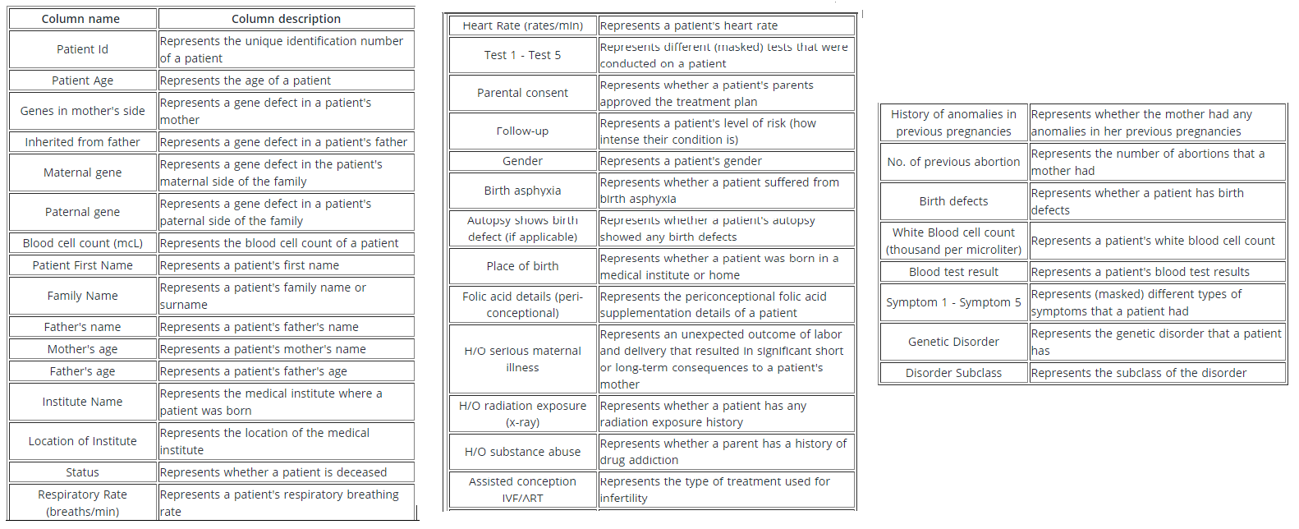
Details of each attribute of the dataset

Slide 14
3 types of genetic disorder in the dataset
Mitochondrial genetic inheritance disorders
Mitochondrial disorders impair the function of mitochondria, the tiny compartments in every cell of the body that produce the energy needed by cells.
Single-gene inheritance disease
Single gene disorders are caused by DNA changes in one particular gene, and often have predictable inheritance patterns.
Multifactorial inheritance disease
Multifactorial inheritance means that many factors are involved in causing a birth defect. The factors are usually both genetic and environmental, where a combination of genes from both parents, in addition to unknown environmental factors, produce the trait or condition.

Slide 15
MatLab Code

