Slide 1
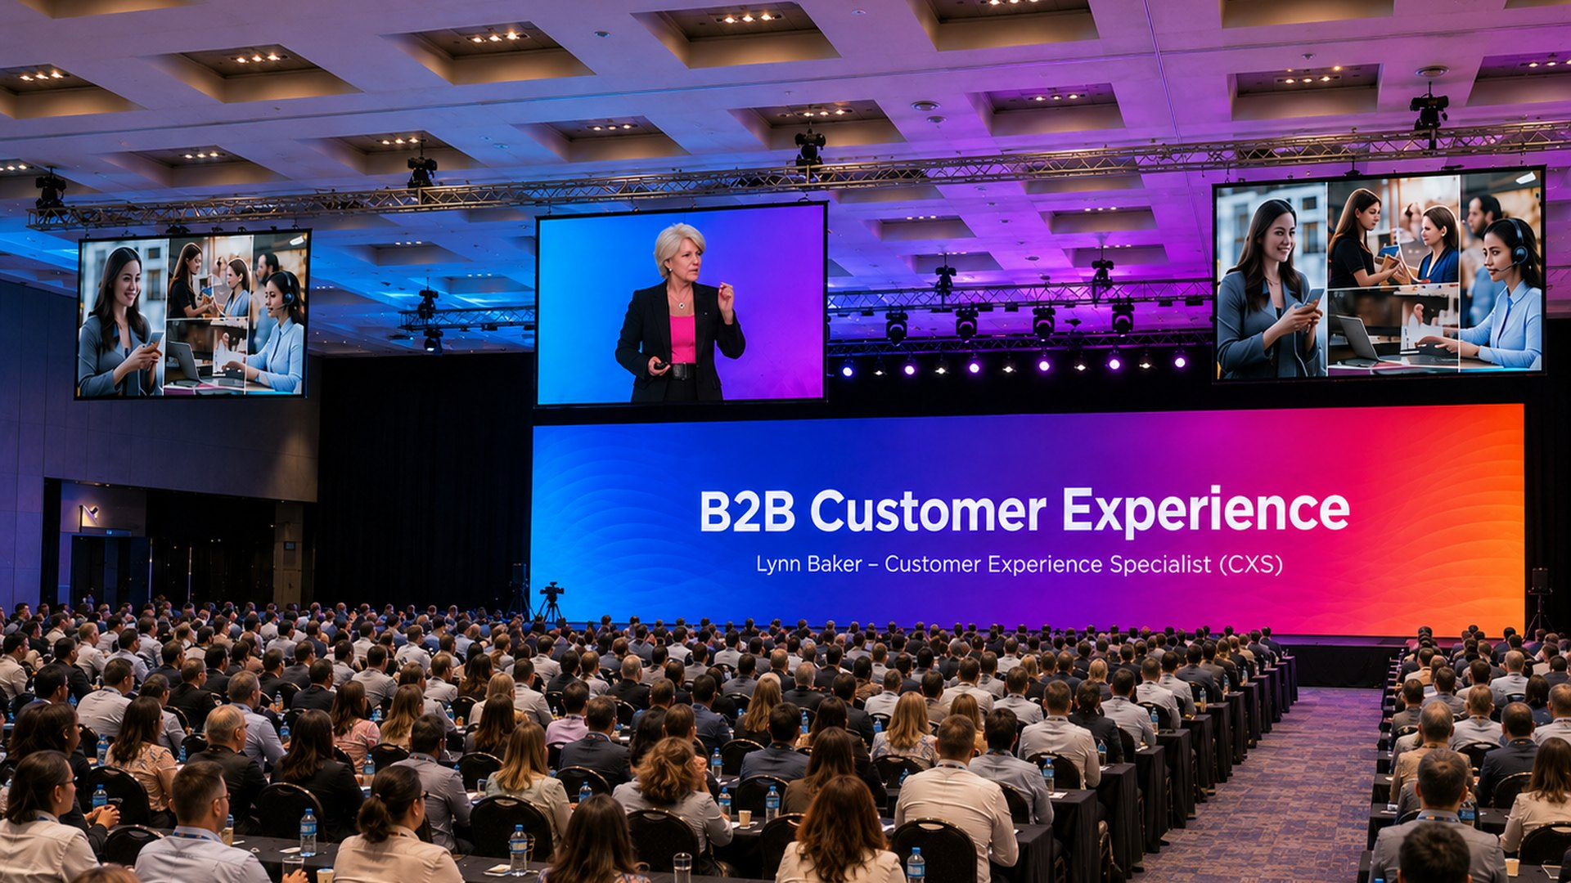
KEYNOTE | B2B CUSTOMER EXPERIENCE
B2B Customer Experience Reimagined
Client Partner Experience (CPX): Reframe - Realign - Retain
Lynn Baker - Customer Experience Specialist (CXS)

Slide 2
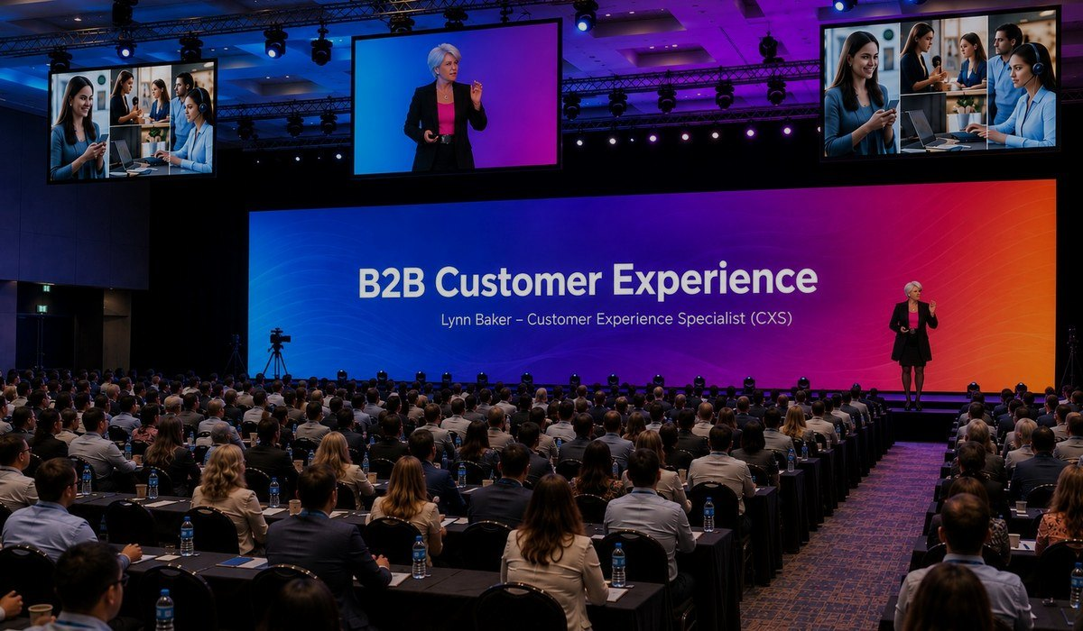
LYNN BAKER THE KEYNOTE
ABOUT THIS KEYNOTE
Designed for B2B leaders, account managers, sales executives, bid teams and account directors who are tired of being one spreadsheet away from being replaced.
This keynote challenges B2B teams to stop competing on products, services and price alone - and start proving their impact on the outcomes their clients value most: KPIs, profitability and growth.
Introducing the Reframe - Realign - Retain framework: a practical path to escape the vendor trap, demonstrate your value and become the strategic partner your clients cannot afford to lose.
FORMATS
45-60 min keynote
Half-day workshop
Virtual / hybrid
High-impact opening or closing keynote.
Teams apply the CPX framework to key accounts.
Same energy, designed for remote audiences.
Lynn Baker | Customer Experience Specialist (CXS)
B2B Customer Experience Reimagined

Slide 3
LYNN BAKER VALUE FOR YOUR AUDIENCE
WHAT AUDIENCES TAKE AWAY
IDEAL FOR
Why B2B relationships are won and lost on experience, not just price
How to reframe your value from supplier inputs to client outcomes
How to realign people, processes and proof around client priorities
How to retain and grow key accounts by making value visible
The difference between a replaceable vendor and a strategic partner
Practical actions bid teams and account directors can use immediately
B2B leadership conferences
Sales kick-offs and account offsites
Bid team strategy sessions
Professional services and consulting firms
Manufacturing and enterprise providers
Financial services and SaaS organisations
Lynn Baker | Customer Experience Specialist (CXS)
B2B Customer Experience Reimagined

Slide 4
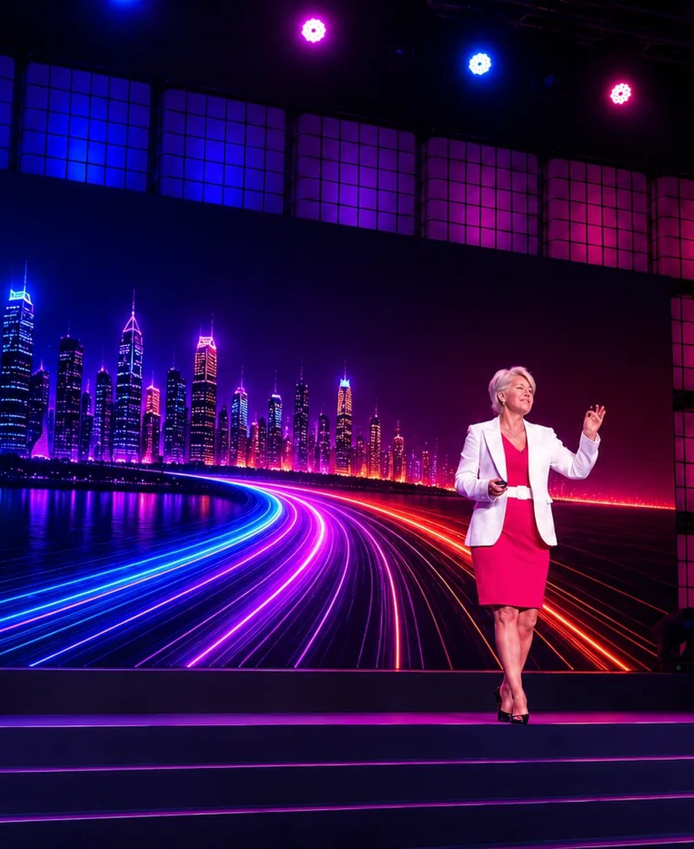
LYNN BAKER ABOUT THE SPEAKER
ABOUT LYNN BAKER
With more than 25 years specialising in Customer Experience, Lynn Baker is a leading keynote speaker and business strategist.
Disney Institute trained, Lynn served as Chair of Judges for the International Customer Experience Awards for six years, and is the founding CEO of the CX Institute SA and CX University SA.
Her presentations combine powerful storytelling, humour, practical business examples, audience interaction and actionable insights that challenge conventional thinking and inspire immediate action.
CREDENTIALS
Disney Institute trained
Chair of Judges - International CX Awards (6 years)
Founding CEO - CX Institute SA & CX University SA
Top 50 Women in CX (2019)
Lynn Baker | Customer Experience Specialist (CXS)
B2B Customer Experience Reimagined

Slide 5






LYNN BAKER PROOF
WHAT CLIENTS SAY
“
“
“
Lynn delivered a riveting keynote. She immediately drew in the audience and had them locked in for the full duration of the address.
Lynn's presentations hugely contributed in making these events impactful and memorable - in content and professionalism.
A total winner. Such an inspiration. It was short, sweet, simple, yet FREAKING DYNAMIC!
- Marketing Manager, Standard Bank
- Head: Client Experience, Nedbank
- Delegate feedback, Pfizer Sales Conference
TRUSTED BY
Lynn Baker | Customer Experience Specialist (CXS)
B2B Customer Experience Reimagined

Slide 6
LYNN BAKER INVESTMENT & BOOKING
SPEAKER FEES (FROM)
TECHNICAL RIDER
Johannesburg
ZAR 40,000
Countryman or wireless head-worn microphone
Screen / projection for slides
Good quality audio for video playback
Slide clicker and Wi-Fi connection
Preferably a comfort monitor
Durban
ZAR 45,000 + travel
Cape Town
ZAR 50,000 + travel
International
US$ 5,000 - 8,000
Travel, transfers and accommodation additional where applicable. Half-day workshops and virtual sessions on request.
BOOK LYNN FOR YOUR EVENT
Email lynn@cx-company.com Call / WhatsApp +27 82 457 5752 Web lynnbakerspeaker.com
Book a Discovery Call
Make an Enquiry
See Lynn in Action
Speaker Fees
Lynn Baker | Customer Experience Specialist (CXS)
B2B Customer Experience Reimagined

