Slide 1

KEYNOTE | BUSINESS SIMULATION
Keynote + The Customer Journey Game
Get your audience actively experiencing a real customer journey
Lynn Baker - Customer Experience Specialist (CXS)

Slide 2

LYNN BAKER THE KEYNOTE
ABOUT THIS KEYNOTE
Take your audience beyond listening and get them actively experiencing a real customer journey.
This powerful combination brings together Lynn's inspirational keynote and the power of interaction with The Customer Journey Game - a business simulation that looks like a board game; but in reality, it's a reflection of your customer's journey.
Teams walk in the shoes of the customer, make the decisions organisations make every day, and see first-hand where experience breaks down between departments and handovers.
FORMATS
120 min session
Fees
Available worldwide
Keynote plus the full Journey Game simulation.
Dedicated pricing per delegate numbers - on request.
In-person delivery, facilitated by Lynn.
Lynn Baker | Customer Experience Specialist (CXS)
Keynote + The Customer Journey Game

Slide 3
LYNN BAKER VALUE FOR YOUR AUDIENCE
WHAT AUDIENCES TAKE AWAY
IDEAL FOR
What the customer journey really looks like from the customer's point of view
How everyday micro-moments shape perception, loyalty and advocacy
Where experience breaks down between departments and handovers
How internal decisions create external customer friction
The commercial cost of poor experience - and the upside of getting it right
Practical actions every team can own the moment they leave the room
Conferences needing an interactive session
CX and culture change programmes
Leadership team offsites
Sales, service and operations teams
Onboarding and induction programmes
Cross-functional teams
Lynn Baker | Customer Experience Specialist (CXS)
Keynote + The Customer Journey Game

Slide 4
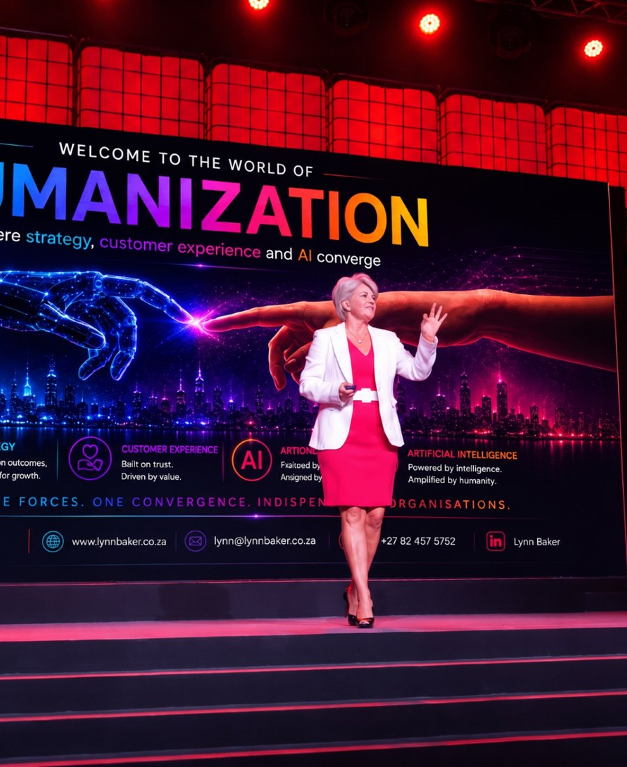
LYNN BAKER ABOUT THE SPEAKER
ABOUT LYNN BAKER
With more than 25 years specialising in Customer Experience, Lynn Baker is a leading keynote speaker and business strategist.
Disney Institute trained, Lynn served as Chair of Judges for the International Customer Experience Awards for six years, and is the founding CEO of the CX Institute SA and CX University SA.
Her presentations combine powerful storytelling, humour, practical business examples, audience interaction and actionable insights that challenge conventional thinking and inspire immediate action.
CREDENTIALS
Disney Institute trained
Chair of Judges - International CX Awards (6 years)
Founding CEO - CX Institute SA & CX University SA
Top 50 Women in CX (2019)
Lynn Baker | Customer Experience Specialist (CXS)
Keynote + The Customer Journey Game

Slide 5






LYNN BAKER PROOF
WHAT CLIENTS SAY
“
“
“
Lynn delivered a riveting keynote. She immediately drew in the audience and had them locked in for the full duration of the address.
Lynn's presentations hugely contributed in making these events impactful and memorable - in content and professionalism.
A total winner. Such an inspiration. It was short, sweet, simple, yet FREAKING DYNAMIC!
- Marketing Manager, Standard Bank
- Head: Client Experience, Nedbank
- Delegate feedback, Pfizer Sales Conference
TRUSTED BY
Lynn Baker | Customer Experience Specialist (CXS)
Keynote + The Customer Journey Game

Slide 6
LYNN BAKER INVESTMENT & BOOKING
SPEAKER FEES (FROM)
TECHNICAL RIDER
Johannesburg
ZAR 40,000
Countryman or wireless head-worn microphone
Screen / projection for slides
Good quality audio for video playback
Slide clicker and Wi-Fi connection
Preferably a comfort monitor
Durban
ZAR 45,000 + travel
Cape Town
ZAR 50,000 + travel
International
US$ 5,000 - 8,000
Travel, transfers and accommodation additional where applicable. Half-day workshops and virtual sessions on request.
BOOK LYNN FOR YOUR EVENT
Email lynn@cx-company.com Call / WhatsApp +27 82 457 5752 Web lynnbakerspeaker.com
Book a Discovery Call
Make an Enquiry
See Lynn in Action
Speaker Fees
Lynn Baker | Customer Experience Specialist (CXS)
Keynote + The Customer Journey Game

