Slide 1
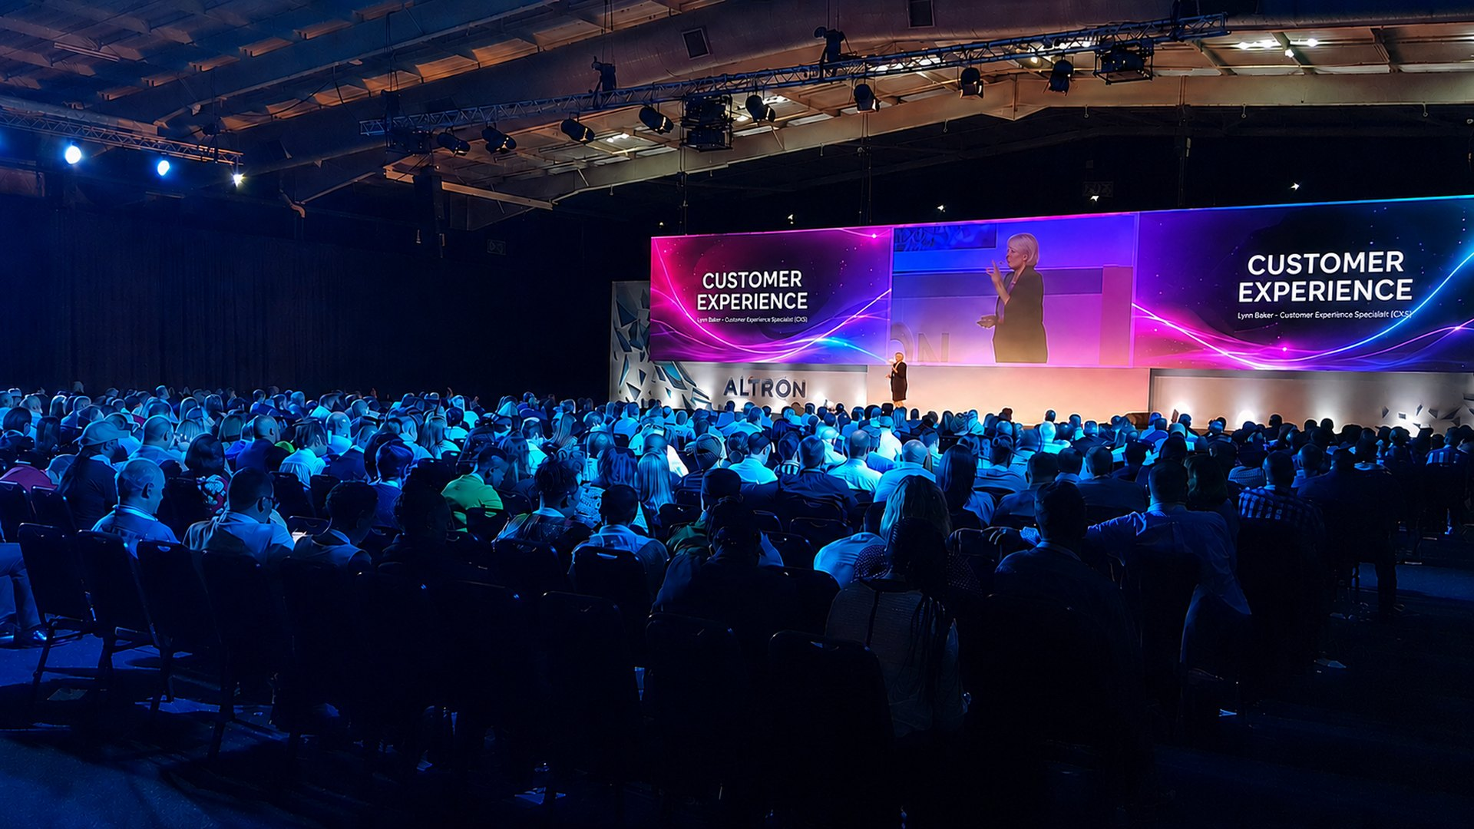
KEYNOTE | CUSTOMER EXPERIENCE
Welcome to the Age of Experience
Moving Beyond Customer Service to Driving Customer Experience
Lynn Baker - Customer Experience Specialist (CXS)

Slide 2
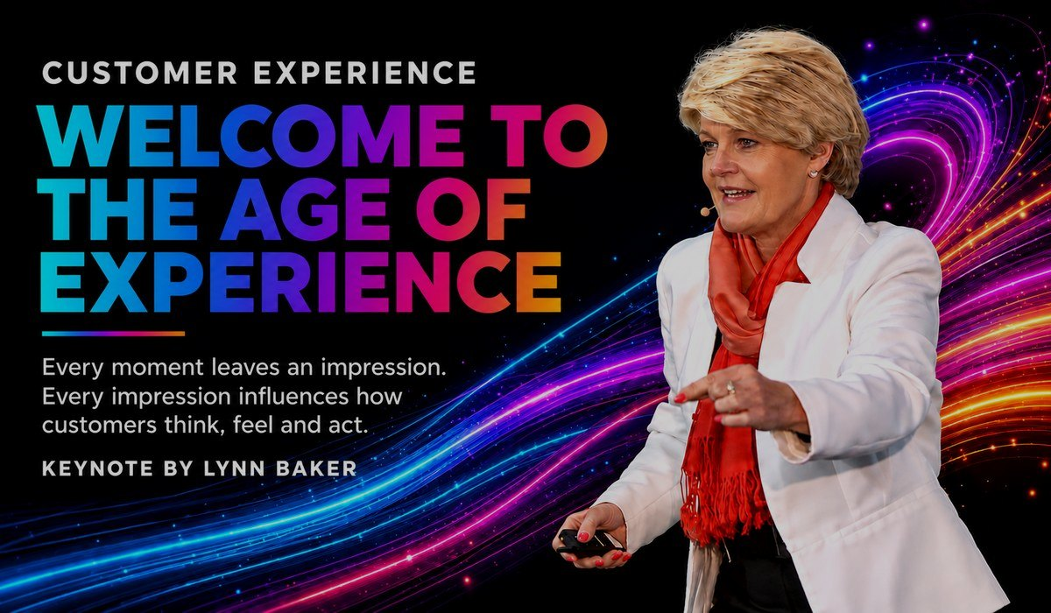
LYNN BAKER THE KEYNOTE
ABOUT THIS KEYNOTE
An inspirational, engaging and informative introduction to the process, value and commercial power of customer experience.
Designed for audiences who want to understand CX and why it matters, this keynote demystifies customer experience, explains how it differs from customer service, and reveals how everyday interactions influence acquisition, retention, loyalty, advocacy and sustainable growth.
Audiences discover how the customer journey extends across five broad stages - Awareness, Consideration, Purchase, Experience, and Loyalty and Advocacy - and how each stage contains touchpoints and micro-moments that shape perception.
FORMATS
45-60 min keynote
120 minutes
Virtual / hybrid
High-impact opening or closing keynote.
Keynote + The Customer Journey Game simulation.
Same energy, designed for remote audiences.
Lynn Baker | Customer Experience Specialist (CXS)
Welcome to the Age of Experience

Slide 3
LYNN BAKER VALUE FOR YOUR AUDIENCE
WHAT AUDIENCES TAKE AWAY
IDEAL FOR
The important difference between customer service and customer experience
Why customer experience belongs to everyone, not only customer-facing teams
How CX influences acquisition, retention, loyalty and advocacy
The five key stages of the customer journey
How journeys translate into touchpoints and micro-moments
Practical ways to make interactions easier, clearer and more human
Conferences and corporate events
Leadership and management meetings
CX and service programmes
Employee engagement events
Sales and marketing conferences
Contact-centre and frontline teams
Lynn Baker | Customer Experience Specialist (CXS)
Welcome to the Age of Experience

Slide 4
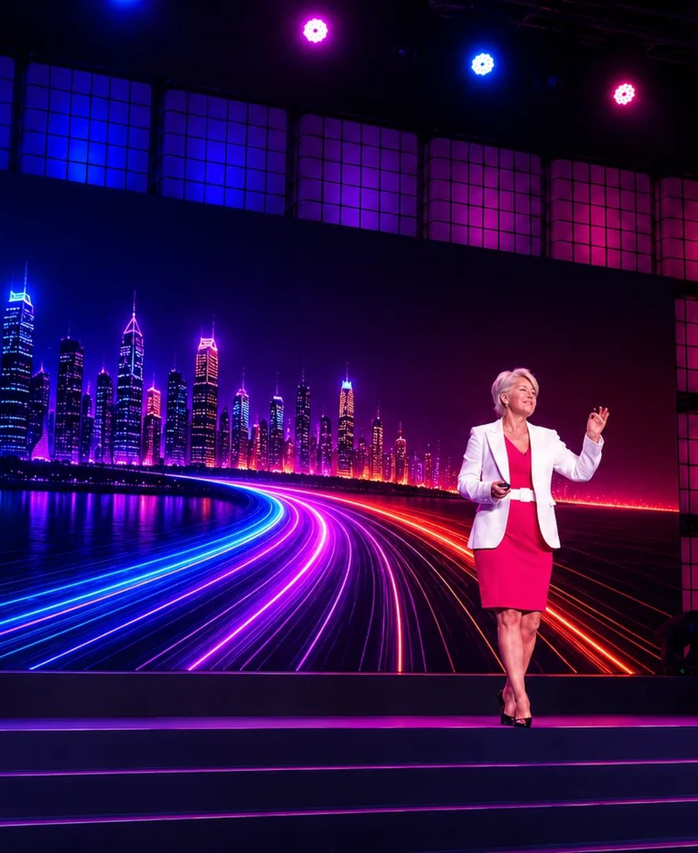
LYNN BAKER ABOUT THE SPEAKER
ABOUT LYNN BAKER
With more than 25 years specialising in Customer Experience, Lynn Baker is a leading keynote speaker and business strategist.
Disney Institute trained, Lynn served as Chair of Judges for the International Customer Experience Awards for six years, and is the founding CEO of the CX Institute SA and CX University SA.
Her presentations combine powerful storytelling, humour, practical business examples, audience interaction and actionable insights that challenge conventional thinking and inspire immediate action.
CREDENTIALS
Disney Institute trained
Chair of Judges - International CX Awards (6 years)
Founding CEO - CX Institute SA & CX University SA
Top 50 Women in CX (2019)
Lynn Baker | Customer Experience Specialist (CXS)
Welcome to the Age of Experience

Slide 5






LYNN BAKER PROOF
WHAT CLIENTS SAY
“
“
“
Lynn delivered a riveting keynote. She immediately drew in the audience and had them locked in for the full duration of the address.
Lynn's presentations hugely contributed in making these events impactful and memorable - in content and professionalism.
A total winner. Such an inspiration. It was short, sweet, simple, yet FREAKING DYNAMIC!
- Marketing Manager, Standard Bank
- Head: Client Experience, Nedbank
- Delegate feedback, Pfizer Sales Conference
TRUSTED BY
Lynn Baker | Customer Experience Specialist (CXS)
Welcome to the Age of Experience

Slide 6
LYNN BAKER INVESTMENT & BOOKING
SPEAKER FEES (FROM)
TECHNICAL RIDER
Johannesburg
ZAR 40,000
Countryman or wireless head-worn microphone
Screen / projection for slides
Good quality audio for video playback
Slide clicker and Wi-Fi connection
Preferably a comfort monitor
Durban
ZAR 45,000 + travel
Cape Town
ZAR 50,000 + travel
International
US$ 5,000 - 8,000
Travel, transfers and accommodation additional where applicable. Half-day workshops and virtual sessions on request.
BOOK LYNN FOR YOUR EVENT
Email lynn@cx-company.com Call / WhatsApp +27 82 457 5752 Web lynnbakerspeaker.com
Book a Discovery Call
Make an Enquiry
See Lynn in Action
Speaker Fees
Lynn Baker | Customer Experience Specialist (CXS)
Welcome to the Age of Experience

