Slide 1
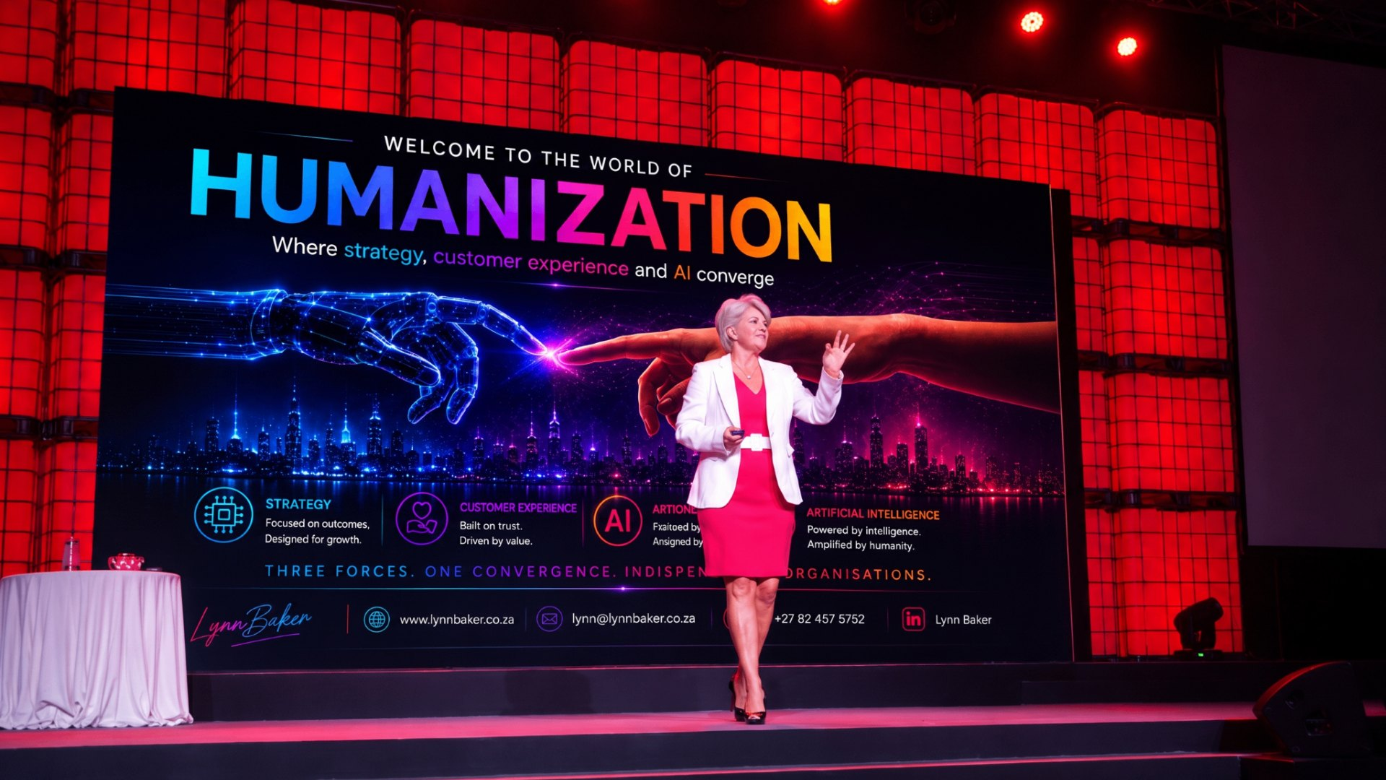
KEYNOTE | AI & HUMANIZATION
Welcome to the World of Humanization
Where humanity meets intelligence: Strategy, Customer Experience and AI
Lynn Baker - Customer Experience Specialist (CXS)

Slide 2
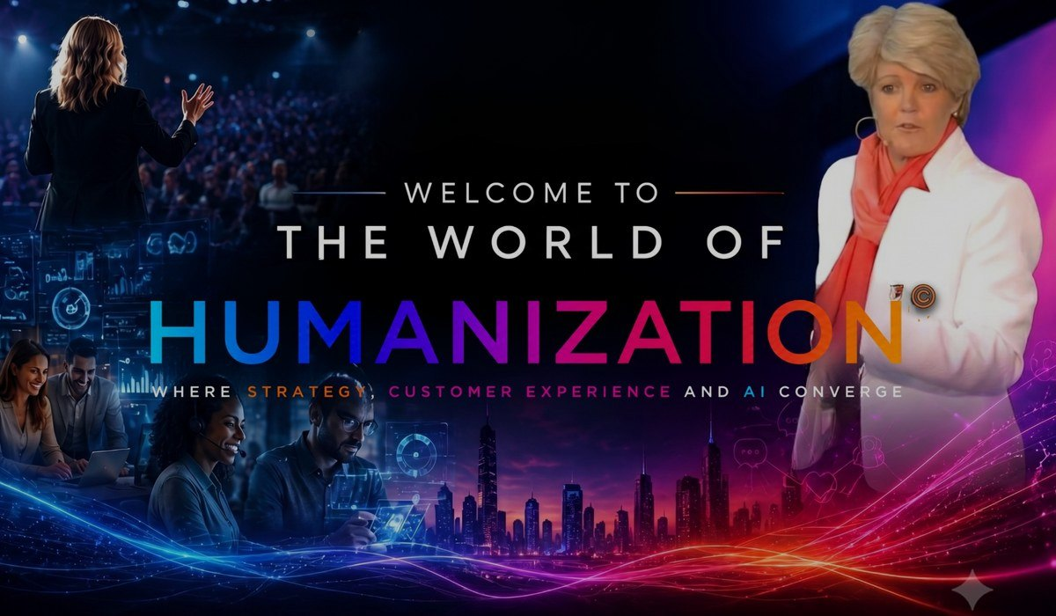
LYNN BAKER THE KEYNOTE
ABOUT THIS KEYNOTE
The future should not be about humans versus AI. It should be about how humans and AI work together to create experiences neither could deliver alone.
Discover how combining the humanity of people with the intelligence and efficiency of AI can create extraordinary customer experiences.
Employee anxiety about AI is real. Now is the time to help people understand and embrace AI, so they can become more productive, work more efficiently and contribute confidently to the future of the business.
FORMATS
Before
During
After
Humanization Sentiment Survey shapes the content.
45-60 min tailored Humanization keynote.
Humanization Playbook - 18 practical Quick Wins.
Lynn Baker | Customer Experience Specialist (CXS)
Welcome to the World of Humanization

Slide 3
LYNN BAKER VALUE FOR YOUR AUDIENCE
WHAT AUDIENCES TAKE AWAY
IDEAL FOR
Reframe: communicate the value, impact and outcomes you create
Realign: strategy, people, process, technology and culture around one promise
Retain: use AI insight for proactive, personalized conversations
How to move employees from AI anxiety to AI confidence
Why customers experience one organisation, not departments
Practical Quick Wins teams can implement immediately
Executive and leadership conferences
Customer experience programmes
Digital and AI transformation events
Employee engagement and culture days
Sales and marketing conferences
Industry association gatherings
Lynn Baker | Customer Experience Specialist (CXS)
Welcome to the World of Humanization

Slide 4
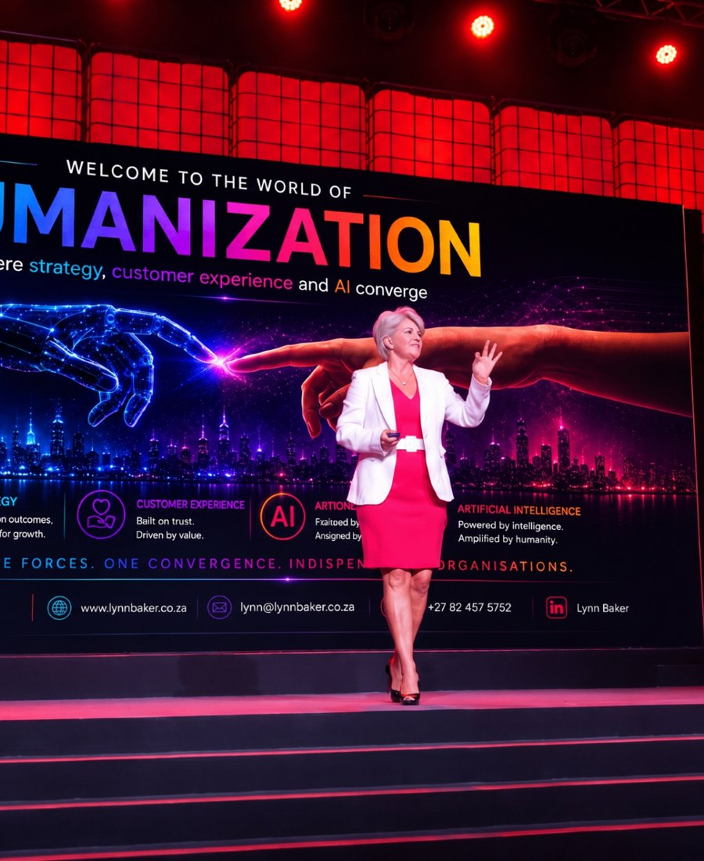
LYNN BAKER ABOUT THE SPEAKER
ABOUT LYNN BAKER
With more than 25 years specialising in Customer Experience, Lynn Baker is a leading keynote speaker and business strategist.
Disney Institute trained, Lynn served as Chair of Judges for the International Customer Experience Awards for six years, and is the founding CEO of the CX Institute SA and CX University SA.
Her presentations combine powerful storytelling, humour, practical business examples, audience interaction and actionable insights that challenge conventional thinking and inspire immediate action.
CREDENTIALS
Disney Institute trained
Chair of Judges - International CX Awards (6 years)
Founding CEO - CX Institute SA & CX University SA
Top 50 Women in CX (2019)
Lynn Baker | Customer Experience Specialist (CXS)
Welcome to the World of Humanization

Slide 5






LYNN BAKER PROOF
WHAT CLIENTS SAY
“
“
“
Lynn delivered a riveting keynote. She immediately drew in the audience and had them locked in for the full duration of the address.
Lynn's presentations hugely contributed in making these events impactful and memorable - in content and professionalism.
A total winner. Such an inspiration. It was short, sweet, simple, yet FREAKING DYNAMIC!
- Marketing Manager, Standard Bank
- Head: Client Experience, Nedbank
- Delegate feedback, Pfizer Sales Conference
TRUSTED BY
Lynn Baker | Customer Experience Specialist (CXS)
Welcome to the World of Humanization

Slide 6
LYNN BAKER INVESTMENT & BOOKING
SPEAKER FEES (FROM)
TECHNICAL RIDER
Johannesburg
ZAR 40,000
Countryman or wireless head-worn microphone
Screen / projection for slides
Good quality audio for video playback
Slide clicker and Wi-Fi connection
Preferably a comfort monitor
Durban
ZAR 45,000 + travel
Cape Town
ZAR 50,000 + travel
International
US$ 5,000 - 8,000
Travel, transfers and accommodation additional where applicable. Half-day workshops and virtual sessions on request.
BOOK LYNN FOR YOUR EVENT
Email lynn@cx-company.com Call / WhatsApp +27 82 457 5752 Web lynnbakerspeaker.com
Book a Discovery Call
Make an Enquiry
See Lynn in Action
Speaker Fees
Lynn Baker | Customer Experience Specialist (CXS)
Welcome to the World of Humanization

