Slide 1
Computer and Robot Vision
Chapter 0
Presented by: 傅楸善
02-23625336 ext. 327
fuh@csie.ntu.edu.tw
Digital Camera and Computer Vision Laboratory
Department of Computer Science and Information Engineering
National Taiwan University, Taipei, Taiwan, R.O.C.

Slide 2
Course Number: 922 U0610
Credits: 3
Time: Tuesday 6, 7, 8 (2:20PM~5:20PM)
Classroom: New CSIE Classroom 103
Classification: Elective for junior, senior, and graduate students
Prerequisite: None
Instructor: Chiou-Shann Fuh (傅楸善)
Office: New Computer Science and Information Engineering 327
Phone: 23625336 ext. 327
Office Hours: Tuesday 11AM~11:59AM
Objective: To learn computer and robot vision through extensive
course projects
DC & CV Lab.
CSIE NTU

Slide 3
Textbook: R. M. Haralick and L. G. Shapiro,
Computer and Robot Vision, Vol. I,
Addison Wesley, Reading, MA, 1992.
Reference: R. Jain, R. Kasturi, and B. G. Schunck,
Machine Vision, McGraw-Hill, New York,
1995.
Reference: R. C. Gonzalez and R. E. Woods, Digital
Image Processing, 2nd Ed., Prentice-Hall, Upper Saddle
River, NJ, 2002.
Reference: R. Szeliski, Computer Vision: Algorithms and Applications, Springer-Verlag, London, 2011.
Projects: will be assigned every week or every other week (30%)
Examinations: one midterm (30%) and one final (40%) 􀀀
DC & CV Lab.
CSIE NTU

Slide 4
Content:
This is the first semester of a fast pace course which covers robot and computer vision.
This semester covers low-level vision and
mostly no reference to three dimension:
DC & CV Lab.
CSIE NTU

Slide 5
Computer Vision Overview
Binary Machine Vision Thresholding and Segmentation: CSWong
Binary Machine Vision Region Analysis: HYChen
Statistical Pattern Recognition: TAHsieh
Mathematical Morphology: TCTung
Neighborhood Operators: YLLee
Conditioning and Labeling: SWWang
The Facet Model: YChen
Texture: HYChou
Image Segmentation: YSChen
Arc Extraction and Segmentation: TAHsieh
Next semester covers higher-level techniques.
DC & CV Lab.
CSIE NTU

Slide 6
Drop this course if you don’t agree.
My graduates students will present course material.
I will only present Chapter 1.
Every toddler has to fall to learn to walk.
This is very important training for their research and presentation.
My hearing is weak, so speak loudly unconsciously and hurt vocal cord and cannot close properly.
DC & CV Lab.
CSIE NTU

Slide 7
Drop this course if you don’t agree.
Don’t complain in teaching feedback survey.
If you agree, praise in teaching feedback.
The purpose is to build solid understanding of textbook in detail.
Fundamental concepts are the most important.
The textbook is slightly old, but it covers every aspect of Computer Vision in depth.
So far, I don’t see any better textbook.
Don’t complain about examination and textbook in teaching feedback.
DC & CV Lab.
CSIE NTU

Slide 8
Please Drop This Tough Course If Unwilling
這門課有240人修, 但是教室容量只有160座位。為維持教學品質。因此希望真正有興趣的人才來修, 所以會嚴格點名。三次不到就會當掉。
作業漏交三次就會當掉。
成績分佈會很嚴格, 大約: A+: 10%, A: 12%, B+: 18%, B: 20%, B-: 18%, C+: 12%, C: 10%
不能吃苦的請儘速退選。
DC & CV Lab.
CSIE NTU

Slide 9
This file: http://www.csie.ntu.edu.tw/~fuh/vcourse/haralick/CH1.ppt
DC & CV Lab.
CSIE NTU

Slide 10
Computer and Robot Vision I
Chapter 1
Computer Vision: Overview
Presented by: 傅楸善
0933 373 485
r94922113@ntu.edu.tw
指導教授: 傅楸善 博士
Digital Camera and Computer Vision Laboratory
Department of Computer Science and Information Engineering
National Taiwan University, Taipei, Taiwan, R.O.C.

Slide 11
1.1 Introduction
Computer vision is the science that develops the
theoretical and algorithmic basis by which useful
information about the world can be automatically
extracted and analyzed from an observed image,
image set, or image sequence from computations
made by special-purpose or general-purpose
computers.
DC & CV Lab.
CSIE NTU
Notes:
Theoretical:理論的
Algorithmic:算法的

Slide 12
1.1 Introduction
computer vision: to emulate human vision
with computers
computer vision: dual process of computer
graphics: 2D → 3D
DC & CV Lab.
CSIE NTU

Slide 13
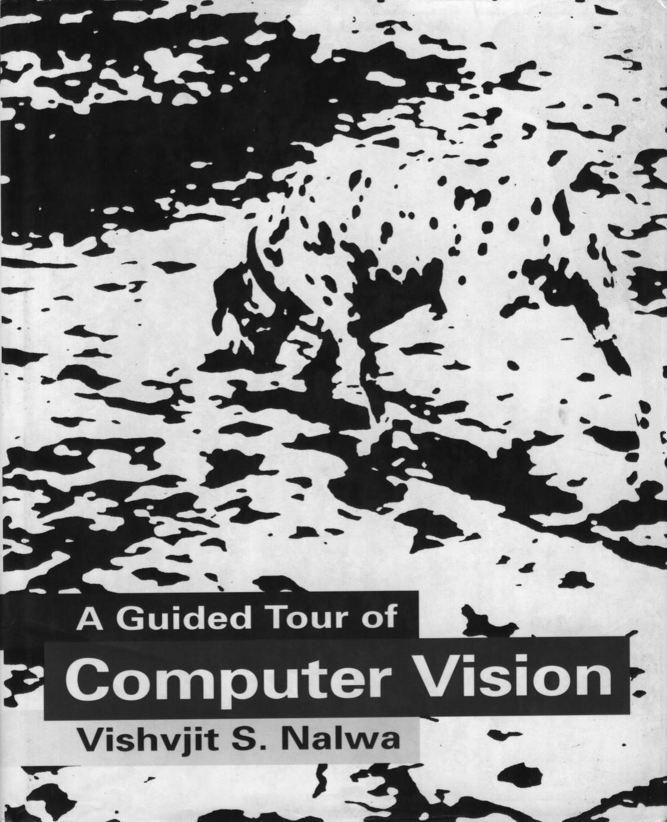
1.1 Introduction
Information:
recognition of a generic object:
DC & CV Lab.
CSIE NTU

Slide 14
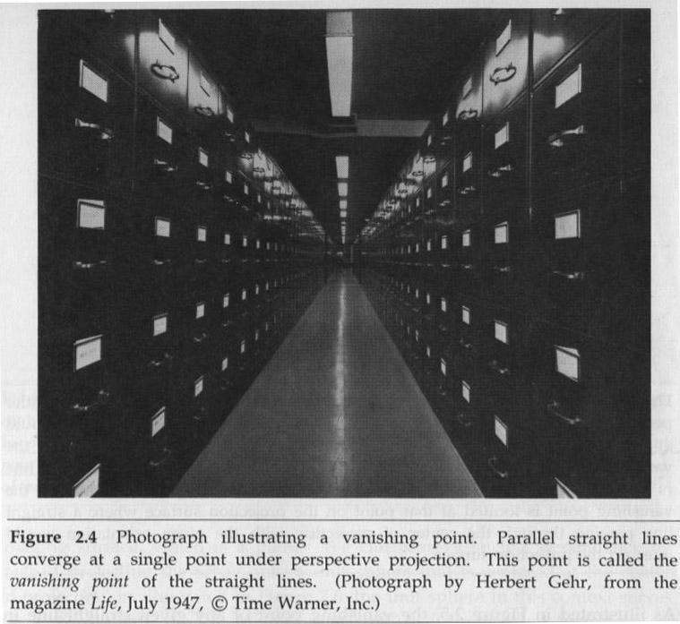
1.1 Introduction
DC & CV Lab.
CSIE NTU

Slide 15
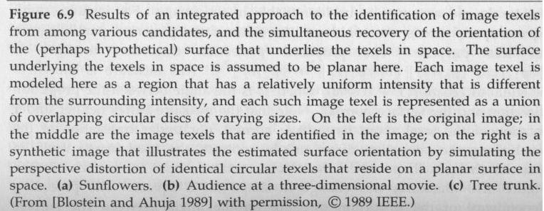
1.1 Introduction
three-dimensional description of an unknown object
DC & CV Lab.
CSIE NTU

Slide 16
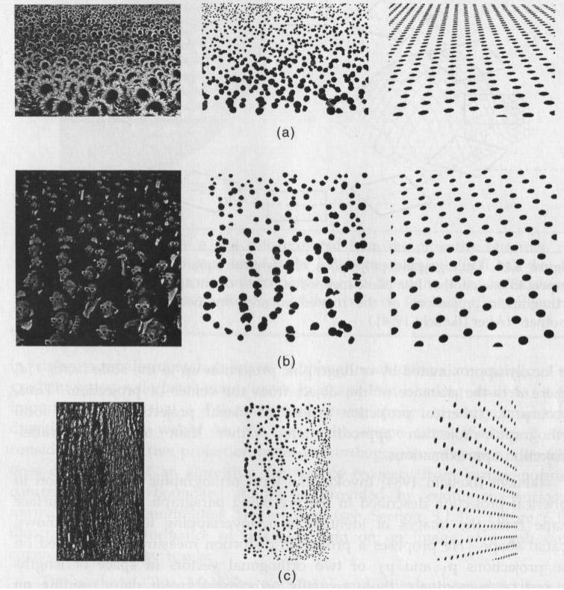
DC & CV Lab.
CSIE NTU

Slide 17
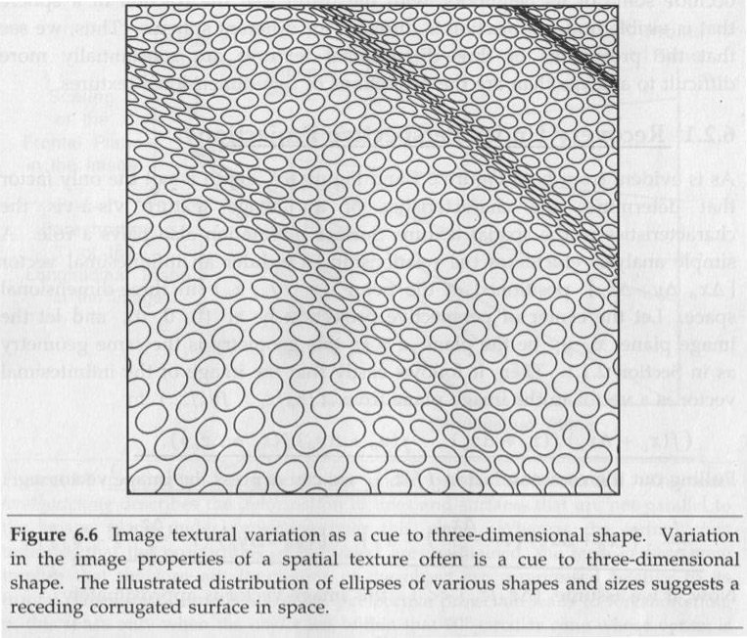
1.1 Introduction
position and orientation of the observed object
DC & CV Lab.
CSIE NTU
Notes:
Orientation: 方向
Cliff:懸崖
Protrude:伸出，突出
Cue: 線索
Variation:變化程度
Demonstrate:說明
Kitten:小貓
Checkered:有方格的
Perception:感覺

Slide 18
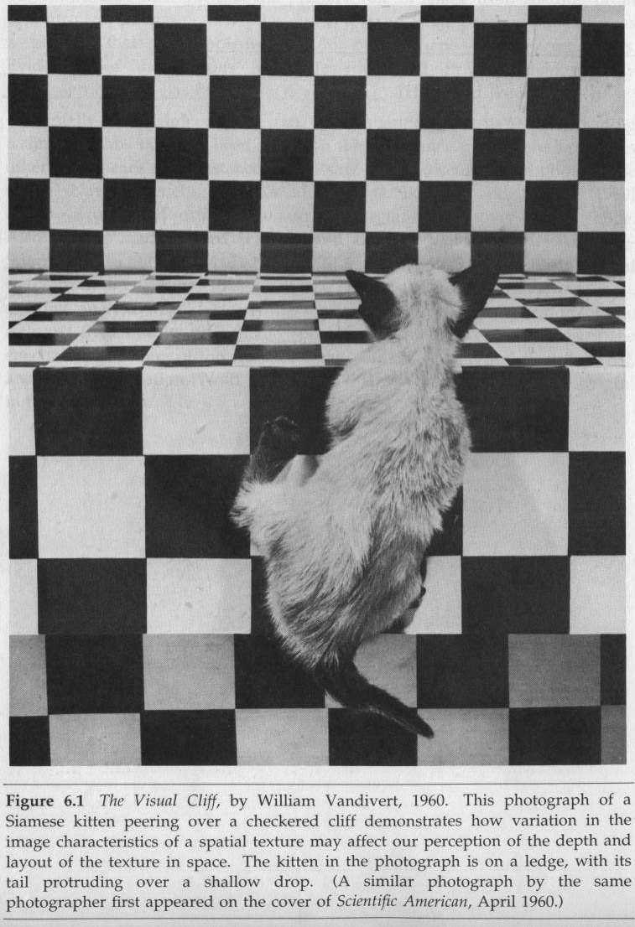
DC & CV Lab.
CSIE NTU

Slide 19
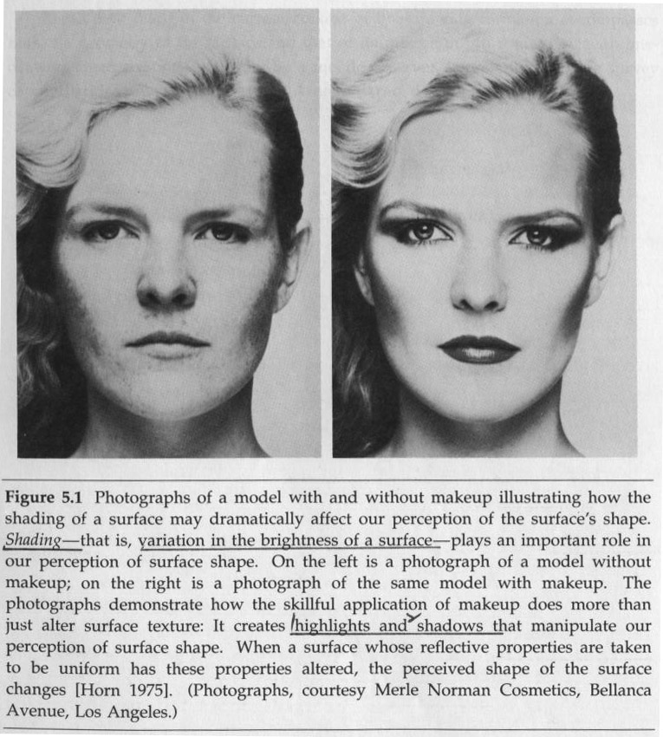
1.1 Introduction
measurement of any spatial property of an object
DC & CV Lab.
CSIE NTU

Slide 20
1.1 Introduction
Applications:
vision-guided robot assembly
inspection tasks: mensuration, verification that all parts are present, determination that surfaces have no defects
pattern recognition: geographic information
system
alignment: printed circuit board drilling
measurement: length, area
DC & CV Lab.
CSIE NTU
Notes:
Mensuration:測量

Slide 21
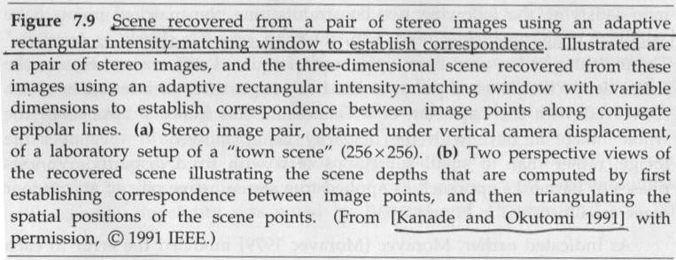
1.1 Introduction
Stereo: 3-D reconstruction
DC & CV Lab.
CSIE NTU
Notes:
Correspondence:相似處

Slide 22
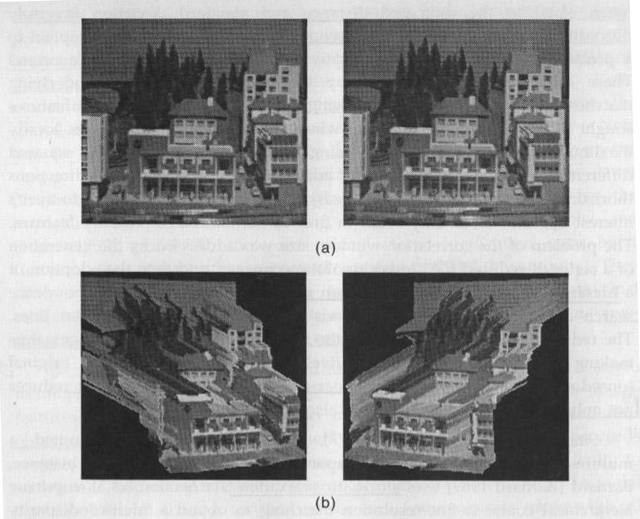
DC & CV Lab.
CSIE NTU

Slide 23
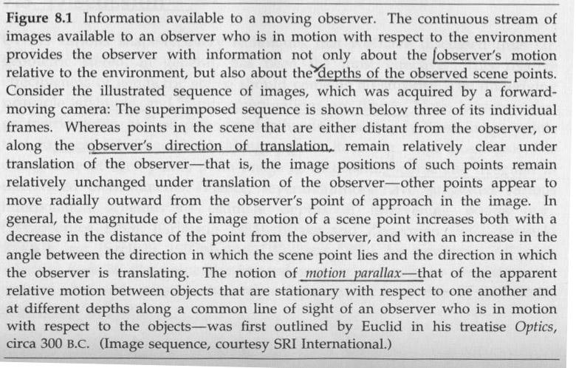
1.1 Introduction
motion and surface structure recovery
DC & CV Lab.
CSIE NTU

Slide 24
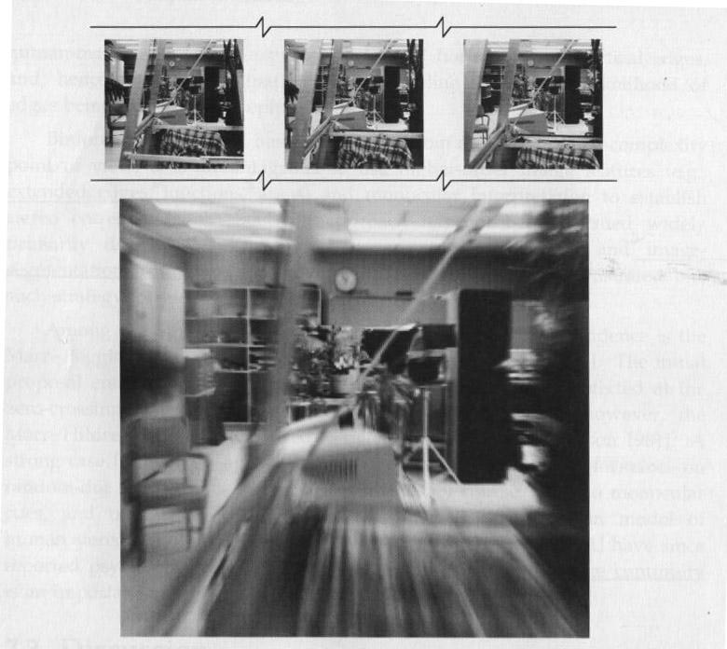
DC & CV Lab.
CSIE NTU

Slide 25
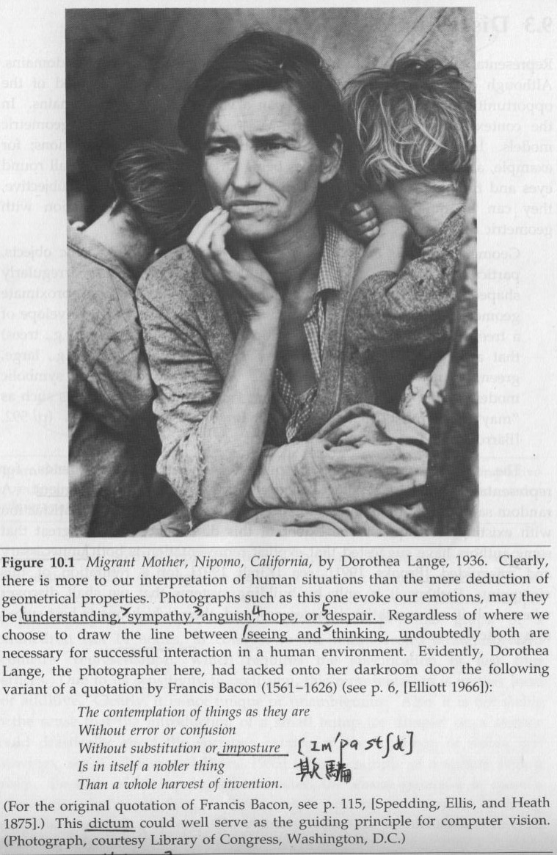
1.1 Introduction
interpretation
DC & CV Lab.
CSIE NTU

Slide 26



1.1 Introduction
image: spatial representation of object, 2D or 3D scene, or another image
intensity image: optic or photographic sensors radiant energy
range image: line-of-sight distance
image intensity value at row and column of
the matrix
pixel: picture element: has properties of position and value
gray levels: pixel values of intensity images,
􀀀 0 (black) – 255 (white) for 8-bit integers
DC & CV Lab.
CSIE NTU
Notes:
Optic:視覺
Line-of-sight:視線

Slide 27
1.1 Introduction
factors determining the difficulty of computer vision problem:
kind of object
way objects are lit
background
kind of imaging sensor
viewpoint of the sensor
DC & CV Lab.
CSIE NTU
Notes:
決定cv問題困難度的因素
1.種類 2.燈照的方式 3.背景 4.sensor的種類 5.Sensor視角

Slide 28
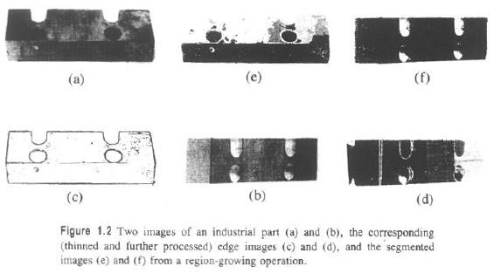
1.1 Introduction
DC & CV Lab.
CSIE NTU
Notes:
Main reason missing edges: lack of contrast

Slide 29
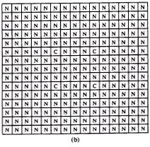
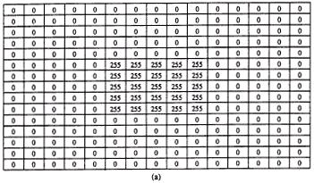

1.1 Introduction
DC & CV Lab.
CSIE NTU
Notes:
One kind of feature extract

Slide 30
1.1 Introduction
atomic image features:
edge
corner
hole
topographic labelings of the gray tone intensity surface
e.g. peaks, pits, ridges, valleys
DC & CV Lab.
CSIE NTU
Notes:
Topographic:地形測量的
Pit:凹處
Ridge:山脊

Slide 31
1.1 Introduction
composite features: atomic features merged
arcs: edge or ridge pixels linked together
regions: connected sets of pixels with similar properties
DC & CV Lab.
CSIE NTU

Slide 32
1.2 Recognition Methodology
Recognition methodology must pay attention to:
image formation e.g. perspective or
orthographic projection
conditioning
labeling
grouping
extracting
matching
DC & CV Lab.
CSIE NTU
Notes:
Methodology:教學法
將iconic data(圖示化的資料)轉換到recognition information的步驟
Formation:構成
Perspective:透視圖法
Orthographic projection: 垂直投影圖

Slide 33
1.2.1 Conditioning
Conditioning is based on a model that suggests that the observed image is composed of an informative pattern modified by uninteresting variations that typically add to or multiply the informative pattern.
e.g. noise suppression,
background normalization
DC & CV Lab.
CSIE NTU
Notes:
Suppress:抑制
Modify:減輕 修改
Informative: 有益的

Slide 34
1.2.2 Labeling
Labeling is based on a model that suggests that the informative pattern has structure as a spatial arrangement of events, each spatial event being a set of connected pixels.
e.g. thresholding, edge detection,
corner finding
DC & CV Lab.
CSIE NTU

Slide 35
1.2.3 Grouping
The grouping operation identifies the events by collecting together or identifying maximal connected sets of pixels participating in the same kind of event.
before grouping: pixels
after grouping: sets of pixels
e.g. segmentation, edge linking
DC & CV Lab.
CSIE NTU

Slide 36
1.2.4 Extracting
The extracting operation computes for each group of pixels a list of its properties.
example properties: centroid, orientation,
area, spatial moments
e.g. region holes, arc curvature
DC & CV Lab.
CSIE NTU

Slide 37
1.2.5 Matching
Matching operation determines the interpretation of some related set of image events, associating these events with some given three-dimensional object or two-dimensional shape.
e.g. template matching
DC & CV Lab.
CSIE NTU

Slide 38

Take a Break
DC & CV Lab.
CSIE NTU

Slide 39
1.3 Outline of Book
This text describes those aspects of computer vision that are needed in robotics and other real-world applications such as industrial-part inspection, medical diagnosis, aerial-image interpretation, and space station maintenance.
DC & CV Lab.
CSIE NTU
Notes:
Diagnosis(重音在後):診斷書
Aerial:大氣

Slide 40
1.3 Outline of Book
Journals
IEEE Transactions on Pattern Analysis and Machine Intelligence
IEEE Transactions on Image Processing
IEEE Transactions on Robotics and Automation
IEEE Transactions on Systems, Man, and Cybernetics
Computer Vision and Image Understanding
formerly CVGIP (Computer Vision, Graphics, and Image Processing)
Image Understanding
CVGIP: Graphical Models and Image Processing
International Journal of Computer Vision
Pattern Recognition
Pattern Recognition Letters
Image and Vision Computing
Machine Vision and Applications
DC & CV Lab.
CSIE NTU
Notes:
Journal:期刊，雜誌

Slide 41
1.3 Outline of Book
Conferences
Asian Conference on Computer Vision
IEEE Conference on Computer Vision and Pattern Recognition
Image Understanding Workshop
International Conference on Computer Vision
International Conference on Image Processing
International Conference on Pattern Recognition
Scandinavian Conference on Image Analysis
SPIE (The International Society for Optical Engineering)
Conferences
DC & CV Lab.
CSIE NTU
Notes:
Conference:會議，研討會

Slide 42
1.3 Outline of Book
Bibliography
T. Acharya and A. K. Ray, Image Processing: Principles and Applications, Wiley, Hoboken, NJ, 2005.
D. H. Ballard and C. M. Brown, Computer Vision, Prentice-Hall, Englewood Cliffs, NJ, 1982.
G. A. Baxes, Digital Image Processing, Wiley, New York, 1994.
K. Castleman, Digital Image Processing,􀀀 Prentice-Hall, Englewood Cliffs, NJ, 1996.
E. R. Davies, Machine Vision: Theory, Algorithms,􀀀 Practicalities, 2nd Ed., Academic Press, San Diego, CA, 1997.
E. Gose, R. Johnsonbaugh, and S. Jost, Pattern Recognition and Image Analysis, Prentice-Hall, Englewood Cliffs, NJ, 1996.
R. M. Haralick and L. G. Shapiro, Computer and Robot Vision, Vol. II Addison Wesley, Reading, MA, 1993.
B. K. P. Horn, Robot Vision, MIT Press, Cambridge, MA, 1986.
DC & CV Lab.
CSIE NTU
Notes:
Bibliography:參考書目

Slide 43
1.3 Outline of Book
A. K. Jain, Fundamentals of Digital Image Processing, Prentice-Hall Englewood, Cliffs, NJ, 1989.
J. S. Lim, Two-Dimensional Signal and Image Processing, Prentice-Hall, Englewood Cliffs, NJ, 1990.
D. Marr, Vision, W. H. Freeman, San Francisco, 1982.
V. S. Nalwa, A Guided Tour of Computer Vision, Addison Wesley, Reading MA, 1993.
W. K. Pratt, Digital Image Processing, 2nd ed., Wiley-Interscience, New York, 1991.
R. J. Schalkoff, Digital Image Processing and Computer Vision: An Introduction to Theory and Implementations, Wiley, New York, 1989.
R. J. Schalkoff, Pattern Recognition: Statistical, Structural, and Neural Approaches, Wiley, New York,1992.
DC & CV Lab.
CSIE NTU

Slide 44
======this file ~fuh/vcourse/haralick/chapter.tex=====
man latex
latex chapter
dvips -f chapter >!t.ps
ghostview t.ps
=====~fuh/vcourse/haralick/programs/stylelena.im=====
=====pseudo.c=====
=====lenab.im=====
Add /usr/local/vision/man to $MANPATH
Add /usr/local/vision/sun to $PATH
man hvision: image processing functions.
cc -o pseudo pseudo.c -lhvision -lm
pseudo lena.im lenar.im lenag.im lenab.im
hview lena.im
laserhs lena.im
􀀀 (to print: change textwidth → 7.2in, textheight → 9.75in, normalsize → normalsize, LARGE → normalsize)
dvips -t landscape -f chapter >!t.ps
lpr t.ps
copy ~fuh/.tkinit to your home directory before invoking tk
tk
>list command
>read image: lena.im lena.im
>ane transform: lena.im lena.aff 0 2 2 0 0 0
>list image: ??
>list image
>view image: lena.aff
>write image: lena.aff lena.aff
>quit
=====lena.aff=====

Slide 45
pseudo.c
/************************************************************************/
/* pseudo.c */
/* This program generates the negative image. */
/************************************************************************/
#include <stdio.h>
#include "hvision.h"
IMAGE *im, *rim, *gim, *bim;
main (argc, argv)
/************************************************************************/
/* main program to generate the negative image. */
/************************************************************************/
int argc;
char **argv;
{
int i, j;

Slide 46
/*********************************************************************/
/* f1.im: The first image frame */
/* f2.im: The second image frame */
/*********************************************************************/
if (argc != 5) {
printf("pseudo lena.im lena_r.im lena_g.im lena_b.im \n");
exit(1);
} /* if */
/* Read in the original image */
im = hvReadImage(argv[1]);
if (im == NULL) {
printf("cannot open file %s\n",argv[1]);
exit(1);
} /*if*/
rim = hvCopyImage(im);
gim = hvCopyImage(im);
bim = hvCopyImage(im);
for (i=0; i<im->height; i++) {
for (j=0; j<im->width; j++) {
B_PIX(rim,i,j) = 255-B_PIX(im,i,j);
B_PIX(gim,i,j) = 128;
} /*j* } /*i*/

Slide 47
hvWriteImage(rim, argv[2]);
hvWriteImage(gim, argv[3]);
hvWriteImage(bim, argv[4]);
} /*main*/

Slide 48

原圖
B channel: 不變

Slide 49
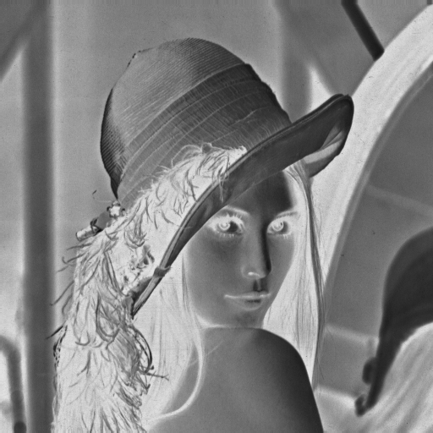

R channel: 負片
G channel: 128

Slide 50
Project due Sep. 24
1. Use B_PIX to write a program to generate
(a) upside-down lena.im
(b) right-side-left lena.im
(c) diagonally mirrored lena.im
2. Use Photoshop to
(a) rotate lena.im 45 degrees clockwise
(b) shrink lena.im in half
(c) binarize lena.im at 128 to get a binary image
DC & CV Lab.
CSIE NTU

