Slide 1
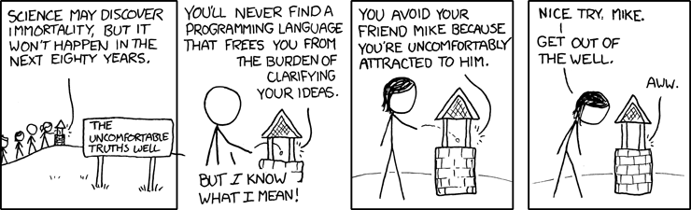
Conditionals and polymorphism

Slide 2
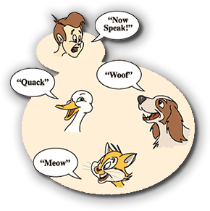
Premise
Most ifs can be replaced with polymorphism
What is polymorphism ?

Slide 3
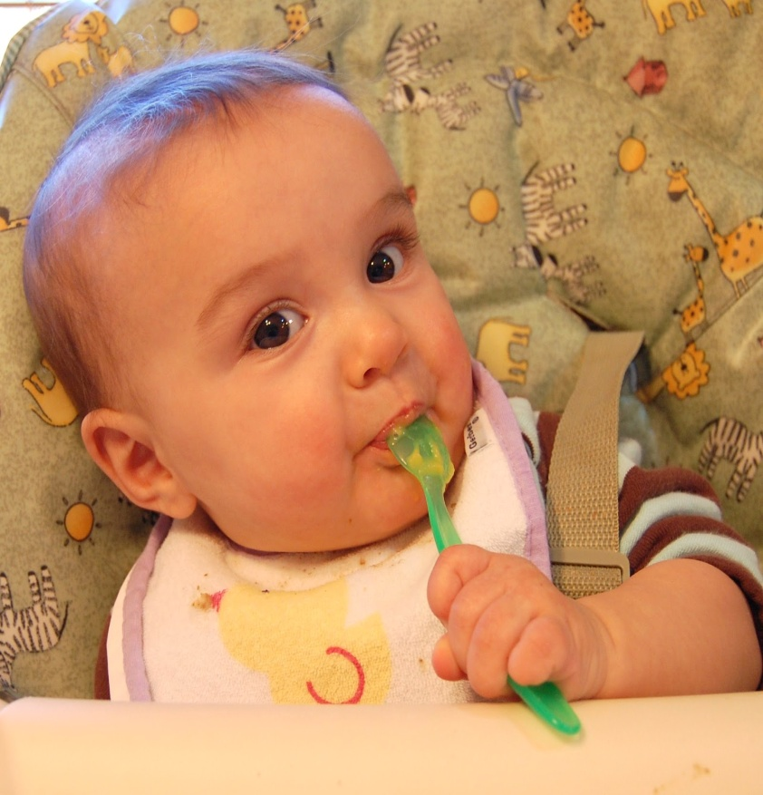
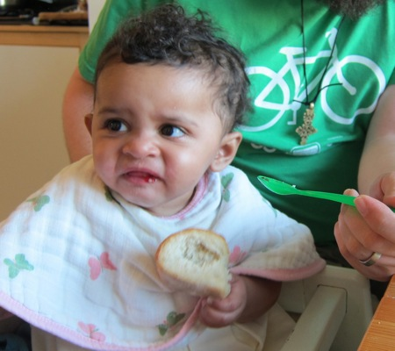
Premise
Ifs are useful however they are like a salt .
Just enough salt
Too much salt

Slide 4
Why polymorphism?
Code is easier to read
Code is easier to test
Code is easier maintain

Slide 5
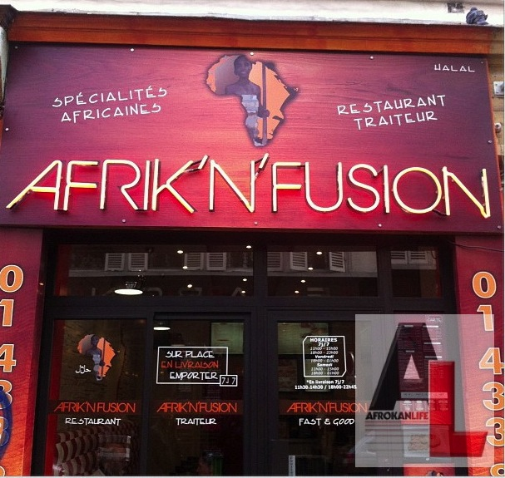
Afrikan fusion restaurant

Slide 6
Tell me and I'll forget.
Show me and I might remember.
But involve me and I will understand

Slide 7

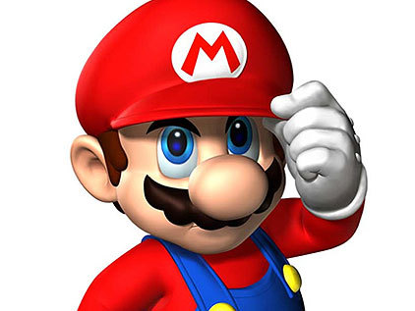
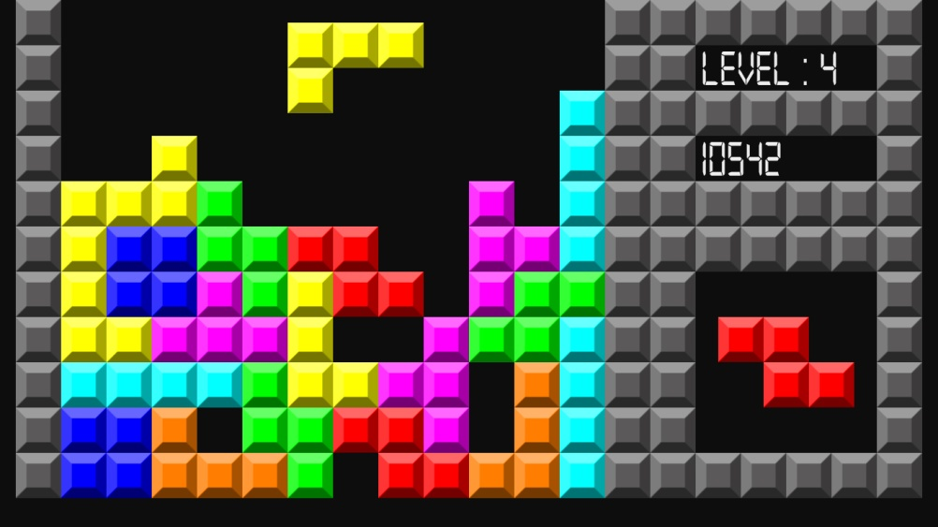
Videos games

Slide 8
Videos games
Things get complex really fast with each new feature or functionality
Let’s try some game programming of our own

