Slide 1
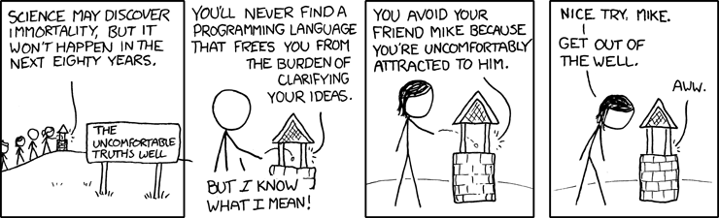
Conditionals and polymorphism

Slide 2
Premise
Most ifs can be replaced with polymorphism

Slide 3
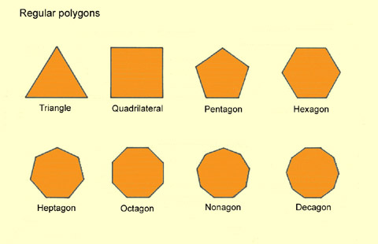

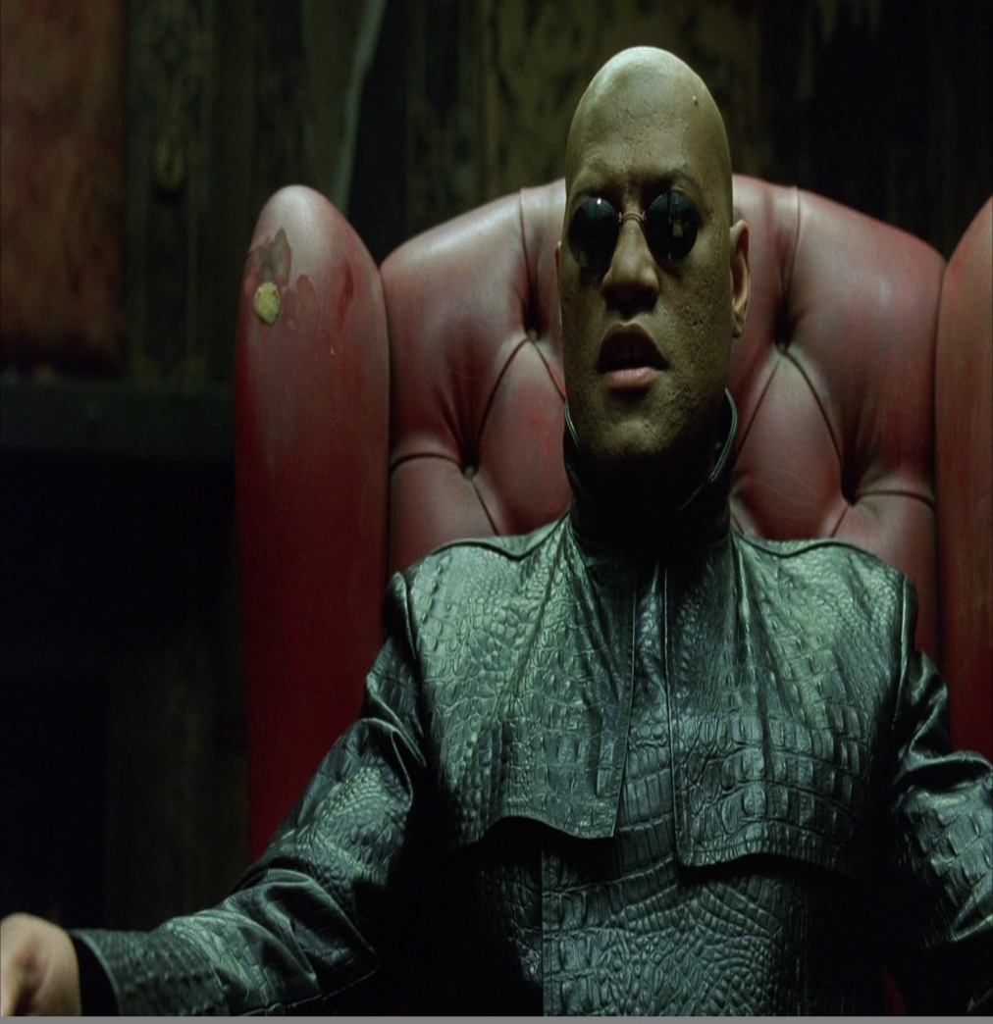
What is polymorphism ?

Slide 4
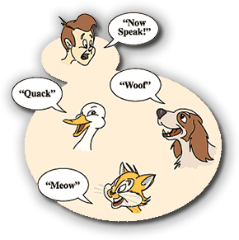
What is polymorphism?

Slide 5
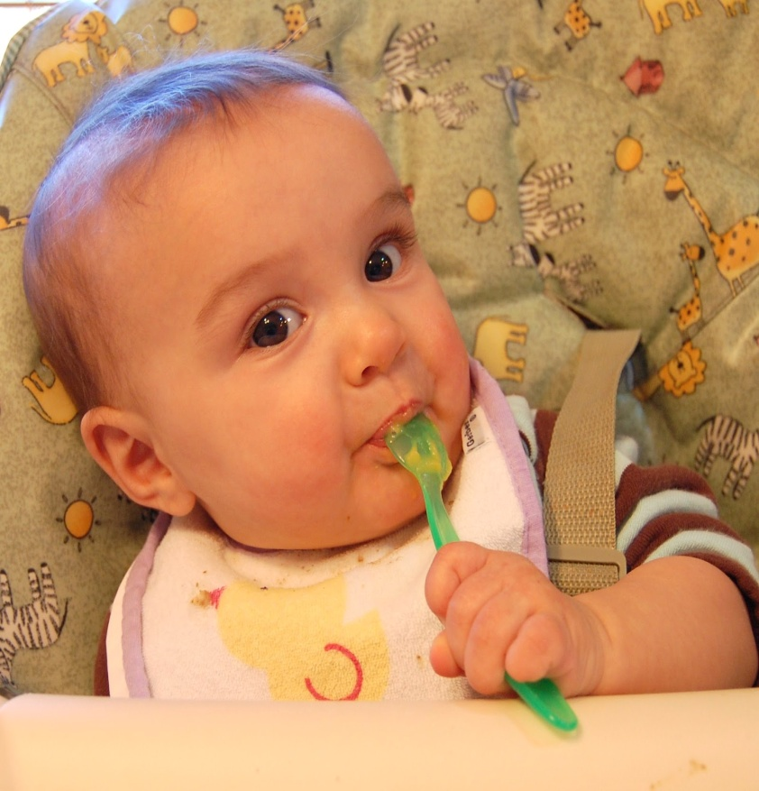
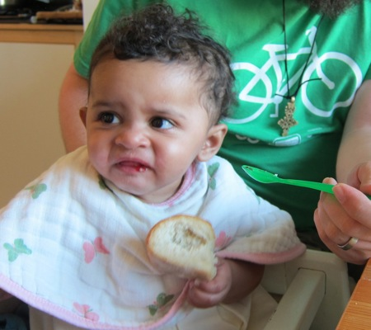
Premise
Ifs are useful however they are like a salt .
Just enough salt
Too much salt

Slide 6
Why polymorphism?
Code is easier to read
Code is easier to test
Code is easier maintain

Slide 7
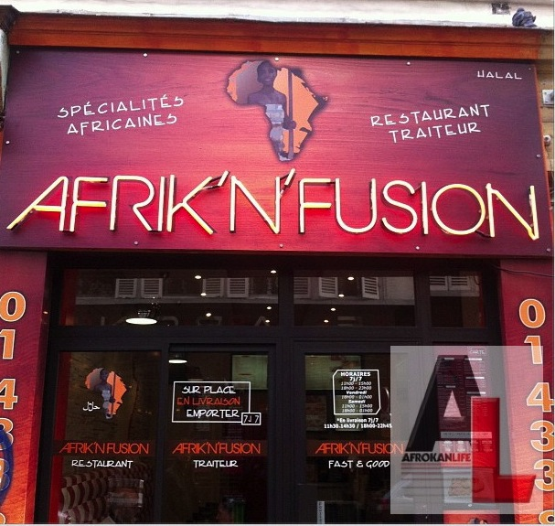
Afrikan fusion restaurant

Slide 8
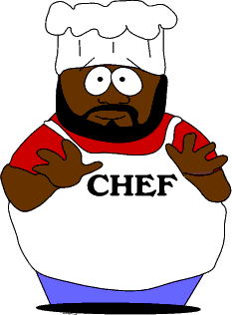
Afrikan fusion restaurant
Menu
Nigerian cuisine
Ghanaian cuisine
Ugandan cuisine
Kenyan cuisine
South African cuisine
Zambian cuisine

Slide 9
Possible Problems with Afrika
Difficult to maintain
Difficult to test new recipes
Substituting Hakim is difficult

Slide 10
Polymorphic Solution
African Fusion
West African Fusion
East African Fusion
Southern African Fusion
Nigerian Fusion
Ghanaian fusion

Slide 11
Tell me and I'll forget.
Show me and I might remember.
But involve me and I will understand

Slide 12

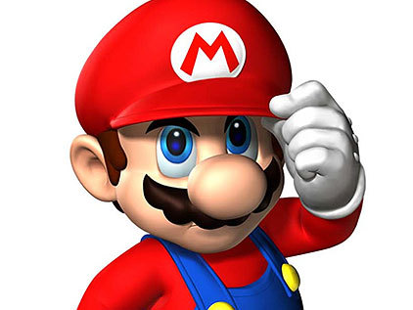
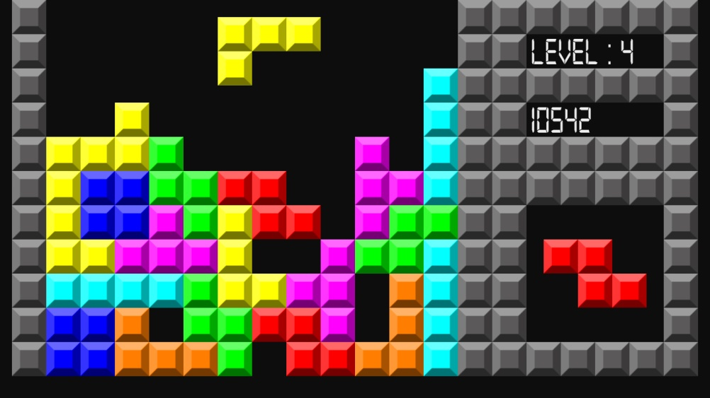
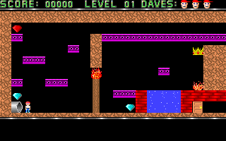
Videos games

Slide 13
Videos games
Things get complex really fast with each new feature or functionality
Let’s try some game programming of our own
(https://github.com/lynnUg/Duckmaze.git)

Slide 14
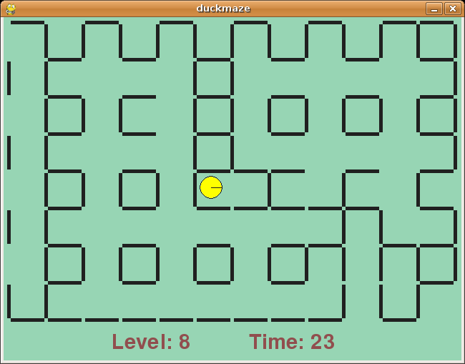
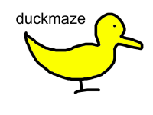
Duckmaze

Slide 15
Duckmaze challenge
Add new music menu using music_menu function in duckmaze.py

Slide 16
Replace conditionals with polymorphism
-Get rid of the if
Each if turns into a sub class
Move common logic to a super class
f

Slide 17
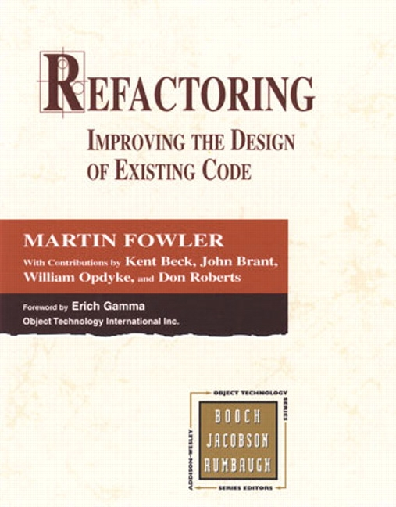
Recommended readings

