Slide 1
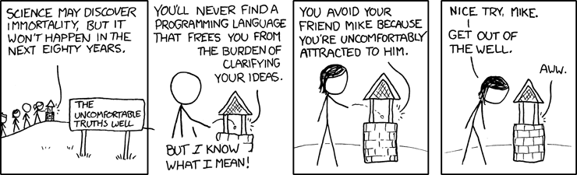
Conditionals and polymorphism

Slide 2
Premise
Most ifs can be replaced with polymorphism

Slide 3
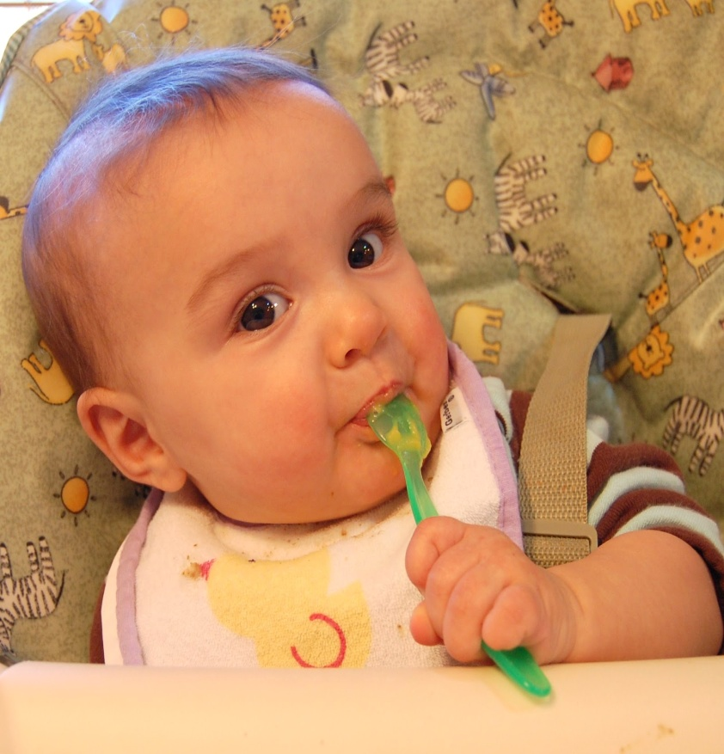
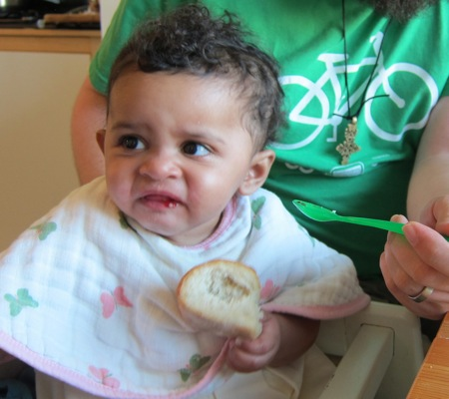
Premise
Ifs are useful however they are like a salt .
Just enough salt
Too much salt

Slide 4
Tell me and I'll forget.
Show me and I might remember.
But involve me and I will understand

Slide 5

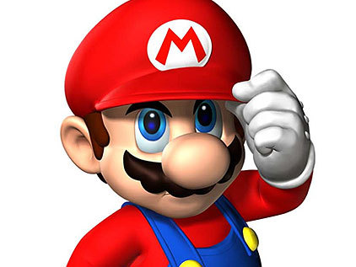
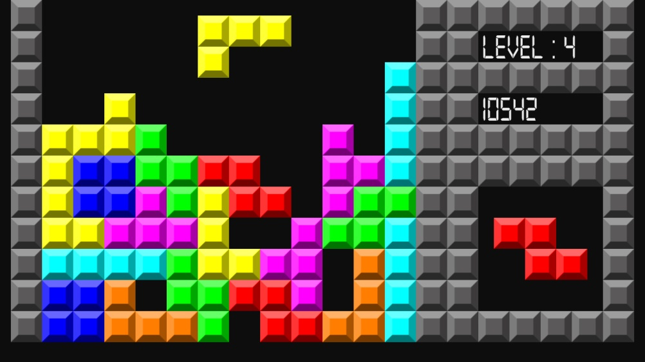
Videos games

Slide 6
Videos games
Things get complex really fast with each new feature or functionality
Let’s try some game programming of our own

