Slide 1
Policing as a mechanism to avoid a tragedy of the commons in P. aeruginosa
Bryan K. Lynn

Slide 2






Policing to avoid a tragedy of the commons
■
■
■
■
■
■
$$\dot{s}=d\left(s^{0}−s\right)−\left(x_{1}+x_{2}+x_{3}\right)f\left(s,e\right)$$
d(s⁰ )
❐
❐
❐
$\dot{e}=q_{1}x_{1}f\left(s,e\right)−de$
■
$$\dot{t}=q_{2}x_{2}f\left(s,e\right)−dt$$
■
■
$$\dot{x_{1}}=x_{1}(\left(1−q_{1}\right)f\left(s,e\right)−d−k_{1}t)$$
$$\dot{x_{2}}=x_{2}(\left(1−q_{2}\right)f\left(s,e\right)−d)$$
■
❐
❐
$$\dot{x_{3}}=x_{3}(f\left(s,e\right)−d−k_{2}t)$$
■
d(s,e,t,x₁,x₂,x₃)
■
■
❐
Reproducibility:
Readme file:
Explains the function of each piece of code, as well as describes all other non-figure files
Text files with each figure:
Records the initial condition and parameter values associated with each figure
x₁ : cooperator
substrate
x₂ : policer
■ enzyme
x₃ : cheater
❐ toxin

Slide 3
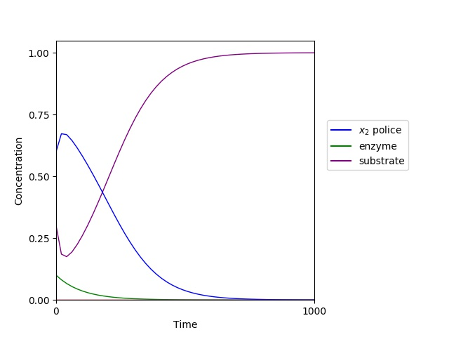
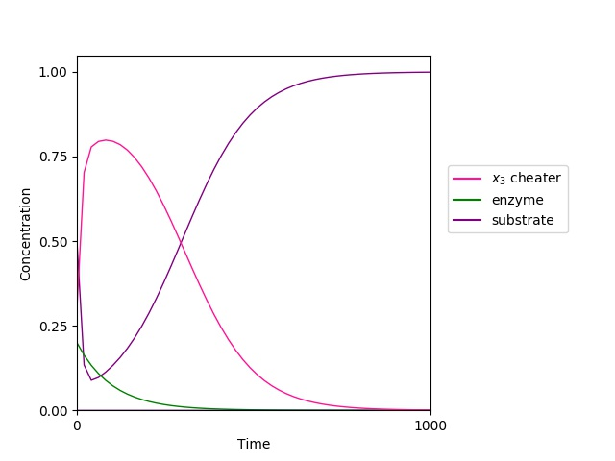
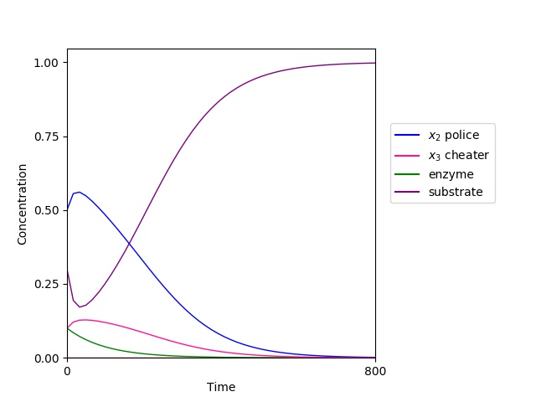


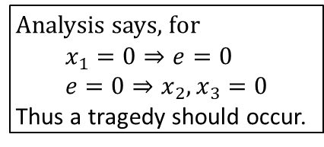











Police only
Cheater only
Police and Cheater
$$\dot{s}=d\left(s^{0}−s\right)−\left(x_{2}\right)f\left(s,e\right)$$
$$\dot{s}=d\left(s^{0}−s\right)−\left(x_{3}\right)f\left(s,e\right)$$
$$\dot{s}=d\left(s^{0}−s\right)−\left(x_{2}+x_{3}\right)f\left(s,e\right)$$
$\dot{e}=−de→0$
$\dot{e}=−de→0$
$\dot{e}=−de→0$
$$\dot{t}=q_{2}x_{2}f\left(s,e\right)−dt$$
$$\dot{t}=−dt→0$$
$$\dot{t}=q_{2}x_{2}f\left(s,e\right)−dt$$
$$\dot{x_{2}}=x_{2}(\left(1−q_{2}\right)f\left(s,e\right)−d)$$
$$\dot{x_{3}}=x_{3}(f\left(s,e\right)−d)$$
$$\dot{x_{2}}=x_{2}(\left(1−q_{2}\right)f\left(s,e\right)−d)$$
$$\dot{x_{3}}=x_{3}(f\left(s,e\right)−d−k_{2}t)$$
Analysis says, for
$$x_{1}=0⇒e=0 \\ e=0⇒x_{2}, x_{3}=0$$
Thus a tragedy should occur.

Slide 4
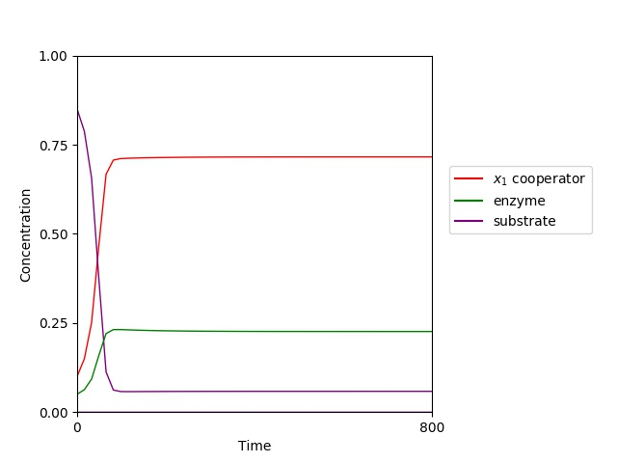
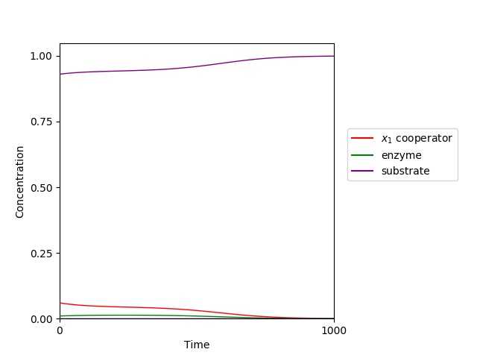
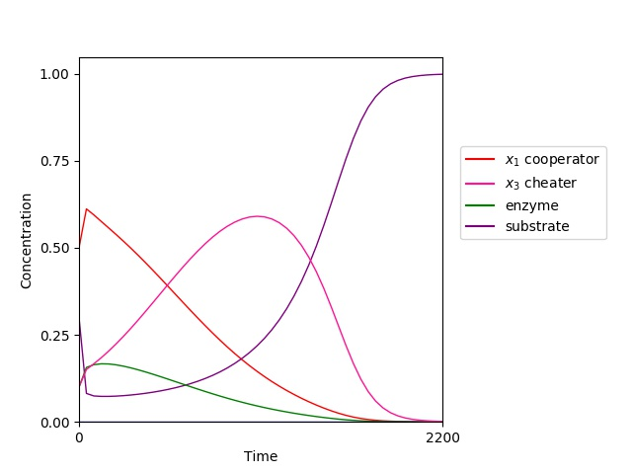



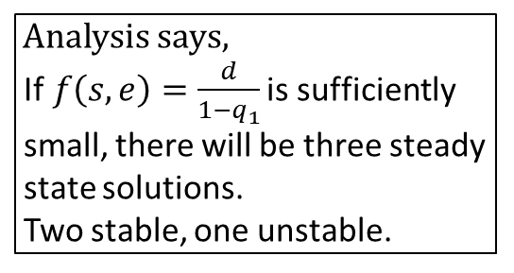






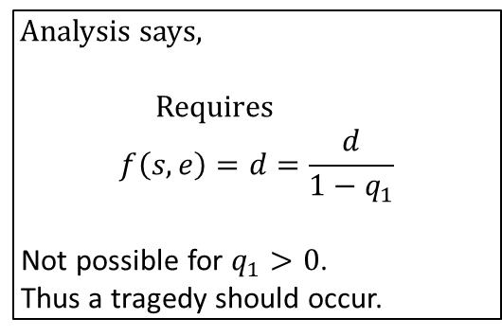
Cooperator only
$$\dot{s}=d\left(s^{0}−s\right)−\left(x_{1}\right)f\left(s,e\right)$$
Analysis says, If$f\left(s,e\right)=\frac{d}{1−q_{1}}$ is sufficiently small, there will be three steady
state solutions. Two stable, one unstable.
$\dot{e}=q_{1}x_{1}f\left(s,e\right)−de$
$$\dot{t}=−dt→0$$
$$\dot{x_{1}}=x_{1}(\left(1−q_{1}\right)f\left(s,e\right)−d)$$
Cooperator and Cheater
$$\dot{s}=d\left(s^{0}−s\right)−\left(x_{1}+x_{3}\right)f\left(s,e\right)$$
Analysis says,
Requires $$f\left(s,e\right)=d=\frac{d}{1−q_{1}}$$
Not possible for $q_{1}>0$.
Thus a tragedy should occur.
$\dot{e}={q_{1}x}_{1}f(s,e)−de$
$$\dot{t}=−dt→0$$
$$\dot{x_{1}}=x_{1}(\left(1−q_{1}\right)f\left(s,e\right)−d)$$
$$\dot{x_{3}}=x_{3}(f\left(s,e\right)−d)$$

Slide 5
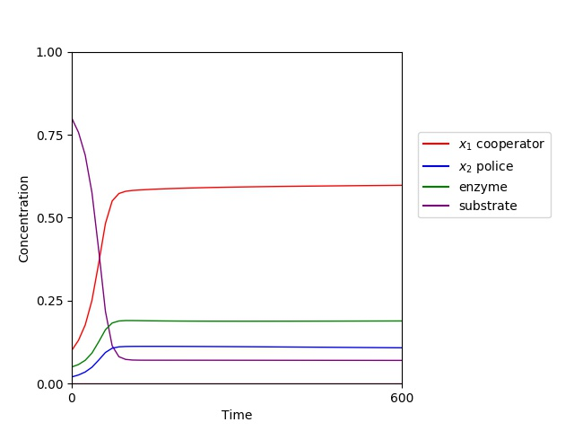
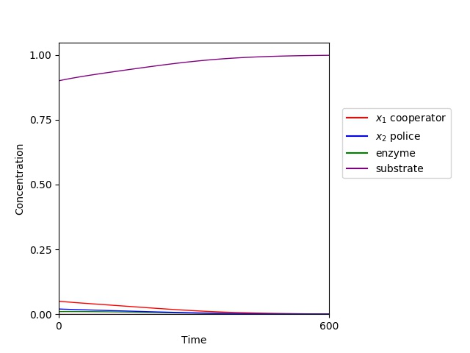
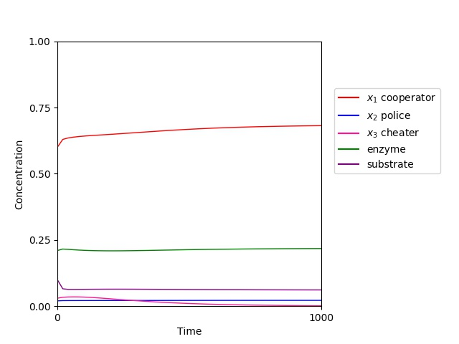
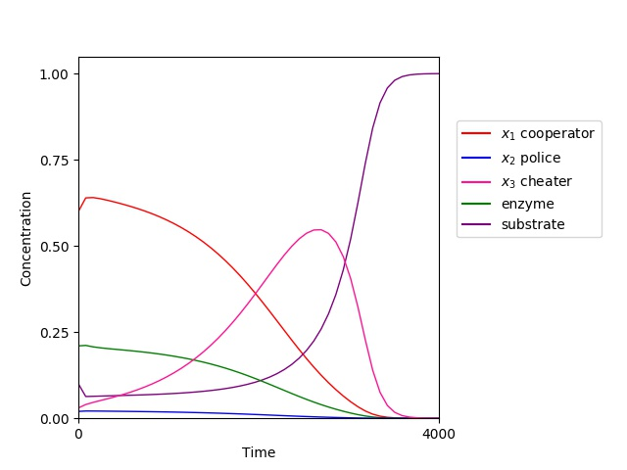


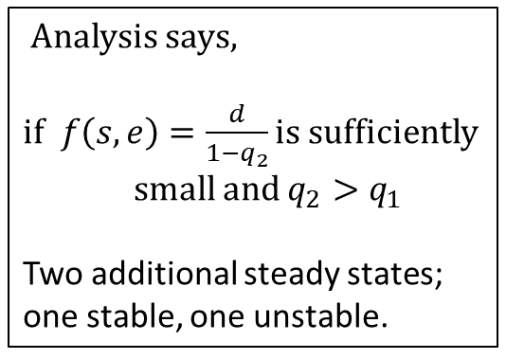









Cooperator and Police
Analysis says,
if$f\left(s,e\right)=\frac{d}{1−q_{2}}$ is sufficiently
small and $q_{2}>q_{1}$
Two additional steady states;
one stable, one unstable.
$$\dot{s}=d\left(s^{0}−s\right)−\left(x_{1}+x_{2}\right)f\left(s,e\right)$$
$\dot{e}=q_{1}x_{1}f\left(s,e\right)−de$
$$\dot{t}=q_{2}x_{2}f\left(s,e\right)−dt$$
$$\dot{x_{1}}=x_{1}(\left(1−q_{1}\right)f\left(s,e\right)−d−k_{1}t)$$
$$\dot{x_{2}}=x_{2}(\left(1−q_{2}\right)f\left(s,e\right)−d)$$
Full system
$$\dot{s}=d\left(s^{0}−s\right)−\left(x_{1}+x_{2}+x_{3}\right)f\left(s,e\right)$$
$\dot{e}=q_{1}x_{1}f\left(s,e\right)−de$
$$\dot{t}=q_{2}x_{2}f\left(s,e\right)−dt$$
$$\dot{x_{1}}=x_{1}(\left(1−q_{1}\right)f\left(s,e\right)−d−k_{1}t)$$
$$\dot{x_{2}}=x_{2}(\left(1−q_{2}\right)f\left(s,e\right)−d)$$
$$\dot{x_{3}}=x_{3}(f\left(s,e\right)−d−k_{2}t)$$
Analysis says,
No classical solutions.

Slide 6
Reproducibility:
Readme file:
explains the function of each piece of code
Describes all other non-figure files
Explains system for naming files
Text files with each figure:
Records the initial conditions and parameter values associated with each figure
Next steps:
Finalize rigorous analysis of what occurs at steady states when cheater introduced.
Finish (carefully) writing the analysis
LaTeX!
Write the paper
Take the nap

