Slide 1
Policing as a mechanism to avoid a tragedy of the commons in P. aeruginosa
Bryan K. Lynn

Slide 2







Division of labor in cooperators
e
e
e
e
e
e
$$\dot{s}=d\left(s^{0}−s\right)−\left(x_{1}+x_{2}+x_{3}\right)f\left(s,e\right)$$
d
t
s⁰
t
t
$\dot{e}=q_{1}x_{1}f\left(s,e\right)−de$
e
$$\dot{t}=q_{2}x_{2}f\left(s,e\right)−dt$$
e
e
$$\dot{x_{1}}=x_{1}(\left(1−q_{1}\right)f\left(s,e\right)−d−k_{1}t)$$
$$\dot{x_{2}}=x_{2}(\left(1−q_{2}\right)f\left(s,e\right)−d)$$
e
t
t
$$\dot{x_{3}}=x_{3}(f\left(s,e\right)−d−k_{2}t)$$
e
d
e
e
t
$$f\left(s,e\right)>0 ∀s,e>0 \\ f\left(0,e\right)=f\left(s,0\right)=0$$
x₁ : cooperator
x₂ : policer
x₃ : cheater

Slide 3
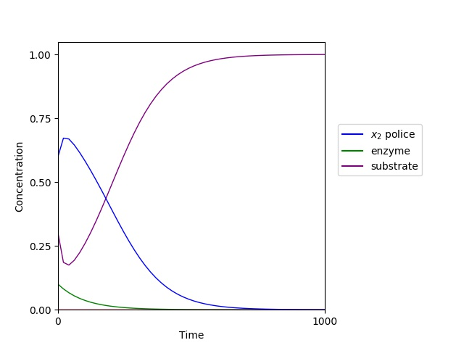


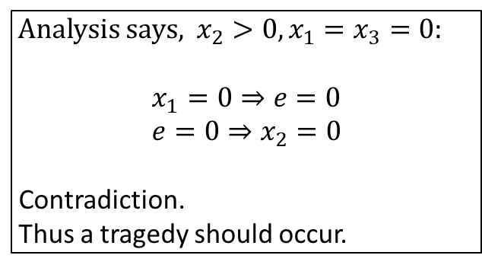


Police only
$$\dot{s}=d\left(s^{0}−s\right)−\left(x_{2}\right)f\left(s,e\right)$$
$\dot{e}=−de→0$
$$\dot{t}=q_{2}x_{2}f\left(s,e\right)−dt$$
$$\dot{x_{2}}=x_{2}(\left(1−q_{2}\right)f\left(s,e\right)−d)$$
Analysis says, $x_{2}>0, x_{1}=x_{3}=0:$
$$x_{1}=0⇒e=0 \\ e=0⇒x_{2}=0$$
Contradiction.
Thus a tragedy should occur.

Slide 4
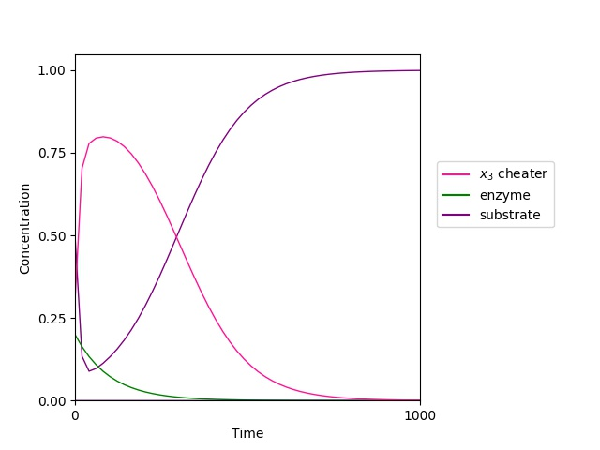

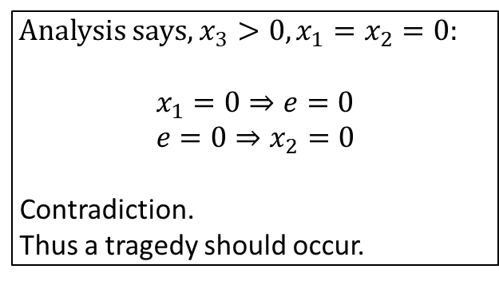



Cheater only
$$\dot{s}=d\left(s^{0}−s\right)−\left(x_{3}\right)f\left(s,e\right)$$
$\dot{e}=−de→0$
$$\dot{t}=−dt→0$$
$$\dot{x_{3}}=x_{3}(f\left(s,e\right)−d)$$
Analysis says, $x_{3}>0, x_{1}=x_{2}=0:$
$$x_{1}=0⇒e=0 \\ e=0⇒x_{2}=0$$
Contradiction.
Thus a tragedy should occur.

Slide 5
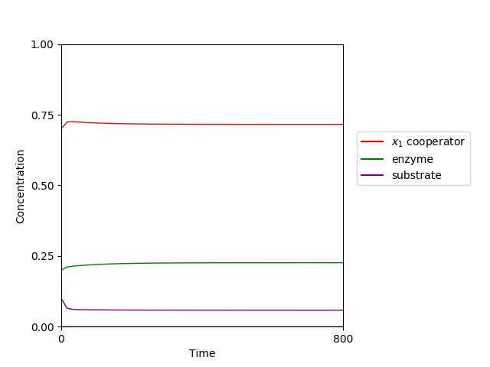
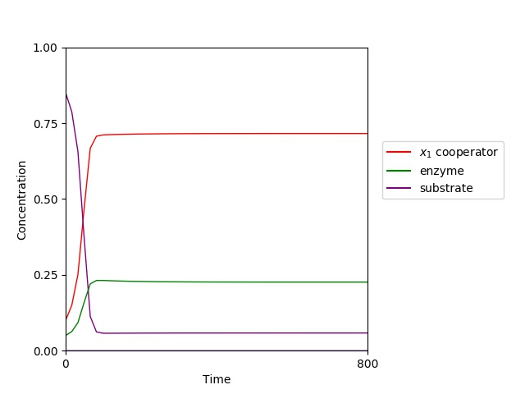
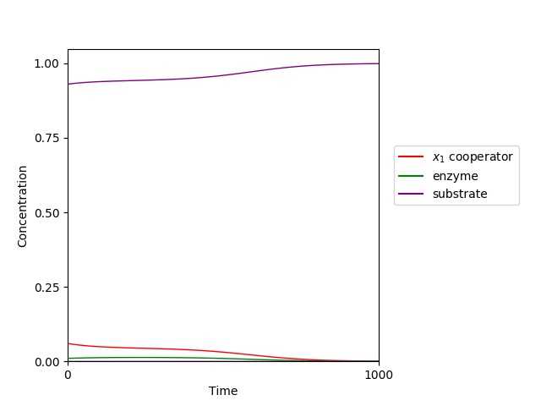

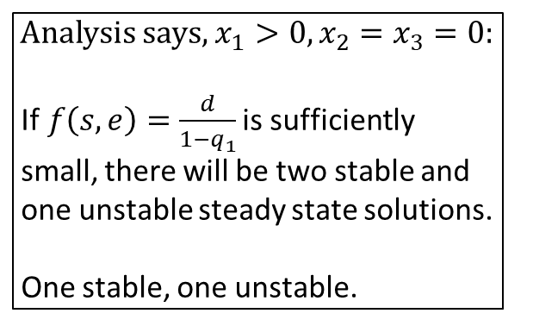



Cooperator only
$$\dot{s}=d\left(s^{0}−s\right)−\left(x_{1}\right)f\left(s,e\right)$$
$\dot{e}=q_{1}x_{1}f\left(s,e\right)−de$
$$\dot{t}=−dt→0$$
$$\dot{x_{1}}=x_{1}(\left(1−q_{1}\right)f\left(s,e\right)−d)$$
Analysis says, $x_{1}>0, x_{2}=x_{3}=0:$ If$f\left(s,e\right)=\frac{d}{1−q_{1}}$ is sufficiently small, there will be two stable and
one unstable steady state solutions.
One stable, one unstable.

Slide 6
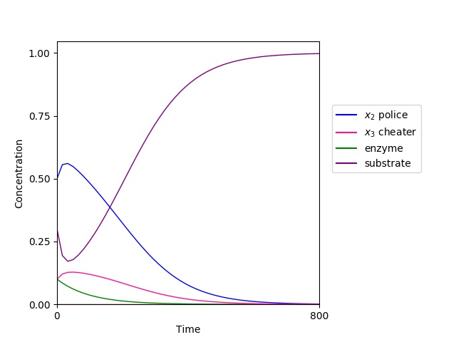

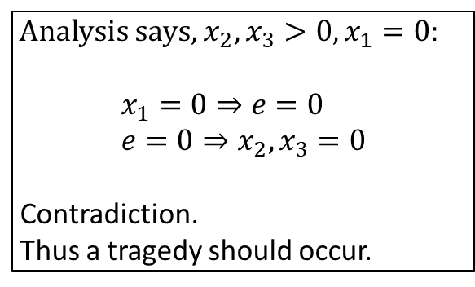




Police and Cheater
$$\dot{s}=d\left(s^{0}−s\right)−\left(x_{2}+x_{3}\right)f\left(s,e\right)$$
$\dot{e}=−de→0$
$$\dot{t}=q_{2}x_{2}f\left(s,e\right)−dt$$
$$\dot{x_{2}}=x_{2}(\left(1−q_{2}\right)f\left(s,e\right)−d)$$
$$\dot{x_{3}}=x_{3}(f\left(s,e\right)−d−k_{2}t)$$
Analysis says, $x_{2}, x_{3}>0, x_{1}=0:$
$$x_{1}=0⇒e=0 \\ e=0⇒x_{2}, x_{3}=0$$
Contradiction.
Thus a tragedy should occur.

Slide 7
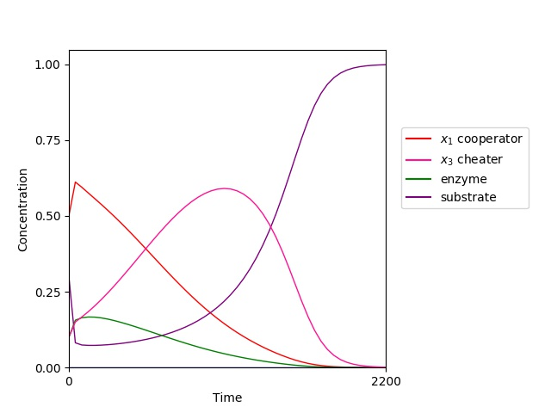



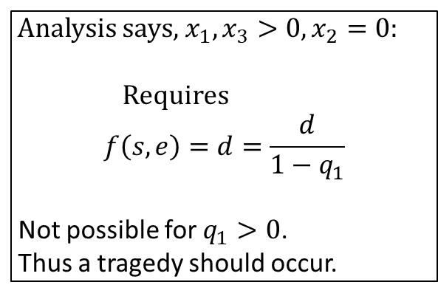


Cooperator and Cheater
$$\dot{s}=d\left(s^{0}−s\right)−\left(x_{1}+x_{3}\right)f\left(s,e\right)$$
$\dot{e}={q_{1}x}_{1}f(s,e)−de$
$$\dot{t}=−dt→0$$
$$\dot{x_{1}}=x_{1}(\left(1−q_{1}\right)f\left(s,e\right)−d)$$
$$\dot{x_{3}}=x_{3}(f\left(s,e\right)−d)$$
Analysis says, $x_{1}, x_{3}>0, x_{2}=0:$
Requires $$f\left(s,e\right)=d=\frac{d}{1−q_{1}}$$
Not possible for $q_{1}>0$.
Thus a tragedy should occur.

Slide 8

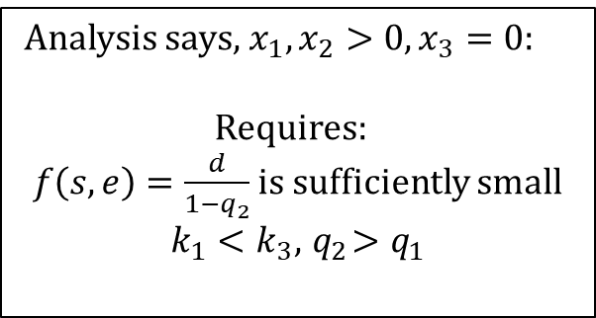




Cooperator and Police
$$\dot{s}=d\left(s^{0}−s\right)−\left(x_{1}+x_{2}\right)f\left(s,e\right)$$
$\dot{e}=q_{1}x_{1}f\left(s,e\right)−de$
$$\dot{t}=q_{2}x_{2}f\left(s,e\right)−dt$$
$$\dot{x_{1}}=x_{1}(\left(1−q_{1}\right)f\left(s,e\right)−d−k_{1}t)$$
$$\dot{x_{2}}=x_{2}(\left(1−q_{2}\right)f\left(s,e\right)−d)$$
Analysis says, $x_{1}, x_{2}>0, x_{3}=0:$
Requires: $f\left(s,e\right)=\frac{d}{1−q_{2}}$ is sufficiently small
$$k_{1}<k_{3}, { q}_{2}>q_{1}$$

