Slide 1
Policing as a mechanism to avoid a tragedy of the commons in P. aeruginosa
Bryan K. Lynn

Slide 2






Policing to avoid a tragedy of the commons
■
■
■
■
■
■
$$\dot{s}=d\left(s^{0}−s\right)−\left(x_{1}+x_{2}+x_{3}\right)f\left(s,e\right)$$
d(s⁰ )
❐
❐
❐
$\dot{e}=q_{1}x_{1}f\left(s,e\right)−de$
■
$$\dot{t}=q_{2}x_{2}f\left(s,e\right)−dt$$
■
■
$$\dot{x_{1}}=x_{1}(\left(1−q_{1}\right)f\left(s,e\right)−d−k_{1}t)$$
$$\dot{x_{2}}=x_{2}(\left(1−q_{2}\right)f\left(s,e\right)−d)$$
■
❐
❐
$$\dot{x_{3}}=x_{3}(f\left(s,e\right)−d−k_{3}t)$$
■
d(s,e,t,x₁,x₂,x₃)
■
■
❐
x₁ : cooperator
substrate
x₂ : policer
■ enzyme
x₃ : cheater
❐ toxin

Slide 3
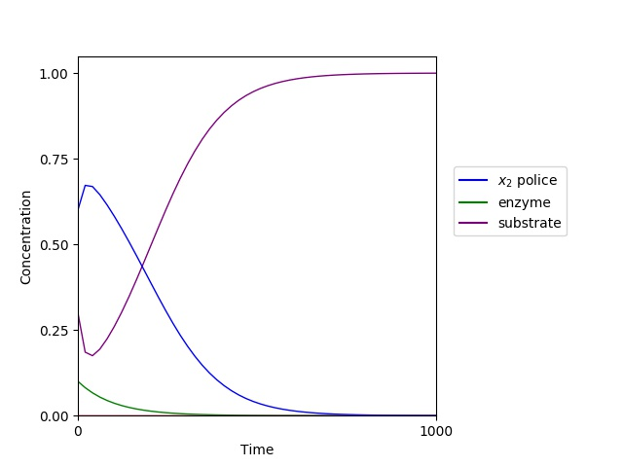
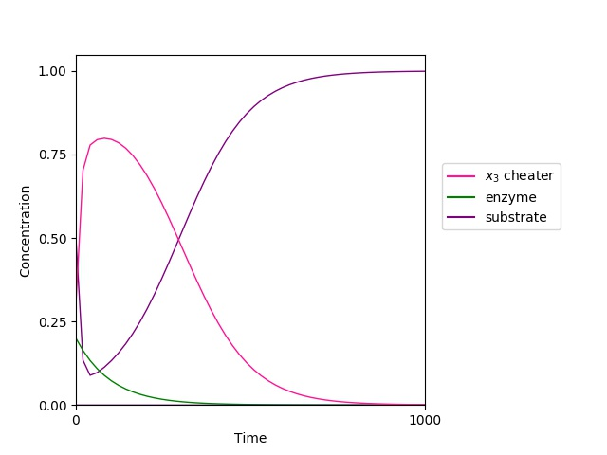
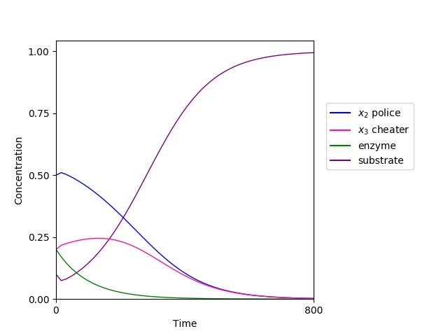


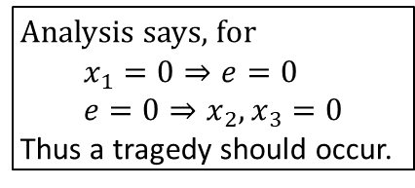











Police only
Cheater only
Police and Cheater
$$\dot{s}=d\left(s^{0}−s\right)−\left(x_{2}\right)f\left(s,e\right)$$
$$\dot{s}=d\left(s^{0}−s\right)−\left(x_{3}\right)f\left(s,e\right)$$
$$\dot{s}=d\left(s^{0}−s\right)−\left(x_{2}+x_{3}\right)f\left(s,e\right)$$
$\dot{e}=−de→0$
$\dot{e}=−de→0$
$\dot{e}=−de→0$
$$\dot{t}=q_{2}x_{2}f\left(s,e\right)−dt$$
$$\dot{t}=−dt→0$$
$$\dot{t}=q_{2}x_{2}f\left(s,e\right)−dt$$
$$\dot{x_{2}}=x_{2}(\left(1−q_{2}\right)f\left(s,e\right)−d)$$
$$\dot{x_{3}}=x_{3}(f\left(s,e\right)−d)$$
$$\dot{x_{2}}=x_{2}(\left(1−q_{2}\right)f\left(s,e\right)−d)$$
$$\dot{x_{3}}=x_{3}(f\left(s,e\right)−d−k_{3}t)$$
Analysis says, for
$$x_{1}=0⇒e=0 \\ e=0⇒x_{2}, x_{3}=0$$
Thus a tragedy should occur.

Slide 4
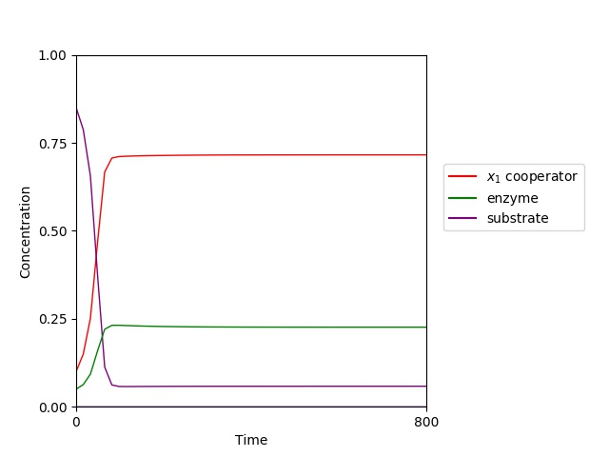
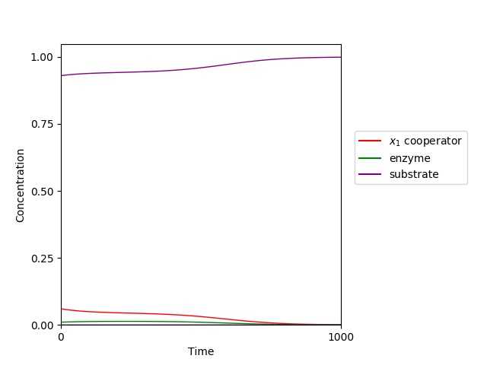
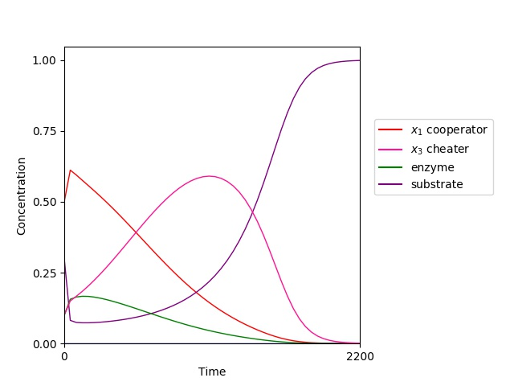



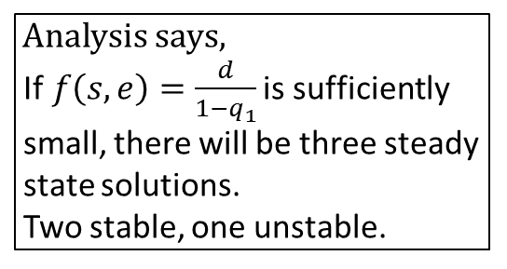






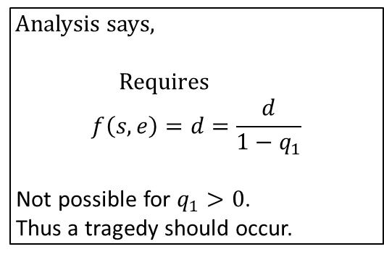
Cooperator only
$$\dot{s}=d\left(s^{0}−s\right)−\left(x_{1}\right)f\left(s,e\right)$$
Analysis says, If$f\left(s,e\right)=\frac{d}{1−q_{1}}$ is sufficiently small, there will be three steady
state solutions. Two stable, one unstable.
$\dot{e}=q_{1}x_{1}f\left(s,e\right)−de$
$$\dot{t}=−dt→0$$
$$\dot{x_{1}}=x_{1}(\left(1−q_{1}\right)f\left(s,e\right)−d)$$
Cooperator and Cheater
$$\dot{s}=d\left(s^{0}−s\right)−\left(x_{1}+x_{3}\right)f\left(s,e\right)$$
Analysis says,
Requires $$f\left(s,e\right)=d=\frac{d}{1−q_{1}}$$
Not possible for $q_{1}>0$.
Thus a tragedy should occur.
$\dot{e}={q_{1}x}_{1}f(s,e)−de$
$$\dot{t}=−dt→0$$
$$\dot{x_{1}}=x_{1}(\left(1−q_{1}\right)f\left(s,e\right)−d)$$
$$\dot{x_{3}}=x_{3}(f\left(s,e\right)−d)$$

Slide 5
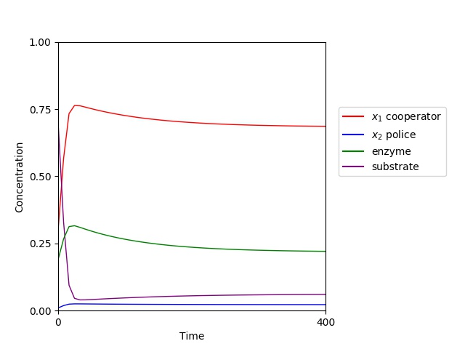
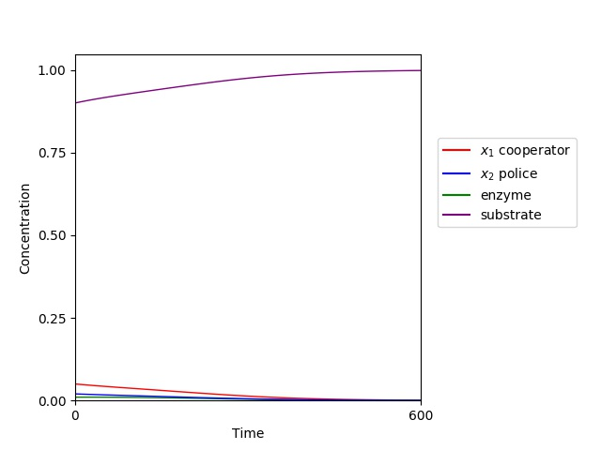
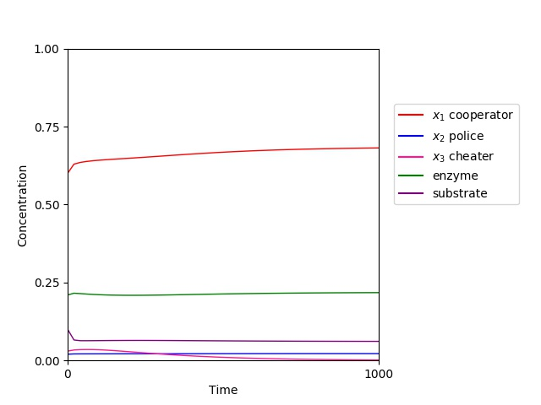
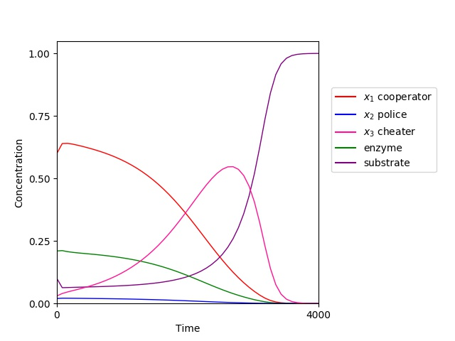


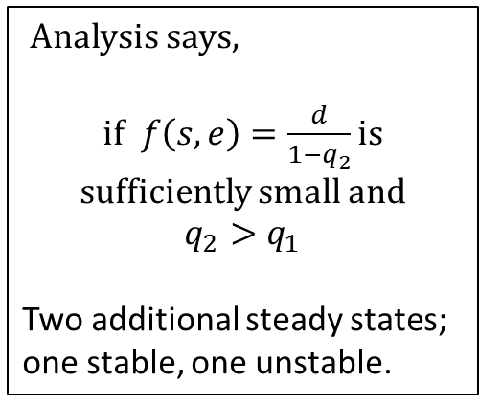









Cooperator and Police
$$\dot{s}=d\left(s^{0}−s\right)−\left(x_{1}+x_{2}\right)f\left(s,e\right)$$
Analysis says,
if$f\left(s,e\right)=\frac{d}{1−q_{2}}$ is sufficiently small and
$$q_{2}>q_{1}$$
Two additional steady states;
one stable, one unstable.
$\dot{e}=q_{1}x_{1}f\left(s,e\right)−de$
$$\dot{t}=q_{2}x_{2}f\left(s,e\right)−dt$$
$$\dot{x_{1}}=x_{1}(\left(1−q_{1}\right)f\left(s,e\right)−d−k_{1}t)$$
$$\dot{x_{2}}=x_{2}(\left(1−q_{2}\right)f\left(s,e\right)−d)$$
Full system
$$\dot{s}=d\left(s^{0}−s\right)−\left(x_{1}+x_{2}+x_{3}\right)f\left(s,e\right)$$
$\dot{e}=q_{1}x_{1}f\left(s,e\right)−de$
$$\dot{t}=q_{2}x_{2}f\left(s,e\right)−dt$$
$$\dot{x_{1}}=x_{1}(\left(1−q_{1}\right)f\left(s,e\right)−d−k_{1}t)$$
$$\dot{x_{2}}=x_{2}(\left(1−q_{2}\right)f\left(s,e\right)−d)$$
Analysis says,
No classical solutions.
$$\dot{x_{3}}=x_{3}(f\left(s,e\right)−d−k_{3}t)$$

Slide 6
Useful things I learned
Reproducibility
Next Steps
The power of doing mathematical analysis before numerical simulations.
Coding best practices:
So, maybe I’m finally convinced of the importance of commenting code and not using silly variable names.
Having a workflow (AKA a roadmap of goals) increased my productivity by narrowing my focus to the immediate steps.
Sometimes what you set out to prove is different from what you find.
Actually commented my code for once.
Readme file:
explains the function of each piece of code
describes all other non-figure files
records system for naming files
Text files with each figure:
Records the initial conditions and parameter values associated with each figure
Finalize rigorous analysis of what occurs at steady states when cheater introduced.
Finish (carefully) writing the analysis
LaTeX!
Write the paper
Take the nap

