Slide 1

Padel Shop
Hussein Barakat Lynn Haydar Sara

Slide 2



EcommerceApp
Launches and initializes the entire application.
Entry point of the JavaFX application.
Sets up the primary stage and displays the welcome screen.
Central control point for starting and managing the application lifecycle.

Slide 3

Database
Manages the database connections central to all data handling in the application.
Provides methods to obtain a database connection instance.
Ensures that only one database connection is active via singleton pattern.
Handles database connectivity and can be extended to manage connection pooling.

Slide 4
User
Singleton class representing the logged-in user.
Stores user details like user ID, username, password, role, and theme preference.
Provides a global access point for user information throughout the application.
Handles updates to user attributes and preferences.

Slide 5
UserCRUD
Manages database operations related to users.
Provides functionalities for user creation, login, and username availability checks.
Central component for user authentication and management.
Uses prepared statements to secure and optimize database interactions.

Slide 6
ThemeManager
Manages application themes (dark and light modes).
Applies themes across all stages and scenes dynamically.
Tracks all stages to ensure consistent theme application.
Provides methods for registering stages and updating themes globally.

Slide 7
ProductsCRUD
Handles CRUD operations for products.
Methods to add, update, delete, and fetch product details from the database.
Integral to inventory management and product details.
Directly interacts with the database to maintain product data.

Slide 8

CartCRUD
Handles CRUD operations for shopping cart items.
Methods include adding, removing, and fetching cart items from the database.
Interacts directly with the database to reflect cart updates.
Uses SQL statements to manage cart data integrity and consistency.

Slide 9

WelcomeStage
The first user interface component that new users interact with.
Displays a greeting image and provides a button to navigate to the signup screen.
Sets the visual and interactive introduction for new users.
Simple and effective entry point into the application's user interface.

Slide 10

Login
Manages user logins, a critical gateway for accessing user-specific features.
Validates user credentials against stored data.
Provides navigational links to sign up or recover accounts.
Connects to UserCRUD for authentication processes.

Slide 11

Signup
Manages user registration.
Collects new user credentials and registers them in the system.
Provides a link for users to switch to the login form if they already have an account.
Validates new user data and interacts with UserCRUD for registration.

Slide 12
OrderCRUD
Handles database operations for orders.
Facilitates order creation, tracking, and management.
Integrates with CartCRUD for order item handling.
Interacts with Payment and Address classes for order finalization.

Slide 13
Settings
Manages user settings, specifically theme preferences.
Allows users to toggle between dark and light themes.
Saves user preferences to a file for persistence across sessions.
Updates application theme dynamically based on user settings.

Slide 14
DisplayProducts
Manages and displays products available for purchase.
Uses a GridPane to arrange product entries dynamically.
Provides features to add products to the shopping cart.
Allows filtering and searching for products by categories.

Slide 15
ProductsManagement
Admin interface for managing product listings.
Features adding, updating, and deleting products.
Utilizes TableView to display and manage product information.
Provides tools for comprehensive product management within the admin panel.

Slide 16
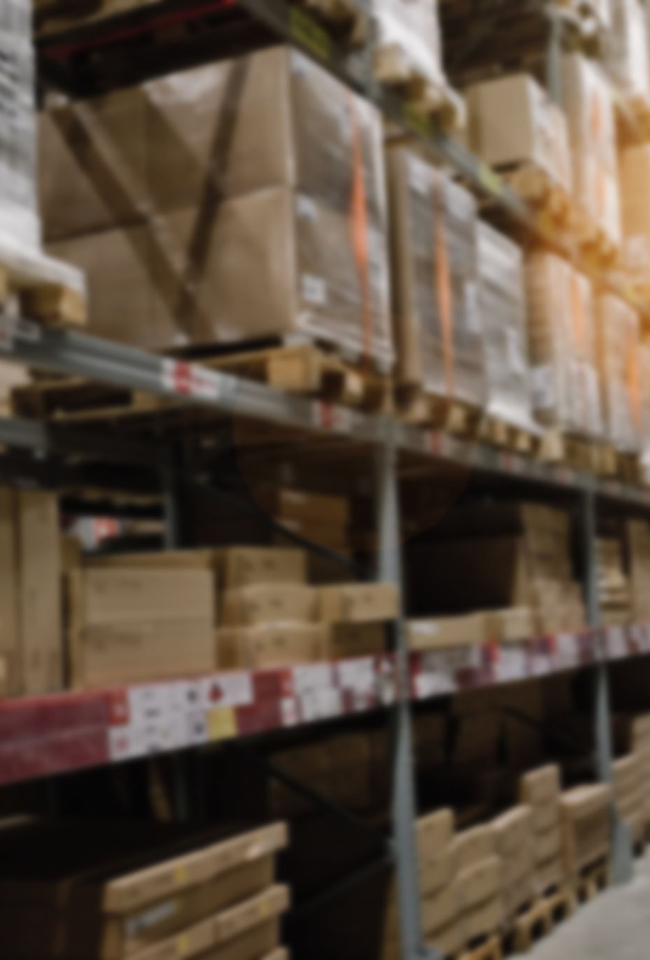
OrderAdmin
Admin interface for managing orders.
Features listing, updating, and deleting orders.
Uses TableView for displaying order details.
Allows administrators to update shipping status and view order items.

Slide 17
InvoiceGenerator
Generates and displays invoices for orders.
Uses TableView to list purchased items and their prices.
Provides functionality to save and print invoices.
Connects with the database to fetch order details and calculate totals.

Slide 18
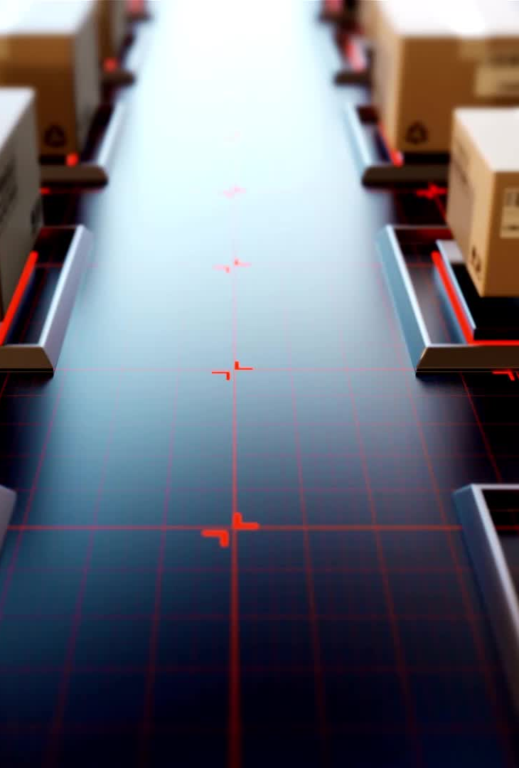
OrderUser
Handles order placement by users.
Collects shipping and payment details via a form interface.
Communicates with database to finalize the order process.
Confirms order placement and updates user interface accordingly.

Slide 19
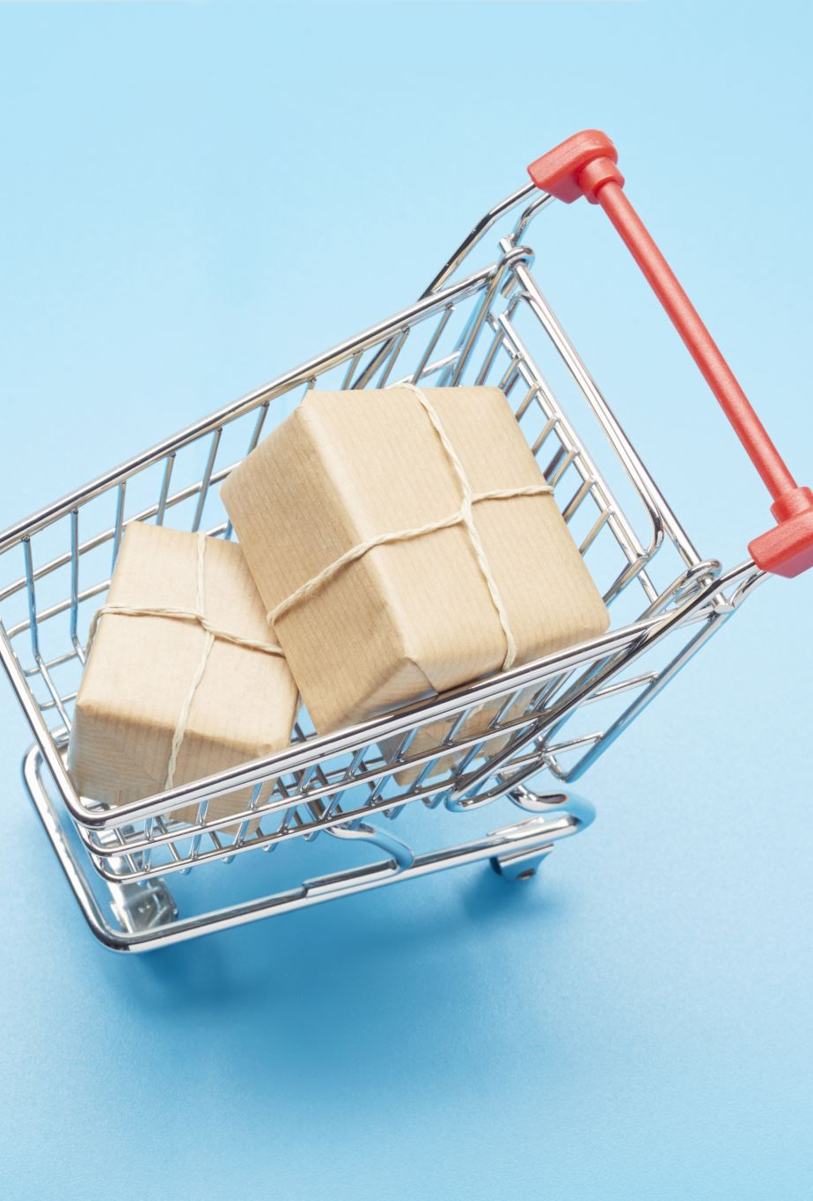
DisplayCart
Displays the user's shopping cart with options to view, update, or delete items.
Utilizes a TableView to list cart items and their details.
Integrates buttons for placing orders and modifying cart contents.
Directly interacts with the CartCRUD class for data management.

Slide 20

OrderHistory
Manages and displays the order history of a user.
Allows users to view past orders and download order details.
Integrates with a database to retrieve user-specific order information.
Provides export functionality to save order data as Excel files.

Slide 21
AdminPaymentMethod
Manages payment methods in an admin context.
Features a UI for adding, editing, and deleting payment methods.
Integrates with the database to fetch and update payment information.
Provides navigation to other admin functions like product and order management.

Slide 22

Address
Manages user address details, used in shipping and billing processes.
Provides getters and setters for address attributes like street, city, and postal code.
Used across various classes for managing shipping addresses.
Contains methods to update and retrieve address details.

Slide 23
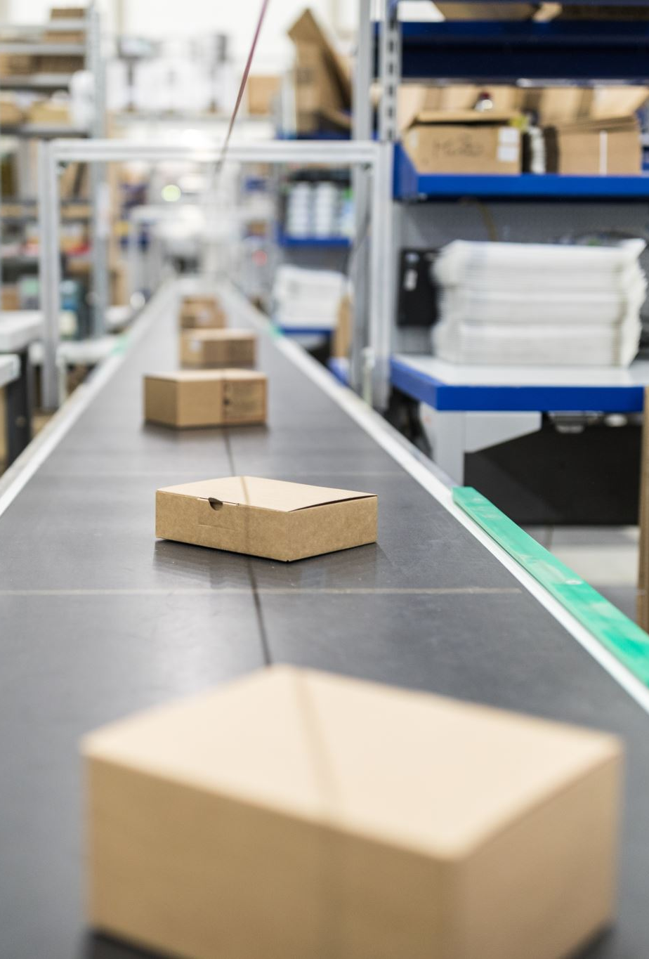
Product
Represents a product in the system.
Contains details like product ID, name, price, description, stock quantity, and image path.
Used across various classes for displaying product information and managing inventory.
Provides methods to manage and update product details.

Slide 24

ShoppingCart
Represents a shopping cart item.
Stores product name, price, quantity, and total price.
Used in cart management to display items added by the user.
Supports operations like cart updating and checkout processes.

Slide 25
OrderItem
Represents an item within an order.
Stores details such as order ID, product ID, product name, and price.
Used in order processing and display in the OrderHistory and InvoiceGenerator classes.
Serves as a detailed component of the order management system.

Slide 26

InvoiceItem
Represents an item within an invoice.
Stores product name, price, quantity, and total price.
Used by InvoiceGenerator to compile and calculate invoice contents.
Serves as a data model within the invoice generation process.

Slide 27

Payment
Manages payment details such as method and currency.
Used in various purchasing scenarios within the application.
Provides getters and setters for payment attributes.
Integral to the order processing and checkout functionalities.

Slide 28

Thanks

