Slide 1
Basic Python Programming Concepts to solve Exercise Problems (P_VTP1)
11/7/2020

Slide 2
Contents
Correspondence Index
What is Python ?
Different Syntax usage of Python from Java
P_VTP1: 1
Few Important Things to Remember
Commenting in Python
Variables and its Names
Data Types
P_VTP1: 1, 3, 4

Slide 3
Value and Built-in Type
P_VTP1: 10
Type Conversion
P_VTP1: 3, 4
Difference between end and sep
P_VTP1: 11
Operators
P_VTP1: 5, 6, 7, 8
String
P_VTP1: 2, 23, 24, 25, 26, 27, 28, 40, 41, 42
Lists
P_VTP1: 36, 37, 38, 39

Slide 4
Tuples
P_VTP1: 9, 29, 30, 31, 32, 33, 34, 35
Dictionary
P_VTP1: 43, 44, 45, 46, 47
Selection Construct
P_VTP1: 12, 13, 14
Iteration Constructs
P_VTP1: 15, 16, 17, 18, 19
Break, Continue, Pass
P_VTP1: 20, 21, 22
Correspondence Between Each Topic and Related VTPs
Conclusion

Slide 5
Correspondence Index
Python Basic Grammar Concept Topic | Related Slide Number
What is Python? | 7
Different Syntax usage of Python from Java | 8
Few Important Things to Remember | 9
Commenting in Python | 10
Variables and its Names | 11
Data Types | 12
Value and Built-in Type | 13
Type Conversion | 14
Difference between end and sep | 15
Operators | 17

Slide 6
Basic Grammar Concept Topic | Related Slide Number
String | 28
Lists | 33
Tuples | 39
Dictionary | 45
Selection Construct | 49
Iteration Construct | 54
Break Statement | 58
Continue Statement | 59
Pass Statement | 60
Correspondence Between Each Topic and Related VTPs | 61
Conclusion | 62

Slide 7
What is Python ?
Python is a high-level programming language, with applications in numerous areas, including web programming, scripting, scientific computing, and artificial intelligence.
It is very popular and used by organizations such as Google, NASA, U tube, I-robot, Intel, Cisco, etc.
Python is easy to use, powerful, and versatile, making it a great choice for beginners and experts.
Therefore, we need to take a lot of study for future learning.
Index Page

Slide 8
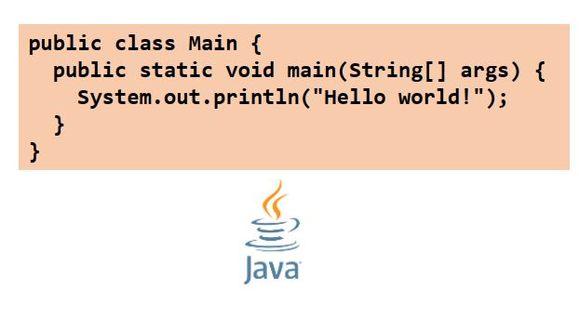
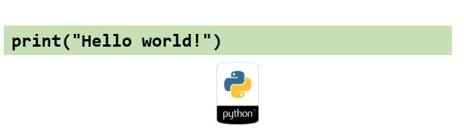
Different Syntax usage of Python from Java
Index Page

Slide 9
Few Important Things to Remember
To represent a statement in Python, newline (enter) is used.
Use of semicolon at the end of the statement is optional (unlike languages like C/C++).
In fact, it's recommended to omit semicolon at the end of the statement in Python.
Instead of curly braces { }, indentations( number of tab) are used to represent a block.
Index Page

Slide 10
Commenting in Python
Python single line comment preceded by a hash symbol (#)
Example: #This is a comment print("Hello, World!")
Three consecutive single quotation marks ‘’’ are used to give multiple comments (or) paragraph comments.
Example:
""" This is a comment written in more than just one line """ print("Hello, World!")
Index Page

Slide 11
Variables and its Names
A variable allows to store a value by assigning it to a name, which can be used to refer to the value later in the program.
Rules for Python variables:
- Must start with a letter or the underscore character
- Cannot start with a number
- Should be meaningful and short, case-sensitive( age, Age are not the same)
Index Page

Slide 12
Data Types
Different types in python are:
(1) Numbers (int, float, etc >> 3, 4.5, etc)
(2) Lists >> [1, 2, 3, 4], ["Hello", "world!"], [1, 2, "Hello"]
(3) Tuples >> (1, 2), ("hi", "hello", "bye"), (2, "Lucy", 45)
(4) Strings >> "Hello world!", ‘K3WL’
(5) Sets >> {"apple", "banana", "cherry"}
(6) Dictionary >> {'StuName': 'Ajeet', 'StuAge': 30, 'StuCity': 'Agra'}
Index Page

Slide 13
Value and Built-in Type
To know type of any value in Python use in-build method called type(value).
Example:
type(‘123’) return build-in type as <class 'int'> type(‘123.33’) return build-in type as <class 'float'>
type(‘hello’) return build-in type as <class 'str'>
type(‘True’) return build-in type as <class 'bool'>
type(‘3+4j’) return build-in type as <class 'complex'>
Index Page

Slide 14
Type Conversion
It is possible to change one type of value/ variable to another type. It is known as type conversion or type casting.
Therefore, casting in python is done using constructor functions.
Example: a= 12.34 b= int(a) print (b ) >> The result is 12.
Index Page

Slide 15
Python automatically converts one data type to another data type. This process doesn't need any user involvement. This is called Implicit type conversion.
Example
num_int = 13
num_flo = 1.1
num_new = num_int + num_flo
print("datatype of num_int:",type(num_int)) >> <class 'int'>
print("datatype of num_flo:",type(num_flo)) >> <class 'float'>
print("Value of num_new:",num_new) >> 14.1
print("datatype of num_new:",type(num_new)) >> <class 'float'>
Index Page

Slide 16
Difference between end and sep
end and sep are optional parameters of Python.
The end parameter basically prints after all the output objects present in one output objects present in one output statement have been returned.
The sep parameter differentiates between the objects.
EXAMPLE: a=2 b='abc' print(a,b,sep=',') print(a,b,end=',')
OUTPUT: 2,abc 2 abc,
Index Page

Slide 17
Operators
Python divides the operators in the following groups:
- Arithmetic Operators
- Assignment Operators
- Comparison Operators
- Logical Operators
- Relational Operators
- Bitwise Operators
- Identity Operators
- Membership Operators
Index Page

Slide 18
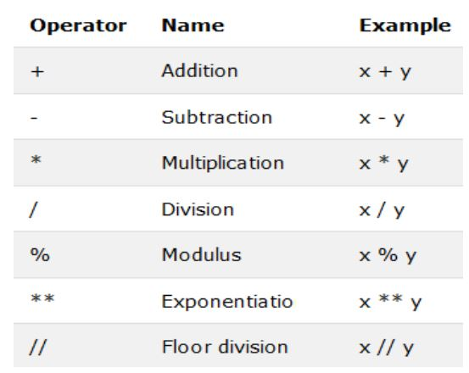
Arithmetic Operators
Arithmetic operators are used with numeric values to perform common mathematical operations.
Index Page

Slide 19
Example
x = 33
y = 2
# Output for addition of x and y
print('x + y = {}'.format(x+y)) >> 35
# Output for subtration of x and y
print('x - y = {}'.format(x-y)) >> 31
# Output for multiplication of x and y
print('x * y = {}'.format(x*y)) >> 66
# Output for division of x and y
print('x / y = {}'.format(x/y)) >> 16.5
# Output for modulus of x and y
print('x // y = {}'.format(x//y)) >> 16
# Output for exponent of x and y
print('x ** y = {}'.format(x**y)) >> 1089
Index Page

Slide 20
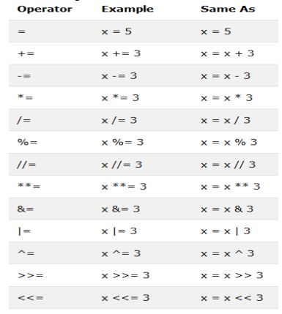
Assignment Operators
Assignment operators are used to assign values to variables:
Index Page

Slide 21
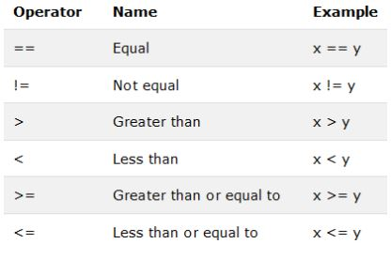
Comparison Operators
Comparison operators are used to compare two values:
Index Page

Slide 22
Example
# Output: x > y is True or False
print('x > y is',x>y) >> False
# Output: x == y is True or False
print('x == y is',x==y) >> False
# Output: x != y is True or False
print('x != y is',x!=y) >> True
# Output: x >= y is True or False
print('x >= y is',x>=y) >> False
# Output: x <= y is True or False
print('x <= y is',x<=y) >> True
Index Page

Slide 23
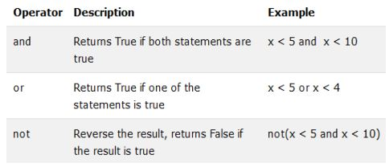
Logical Operators
Logical operators are used to combine conditional statements.
Index Page

Slide 24
Example
x = False
y = True
print('x and y is',x and y) >> False
print('x or y is',x or y) >> True
print('not x is',not x) >> True
Index Page

Slide 25
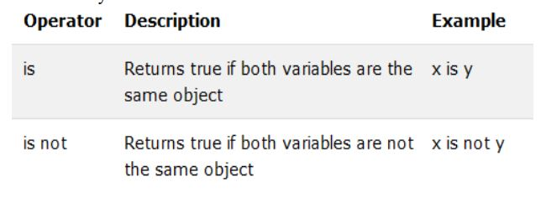
Identity Operators
Identity operators are used to compare the objects.
Index Page

Slide 26
Example
x1 = 3
y1 = 3
x2 = 'Welcome'
y2 = 'Welcome'
x3 = [1,2,3,4]
y3 = [1,2,3]
print("x1 is not y1", x1 is not y1) >> False
print("x2 is y2", x2 is y2) >> True
print("x3 is y3", x3 is y3) >> False
Index Page

Slide 27
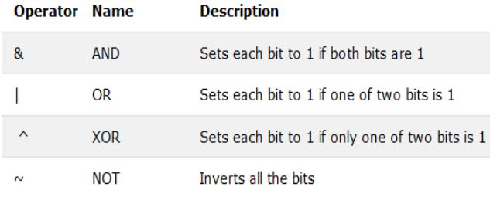
Bitwise Operators
Bitwise operators are used to compare (binary) numbers.
Index Page

Slide 28
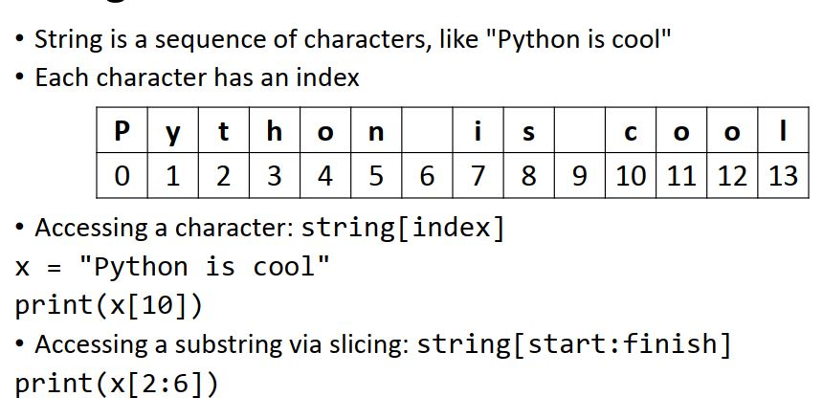
String
// Output is c.
// Output is thon.
Index Page

Slide 29
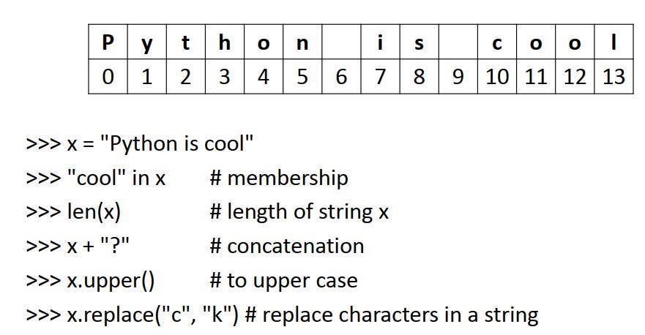
String Operations
>> True
>> 14
Python is cool?
Index Page

Slide 30
subscripting of strings
'Hello'[2] → 'l'
slice: 'Hello'[1:2] → 'el‘
'Hello'[:2] → ‘He‘
'Hello'[2:] → ‘llo‘
'Hello'[2:-1] → ‘llo'
word[-1] → last character ‘o’
len(word) → 4
‘Hello’* 3 → HelloHelloHello (String Replication)
Index Page

Slide 31
Relational Operator on String
The ASCII value of a is 97, b is 98 and so on.
The ASCII value of A is 65, B is 66 and so on.
Example
str1 = 'A'
str2 = 'B'
str3 = 'a'
str4 = 'b'
print (“str1>str3”, str1>str3) ,The output is False.
print (“str2> str1”, str2>str1), The output is True.
Index Page

Slide 32
String Format
Strings and numbers can be combined by using the format() method.
The format() method takes the passed arguments, formats them, and places them in the string where the placeholders {} are.
Example: age = 36 txt = "My name is John, and I am {}" print(txt.format(age))
Output: My name is John, and I am 36
Index Page

Slide 33
Lists
A list is created by placing all the items (elements) inside a square bracket [], separated by commas.
It can have any number of items, and they may be of different types (integer, float, string, etc.)
Lists are mutable, meaning, their elements can be changed.
Index Page

Slide 34
Creating List
Example
#empty list >> my_list = []
#list of integers >> my_list = [1,2,3]
#list with mixed data types>> my_list = [1, “Hello”, 3.4]
#nested list >> my_list = [“Welcome”, [8,4,6]]
Index Page

Slide 35
Accessing Items from a list
Use the index operator []
Example
list = [‘p’,’r’,’o’,’b’,’e’]
# positive indexing
Print (list[2]) >> o
# negative indexing and negative index -1 refers to the last item
Print (list[-2]) >> b
# Slicing operation on list
Print(list[1:3]) >> r,o
# nested list
list = [“welcome”, [8,4,6]]
Print(list[1][0]) >> 8
Index Page

Slide 36
Change or Add Elements to a list
#Change Elements
marks=[90,60,80,66,76,45,60] marks[1]=100
marks[3:6] = [11, 22, 33] print(marks) >>>[90, 100, 80, 11, 22, 33, 60] #Add Elements -add one item to a list using append() method -add several items using extend() -insert one item at a desired location by insert() method
marks.append(50) print(marks) >>>[90, 100, 80, 50] marks.extend([60,80,70]) print(marks) >>>[90, 100, 80, 50, 60, 80, 70 ]
marks.insert(3,40)
print(marks) >>>[90, 100, 80, 40, 50, 60, 80, 70]
Index Page

Slide 37
Delete or Remove Elements from a List
del keyword to delete one or more items from a list. marks = [90, 100, 80, 40, 50, 60, 80, 70] del marks[6] print(marks) >>> [90, 100, 80, 40, 50, 60, 70]
del marks[2:4] >>> [90,100,50,60,70]
clear() method to empty a list. marks.clear() print(marks) >>> []
remove() method to remove the given item marks.remove(50) print(marks) >>> [90, 100, 60, 70]
Index Page

Slide 38
pop() method to remove an item at the given index.
marks=[100,20,30] marks.pop() >>> 30 print(marks) >>> [100, 20] marks.pop(0) >>> 100 print(marks) >>>[20]
Index Page

Slide 39
Tuples
Tuples are very similar to lists, except that they are immutable ( they cannot be changed).
They are created using parentheses, rather than square brackets.
Index Page

Slide 40
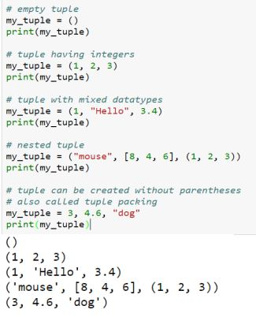
Creating a Tuple
Index Page

Slide 41
Accessing Elements in a Tuple
Can access the values with their index.
Nested tuple are accessed using nested indexing.
A range of items can be accessed by using slicing operator.
marks = (23,45,32,44,30,80,70)
print (marks[0]) >>> 23
print (marks[-2]) >>> 80
print (marks[1:5]) >>> 45,32,44,30
# nested tuple
n_tuple = ("Skin", [8,4,6], (1,2,3))
print (n_tuple[0]) >>> Skin
print(n_tuple[1]) >>> [8,4,6]
print (n_tuple[0][0]) >>> S
print(n_tuple[1][0]) >>> 8
Index Page

Slide 42
Iteration on Tuple
Example
# tuple of names
my_tuple = (“John", “Smitt", “Roy San", “Carlk")
# iterating over tuple elements
for name in my_tuple:
print(name)
Then, the output is John, Smitt, Roy San, Carlk.
Index Page

Slide 43
Changing a Tuple
If the element is itself a mutable data type like list, its nested items can be changed.
Example
n_tuple = ("Skin", [8,4,6], (1,2,3))
n_tuple[1][1] = 23
print (n_tuple) >>> ('Skin', [8,23,6], (1,2,3))
+ operator can be used to combine two tuples.
* operator can be used to repeat the elements in the tuples for a given number of times.
Example
# Concatenation
print ((1,2,3)+(4,5,6)) >>> (1,2,3,4,5,6)
# Repeat
print (("Repeat")*2) >>> ('Repeat', 'Repeat')
Index Page

Slide 44
Tuple Membership Test
in keyword is used to test if an item exists in a tuple or not.
Example
my_tuple = ('a','p','p','l','e')
print('a' in my_tuple) >>> True
print('b' in my_tuple) >>> False
print('g' not in my_tuple) >>> True
Iterating Through a Tuple
names = ("John", "Kate", "Shan")
for name in names:
print('Hello', name)
Output >>> Hello John
Hello Kate
Hello Shan
Index Page

Slide 45
Dictionary
A dictionary is mutable and is another container type that can store any number of Python objects.
It consists of pairs (called items) of keys (unique) and their corresponding values.
The values can be of any type, but the keys must be of an immutable data type such as strings, numbers, or tuples.
The general syntax of a dictionary is as follows:
dict = {'A': '2341', 'B': '9102', 'C': '3258'}
Index Page

Slide 46
Accessing Values in Dictionary
To access dictionary elements, the familiar square brackets along with the key can be used to obtain its value.
Example
dict = {‘Name’: ‘Zara’, ‘Age’: 7, ‘Class’: ‘First’};
print ( dict[‘Name’]) >>> Zara
# loop through dictionary
for e in mydict:
print("Key:",e,"Value:",dict[e])
Then, the output is Key: Name Value: Zara
Key: Age Value: 7
Key: Class Value: First
Index Page

Slide 47
Updating Dictionary
A dictionary can be updated by adding a new entry or item (i.e., a key-value pair), modifying an existing entry or deleting an existing entry.
Example
dict = {'Name': 'Zara', 'Age': 7, 'Class': 'First'};
dict['Age'] = 8; # update existing entry
dict['School'] = "DPS School"; # Add new entry
print("dict['Age']:", dict['Age']); >>> 8
print("dict[School']:", dict['School']); >>> DPS School
Index Page

Slide 48
Delete Dictionary Elements
Individual dictionary elements can either be removed or the entire contents of a dictionary can be cleared.
Example
dict = {'Name': 'Zara', 'Age': 7, 'Class': 'First'};
del dict['Name']; # remove entry with key 'Name'
dict.clear(); # remove all entries in dict
del dict; # delete entire dictionary
Index Page

Slide 49
Selection Construct
It is also known as conditional construct. This structure helps the programmer to take appropriate decision.
There are five kinds of selection constructs
1. Simple – if 2. if – else 3. elif 4. Nested – if 5. Multiple Selection
Index Page

Slide 50
1. Simple-if
The general form of simple – if statement is:
if x > 0: Statement 1
Statement 2
Here, if the result of the test condition is TRUE then the Statement 1 is executed. Otherwise, Statement 2 is executed
Index Page

Slide 51
2. if-else Statement
This structure helps to decide whether a set of statements should be executed or another set of statements should be executed. This statement is also called as two-way branch.
The general form of if – else statement is: if (Test Condition A): Statement B else: Statement C
Here, If the test-condition is TRUE, statement-B is executed. Otherwise, Statement C is execute
Index Page

Slide 52
3. elif Statement
This structure helps the programmer to decide the execution of a statement from multiple statements based on a condition.
There will be more than one condition to test. This statement is also called as multiple-way branch.
The general form of if – else – if statement is:
if (Test Condition 1): Statement 1; elif (Test Condition 2): Statement 2 ……… elif( test Condition N): Statement N
Index Page

Slide 53
4. Nested if statement
The statement within the if statement is another if statement is called Nested– if statement.
The general form of Nested – if statement is:
if (Test Condition 1):
if (Test Condition 2): Statement 1 else: Statement 2; else: if (Test Condition 3): Statement 3; else: Statement 4;
Index Page

Slide 54
Iteration Constructs
Python provides two types of looping constructs:
(1) While statement (2) For statement
While: The set of statements are executed repeatedly until the condition is true. When it becomes false, control is transferred out of the structure.
Index Page

Slide 55
The general form of while structure is:
While ( Test Condition): Statement 1 Statement 2 …….. Statement N [else: # optional part of while STATEMENTs BLOCK 2]
Index Page

Slide 56
Nested loops Block of statement belonging to while can have another while statement, i.e. a while can contain another while. Example i=1 while i<=3: j=1 while j<=i: print j, # inner while loop j=j+1 print i=i+1 The output is printed as: >>>1 1 2 1 2 3
Index Page

Slide 57
For Loop
This structure is usually used when we know in advance exactly how many times asset of statements is to be repeatedly executed repeatedly.
It can be used as increment looping or decrement looping structure.
The general form of for structure is as follows:
for i in range (initial value, limit, step): STATEMENT BLOCK 1 [else: # optional block STATEMENT BLOCK 2] Example # loop to print value 1 to 10 for i in range (1, 11, 1): print (i) # the output is 1,2,3,4,5,6,7,8,9,10
Index Page

Slide 58
Break Statement
Break can be used to unconditionally jump out of the loop.
It terminates the execution of the loop.
Example for letter in ‘’Python’’: if letter = = ‘’h’’: break print letter The output will be printed like: P y t
Index Page

Slide 59
Continue Statement
This statement is used to skip the rest of the statements of the current loop block and to move to next iteration, of the loop.
Example: for letter in “Python”: if letter == “h”: continue print letter Will result into P y t o n
Index Page

Slide 60
Pass Statement
pass does nothing
Example :
i = 3
if i==3:
pass;
print("\nWe are inside pass block\n")
The output will be printed like We are inside pass block.
Index Page

Slide 61
Correspondence Between Each Topic and Related VTPs
Basic Grammar Concepts | Related Problem Number
Data Types | 1
Value and Built-in Type | 10
Type Conversion | 3,4
Difference between end and sep | 11
Operators | 5,6,7,8
String | 2,23,24,25,26,27,28,40,41,42
Lists | 36,37,38,39
Tuples | 9,29,30,31,32,33,34,35
Dictionary | 43,44,45,46,47
Selection Construct | 12,13,14
Iteration Construct | 15,16,17,18,19
Break, Continue, Pass | 20,21,22
Index Page

Slide 62
Conclusion
This presentation includes basic concepts for python Programming.
I hope that it will help for your study.
Index Page

