Slide 1



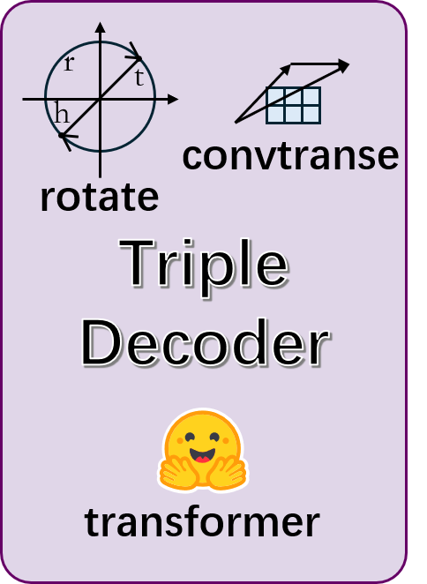

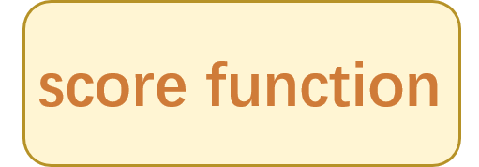
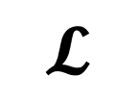
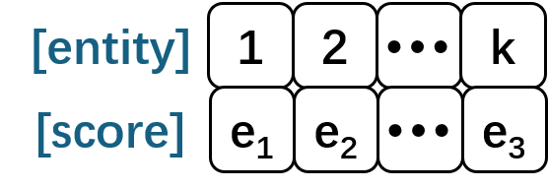
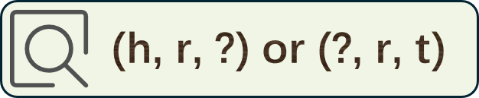
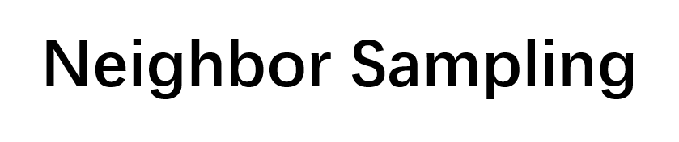

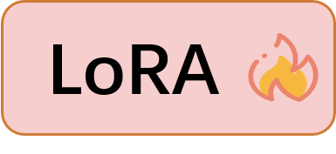
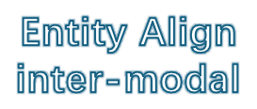
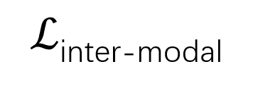
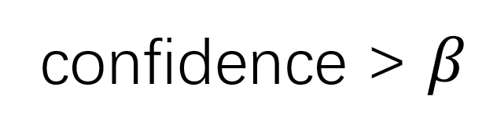
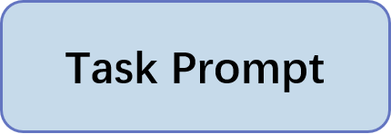
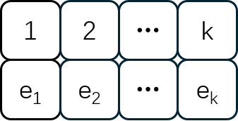

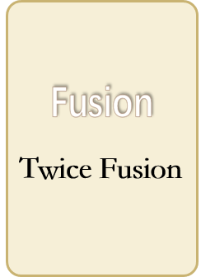



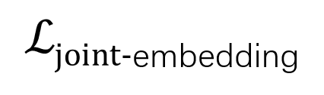
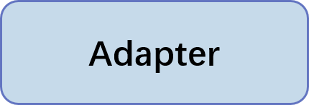

r₃
r₁
r₂
r₁
r₂
seed pair
r₃

Slide 2
r₃
r₁
r₂
r₁
r₂
seed pair
r₃

Slide 5








Slide 8












$$ℒ$$

Slide 9

$$ℒ$$

Slide 10
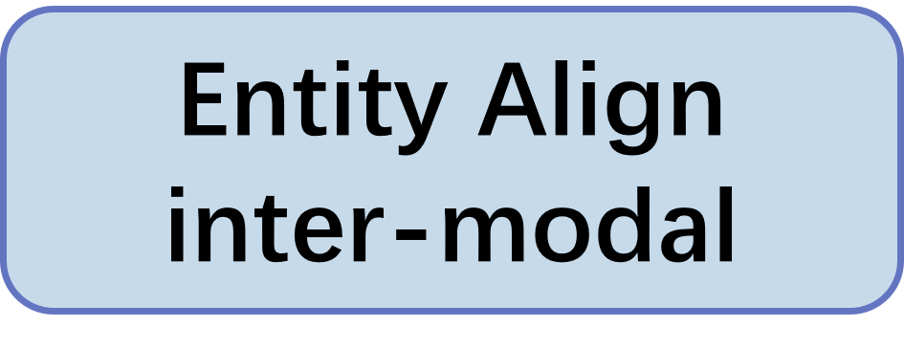
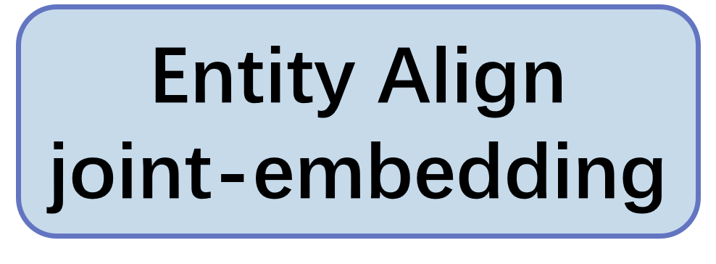
Seed Pair

Slide 11
r₃
r₁
r₂
r₁
r₂
seed pair
r₃

Slide 15


Slide 21
Twice Fusion

Slide 24




Fusion
Encoder
Fusion
Encoder
concat
concat
GRU
GRU
transformer
transformer
weight-sum

Slide 25

(h, r, ?) or (?, r, t)
(h, r, ?) or (?, r, t)

Slide 26
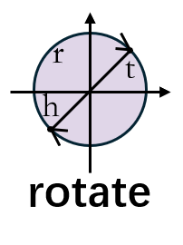
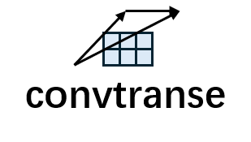
Triple
Decoder
Triple
Decoder
transformer
transformer

Slide 27
Fusion
Encoder
Triple
Decoder
transformer

Slide 28
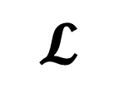
$$𝓛$$
h
r
t
convtranse
convtranse
rotate
rotate

Slide 29

$$ℒ$$
[entity]
1
2
k
score function
[score]
e₁
e₂
e₃
score function
1
2
k
e₁
e₂
e₃
[entity]
1
2
k
[score]
e₁
e₂
e₃

Slide 30
r₁
r₂
r₁
r₂
r₃
r₃
r₁
r₃
r₂
r₁
r₂
seed pair
r₃
r₃
r₁
r₂
r₃
r₁
r₃
r₂
r₁
r₂
r₁
r₂
seed pair
r₃

Slide 31
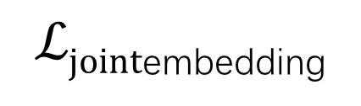
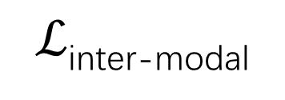
Entity Align
inter-modal
$ℒ$_{inter-modal}
Entity Align
inter-modal
$ℒjoint$_{embedding}
Entity Align
joint-embedding
Entity Align
joint-embedding
Adapter
Task Prompt

Slide 32

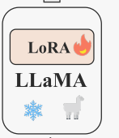
LoRA

Slide 33
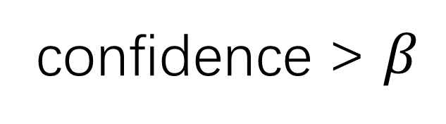
confidence > $β$
Neighbor Sampling
Data Selection

Slide 35


(h, r, ?) or (?, r, t)
t or h
t or h

Slide 36
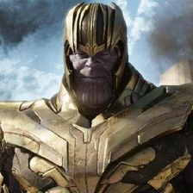
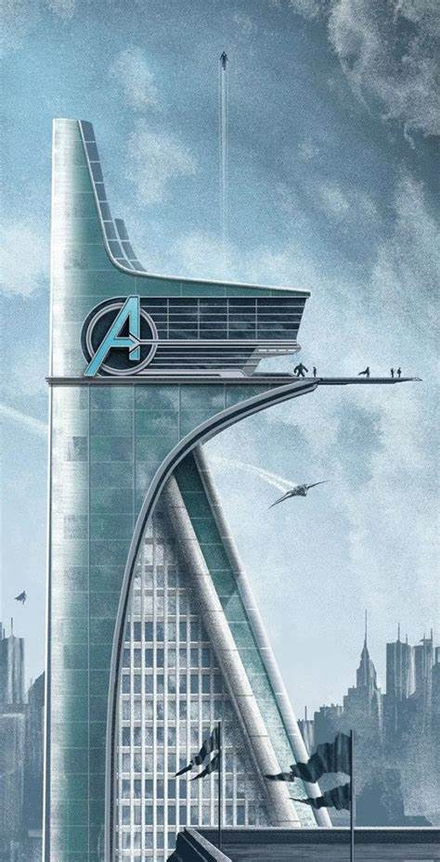
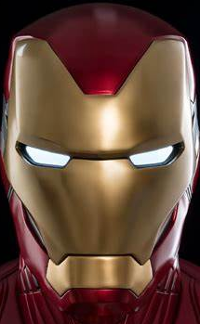
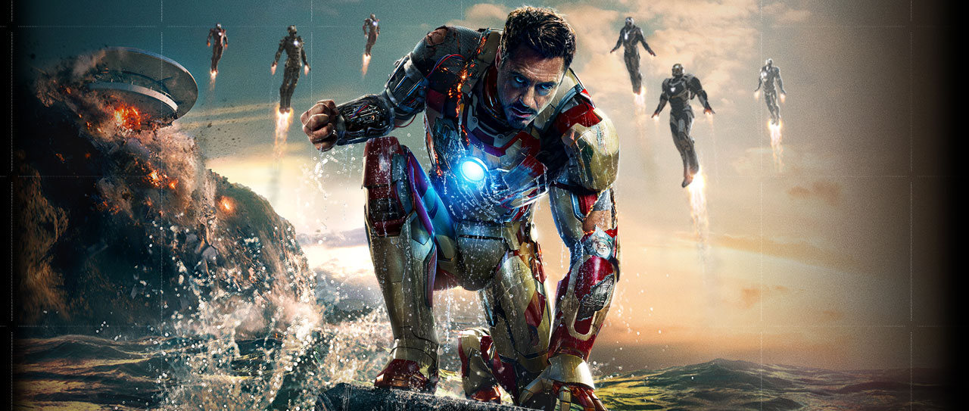
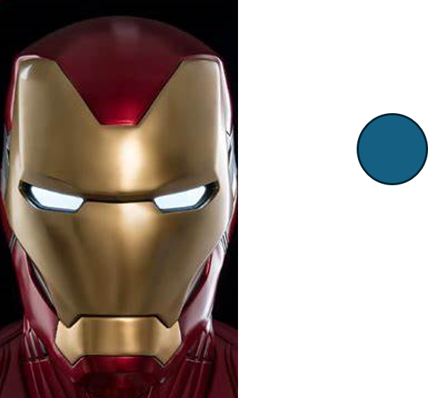
fight_for
menber_of
fight_for
menber_of
Iron Man, aka Tony Stark, is a brilliant inventor and philanthropist who combats threats using advanced suits and sharp intellect.
Iron Man, aka Tony Stark, is a brilliant inventor and philanthropist who combats threats using advanced suits and sharp intellect.

Slide 37
fight_for
menber_of
Iron Man, aka Tony Stark, is a brilliant inventor and philanthropist who combats threats using advanced suits and sharp intellect.

Slide 38
fight_for
menber_of
Iron Man, aka Tony Stark, is a brilliant inventor and philanthropist who combats threats using advanced suits and sharp intellect.

Slide 39

Add & Norm
Feed
Forward
Add & Norm
Multi-Head
Attention
Input
Embedding
Inputs

