Slide 1
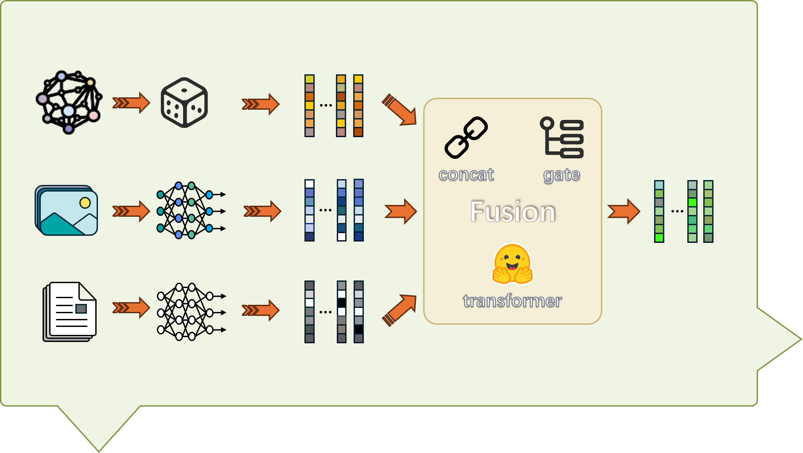

Slide 4






concat
gate
Fusion
transformer

Slide 5
concat
gate
Fusion
transformer

Slide 7




$$ℒ$$
r
t
h
convtranse
rotate
Triple
Decoder
score function
transformer
$$ℒ$$
[entity]
1
2
k
(h, r, ?) or (?, r, t)
[scores]
e₁
e₂
e_{k}

Slide 9


Slide 16


concat
gate
concat
gate
Fusion
Fusion
transformer
transformer
concat
concat
gate
gate
concat
transformer
transformer
weight-sum

Slide 17
(h, r, ?) or (?, r, t)
(h, r, ?) or (?, r, t)
(h, r, ?) or (?, r, t)
(h, r, ?) or (?, r, t)

Slide 18
r
r
t
r
t
h
t
h
convtranse
h
convtranse
rotate
rotate
Triple
Decoder
rotate
Triple
Decoder
transformer
transformer

Slide 19
convtranse
convtranse
r
t
h
r
t
r
h
t
h
rotate
rotate

Slide 20

$$ℒ$$
score function
[entity]
1
2
k
[scores]
e₁
e₂
e_{k}
score function
[entity]
1
2
k
[scores]
e₁
e₂
e_{k}

