Slide 1
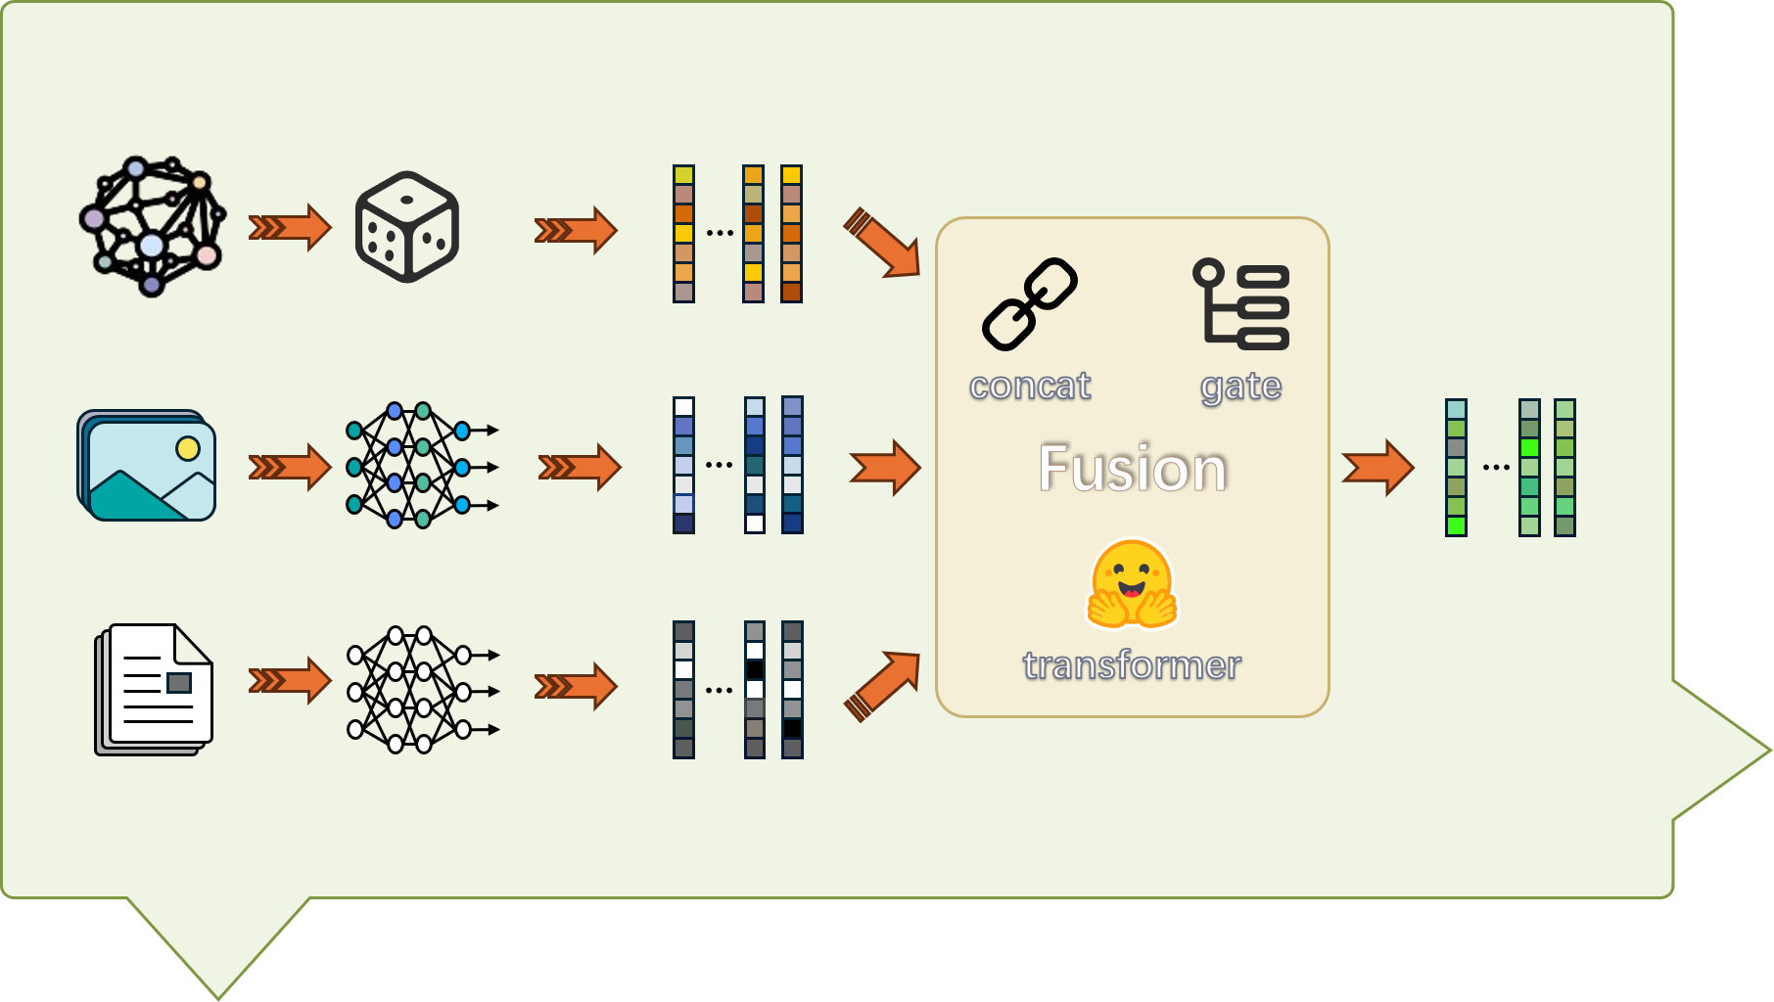

Slide 4






concat
gate
Fusion
transformer

Slide 5
concat
gate
Fusion
transformer

Slide 7


Slide 9


Slide 16


concat
gate
concat
gate
Fusion
Fusion
transformer
transformer
concat
concat
gate
gate
concat
transformer
transformer
weight-sum

Slide 17


(h, r, ?) or (?, r, t)
(h, r, ?) or (?, r, t)

Slide 18
Triple
Decoder
transformer

