Slide 1
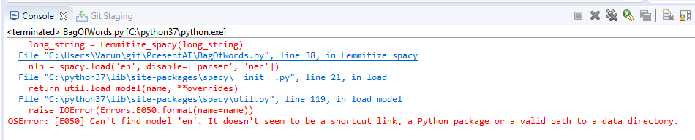
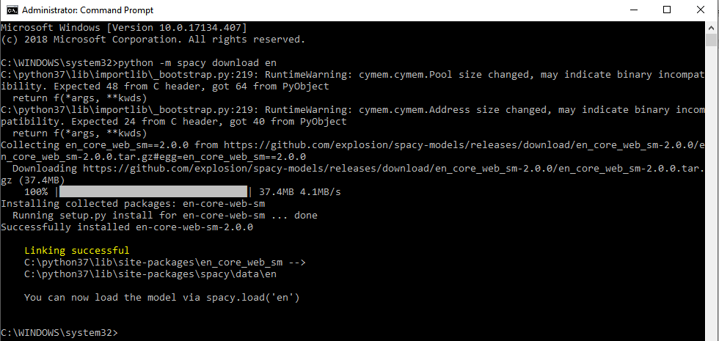
If you get the following error while running the code (using spacy), run the command python -m spacy download en in command prompt. Run as Administrator

