Slide 1
Step 1
Step 2
Training
Test
Model
Target
Label
Sentiment140
Classifier
Health Tweets
Use the Sentiment140 to train a sentiment model. We are using a random sample of 25K rows with a positive & negative ratio of 1:1
Use this model to score the Health tweet data.

Slide 2
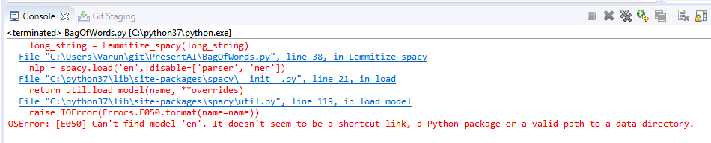
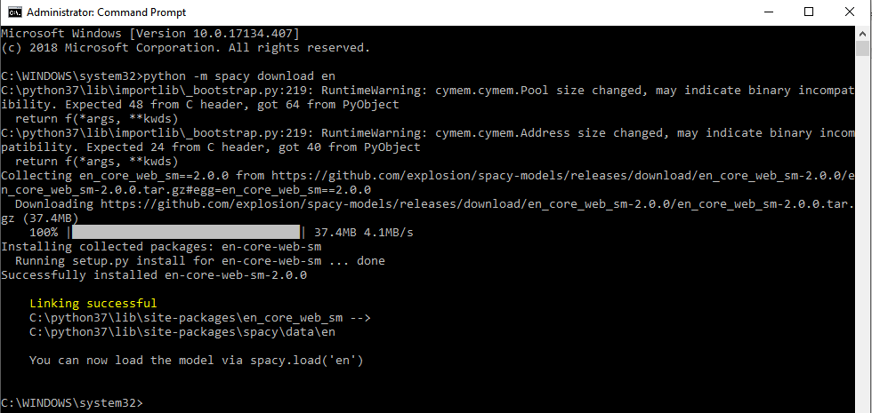
If you get the following error while running the code (using spacy), run the command python -m spacy download en in command prompt. Run as Administrator

