Slide 1
Homework2
Machine Learning in Bioinformatics

Slide 2
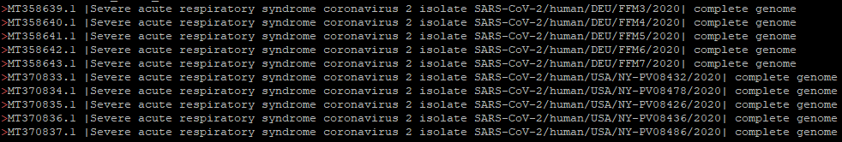

Homework2
Goal of this assignment: Practicing profile HMM with actual sequences
  Perform multiple sequence alignment to prepare input data for profile HMM (using MUSCLE)
  Build profile HMM and perform experiments with the given query sequences (using HMMER)
Given data files: COVID19 virus genome sequences
  mlbio_input_seq.fasta: Sequences from 5 Germans and 5 Americans (10 seqs in total)
  mlbio_input_seq_accession_info: The accession IDs corresponding to each sequence
  Reference Link:
    https://www.ncbi.nlm.nih.gov/labs/virus/vssi/#/virus?VirusLineage_ss=Severe%20acute%20respiratory%20syndrome%20coronavirus%202%20(SARS-CoV-2),%20taxid:2697049&SeqType_s=Nucleotide

Slide 3
Homework2
Perform multiple sequence alignment using MUSCLE
  Show the screenshot of the result
Build pHMM
  Use the command ‘hmmbuild’
  Show the screenshot of the model file
Query the following sequences to the pHMM and report the result
  mlbio_query_1.fasta, mlbio_query_2.fasta, mlbio_query_3.fasta
  When querying, use the command ‘hmmsearch’
  Show the screenshot of the search result
Write a simple report showing the results (screenshots) and a simple explanation of what each represents.
  There report does not need to be long
  Submit the report in MS Word format by June 10th to ‘alu.minwoo@gmail.com’
    The title of the email and the file name should be: name_studentnumber

Slide 4
pHMM Tutorial

Slide 5
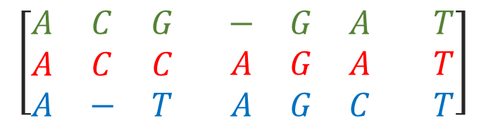
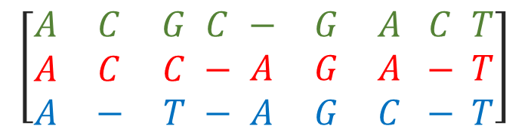

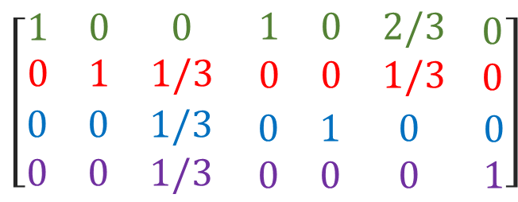
profile HMM
Too many gaps : Remove column
Widely used for classification of a protein into family
  Function identification
  Similarities are subtle
    Hard to detect with pair-wise comparison
    Need comparisons among many sequences
    Implement HMM!!
Overview:
  Start with Multiple Sequence Alignment
  Build profile from MSA
  Build HMM from profile
$$\left[\begin{matrix}A & C & G \\ A & C & C \\ A & − & T\end{matrix} \begin{matrix}C \\ − \\ −\end{matrix} \begin{matrix}− & G & A \\ A & G & A \\ A & G & C\end{matrix} \begin{matrix}C \\ − \\ −\end{matrix} \begin{matrix}T \\ T \\ T\end{matrix}\right]$$
Alignment
$$\left[\begin{matrix}A & C & G \\ A & C & C \\ A & − & T\end{matrix}\begin{matrix} \\ \\ \end{matrix} \begin{matrix}− & G & A \\ A & G & A \\ A & G & C\end{matrix}\begin{matrix} \\ \\ \end{matrix} \begin{matrix}T \\ T \\ T\end{matrix}\right]$$
Alignment*
$$\begin{matrix}A \\ C\end{matrix}$$
$$\begin{matrix}G \\ T\end{matrix}$$
$$\left[\begin{aligned}\begin{matrix}1 & 0 & 0 \\ 0 & 1 & 1/3\end{matrix}\begin{matrix} \\ \end{matrix} \begin{matrix}1 & 0 & 2/3 \\ 0 & 0 & 1/3\end{matrix}\begin{matrix} \\ \end{matrix}\begin{matrix}0 \\ 0\end{matrix} \\ \begin{matrix}0 & 0 & 1/3 \\ 0 & 0 & 1/3\end{matrix}\begin{matrix} \\ \end{matrix} \begin{matrix}0 & 1 & 0 \\ 0 & 0 & 0 \end{matrix}\begin{matrix} \\ \end{matrix}\begin{matrix}0 \\ 1\end{matrix}\end{aligned}\right]$$
Profile
HMM
S1
S2
S3
S4
S5
S6
S7
o1
o2
o3
o4
o5
o6
o7

Slide 6
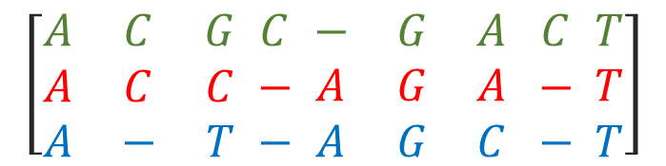
profile HMM
$$\left[\begin{matrix}A & C & G \\ A & C & C \\ A & − & T\end{matrix} \begin{matrix}C \\ − \\ −\end{matrix} \begin{matrix}− & G & A \\ A & G & A \\ A & G & C\end{matrix} \begin{matrix}C \\ − \\ −\end{matrix} \begin{matrix}T \\ T \\ T\end{matrix}\right]$$
Alignment
Build HMM from profile
  Hidden states
    Each position
    Insertion
    Deletion
  Transition: # visits / total # visits
  Emission: Profile
What about insertion/deletion?
  Add insertion states
  Add deletion states
  Add pseudocounts
    Avoid transition matrix becoming to sparse
D1
D2
D3
D4
D5
D6
D7
S
I1
I2
I3
I4
I5
I6
I7
I8
E
S1
S2
S3
S4
S5
S6
S7
Emission_{S3}(G) = 1/3
Emission_{S3}(C) = 1/3
Emission_{S3}(T) = 1/3
Transition_{S3→I4} = 1/3
Transition_{S3→S4} = 2/3
Transition_{S3→D4} = 0

Slide 7
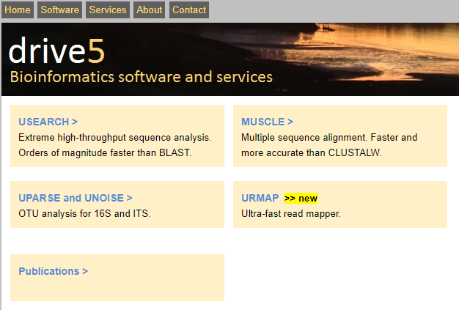
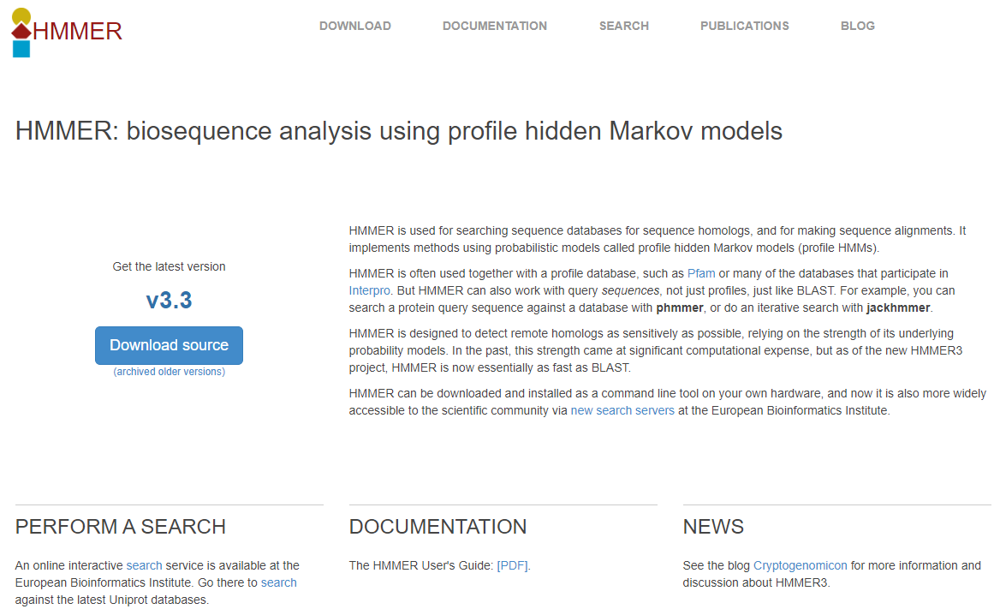
Tutorial
Multiple Sequence Alignment: MUSCLE
  https://drive5.com/muscle/manual/install.html
pHMM: HMMER
  http://hmmer.org/
HMMER Installation with conda:
> conda install -c biocore hmmer

Slide 8
Tutorial - MUSCLE
Ref: https://en.wikipedia.org/wiki/Stockholm_format
Input: Sequences
Output: Multiple Sequence Alignment
  Options
    in : input data
    out : output file name
    clwstrict : clustalw format
  Example:
> muscle –in input_seqs.fasta –out output.msa [–clwstrct]
> muscle –in MYB_Mus_musculus.fasta –out mus.msa

Slide 9
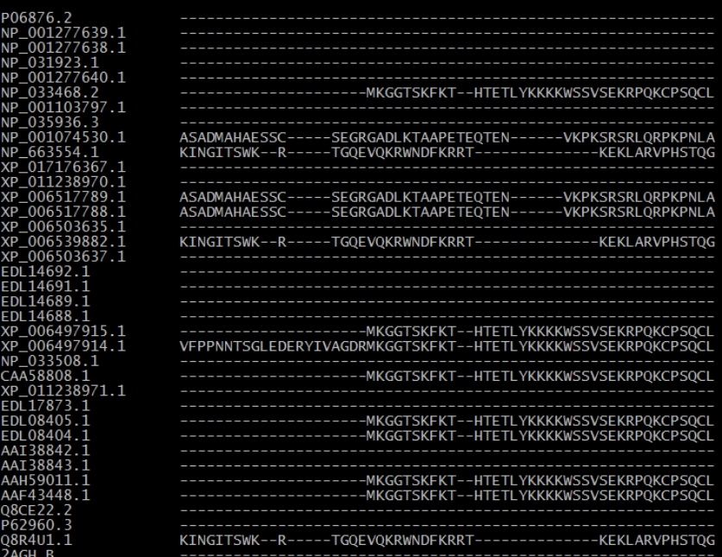
Tutorial - MUSCLE
Ref: https://en.wikipedia.org/wiki/Stockholm_format
Output: Multiple Sequence Alignment
  Stockholm format

Slide 10
Tutorial - pHMM
HMMBuild
  Build a profile Hidden Markov Model for each MSA file
  Options
    -h : show brief help on version and usage
    -n <file> : Name the profile HMM
    -o <file> : Direct the summary output to a file
  Example:
> hmmbuild [–options] <hmmfile output> <msa file>
> hmmbuild myhmm.hmm mus.msa

Slide 11
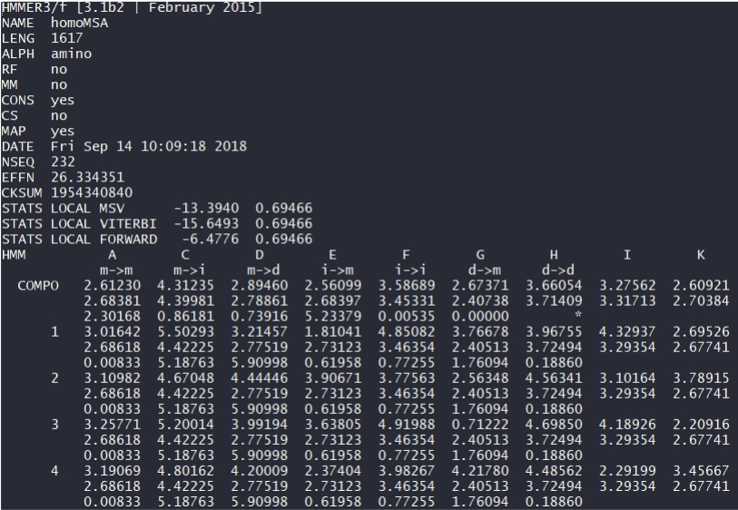
Tutorial - pHMM
Output file of hmmbuild
Start Node information:
line1: InsertO emission
line2: transition(start → insert0)
Metadata
Model start indicator
Three lines per node:
line1: Match Emission
line2: Insert Emission
line3: State Transition
Model
negative natural log values

Slide 12
Tutorial - pHMM
HMMSearch
  Searching the query sequence file from hmm database
    -E : Report target sequences with an E-value of <= <x>
    -T : Report target sequences with a bit of score of >= <x>
  Example:
> hmmsearch [–options] <hmmfile> <sequence file>
> hmmsearch human.hmm test.seq > result.out

Slide 13
Tutorial - pHMM
hmmsearch result example
  If both E-values are significant(<<1), the sequence is likely to be homologous to your query
  If the full sequence E-value is significant but the single best domain E-value is not, the target sequence is probably a multidomain remote homolog
    But be wary, and watch out for the case where it’s just a repetitive sequence

