Slide 1
영상정보처리 Lab 06
Dithering - 2D Halftoning

Slide 2
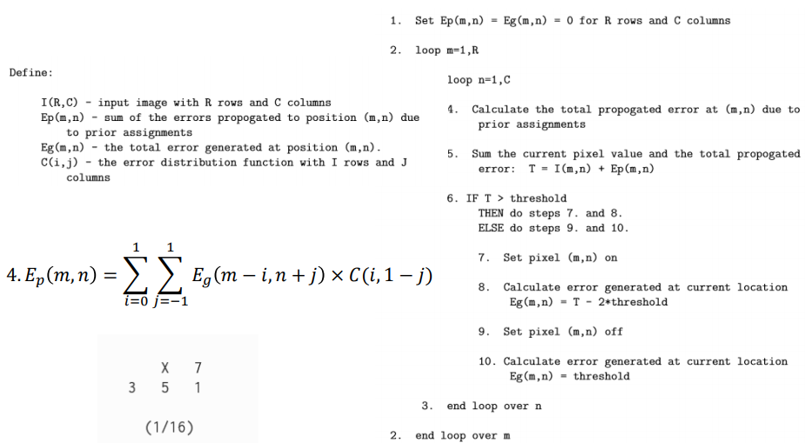
1. 2D Halftoning

Slide 3
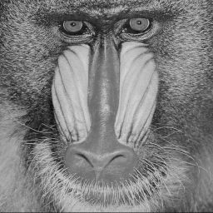
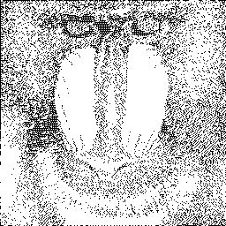
1. 2D Halftoning
Mandrill_g.bmp
2DHalftoning.bmp
원본영상
결과영상

