Slide 1
Report 2~3
정혜린

Slide 2
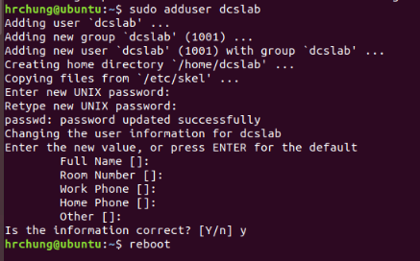
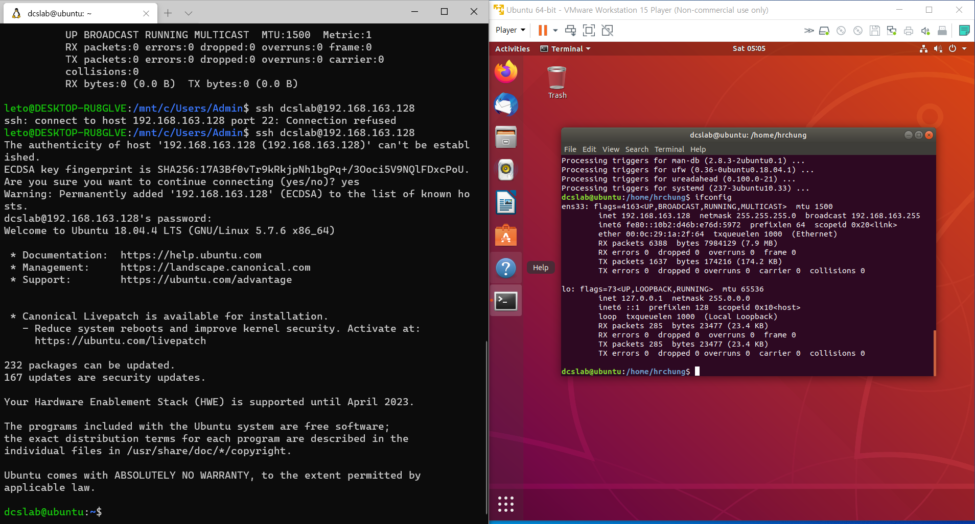
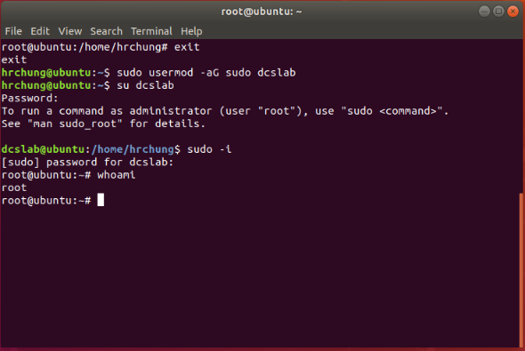
가상머신에 dcslab 계정 생성하여 해당 계정으로 ssh 접속 후 수행
Host에서 dcslab@virtual machine으로 접속

Slide 3
리눅스 command + 옵션 실행
uniq [options] input output
options -c prefix lines by number of occurrences -d only print duplicate lines -u only print unique lines sort [options] files options -n numeric sort
-b ignore blank lines -f ignore case -r reverse order tar [options] file options -f file: archive file -c create
-t list -x extract -C DIR : cd to DIR -z gzip -j bzip2
du [options] file options -c : a grand total
-h : human readable -L : deference sym links -P : no deference of sym links -s : total for each argument -exclude=pattern
df [options] file options
-h human readable -i list inodes info -P no deferences of sym links
diff [options] pattern files options -r recursive -w ignore whitespaces -B ignore blank lines -q only show file names grep [options] pattern files options -i ignore case -P pattern is a perl rgex -m stop after m matches
-n also show matching line number -R recurse directories
cat [options] files options -v non asci -T show tabs tail [options] file options -f show end of file live -n last n lines
head [options] file options -n show first n lines
tac files(s)
print files starting from last line
cut [options] file options -d char : user char as delimiter -f 1,3,5 : print fields 1,3,5
mv [options] source dest options -b backup dest before overwrite -f force -i interactive -u move only if source newer than dest ln [options] file link options -s sym link (hard by default) -f overwrite -b backup old link before overwrite rm [options] file options -f force -I interactive chmod [options] mode files(s) options -R recursive symbolic mode format:[ugoa][+-=][perms] find path [options][tests][actions] options -mindepth:start from min level in hierarchy -maxdepth:end with max level in hierarchy tests -type d only directories
# File Commands
ls [options] file
options
-a show hidden file
-A show hidden file except . and ..
-d only show directories
-h human readable size
-I inode info
-m output as csv
-n numeric uid and guid
-r sort in reverse order
-S sort by file size
tree [options] dir
options -d only directories -f show full path
-P pattern only matching pattern
-I pattern except matching pattern
-h print size in human readable format
-C use colors
-L max level depth
cp [options] source dest option -b backup dest before overwrite -r recursive -f force -l link files instead of copy -P don’t follow sym links -i interactive -u copy only if source newer than dest

Slide 4
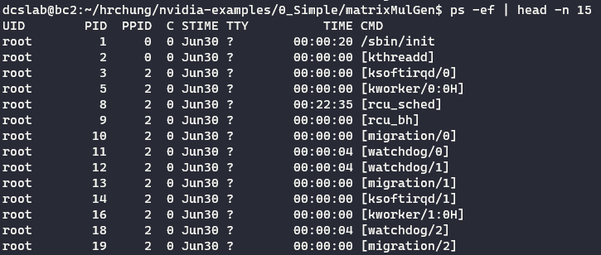
리눅스 command + 옵션 실행
scp [options] source dest options -r : recursive
traceroute [options] host [packet_len] options -i device -p port
mail [options] to-address
options -s subject : email with subject -c address1, address2 : cc copy -b address1, address2 : bcc copy
# Version Control Command git [options] options -init : initialize -add : stage files -commit [-m “message”] : commit staged files
-checkout [-B|-D] branch : checkout to branch -branch name : create branch name
# Processs Commands
ps [options]
options -e : all processes -f : full listing -H : show hierarchy -P pid : this process pid -o x,y,z : show columns x y z -N : negation -u user : process owned by user -sort=[+time|-time] : sort by [ascend|desc] time
top [options]
options
-d x : refresh every x seconds -p pid_# : only process with pid_# interactive commands space : update display
e: human readable format k : kill a process o : change order +T : sort by time
pgrep [options] pattern
Options -l : show pid and process name -a : show pid and full command line
-n : if more than one show newest -o : if more than one show oldest -u uid : show only processes of uid
-c : count result
# Network & Remote
ssh [options] user@host [“cmd1;cmd2”] options:
-2 : force protocol 2 -o StrictHostKeyChecking=no : ignore warning due to remote host key change -X: forward X11 display
wget [options] url options -b : run in background -o file : print wget output in file -q : be quiet -d : debug -O file : save response to file
-user=user: basic https user -password=password : basic https auth password curl [options] url
options
-H header : like –H “Host:st.com” -u <user:password> : basic https auth -s : be silent -S : show errors if silent mode
-data-binary@filename : post filename content -X method : PUT | GET | POST
ping [options] address options -c count -s packet size
-W timeout

Slide 5
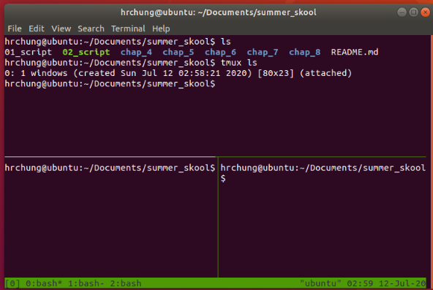
tmux session command 실행
# PREFIX = <CTRL-B> (default)
# pane
$ PREFIX % # 세로로 pane 가르기
$ PREFIX " # 가로로 가르기
# window
$ PREFIX c # 탭 열기
$ PREFIX N # 해당 탭 번호로 이동하기
$ PREFIX & # 탭 종료
$ PREFIX p # 이전 탭으로 이동
$ PREFIX n # 다음 탭으로 이동
# session
$ tmux ls
$ tmux attach # 세션을 불러온다.
$ PREFIX d # 해당 탭에서 나가되, 프로세스는 유지
$ tmux kill-session –t N # 세션을 죽인다.
# TARGET_SESSION이라는 이름의 세션이 열려있는지 확인
$ tmux has-session –t TARGET_SESSION
# TARGET_SESSION이라는 이름의 세션을 가져온다. $ tmux attach-session –t TARGET_SESSION

Slide 6
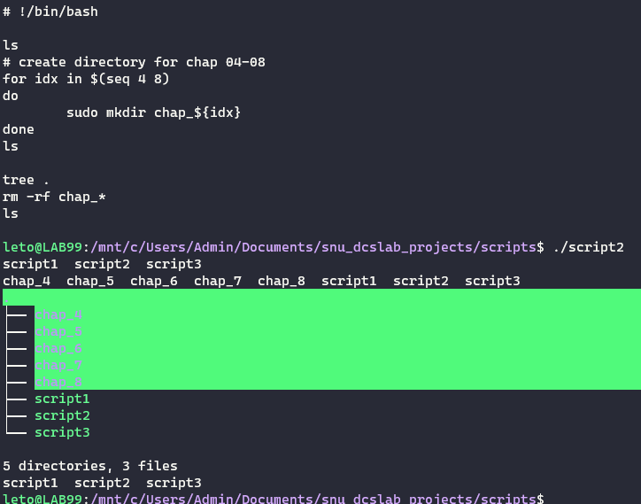
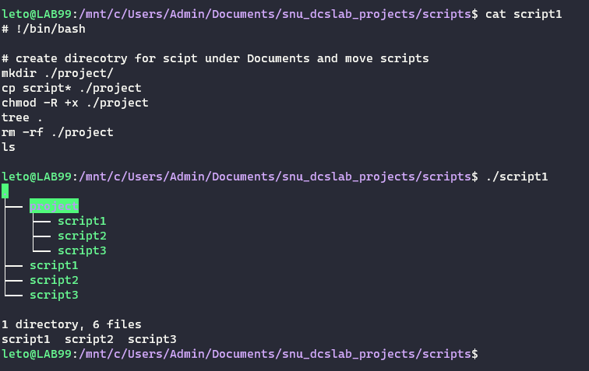
Realistic 시나리오를 특정하고 필요한 cmd 조합하는 경우 3가지 이상 포함

Slide 7
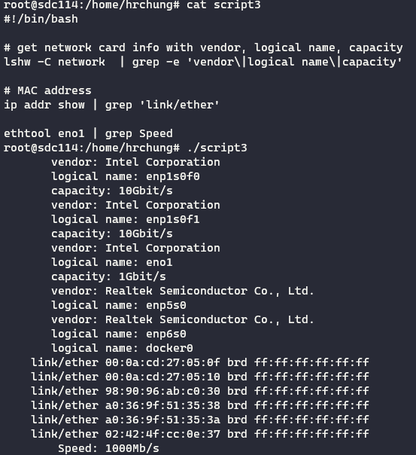

Slide 8

CPU, Memory, Storage, NIC 정보 확인
# check CPU
$ grep “model name” /proc/cpuinfo | tail -1
# check Memory
$ dmidecode –t 17 | egrep ‘Memory | Device’ | egrep –v ‘No|Device’
# check NIC
$ lshw –C network | grep –e ‘logical name \|capacity’

Slide 9
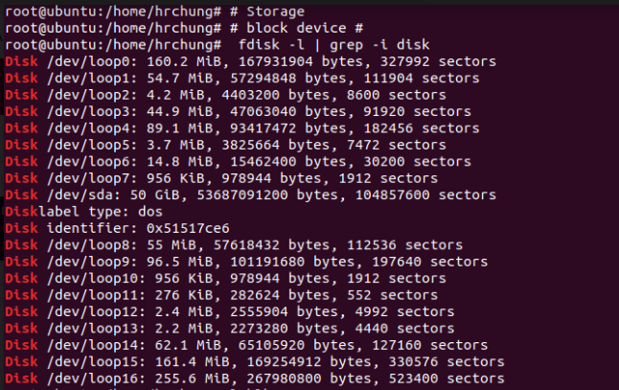
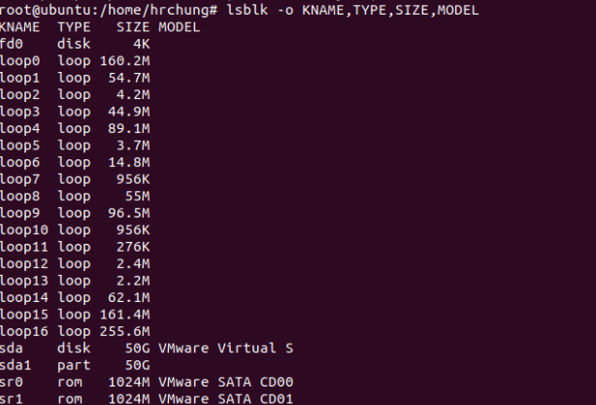
CPU, Memory, Storage, NIC 정보 확인

