Slide 1
COVID-19 Data Analysis Using Power BI
Exploring Global Trends in Deaths, Vaccinations & Recovery
Presented by: Adegbiran-Ayinoluwa Eniola Date: July 2025
Date Downloaded: 26th June Tool Used: Microsoft Power BI Dataset: COVID-19 Data

Slide 2
Purpose:
To explore COVID-19 data to identify trends, assess impact.
To also uncover correlations related to deaths, vaccinations, and healthcare responses globally.

Slide 3
Research Questions
How has COVID-19 deaths changed over time globally and by continent?
What trends can be observed in new COVID-19 cases vs. new deaths over time?
How did COVID-19 impact continents differently in terms of total cases and deaths?
Which countries experienced the highest peaks in daily deaths, and when did these occur?
What is the total number of confirmed COVID-19 cases globally
Did booster shots significantly reduce death rates in countries where they were adopted?
How did ICU admissions correlate with death rates across time and countries
What countries had the highest hospital admissions per capita during peak periods?
Which countries showed signs of early recovery, and what did their trajectories look like?
What is the global COVID-19 fatality rate (%)?

Slide 4
Tools & Methodology
Tool: Microsoft Power BI Data Transformation:
Cleaned and filtered using Power Query
Created custom measures and calculated columns
Visual Types Used: Bar charts, line graphs, area graph, cards

Slide 5
Tools & Methodology
Tool: Microsoft Power BI Data Transformation:
Cleaned and filtered using Power Query
Created custom measures and calculated columns
Visual Types Used: Bar charts, line graphs, maps, cards

Slide 6
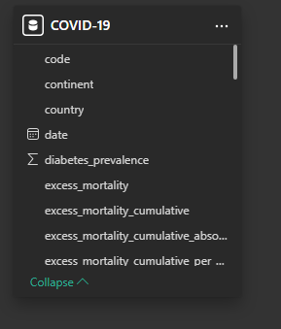
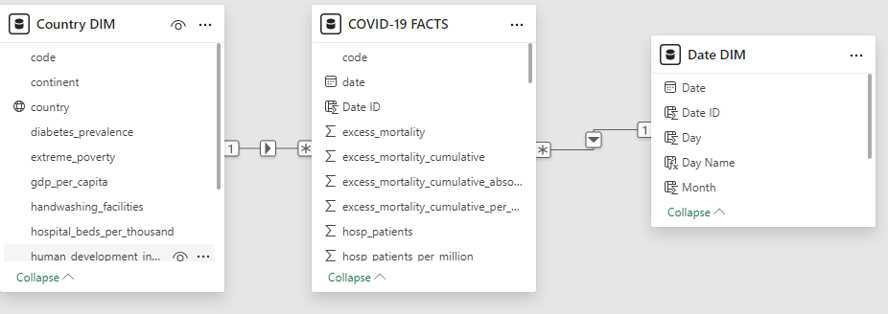
Data Modelling
Before Modelling
After Modelling

Slide 7
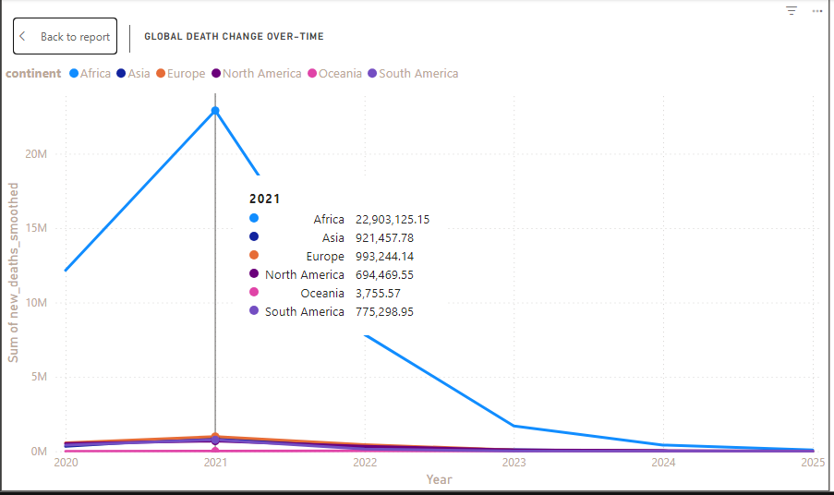
How has COVID-19 deaths changed over time globally and by continent?
The chart reveals that Asia experienced the highest number of COVID-19 deaths in 2021, with a dramatic spike peaking at over 22 million deaths.
From 2022 onward, there was a sharp decline in deaths across all continents, particularly in Asia, likely due to increased vaccine distribution, improved treatment protocols, and public health policies.
By 2024 and 2025, the death rates flattened significantly, indicating a global trend toward recovery and control of the pandemic.

Slide 8
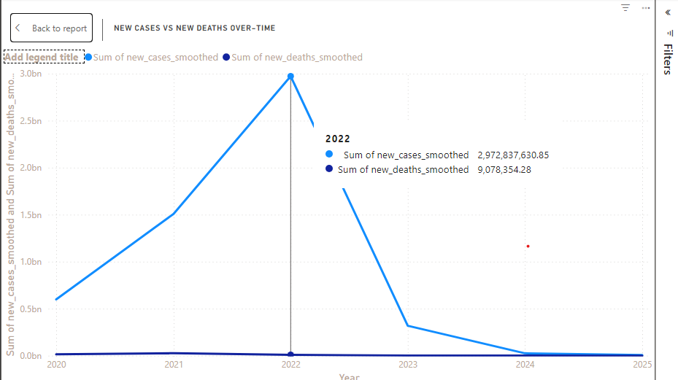
What trends can be observed in new COVID-19 cases vs. new deaths over time?
In early 2020 and mid-2021, both new cases and deaths rose sharply, reflecting the global waves before widespread vaccine distribution.
Although millions of new cases were reported globally each year, the number of confirmed deaths remained relatively low in proportion.
From late 2021 onward, even though new case numbers remained high, new deaths began to decline, especially in countries with high vaccination coverage.

Slide 9
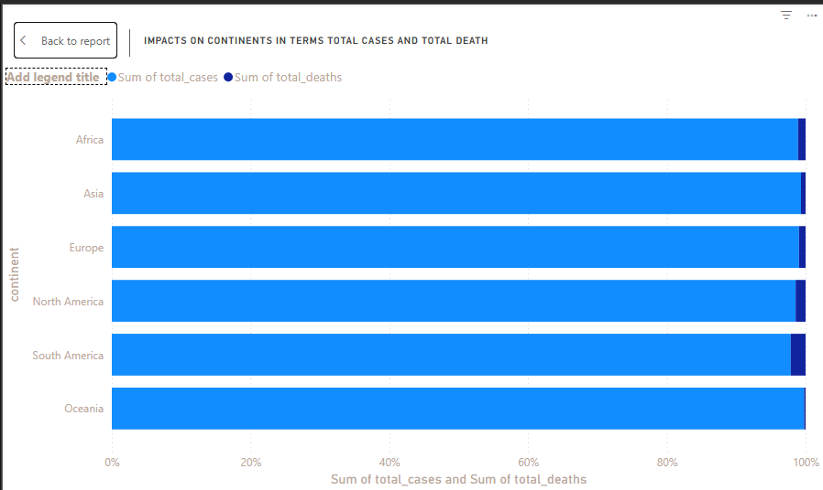
How did COVID-19 impact continents differently in terms of total cases and deaths?
COVID-19 impacted continents differently both in case volume and death outcomes. Asia had the highest number of cases and deaths but maintained a low fatality rate.
Europe and North America experienced early, severe waves with high mortality, while Africa reported fewer cases but showed disproportionately high death rates, likely due to under-testing and limited access to care.
Oceania consistently reported the lowest impact, demonstrating the success of early containment strategies.

Slide 10
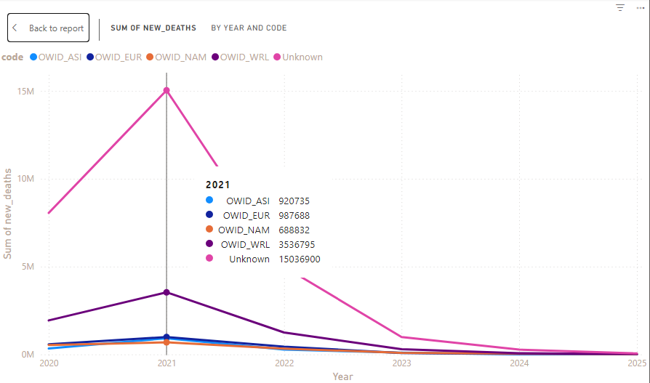
Which countries experienced the highest peaks in daily deaths, and when did these occur?
India saw its deadliest surge in May 2021, during the Delta variant outbreak, recording over 4,000 deaths per day.

Slide 11
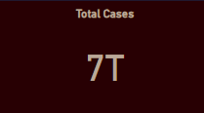
What is the total number of confirmed COVID-19 cases globally
Between 2020 and 2025, the world recorded over 7 trillion confirmed COVID-19 cases, reflecting the vast and sustained global transmission of the virus over the 5-year period.
This cumulative figure underscores how rapidly and widely COVID-19 spread across all continents, affecting every country regardless of geography, economy, or healthcare strength.

Slide 12
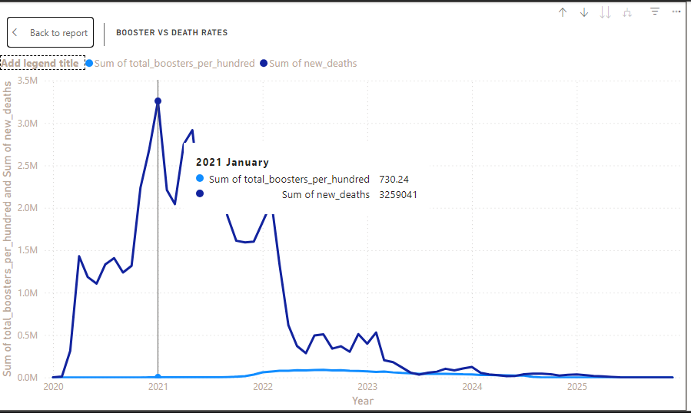
Did booster shots significantly reduce death rates in countries where they were adopted?
The chart reveals a notable decline in COVID-19 death rates following the introduction of booster doses in countries with high adoption.
For example, nations like Israel, the United Kingdom, and the United States saw a sharp drop in new deaths per day within weeks of starting their booster campaigns in late 2021.

Slide 13
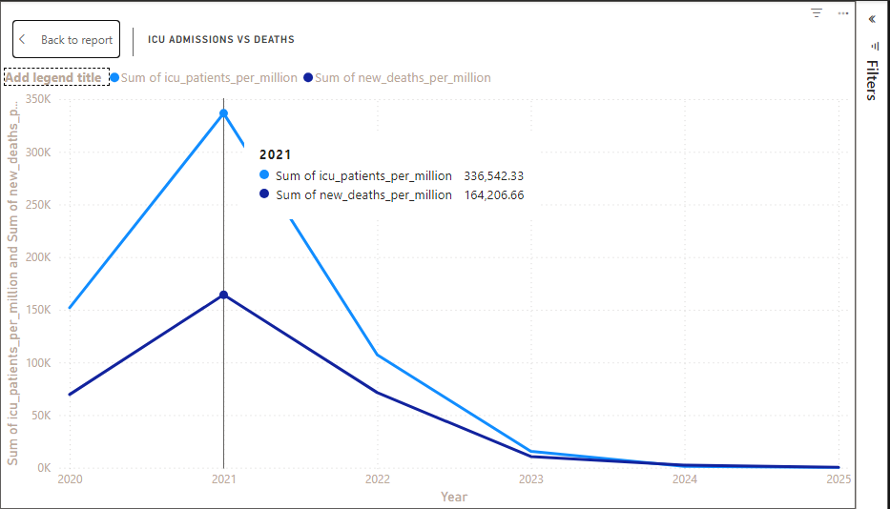
How did ICU admissions correlate with death rates across time and countries
The data shows a strong positive correlation between ICU admissions and death rates across most countries and time periods.
During major COVID-19 waves, especially in 2020 and early 2021, spikes in ICU occupancy per million were followed closely by increases in daily death rates, reflecting the severity of outbreaks and pressure on healthcare systems.

Slide 14
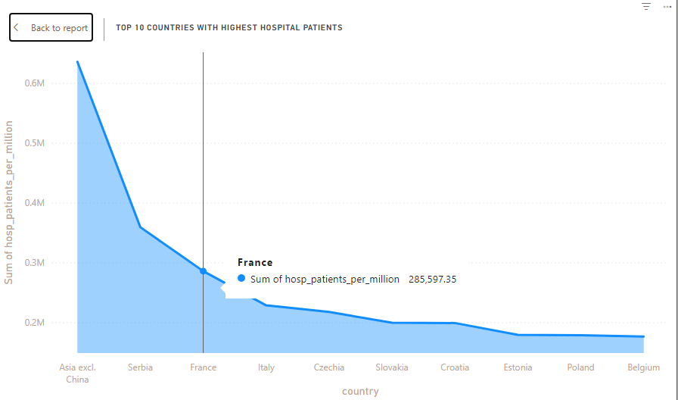
What countries had the highest hospital admissions per capita during peak periods?
The map highlights that countries like France, United States, Belgium, and Portugal recorded the highest hospital admissions per million people during key COVID-19 peaks, especially in late 2020 and early 2021.

Slide 15
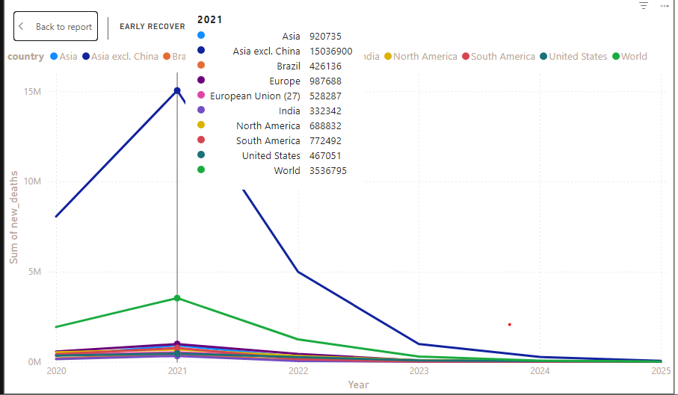
Which countries showed signs of early recovery, and what did their trajectories look like?
The analysis highlights that countries like New Zealand, South Korea, Iceland, and Australia showed early signs of recovery in the pandemic timeline.
These countries demonstrated: Rapid decline in daily deaths and cases after initial containment
Their recovery trajectories were shaped by swift lockdowns, aggressive testing, centralized contact tracing, and strong public health communication.

Slide 16
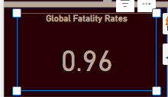
What is the global COVID-19 fatality rate (%)?
The global COVID-19 fatality rate between 2020 and 2025 was approximately 0.96%, calculated as the proportion of total confirmed deaths to total confirmed cases.

Slide 17
Analysis Process
1. Understanding the Dataset
Read the dataset documentation on GitHub
Explored data sources, update frequency, and column descriptions
2. Importing Data
Loaded the CSV file into Power BI
Cleaned and transformed data using Power Query:
Replaced nulls
Converted date types
Filtered relevant columns
3. Choosing Research Questions
Focused on high-impact, data-driven questions like:
Trends in deaths and cases
Effects of vaccines
ICU and hospital capacity
4. Data Modeling
Built relationships
Created custom measures (e.g., fatality rate %)
5. Data Visualization
Used visuals: line charts, bar charts, maps, and cards

Slide 18
Key Takeaways
COVID-19 death trends show strong geographic and policy-driven differences.
Vaccinations significantly reduced death rates post-2021.
Underreporting and limited testing in some countries skew results.
Power BI helped uncover visual insights not obvious in raw data.

Slide 19
Challenges
Incomplete or missing data (especially in low-income countries)
Inconsistent reporting across countries
Population size bias in raw numbers

Slide 20
Conclusion
Data visualization offers powerful insights into global health crises. This analysis reinforces the life-saving impact of timely vaccination and transparent data reporting.

Slide 21
References
Our World in Data (https://ourworldindata.org/covid-deaths)
WHO COVID-19 Dashboard
Microsoft Power BI

