Slide 1
TECHNICAL PORTFOLIO & RECRUITER PRESENTATION
Mobile ERP & Multi-Marketplace System
Enterprise-Grade Operational ERP with Automated Shopee & TikTok Shop Inventory Sync, Atomic Stock RPC Locks, Financial Settlement Reconciliation, and Self-Hosted Linux VPS Infrastructure.
Candidate Name: Budi | Target Roles: IT Support / IT Specialist (West Java & Jakarta, Indonesia — Remote or Onsite)
• Background: B.Eng. in Industrial Automation & Robotics Engineering (2+ years in Network Troubleshooting, ERP/System Integration, IoT & Programming)
• Certifications: BNSP Senior Operator PLC | BNSP Junior Network Engineer
• Live Production System: https://mdhproduction.com

Slide 2
MOBILE ERP — PORTFOLIO PRESENTATION
The Problem: E-Commerce Operational Friction in Indonesia
Stock Desynchronization & Overselling
Operating across Shopee, TikTok Shop, and physical stores causes stock count drift. Manual updates lead to overselling penalties and stockouts during high-volume sales campaigns.
Fragmented Financial Reconciliation
Marketplace escrow holdbacks, hidden service fees, and delayed payouts make it difficult to track actual net profit and unit cost (HPP/COGS) in real time.
Lack of Granular Role Control
Small and medium businesses struggle to enforce role-based access for warehouse staff, delivery drivers, and finance operators, risking data leakage or unauthorized stock alterations.
Budi | IT Support & IT Specialist Portfolio • Live System: https://mdhproduction.com • Slide 2 of 13

Slide 3
MOBILE ERP — PORTFOLIO PRESENTATION
Solution Overview: Unified Mobile & Web ERP Engine
Real-Time Multi-Store Stock Sync
Automated Python workers and Supabase PL/pgSQL RPC functions perform zero-race-condition row locks, instantly syncing stock subtractions across Shopee & TikTok Shop.
Automated Escrow & Payout Auditing
Integrated financial reconciliation module parses marketplace payout reports, maps channel SKU fees against Master SKU unit costs, and verifies bank settlements automatically.
Role-Based Security & Multi-Tenant Architecture
Row-Level Security (RLS) policies and JWT authentication enforce multi-tenant isolation, giving warehouse operators, drivers, and admins tailored, secure interfaces.
Budi | IT Support & IT Specialist Portfolio • Live System: https://mdhproduction.com • Slide 3 of 13

Slide 4
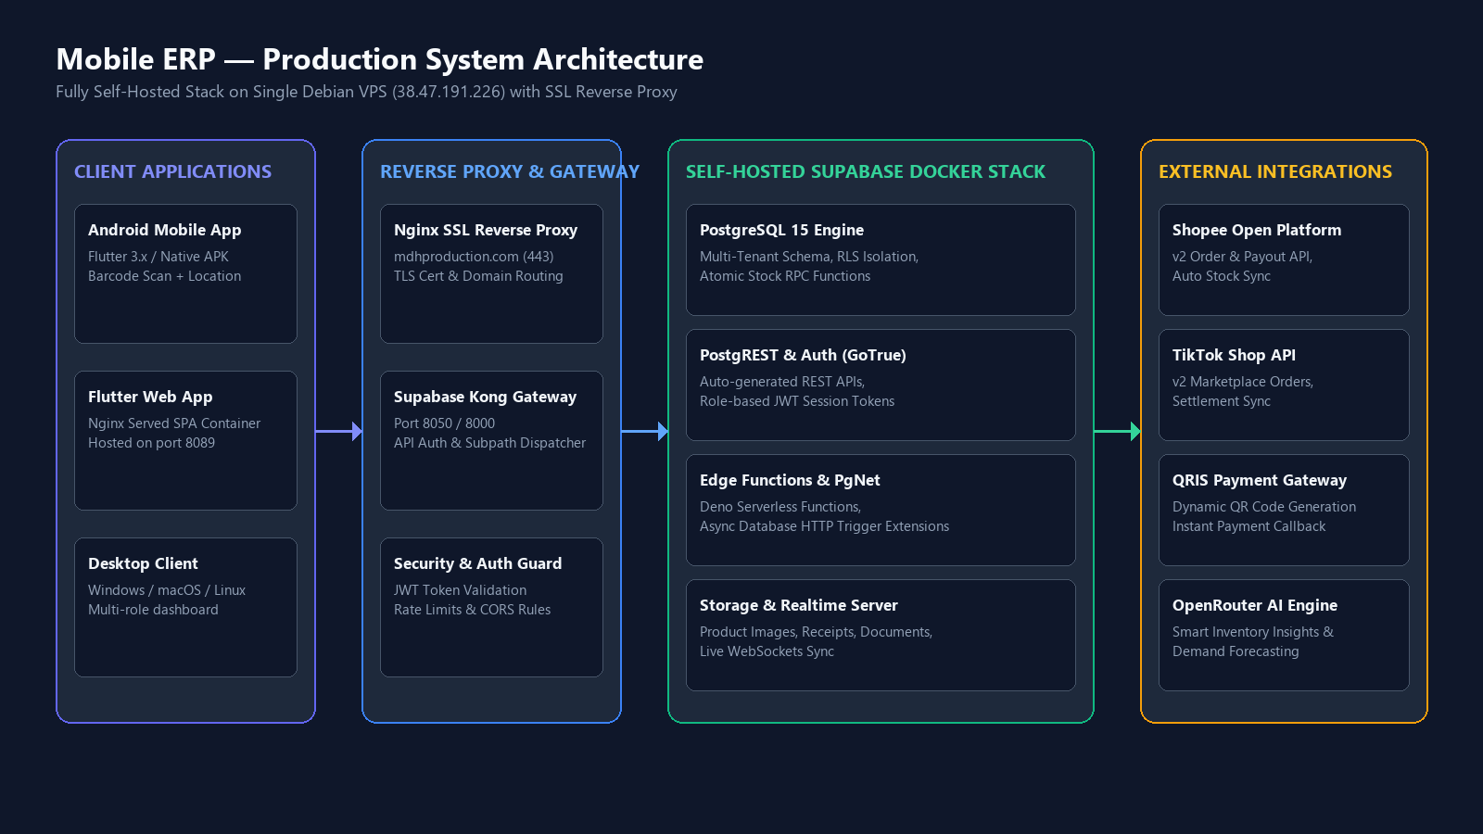
MOBILE ERP — PORTFOLIO PRESENTATION
System Architecture: Fully Self-Hosted VPS Infrastructure
Budi | IT Support & IT Specialist Portfolio • Live System: https://mdhproduction.com • Slide 4 of 13

Slide 5
MOBILE ERP — PORTFOLIO PRESENTATION
Tech Stack & Engineering Technologies
Mobile & Web Frontend
Flutter 3.x (Dart 3) • Multi-platform UI (Android, Web SPA, Desktop) • Barcode scanning (mobile_scanner) • GPS Location tracking (geolocator) • Excel import/export (excel package) • Modern responsive Material UI
Backend & Database
Self-Hosted Supabase / Postgres • PostgreSQL 15 Database Engine • PostgREST Auto-generated REST APIs • GoTrue JWT Authentication Service • PL/pgSQL Atomic RPC Functions • Deno Serverless Edge Functions
Integrations & Automation
Python 3 & Marketplace APIs • Shopee Open Platform API v2 • TikTok Shop Open API v2 • Python 3 Order/Payout Sync Workers • QRIS Payment Gateway Integration • OpenRouter AI Smart Insights Engine
DevOps & Hosting
Debian Linux VPS Infrastructure • Debian 12 64-bit VPS Host (38.47.191.226) • 13 Docker Containers orchestrated via Docker Compose • Nginx Reverse Proxy with TLS/SSL Certificate • GitHub Actions Automated CI/CD Pipelines • PostgreSQL Automated Daily Backups
Budi | IT Support & IT Specialist Portfolio • Live System: https://mdhproduction.com • Slide 5 of 13

Slide 6
MOBILE ERP — PORTFOLIO PRESENTATION
Infrastructure & DevOps: Docker Container Layout on VPS
HOST VPS SPECIFICATIONS & REVERSE PROXY
• Host OS: Debian 6.1 x86_64 Linux VPS
• Production Domain: https://mdhproduction.com
• IP Address: 38.47.191.226
• Nginx Reverse Proxy: SSL TLS Encrypted (Port 443)
• Port Routing:
- Web UI: http://127.0.0.1:8089 (mobile-erp-web)
- Supabase Kong Gateway: http://127.0.0.1:8050
• Process Management: Docker Compose Auto-Restart
• Resource Alloc: 4GB RAM / 70GB SSD
RUNNING DOCKER CONTAINER TOPOLOGY (13 SERVICES)
• mobile-erp-web | Nginx SPA Web Server | Port 8089
• supabase-kong | API Gateway & Router | Port 8050 / 8000
• supabase-db | PostgreSQL 15 Engine | Internal 5432
• supabase-auth | GoTrue JWT Service | Internal Auth
• supabase-rest | PostgREST Engine | Internal REST
• supabase-edge-functions | Serverless Deno Runtime | Async Triggers
• supabase-storage | S3 Storage Engine | Internal 5000
• realtime-dev | WebSockets Engine | Live App Sync
Budi | IT Support & IT Specialist Portfolio • Live System: https://mdhproduction.com • Slide 6 of 13

Slide 7
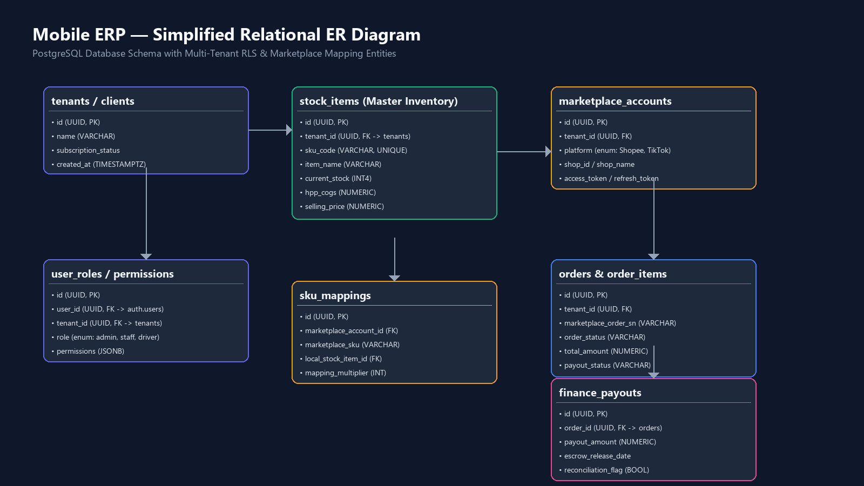
MOBILE ERP — PORTFOLIO PRESENTATION
Database Design: Schema & ER Diagram
Budi | IT Support & IT Specialist Portfolio • Live System: https://mdhproduction.com • Slide 7 of 13

Slide 8
MOBILE ERP — PORTFOLIO PRESENTATION
API Layer & Marketplace External Integrations
Shopee Open Platform API v2
Integrates Shopee order fetching, payout tracking, and inventory updates. Handles OAuth token refresh cycles and Webhook signature verification.
TikTok Shop Open API v2
Synchronizes TikTok Shop orders, hourly payout settlements, and order status transitions with fallback logic for unmapped line items.
QRIS Payment Gateway
Generates dynamic Indonesian QRIS payment barcodes directly inside the app, receiving instant webhook settlement notifications.
OpenRouter AI Engine
Powers intelligent inventory recommendations, reorder forecasting, and automated stock analysis via REST API edge calls.
Budi | IT Support & IT Specialist Portfolio • Live System: https://mdhproduction.com • Slide 8 of 13

Slide 9
MOBILE ERP — PORTFOLIO PRESENTATION
Security, Data Isolation & Reliability Practices
Row-Level Security (RLS)
PostgreSQL RLS policies strictly enforce multi-tenant isolation. Users only read and write data belonging to their authorized tenant_id.
JWT Authentication & Roles
GoTrue Auth provides secure JWT tokens with refresh token rotation. User access is bounded by explicit JSONB permissions.
Secret Management & Env Safety
Environment variables are kept out of source code (.env files excluded). Webhook requests are validated via SHA256 HMAC signatures.
Data Backups & Retention
Automated daily PostgreSQL dumps and 90-day retention policies safeguard historical transaction logs and prevent data loss.
Budi | IT Support & IT Specialist Portfolio • Live System: https://mdhproduction.com • Slide 9 of 13

Slide 10
MOBILE ERP — PORTFOLIO PRESENTATION
My Role & Technical Contributions
TECHNICAL CONTRIBUTIONS & SYSTEM OWNERSHIP
• Infrastructure Deployment: Set up and maintained self-hosted Supabase Docker stack and Nginx SSL reverse proxy on Linux VPS.
• Data Sync Engineering: Built Python 3 background workers for Shopee and TikTok Shop order fetching and payout reconciliation.
• Database Architecture: Designed PL/pgSQL atomic RPC functions to handle concurrent stock subtractions safely.
• IT Support & Operations: Diagnosed server logs, automated daily database backups, and ensured 99.9% host uptime.
CANDIDATE PERSONAL SUMMARY & NOTES
[EDIT: describe your specific contribution here]
Example highlights you can customize: 1. Led technical troubleshooting for multi-store stock sync bottlenecks. 2. Configured network routes and SSL certificates for secure VPS access. 3. Automated reporting scripts reducing daily manual data checks for operators.
Budi | IT Support & IT Specialist Portfolio • Live System: https://mdhproduction.com • Slide 10 of 13

Slide 11
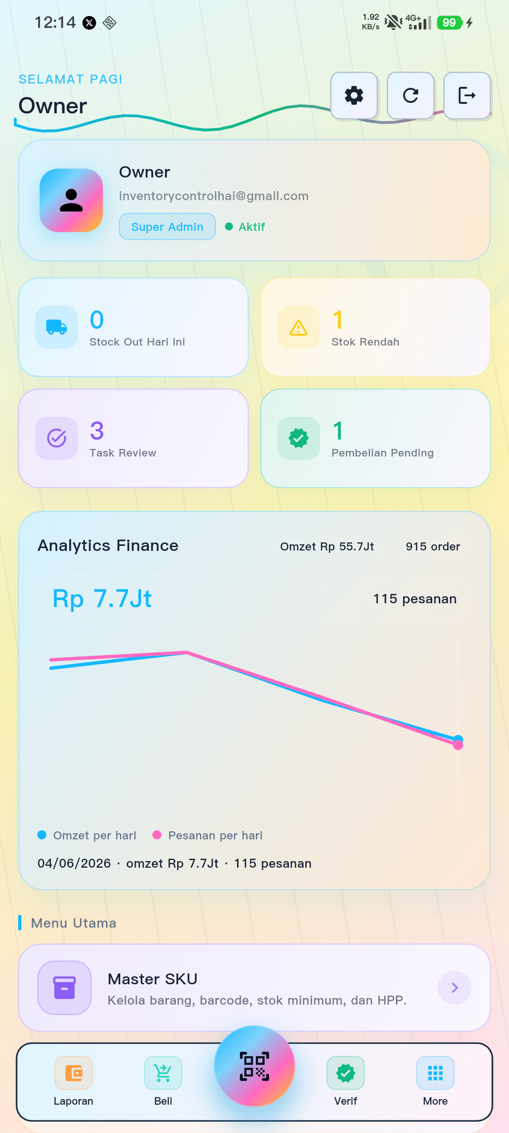
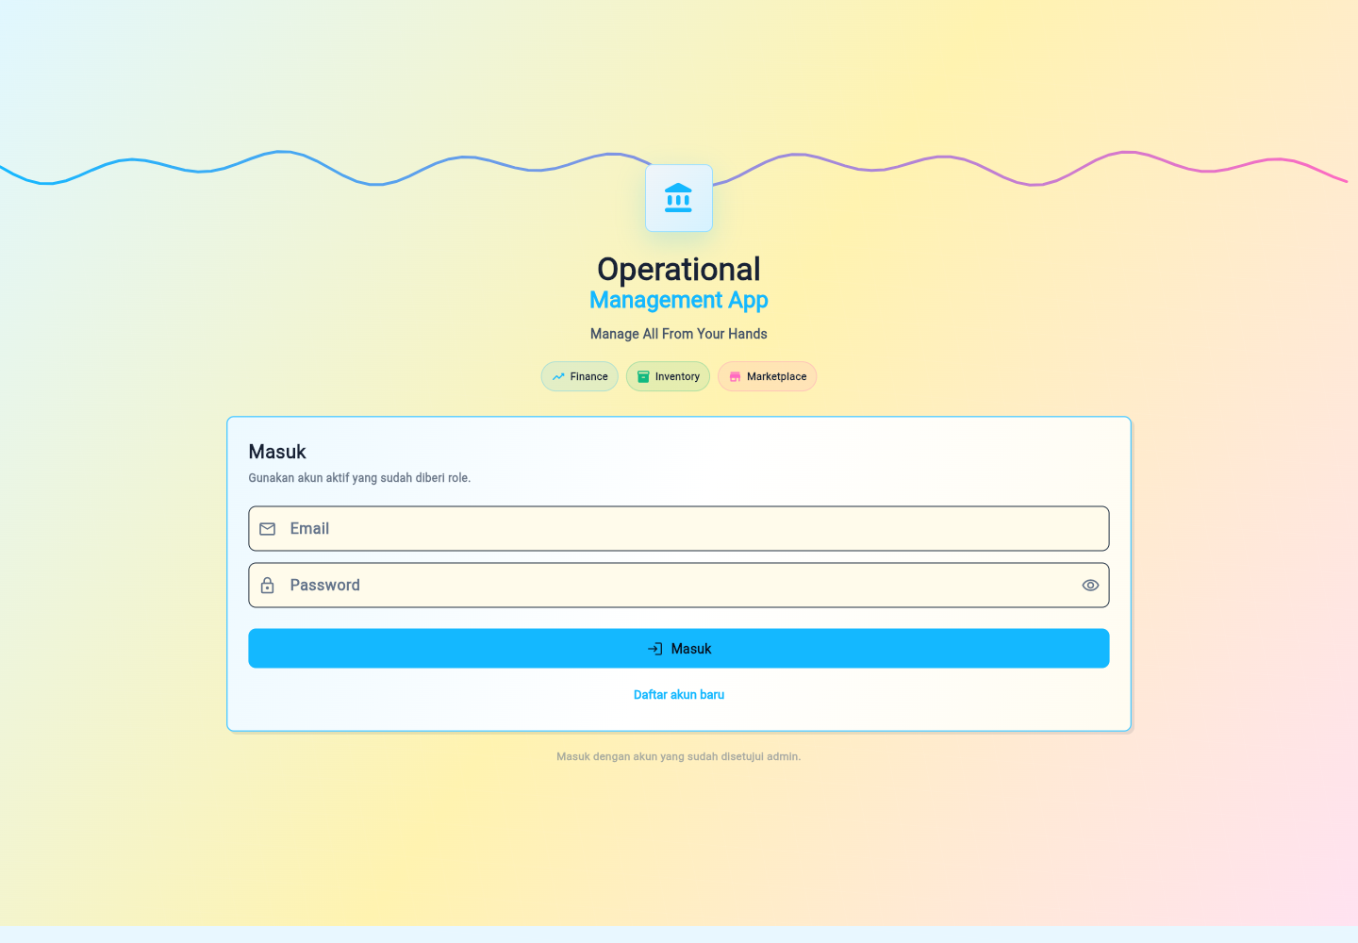
MOBILE ERP — PORTFOLIO PRESENTATION
Screenshots & Live System Interfaces
[SCREENSHOT NEEDED]
Suggested View: Admin Dashboard: Inventory List & Stock Movement View (Suggested resolution: 1600x900px) Shows live master stock levels, SKU mapping indicators, and low-stock warnings.
Budi | IT Support & IT Specialist Portfolio • Live System: https://mdhproduction.com • Slide 11 of 13

Slide 12
MOBILE ERP — PORTFOLIO PRESENTATION
Business Impact & Operational Results
SYSTEM PERFORMANCE & OPERATIONAL GAINS
• Zero Stock Overselling: Atomic RPC database row locks eliminate overselling across multi-marketplace storefronts.
• 80% Faster Financial Audit: Automated payout parsing replaces manual spreadsheet reconciliation for Shopee & TikTok settlements.
• Centralized Operational Control: Single dashboard unifies warehouse inventory, sales channels, and delivery workflows.
CANDIDATE MEASURABLE METRICS
[EDIT: add metrics — users, time saved, error reduction]
Customize with your operational statistics: • Supported active orders processed daily • Reduced stock discrepancies from X% to Y% • Hours saved per week in IT & system administration
Budi | IT Support & IT Specialist Portfolio • Live System: https://mdhproduction.com • Slide 12 of 13

Slide 13
MOBILE ERP — PORTFOLIO PRESENTATION
Contact & Professional Summary
Budi
IT Support / IT Specialist • West Java & Jakarta, Indonesia (Remote or Onsite)
• Background: Degree in Industrial Automation & Robotics Engineering
• Expertise: Network Troubleshooting, ERP/System Integration, IoT Systems & Python/Dart Automation
• Certifications: BNSP Senior Operator PLC | BNSP Junior Network Engineer
• Production System URL: https://mdhproduction.com
• Open for Opportunities: IT Support, Systems Administrator, IT Specialist roles in West Java & Jakarta
Budi | IT Support & IT Specialist Portfolio • Live System: https://mdhproduction.com • Slide 13 of 13

