Slide 1




Next Gen Employability Program
Full Stack Web Development with AI Tools
Team Details – NG_CP_TEAM_5219
Ajai Adithyan K
Appas S
Iraianbu G
Navinesh D
College: Adhiparasakthi Engineering College,
Chennai

Slide 2

The content is curated from online/offline resources and used for educational purpose only.
Notes:
Speaker would be briefing the students that this content has been prepared for the educational purpose only and is referred from multiple sites which are cited in the last.​​
---------------------------------------------------​​
A disclaimer is a statement or notice that is intended to clarify, limit, or provide information about the scope, limitations, or potential risks associated with certain actions, information, products, services, or content. ​​
​​
​

Slide 3

Project Title
INVENTORY MANAGEMENT SYSTEM
Notes:
In this slide speaker will be introducing the program and its outcomes. The speaker will introduce himself in brief

Slide 4

Table of Contents
Problem Statement
Existing System
Objectives Of Project
Introduction
Requirements
Modules
Home page
Login Page
Dashboard
Future Enhancement
Conclusion
Reference
Notes:
This slide, The speaker will talk about the content that we will be covering in this session as follows:
Introduction
Importance of UI/UX in industry
History and Definitions of UI and UX
Key Differences between UI/UX
Use Cases
Significance in Web Development
Use Cases
Visual Design Principles
Design process
Color theory and psychology
Typography and readability
Layout and Spacing
Responsive design basics
Usability and Accessibility
Usability Aspects
Web Content Accessibility Guidelines (WCAG)
Inclusive design practices
Consistency
User Experience
User-Centered Design
User research methods
Interactive Elements and Feedback
Mini Case Study
Discussing a popular UI/UX design
Hands-On
Introduction to Figma for UI/UX design

Slide 5
Problem Statement
Manual inventory handling leads to errors in stock records
Difficulty in tracking product availability in real time
Stock overloading or shortage occurs due to poor monitoring
Purchase and sales records are maintained inefficiently
Managing expiry products and discounts becomes challenging
Overall business operations become slow and less accurate
Existing System
Stock is managed manually using registers or spreadsheets
High chances of human error in product entry and billing
No centralized monitoring of inventory levels
Delay in updating stock after sales or purchases
Difficulty in generating reports and tracking expiry items
Limited support for modern payment and automation features
Notes:
This slide, The speaker will talk about the content that we will be covering in this session as follows:
Introduction
Importance of UI/UX in industry
History and Definitions of UI and UX
Key Differences between UI/UX
Use Cases
Significance in Web Development
Use Cases
Visual Design Principles
Design process
Color theory and psychology
Typography and readability
Layout and Spacing
Responsive design basics
Usability and Accessibility
Usability Aspects
Web Content Accessibility Guidelines (WCAG)
Inclusive design practices
Consistency
User Experience
User-Centered Design
User research methods
Interactive Elements and Feedback
Mini Case Study
Discussing a popular UI/UX design
Hands-On
Introduction to Figma for UI/UX design

Slide 6
Objectives
The main objective of this project is to develop an Inventory Management System that helps businesses manage stock efficiently and accurately.
The system aims to reduce manual work, minimize errors, and provide real-time updates of product availability.
It also focuses on implementing a role-based platform where administrators can manage products, staff can handle sales and purchases, and the system can generate detailed reports.
The project improves operational efficiency, reduces product wastage, and provides a scalable solution for modern retail and warehouse environments.
Notes:
This slide, The speaker will talk about the content that we will be covering in this session as follows:
Introduction
Importance of UI/UX in industry
History and Definitions of UI and UX
Key Differences between UI/UX
Use Cases
Significance in Web Development
Use Cases
Visual Design Principles
Design process
Color theory and psychology
Typography and readability
Layout and Spacing
Responsive design basics
Usability and Accessibility
Usability Aspects
Web Content Accessibility Guidelines (WCAG)
Inclusive design practices
Consistency
User Experience
User-Centered Design
User research methods
Interactive Elements and Feedback
Mini Case Study
Discussing a popular UI/UX design
Hands-On
Introduction to Figma for UI/UX design

Slide 7
Introduction
The Inventory Management System is designed to provide a digital solution for managing products, stock levels, purchases, and sales in an organized way.
It replaces traditional manual inventory tracking with an automated platform that ensures accurate stock monitoring.
The system allows administrators to manage product categories, suppliers, purchases, and expiry-based offers through a centralized dashboard.
It is developed using Django framework with modern frontend technologies to ensure a responsive and user-friendly experience.
Notes:
This slide, The speaker will talk about the content that we will be covering in this session as follows:
Introduction
Importance of UI/UX in industry
History and Definitions of UI and UX
Key Differences between UI/UX
Use Cases
Significance in Web Development
Use Cases
Visual Design Principles
Design process
Color theory and psychology
Typography and readability
Layout and Spacing
Responsive design basics
Usability and Accessibility
Usability Aspects
Web Content Accessibility Guidelines (WCAG)
Inclusive design practices
Consistency
User Experience
User-Centered Design
User research methods
Interactive Elements and Feedback
Mini Case Study
Discussing a popular UI/UX design
Hands-On
Introduction to Figma for UI/UX design

Slide 8
Requirements
Hardware Requirements
Processor: Intel i3 or above
RAM: Minimum 4 GB
Hard Disk: Minimum 50 GB free space
Device: Desktop / Laptop
Internet connection required
Software Requirements
Operating System: Windows / Linux / macOS
Frontend: HTML, CSS, JavaScript
Backend: Python 3.8 or higher
Framework: Django 5.0
Database: MySQL 8.0
Web Browser: Chrome / Edge / Firefox
Notes:
This slide, The speaker will talk about the content that we will be covering in this session as follows:
Introduction
Importance of UI/UX in industry
History and Definitions of UI and UX
Key Differences between UI/UX
Use Cases
Significance in Web Development
Use Cases
Visual Design Principles
Design process
Color theory and psychology
Typography and readability
Layout and Spacing
Responsive design basics
Usability and Accessibility
Usability Aspects
Web Content Accessibility Guidelines (WCAG)
Inclusive design practices
Consistency
User Experience
User-Centered Design
User research methods
Interactive Elements and Feedback
Mini Case Study
Discussing a popular UI/UX design
Hands-On
Introduction to Figma for UI/UX design

Slide 9
Modules
Authentication & User Interface Module
Secure login for Admin and Staff
Responsive and user-friendly interface
User Role Management Module
Permissions based on roles
Separate dashboards for admin and staff
Product & Category Management Module
Add, update, and organize products
Categorize items for easy access
Stock Monitoring Module
Real-time stock updates
Low stock and availability alerts
Notes:
This slide, The speaker will talk about the content that we will be covering in this session as follows:
Introduction
Importance of UI/UX in industry
History and Definitions of UI and UX
Key Differences between UI/UX
Use Cases
Significance in Web Development
Use Cases
Visual Design Principles
Design process
Color theory and psychology
Typography and readability
Layout and Spacing
Responsive design basics
Usability and Accessibility
Usability Aspects
Web Content Accessibility Guidelines (WCAG)
Inclusive design practices
Consistency
User Experience
User-Centered Design
User research methods
Interactive Elements and Feedback
Mini Case Study
Discussing a popular UI/UX design
Hands-On
Introduction to Figma for UI/UX design

Slide 10
Order Management Module
Supplier details and purchase invoices
Stock replenishment tracking
Sales & Billing Module
Sales transactions and invoice generation
Automatic stock reduction after sales
Payment Processing Module
Supports cash and online payments
Secure transaction recording
Offers & Near Expiry Module
Detect expiry products
Apply discounts to reduce wastage
Notes:
This slide, The speaker will talk about the content that we will be covering in this session as follows:
Introduction
Importance of UI/UX in industry
History and Definitions of UI and UX
Key Differences between UI/UX
Use Cases
Significance in Web Development
Use Cases
Visual Design Principles
Design process
Color theory and psychology
Typography and readability
Layout and Spacing
Responsive design basics
Usability and Accessibility
Usability Aspects
Web Content Accessibility Guidelines (WCAG)
Inclusive design practices
Consistency
User Experience
User-Centered Design
User research methods
Interactive Elements and Feedback
Mini Case Study
Discussing a popular UI/UX design
Hands-On
Introduction to Figma for UI/UX design

Slide 11
Reports & Analytics Module
Daily/monthly sales reports
Stock summary and performance insights
Chatbot Assistance Module
Provides instant support for users
Helps in checking product availability and offers
Notes:
This slide, The speaker will talk about the content that we will be covering in this session as follows:
Introduction
Importance of UI/UX in industry
History and Definitions of UI and UX
Key Differences between UI/UX
Use Cases
Significance in Web Development
Use Cases
Visual Design Principles
Design process
Color theory and psychology
Typography and readability
Layout and Spacing
Responsive design basics
Usability and Accessibility
Usability Aspects
Web Content Accessibility Guidelines (WCAG)
Inclusive design practices
Consistency
User Experience
User-Centered Design
User research methods
Interactive Elements and Feedback
Mini Case Study
Discussing a popular UI/UX design
Hands-On
Introduction to Figma for UI/UX design

Slide 12
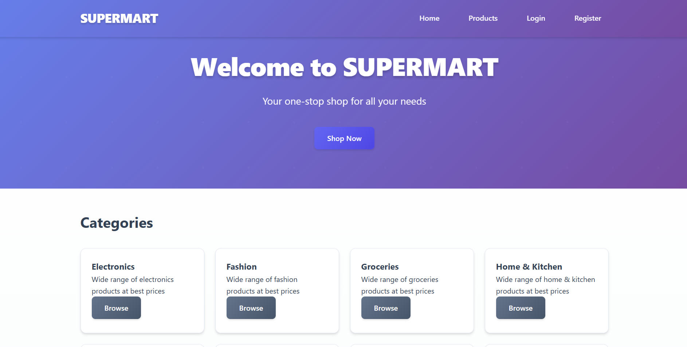
Home Page
Notes:
This slide, The speaker will talk about the content that we will be covering in this session as follows:
Introduction
Importance of UI/UX in industry
History and Definitions of UI and UX
Key Differences between UI/UX
Use Cases
Significance in Web Development
Use Cases
Visual Design Principles
Design process
Color theory and psychology
Typography and readability
Layout and Spacing
Responsive design basics
Usability and Accessibility
Usability Aspects
Web Content Accessibility Guidelines (WCAG)
Inclusive design practices
Consistency
User Experience
User-Centered Design
User research methods
Interactive Elements and Feedback
Mini Case Study
Discussing a popular UI/UX design
Hands-On
Introduction to Figma for UI/UX design

Slide 13
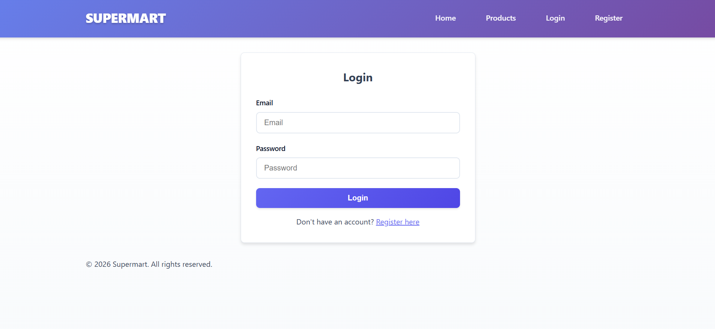
Login Page
Notes:
This slide, The speaker will talk about the content that we will be covering in this session as follows:
Introduction
Importance of UI/UX in industry
History and Definitions of UI and UX
Key Differences between UI/UX
Use Cases
Significance in Web Development
Use Cases
Visual Design Principles
Design process
Color theory and psychology
Typography and readability
Layout and Spacing
Responsive design basics
Usability and Accessibility
Usability Aspects
Web Content Accessibility Guidelines (WCAG)
Inclusive design practices
Consistency
User Experience
User-Centered Design
User research methods
Interactive Elements and Feedback
Mini Case Study
Discussing a popular UI/UX design
Hands-On
Introduction to Figma for UI/UX design

Slide 14
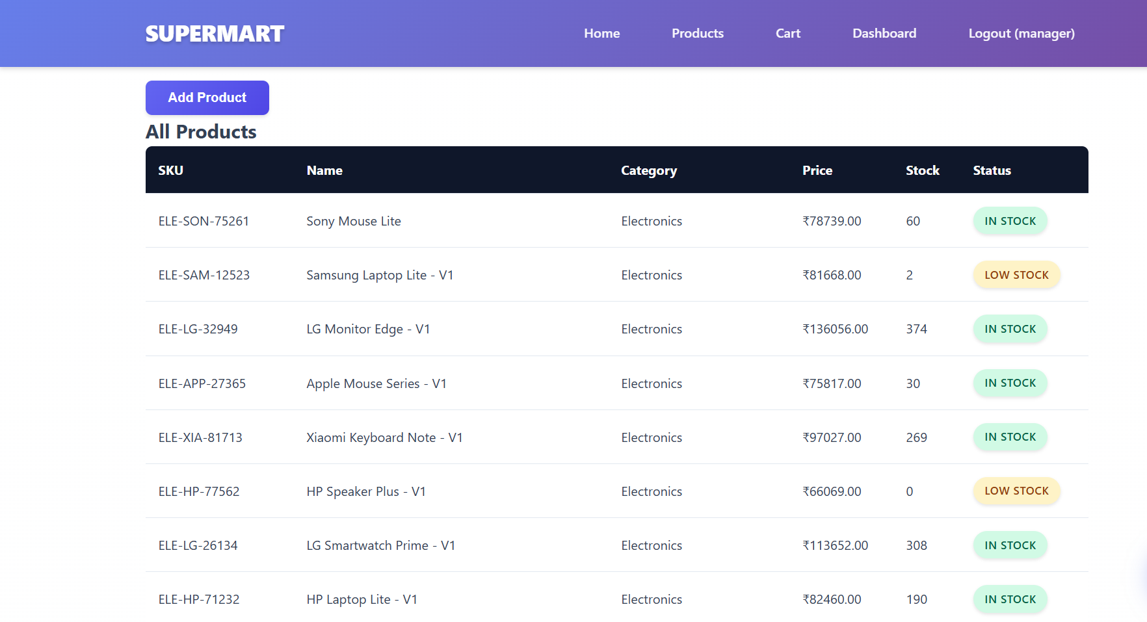
Dashboard
Notes:
This slide, The speaker will talk about the content that we will be covering in this session as follows:
Introduction
Importance of UI/UX in industry
History and Definitions of UI and UX
Key Differences between UI/UX
Use Cases
Significance in Web Development
Use Cases
Visual Design Principles
Design process
Color theory and psychology
Typography and readability
Layout and Spacing
Responsive design basics
Usability and Accessibility
Usability Aspects
Web Content Accessibility Guidelines (WCAG)
Inclusive design practices
Consistency
User Experience
User-Centered Design
User research methods
Interactive Elements and Feedback
Mini Case Study
Discussing a popular UI/UX design
Hands-On
Introduction to Figma for UI/UX design

Slide 15
Future Enhancement
Barcode scanning integration for faster billing
AI-based demand prediction for smart stock planning
Mobile application development
Advanced analytics dashboard with graphs
Online supplier and customer portal integration
Automated email/SMS alerts for low stock and expiry items
Notes:
This slide, The speaker will talk about the content that we will be covering in this session as follows:
Introduction
Importance of UI/UX in industry
History and Definitions of UI and UX
Key Differences between UI/UX
Use Cases
Significance in Web Development
Use Cases
Visual Design Principles
Design process
Color theory and psychology
Typography and readability
Layout and Spacing
Responsive design basics
Usability and Accessibility
Usability Aspects
Web Content Accessibility Guidelines (WCAG)
Inclusive design practices
Consistency
User Experience
User-Centered Design
User research methods
Interactive Elements and Feedback
Mini Case Study
Discussing a popular UI/UX design
Hands-On
Introduction to Figma for UI/UX design

Slide 16
Conclusion
      The Inventory Management System provides an efficient solution for managing stock, purchases, sales, and payments digitally. It reduces manual effort, improves accuracy, and ensures real-time monitoring of inventory.
      The system helps businesses minimize product wastage through expiry-based offers and provides better decision-making using reports and analytics.
      With its scalable and user-friendly design, it offers a reliable platform for modern inventory operations.
Notes:
This slide, The speaker will talk about the content that we will be covering in this session as follows:
Introduction
Importance of UI/UX in industry
History and Definitions of UI and UX
Key Differences between UI/UX
Use Cases
Significance in Web Development
Use Cases
Visual Design Principles
Design process
Color theory and psychology
Typography and readability
Layout and Spacing
Responsive design basics
Usability and Accessibility
Usability Aspects
Web Content Accessibility Guidelines (WCAG)
Inclusive design practices
Consistency
User Experience
User-Centered Design
User research methods
Interactive Elements and Feedback
Mini Case Study
Discussing a popular UI/UX design
Hands-On
Introduction to Figma for UI/UX design

Slide 17
Reference
      https://docs.djangoproject.com/en/stable/
      https://www.python.org/doc/
      https://dev.mysql.com/doc/
      https://developer.mozilla.org/
      https://www.w3schools.com/
      https://getbotstrap.com/docs
      https://owasp.org/www-community/attacks/csrf
Notes:
This slide, The speaker will talk about the content that we will be covering in this session as follows:
Introduction
Importance of UI/UX in industry
History and Definitions of UI and UX
Key Differences between UI/UX
Use Cases
Significance in Web Development
Use Cases
Visual Design Principles
Design process
Color theory and psychology
Typography and readability
Layout and Spacing
Responsive design basics
Usability and Accessibility
Usability Aspects
Web Content Accessibility Guidelines (WCAG)
Inclusive design practices
Consistency
User Experience
User-Centered Design
User research methods
Interactive Elements and Feedback
Mini Case Study
Discussing a popular UI/UX design
Hands-On
Introduction to Figma for UI/UX design

