Slide 1

Solutions for the Digital Economy
Front-end Test
Convert into HTML5 this Template from AI
Requirement :
a. Responsive using Bootstrap and custom media query
b. W3C HTML Compliance
c. Validate and pass with SortSite
https://www.powermapper.com/products/sortsite/
d. Crossbrowser support (IE9/Chrome/Firefox/Safari)
3. Please see next slide for the feature and function of the template
4. Please try finish and send us the full code in zip file max 5 days.

Slide 2
TEMPLATE
Please open attached zip file with AI file inside
Banner carousel using OwlCarousel
4 banner: 2 are videos and its autoplaying on the banner and auto off on slide to next slider. The other two are just images.
Solutions for the Digital Economy

Slide 3
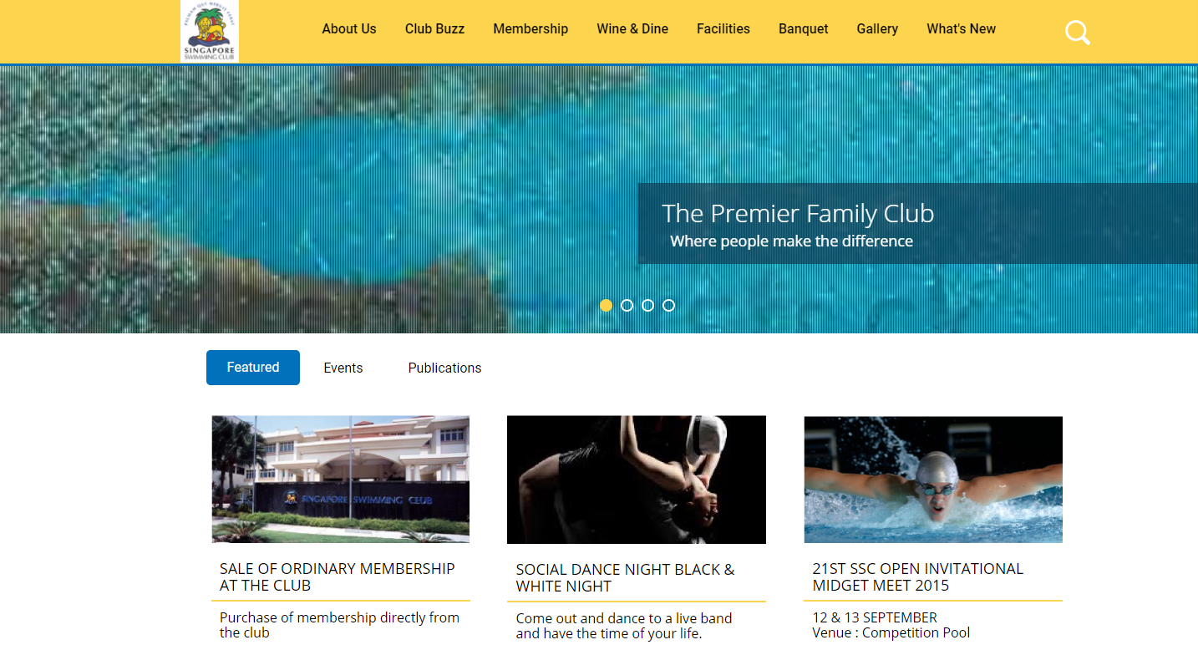
TEMPLATE
From box by default, become like this on scroll
3. The main menu, on scrolldown become sticky
These are tabs
Solutions for the Digital Economy

Slide 4

TEMPLATE
Search button by default just icon, on click showing the field
Solutions for the Digital Economy

Slide 5
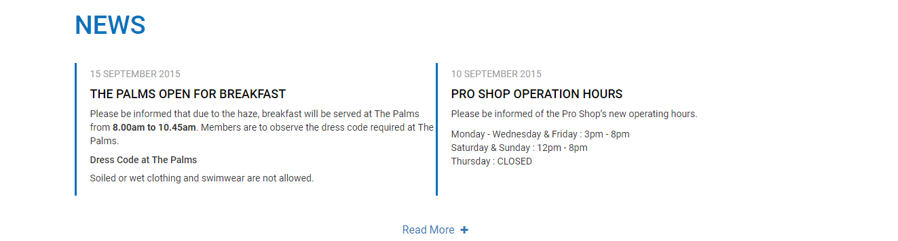
TEMPLATE
4. Please add this function
On click, will show the next same two columns, just use dummy text
Solutions for the Digital Economy

Slide 6
TEMPLATE
5. For the responsive, there is no design for it. Please use your feeling and initiative how to display the clean and tidy layout when become to responsive.
6. Please learn to use SortSite or you may use HTML compliance from w3c validator
Solutions for the Digital Economy

