Slide 1
Image Captioning
Instructor: Ph.D Nguyễn Thiên Bảo
Students: Nguyễn Đình Lộc
Phạm Quốc Bảo

Slide 2
Overview
Introduction
Related work
Architecture
Dataset
Training
Evaluation
Future work
References

Slide 3
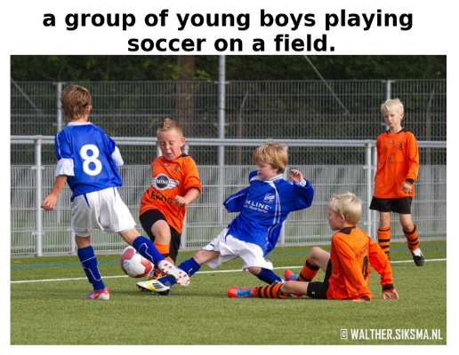
Introduction
Image captioning is the process of generating textual description of an image.
It uses both Natural Language Processing and Computer Vision to generate the captions.
Caption generation models be powerful enough to solve the computer vision challenges of determining which objects are in an image, but they must also be capable of capturing and expressing their relationships in a natural language.

Slide 4
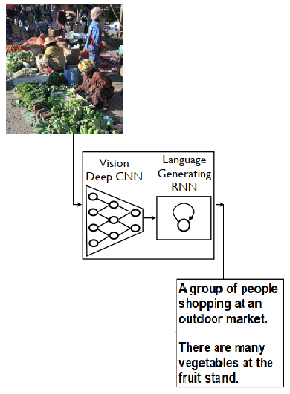
Related work
Recent work has significantly improved the quality of caption generation using encoder – decoder framework.
Google Show and Tell using a combination of convolutional neural networks (CNN) to obtain vectorial representation of images and recurrent neural networks (RNN) to decode those representations into natural language sentences.

Slide 5
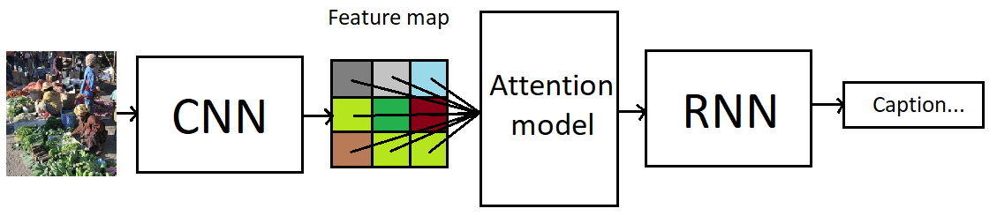
Architecture
Encoder: A CNN has been trained for recognition task such as image classification, object detection, ...
Attention model: A feedforward neural network for implementing attention mechanism.
Decoder: A language model based on RNN.

Slide 6
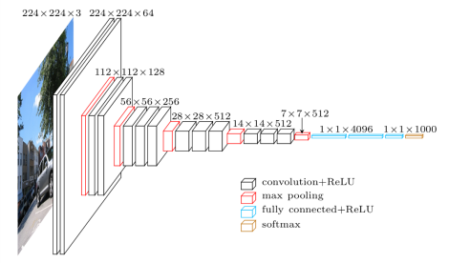
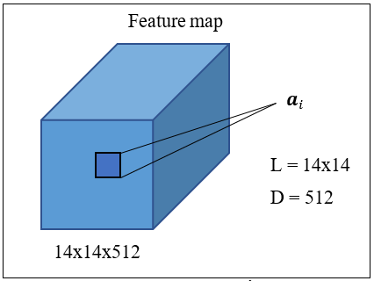
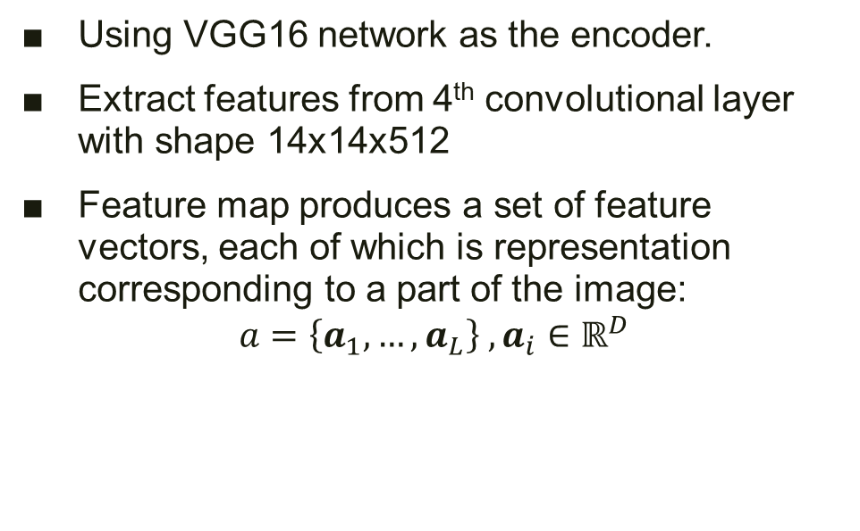
Encoder
Using VGG16 network as the encoder.
Extract features from 4th convolutional layer with shape 14x14x512
Feature map produces a set of feature vectors, each of which is representation corresponding to a part of the image:
$$a=\left\{a_{1},…,a_{L}\right\} , a_{i}∈ℝ^{D}$$

Slide 7
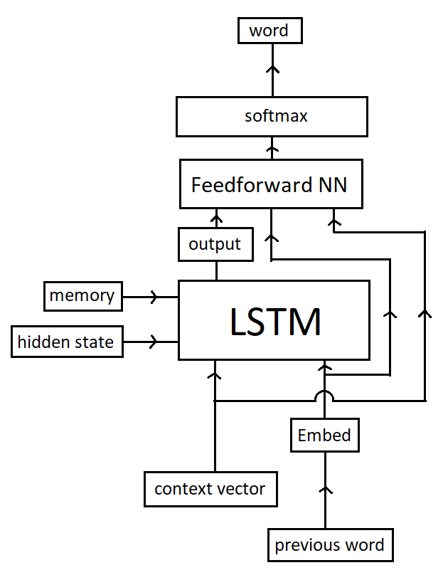
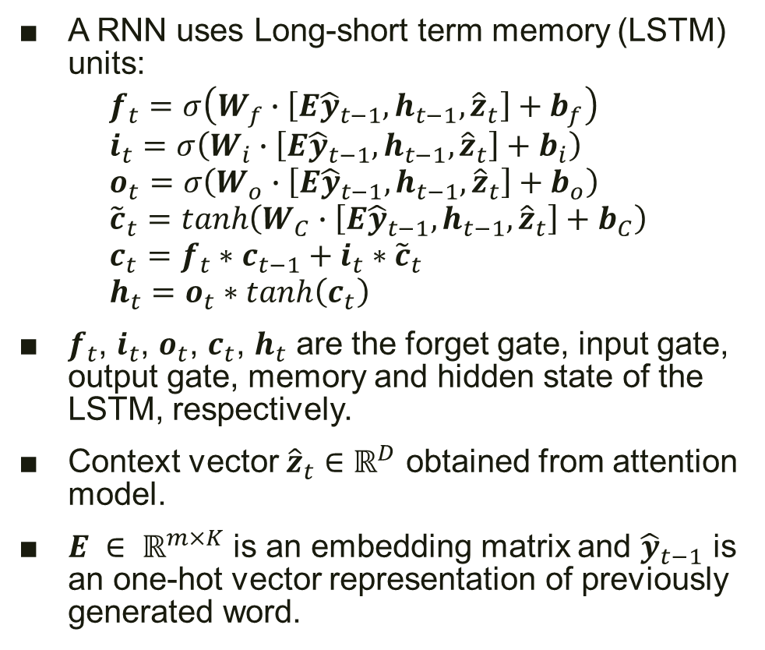
Decoder
A RNN uses Long-short term memory (LSTM) units:
$$f_{t}=σ\left(W_{f}∙\left[E{\hat{y}}_{t−1},h_{t−1},{\hat{z}}_{t}\right]+b_{f}\right) \\ i_{t}=σ\left(W_{i}∙\left[E{\hat{y}}_{t−1},h_{t−1},{\hat{z}}_{t}\right]+b_{i}\right) \\ o_{t}=σ\left(W_{o}∙\left[E{\hat{y}}_{t−1},h_{t−1},{\hat{z}}_{t}\right]+b_{o}\right) \\ {\tilde{c}}_{t}=tanh\left(W_{C}∙\left[E{\hat{y}}_{t−1},h_{t−1},{\hat{z}}_{t}\right]+b_{C}\right) \\ c_{t}=f_{t}∗c_{t−1}+i_{t}∗{\tilde{c}}_{t} \\ h_{t}=o_{t}∗tanh\left(c_{t}\right)$$
$f_{t}$, $i_{t}$, $o_{t}$, $c_{t}$, $h_{t}$ are the forget gate, input gate, output gate, memory and hidden state of the LSTM, respectively.
Context vector ${\hat{z}}_{t}∈ℝ^{D}$ obtained from attention model.
$E ∈ ℝ^{m×K}$ is an embedding matrix and ${\hat{y}}_{t−1}$ is an one-hot vector representation of previously generated word.

Slide 8
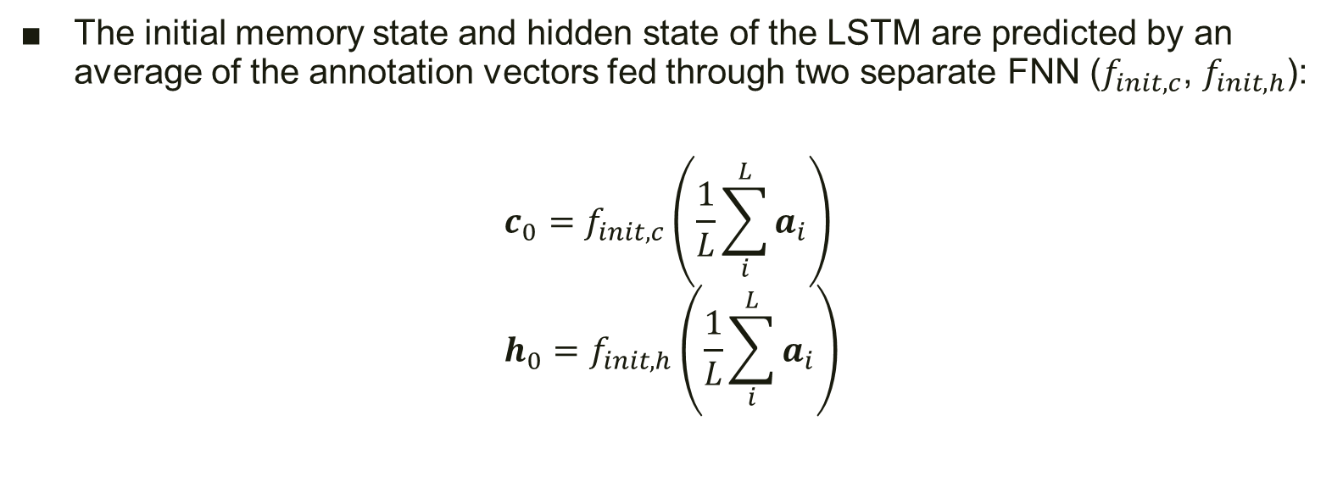
Decoder
The initial memory state and hidden state of the LSTM are predicted by an average of the annotation vectors fed through two separate FNN ($f_{init,c}$, $f_{init,h}$):
$$c_{0}=f_{init,c}\left(\frac{1}{L}\sum_{i}^{L}{a_{i}}\right) \\ h_{0}=f_{init,h}\left(\frac{1}{L}\sum_{i}^{L}{a_{i}}\right)$$

Slide 9
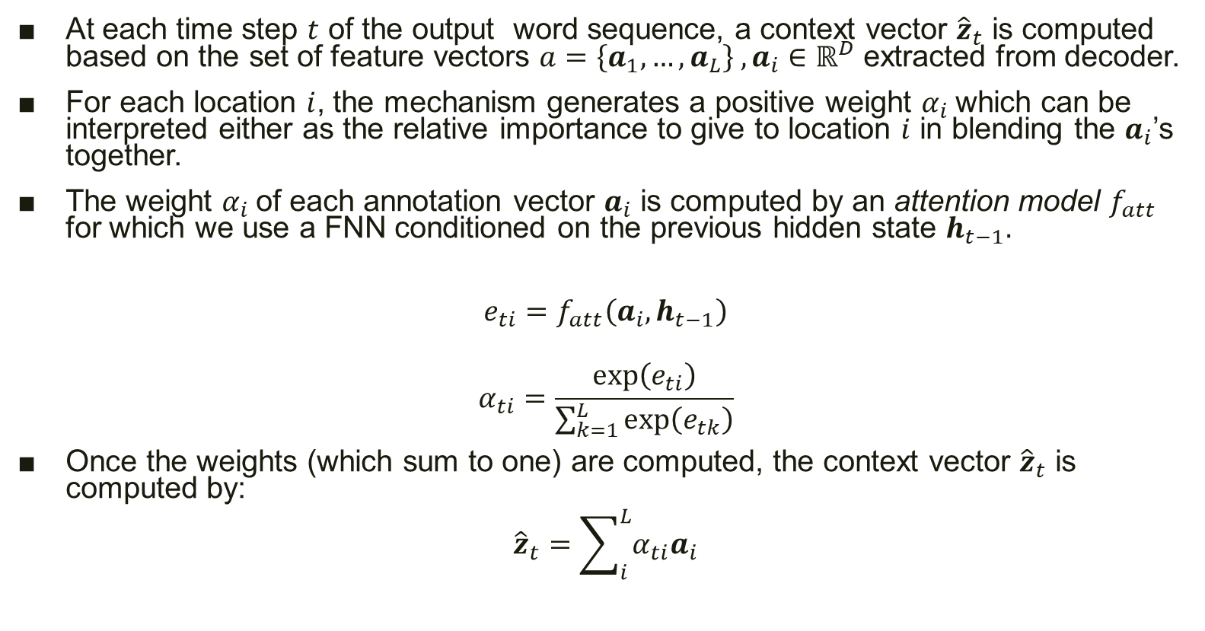
Attention model
At each time step $t$ of the output word sequence, a context vector ${\hat{z}}_{t}$ is computed based on the set of feature vectors $a=\left\{a_{1},…,a_{L}\right\} , a_{i}∈ℝ^{D}$ extracted from decoder.
For each location $i$, the mechanism generates a positive weight $α_{i}$which can be interpreted either as the relative importance to give to location $i$ in blending the $a_{i}$’s together.
The weight $α_{i}$of each annotation vector $a_{i}$ is computed by an attention model $f_{att}$ for which we use a FNN conditioned on the previous hidden state $h_{t−1}.$
$$e_{ti}=f_{att}\left(a_{i},h_{t−1}\right)$$
$$α_{ti}=\frac{exp\left(e_{ti}\right)}{\sum_{k=1}^{L}{exp\left(e_{tk}\right)}}$$
Once the weights (which sum to one) are computed, the context vector ${\hat{z}}_{t}$ is computed by:
$${\hat{z}}_{t}=\sum_{i}^{L}{α_{ti}a_{i}}$$

Slide 10
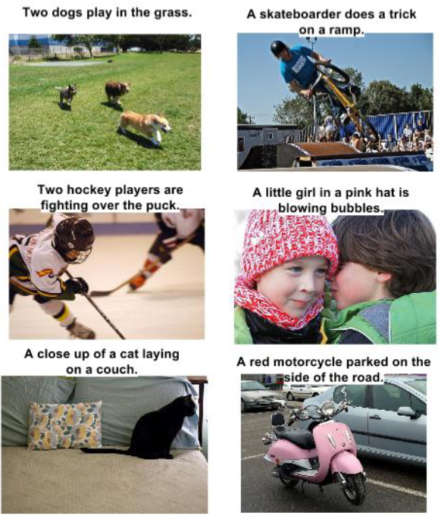
Flickr8k Dataset
Dataset consisting of 8,000 images that are each paired with five different captions which provide clear descriptions of the salient entities and events.

Slide 11
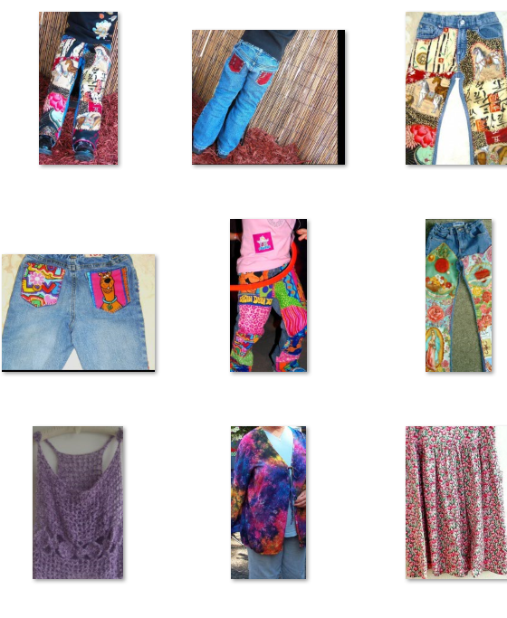
Etsy Dataset
A fashion dataset consisting of 5,000 images that are each paired with three different captions which provide clear descriptions of the types, styles and attributes.
Dataset comes with 3000 images for training, 1000 validation and 1000 testing.

Slide 12
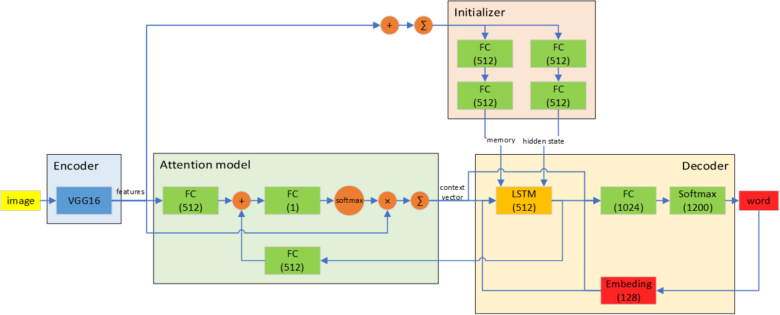
Model

Slide 13
Training
Cross entropy loss
Adam optimizer
Learning rate decay
Batch size 32
Input Normalization
Image Distortion
Dropout Regularization
L2 Regularization
Clip gradient

Slide 14
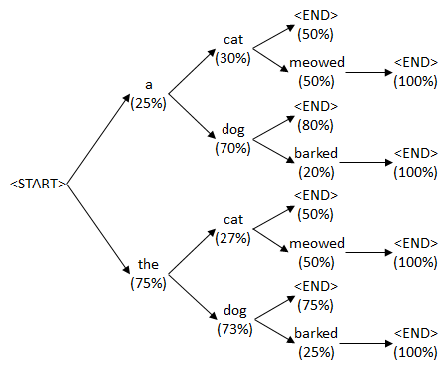
Prediction
At the prediction, generating caption using beam search to find high-probability caption.
Beam search is an optimization of best-first search that reduces its memory requirements, only a predetermined number of best partial solutions are kept as candidates in beam search.

Slide 15
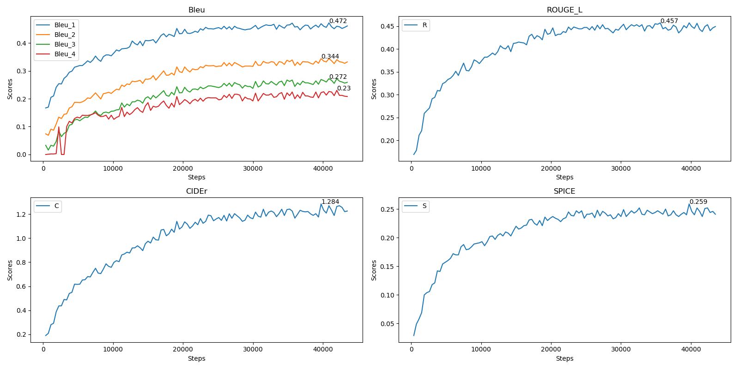
Etsy evaluation

Slide 16
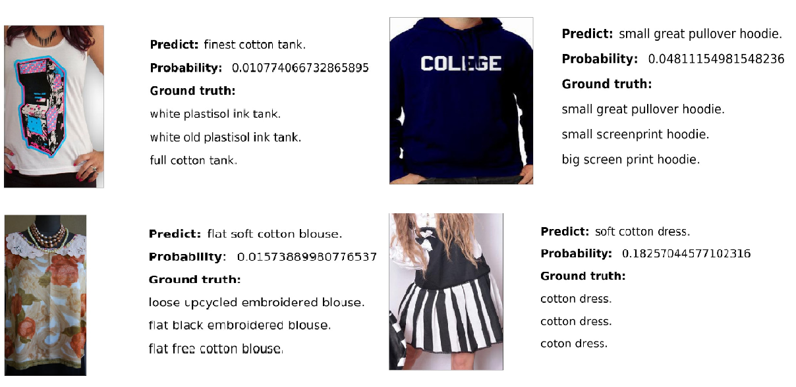
Good predictions

Slide 17
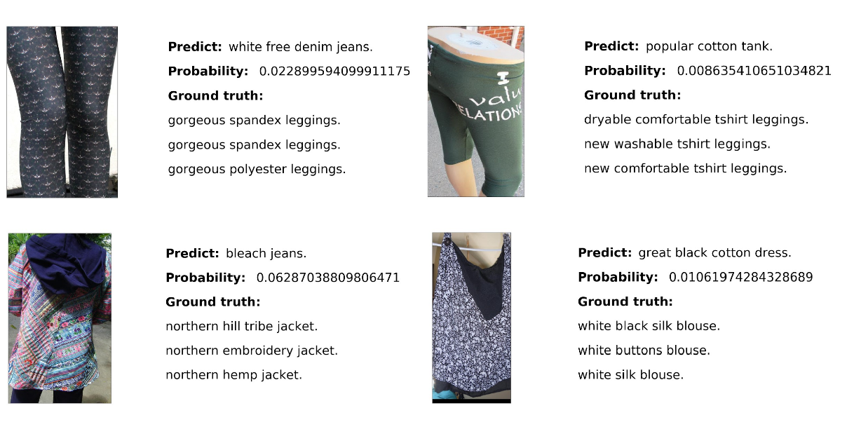
Bad predictions

Slide 18
Evaluation
Dataset | Model | Bleu-1 | Bleu-2 | Bleu-3 | Bleu-4 | ROUGE-L | CIDEr | SPICE
Flick8k | Google NIC(1) | 0.630 | 0.410 | 0.270 | - | - | - | -
 | Soft-attention(2) | 0.670 | 0.448 | 0.299 | 0.195 | - | - | -
 | Our model | 0.663 | 0.491 | 0.350 | 0.245 | - | - | -
Etsy | Our model | 0.469 | 0.344 | 0.269 | 0.222 | 0.457 | 1.284 | 0.259
(1): Vinyals et al. Show and tell: A neural image caption generator, 2014.
(2): Kelvin Xu et al. Show and tell: A neural image caption generator, 2015.

Slide 19
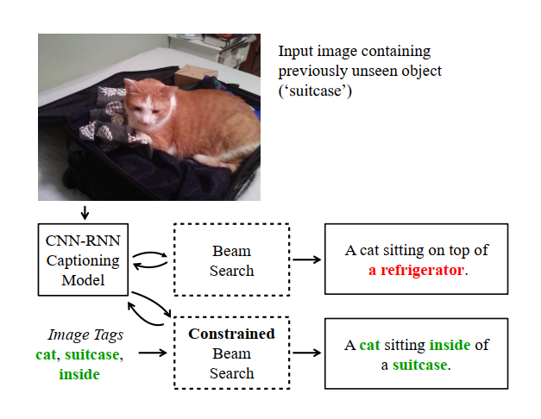
Future work
Constrained beam search: caption images containing previously unseen objects by incorporating semantic attributes (i.e., image tags) during RNN decoding.

Slide 20
References
Kelvin Xu, Jimmy Ba, Ryan Kiros, Kyunghyun Cho, Aaron Courville, Ruslan Salakhutdinov, Richard Zemel, Yoshua Bengio. (2015). Show, Attend and Tell: Neural Image Caption with Generation with Visual Attention.
Bahdanau, Dzmitry, Cho, Kyunghyun, Bengio, & Yoshua. (September 2014). Neural machine translation by jointly learning to align and translate. arXiv:1409.0473.
Hochreiter, S., & Schmidhuber, J. (1997). Long short-term memory. Neural Computation, 9(8):1735–1780.
Pascanu, Razvan, Gulcehre, Caglar, Cho, Kyunghyun, . . . Yoshua. (2014). How to construct deep recurrent neural networks. ICLR.
Vinyals, Oriol, Toshev, Alexander, Bengio, Samy, and Erhan, Dumitru. Show and tell: A neural image caption generator. November 2014.

Slide 21
Related work
Recently, several methods have been proposed for generating image descriptions:
The first approach to use neural networks for caption generation using a multimodal log-bilinear model that was biased by features from the image
The second approach to see the image at each time step of the output word sequence only show the image to the RNN at the beginning

Slide 22
Challenges

