Slide 1


Causes and severity of car crashes
Created by,
Hunter Lyons

Slide 2
Why this study was conducted
To help first responders allocate sufficient resources
To define higher risk areas
To show the public what impacts car accident severity
And most importantly, to promote driver safety

Slide 3
Data acquisition and cleaning
Data source: Data-Collisions.csv
Map source: https://www.latlong.net/place/space-needle-seattle-usa-16629.html
Raw Data set consisted of 180,477 rows and 38 features
Cleaned Data set consisted of 90,100 rows and 18 features

Slide 4
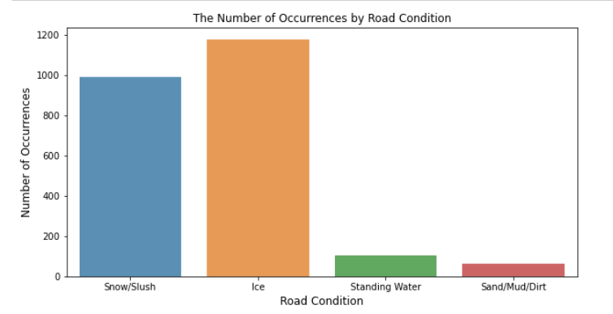
Ice was the worst road condition

Slide 5
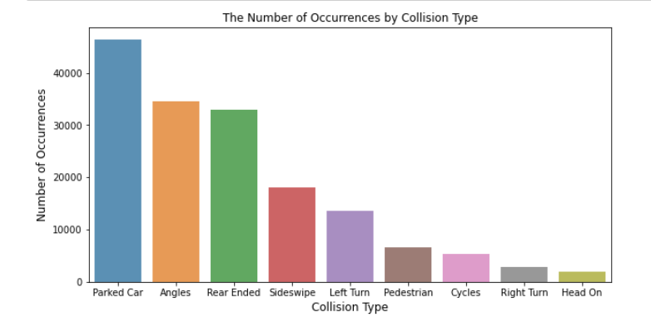
Parked cars collisions were most frequent

Slide 6
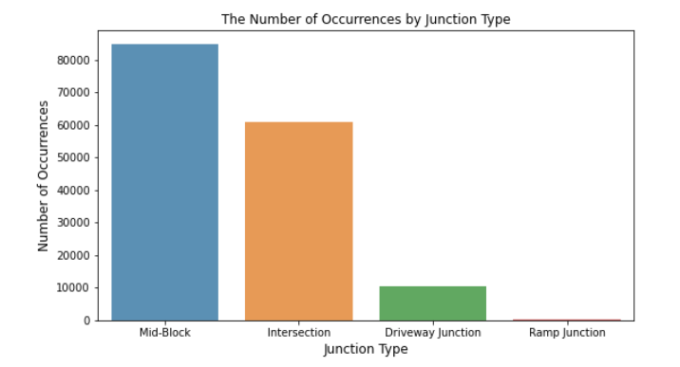
Mid-block accidents were the most common

Slide 7
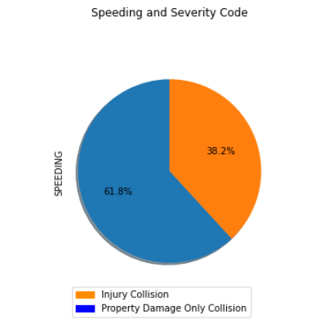
The majority of speeding accidents resulted only in property damage

Slide 8
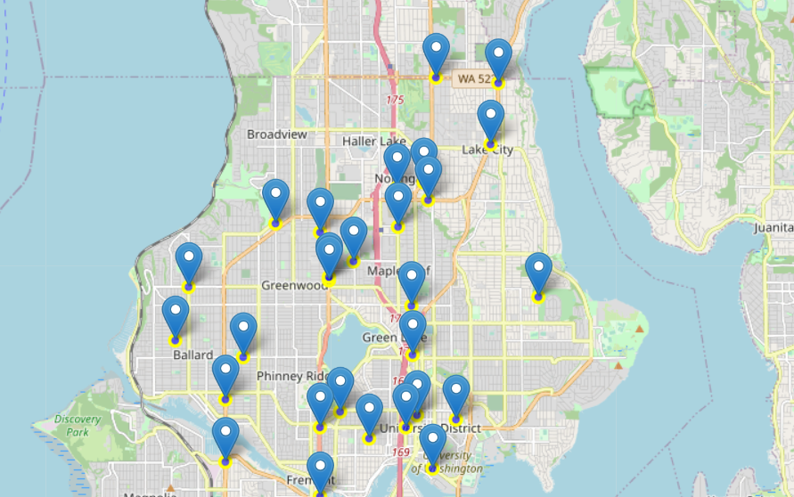
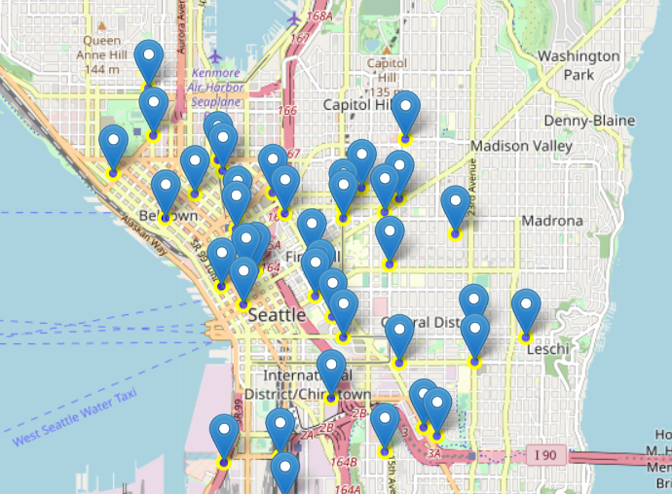
Accident locations
Northern peninsula
Downtown Seattle

Slide 9
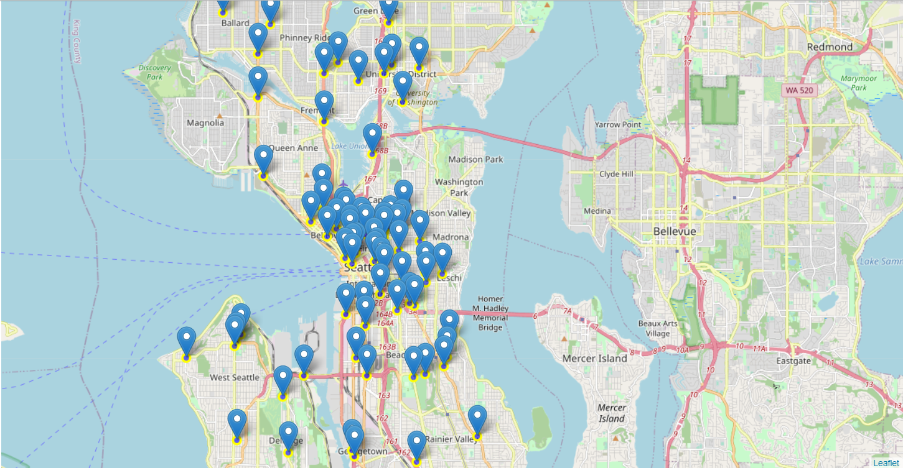
Accidents were more frequent closer to the city center

Slide 10
Conclusion and insights
Ice was the worst road condition
Parked cars collisions were most frequent accident type
Mid-block accidents were the most common junction occurrence
The majority of speeding accidents resulted only in property damage
Accidents were more frequent closer to the city center

