Slide 1

Palmer Lao
Sean Lyons
Eliece

Slide 2
Error-Correcting Codes
Code: set of bit strings e.g. {000,111}
Codewords: element of a code e.g. 000
Distance: # differences between codewords
        OR
        Minimum distance among codewords in a code

Slide 3
Error-Detecting
Consider the Code {000,111}
How many errors could we notice if they were to occur?

Slide 4
Error-Correcting
Consider the same Code {000,111}
How many errors could occur with us still being able to determine the original codeword?

Slide 5
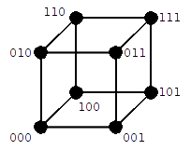

Slide 6
McEliece Cryptosystem
Public-Key
Asymmetric
Secure due to hardness of decoding

Slide 8
The Algorithm
TO THE BOARD!

Slide 9
Questions?

