Slide 1
MATH 6380J Mini project 1
Dong, Chenyang
Lo, Tsz Cheung
Xia, Jiacheng

Slide 2
Outline
Review our Kaggle competition
The American Crime Dataset
Feature selection and analysis on Crime Data.
Prediction for Crime Data.
Conclusion.

Slide 3
Outline
Review on our Kaggle competition
The American Crime Dataset
Feature selection and analysis on Crime Data.
Prediction for Crime Data.
Conclusion.

Slide 4
In-class IC50 Data Kaggle Competition
Description of Data & Learning Task
Framework of Constructing our Model
Result & Insights
will focus more on the process of building models, instead of medical results

Slide 5
Data Description & Learning Task
Data
IC50 Dataset
x, Features: around 20,000 genes value (double)
y, Response: Drug Sensitivity after 72 hours
p >> N case: N = 129, p ~= 20,000
Learning Task
Given around 20,000 genes (variables), to predict 20 missing drug sensitivity data
Difficulty
Very few data
High dimension

Slide 6
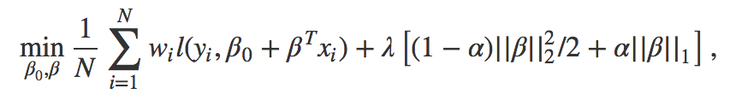
Framework of Constructing Model
R Language
glmnet(generalized linear model) Package, by Stanford
Data Splitting
data = model_data + kaggle_data
model_data = training_data + test_data (random, 50:50)
One-step variable selection with cross-validation
Elastic-net, try alpha (linear weight on L1-Norm) in [0,1] with step = 0.05
For a fixed alpha, glmnet will help select the ”best” model with least MSE of training_data (find best lambda)
For all 20 models (different alpha), select the model (alpha) with least MSE of test_data

Slide 7
Result & Insights
Final Model
(I think) elastic-net MLR is a good model for this data:
perform huge var reduction (20,000 -> 36)
perform reliable prediction (Kaggle Score (MSE): around 0.15, while best is around 0.11)
Some Insights from Building Models
When comparing different alpha, should use same (training & test) set for different model
Diff alpha + same set = kaggle 0.15;
Diff alpha + diff set = kaggle 0.27
Other problems to be solved
Step-wise/Recursive methods rather than one-step?
What is the “best” percentage to split training & test set?

Slide 8
Outline
Review our Kaggle competition
The American Crime Dataset
Feature selection and analysis on Crime Data.
Prediction for Crime Data.
Conclusion.

Slide 9
Data Preprocessing
Omit the instance with incomplete attributes.
All # of crimes and # of police are divided by the city population.
Eliminate “term4” to avoid perfect multicollinearity.
Centering and scaling all the numerical attributes and retaining all the 6 indicator variables.
17 continuous variables, 6 indicator variables.
7 types of crimes.

Slide 10
Data description
Contains 7 crime types and 26 input features with 1000+ instances.
We deleted entries with incomplete information
Cut-off city-names, year and unnecessary election rounds indicator.
Features are more “strongly” related to outcomes.

Slide 11
Outline
Review our Kaggle competition
The American Crime Dataset
Feature selection and analysis on Crime Data.
Prediction for Crime Data.
Conclusion.

Slide 12
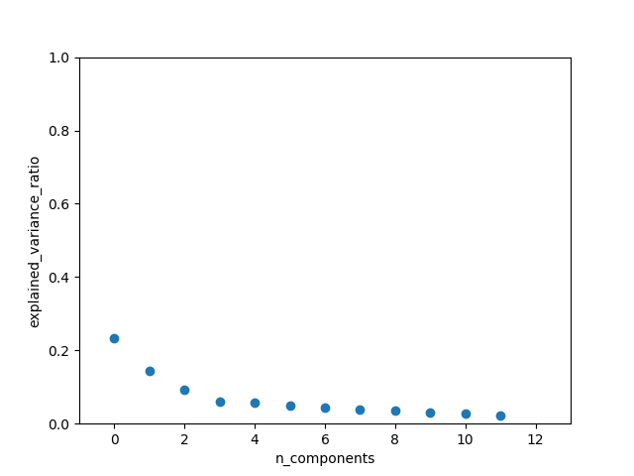
Feature Selection: PCA

Slide 13
PCA doesn’t perform well
We found that each component doesn’t have a high explained variance ratio.
Top 12 explained_variance_ratio: 0.23396449 0.14390731 0.09129552 0.06091442 0.0579744 0.04808905 0.04468014 0.03800987 0.03494981 0.03108402 0.02839217 0.02346042
Also, nearly all entries have value between 1e-3 and 1e-1.
SparsePCA, RobustPCA are not applicable.

Slide 14
Feature Selection: Lasso
Nearly all variables are related to each kind of crime but not strongly.
Most important ones: Population, Age 0-5, Age 15-19, Female household and police force.
Different crime type varies…

Slide 15
Lasso for Rape crime
Positively correlated with City Populations.
Negatively correlated with no. of Sworn police.

Slide 16
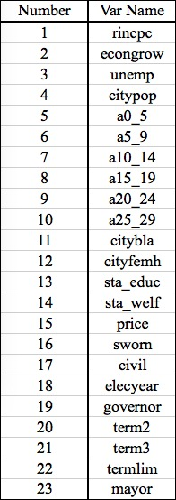
Lasso…

Slide 17
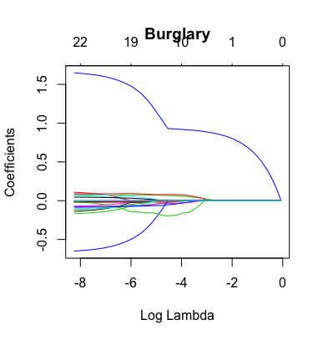
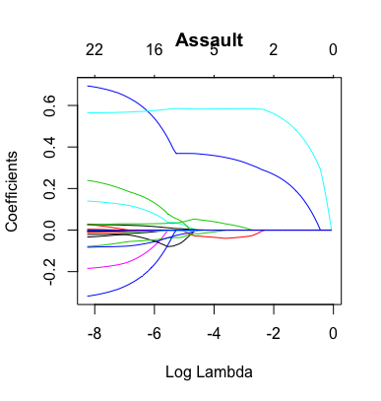
Lasso for others…

Slide 18
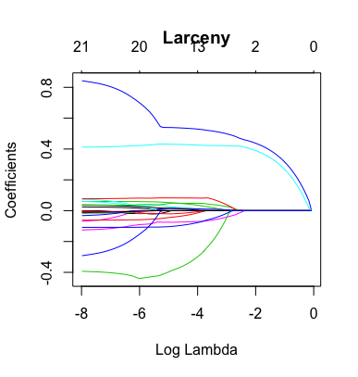
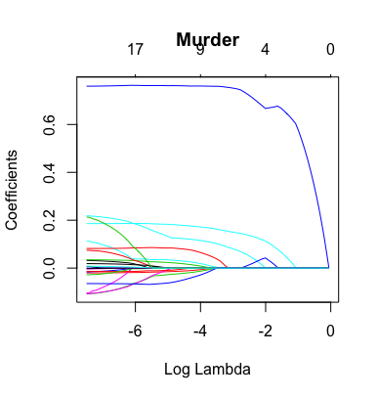
Lasso for others…

Slide 19
Outline
Review our Kaggle competition
The American Crime Dataset
Feature selection and analysis on Crime Data.
Prediction for Crime Data.
Conclusion.

Slide 20
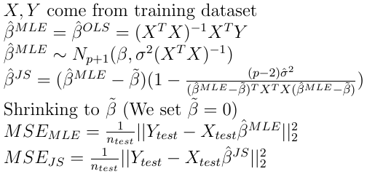
J-S and MLE Estimator Discussion
Under the normality assumption of random error, OLS estimator is the same as MLE estimator for regression coefficients. Beta follows multivariate normal distribution.
Test dataset: randomly choose 10% of the whole data (10-fold cross validation).

Slide 21
Comparison Between J-S and MLE
Crime | MSE(J-S Estimator) | MSE(MLE Estimator)
Murder | 0.111113 | 0.110897
Rape | 0.162354 | 0.162546
Robbery | 0.168508 | 0.167938
Assault | 0.063957 | 0.064234
Burglary | 0.150071 | 0.149294
Larceny | 0.138588 | 0.138807
Auto | 0.123945 | 0.123703

Slide 22

Comparison Between J-S and MLE
N>>P, i.e. # of instances is much larger than # of dimensions.
Both estimators do not differ much.
No significant improvement after using J-S Estimator, due to X’X >> p.

Slide 23
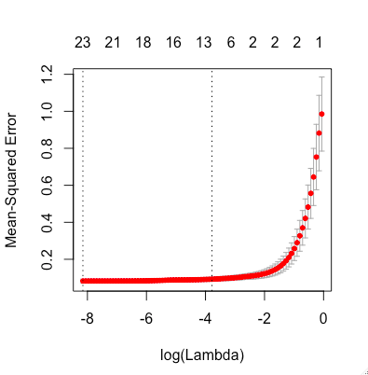
MSE for Lasso (10-fold Cross Validation)
An example for crime type: Larceny
Crime | MSE(J-S Estimator) | MSE(MLE Estimator)
Larceny | 0.138588 | 0.138807
Around 0.06

Slide 24
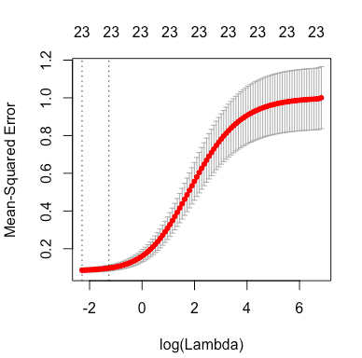
MSE for Ridge (10-fold Cross Validation)
An example for crime type: Larceny
Predicting power is similar
to that of Lasso but the model
Preserves all of the regressors,
Which adds to the complexity
Of the model.

Slide 25
Outline
Review our Kaggle competition
The American Crime Dataset
Feature selection and analysis on Crime Data.
Prediction for Crime Data.
Conclusion.

Slide 26
Conclusion
Population size, police force are strongly related to crime rate.
Lasso estimator has the best predicting power for crime data.
Please refer to our project GitHub page and poster for more details.

