Slide 1
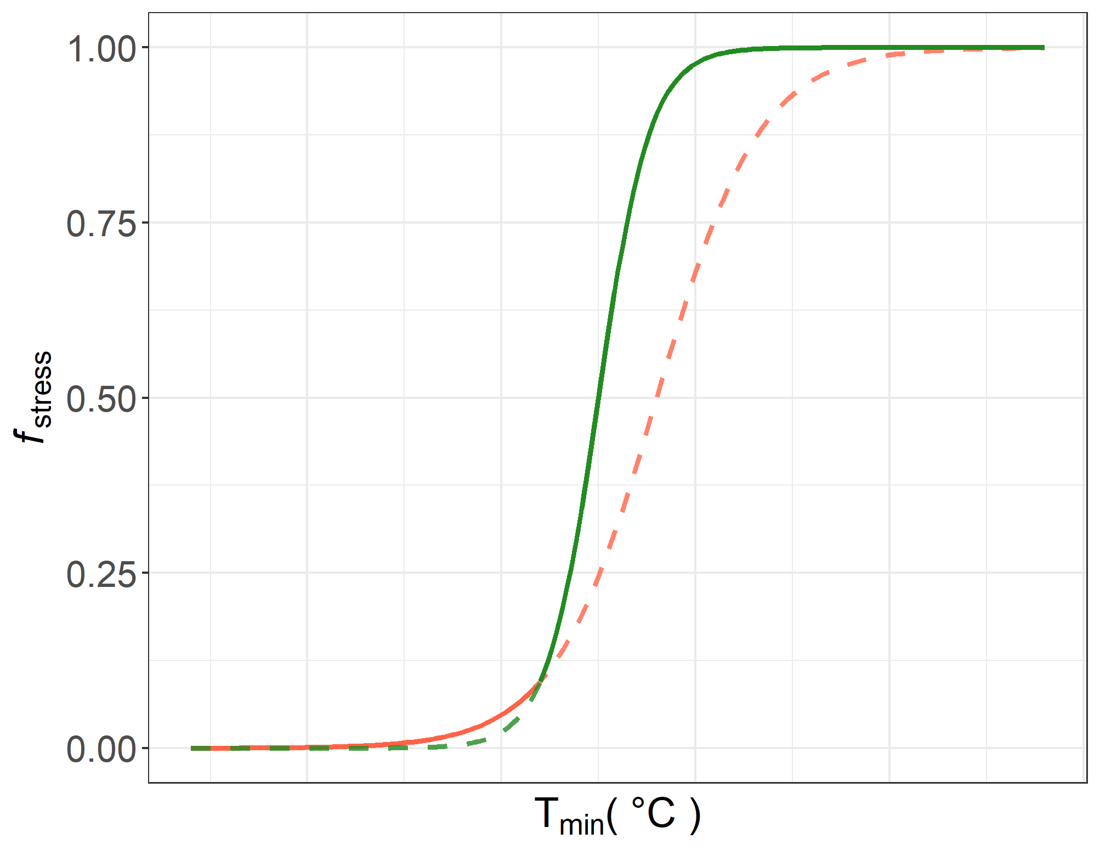


$$f2(Tmin)=\frac{1}{1+e^{−b_{2}(T_{min} −a_{2})}}$$
$$f1(Tmin)=\frac{1}{1+e^{−b_{1}(T_{min} −a_{1})}}$$
Phase 1
Phase 2
GDD_{threshold} (k)

Slide 2
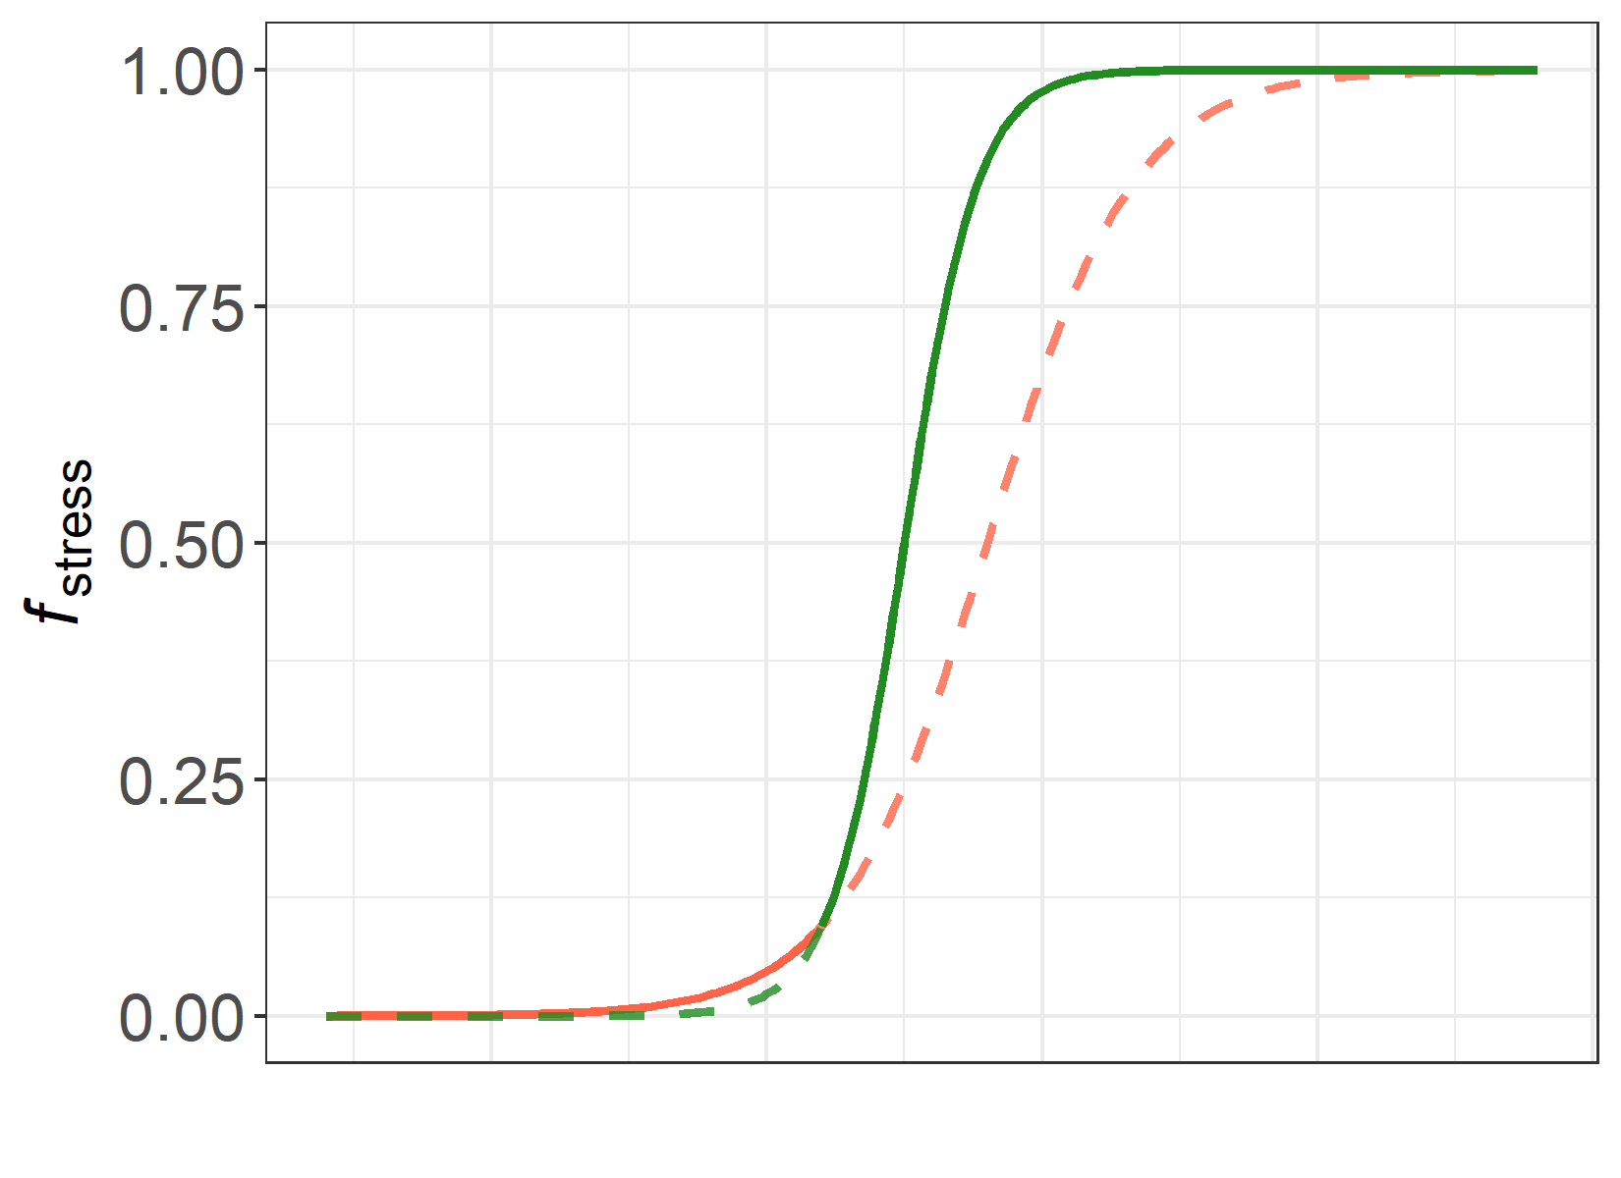


peak of season
$$f2(GDD)=\frac{1}{1+e^{−b_{2}(GDD−a_{2})}}$$
$$f1(Tmin)=\frac{1}{1+e^{−b_{1}(T_{min} −a_{1})}}$$
Phase 1
Phase 2
GDD_{threshold} (k)

Slide 3
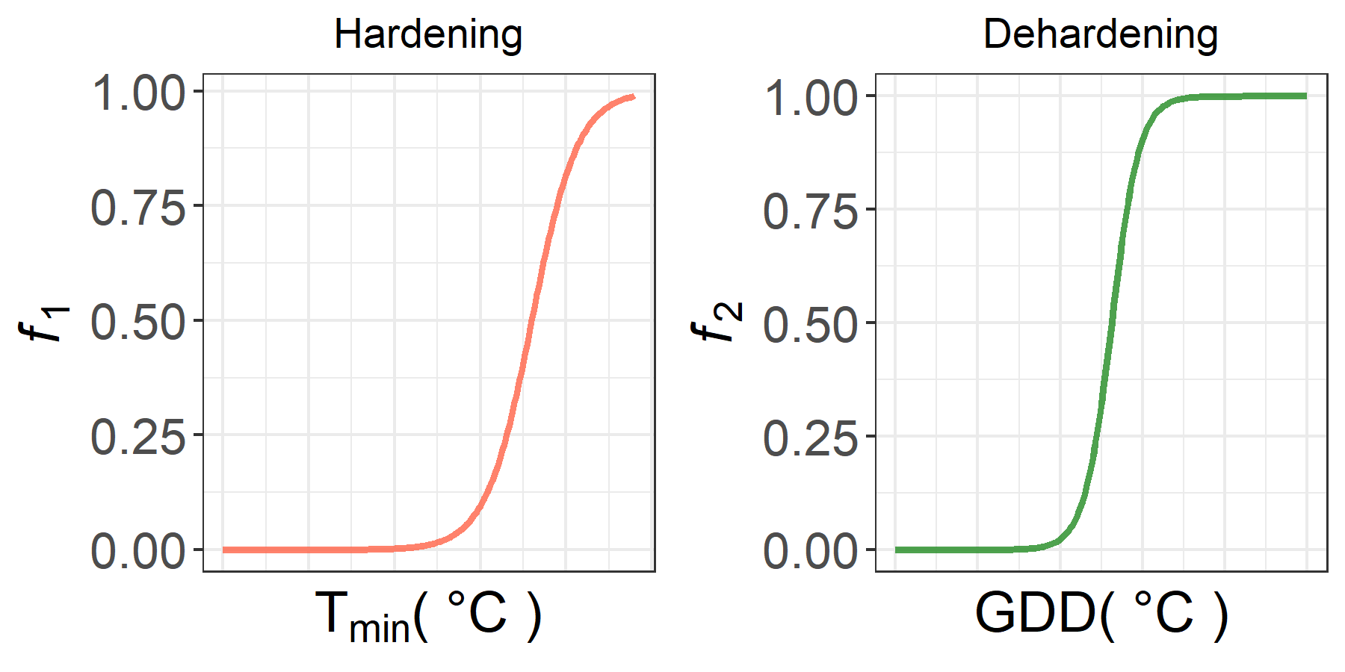


$$f1(t)=\frac{1}{1+e^{−b_{1}(T_{min}(t) −a_{1})}}$$
$$f2(t)=\frac{1}{1+e^{−b_{2}(GDD(t)−a_{2})}}$$

