Slide 1
我校数学建模活动开展情况及组织培训安排
华南理工大学数学学院
丁为建

Slide 2
目 录
我校数学建模活动开展情况
2025MCM/ICM - Contest Rules
2025MCM/ICM - 培训安排表
美国赛备战
竞赛纪律
Matlab的使用许可问题

Slide 3
数学建模活动开展情况介绍
围绕官方两大赛事，每年两个周期：
  全国大学生数学建模竞赛（CUMCM）
    每年3月-9月
  美国大学生数学建模竞赛（MCM/ICM）
    每年10月-次年2月

Slide 4
数学建模活动开展情况介绍
各类数学建模竞赛
  中国研究生数学建模竞赛（9月-研究生）
  MathorCup高校数学建模挑战赛（4月-中文）
  广州高校数学建模联赛（5月-校内选拔赛）
  “深圳杯”大学生数学建模挑战赛 （5-8月）
  “大湾区杯”粤港澳金融数学建模竞赛（11月-中文）
  华南理工大学数理大赛（11月-中文）
  亚太地区大学生数学建模竞赛（11月-英文）
  ……

Slide 5
数学建模活动开展情况介绍
  美国大学生数学建模竞赛（ICM/MCM）
  美国大学生数学建模竞赛（MCM/ICM）由美国数学及其应用联合会（COMAP）主办，是唯一的国际性数学建模竞赛，也是世界范围内最具影响力的数学建模竞赛。
  竞赛始于1985年，为现今各类数学建模竞赛之鼻祖。
  竞赛分为两种类型
    数学建模竞赛（Mathematical Contest In Modeling,MCM）
    交叉学科竞赛（Interdisciplinary Contest In Modeling,ICM）
    每类包括三道题。
MCM |  | ICM
A | 连续型 | D | 运筹学/网络科学
B | 离散型 | E | 环境科学
C | 大数据 | F | 政策

Slide 6
数学建模活动开展情况介绍
  美国大学生数学建模竞赛（ICM/MCM）
  2024年，竞赛共吸引全球28913支队伍报名，超过八万选手参与角逐。
  • 35 Outstanding Winners (0.12%)
  • 515 Finalist Winners (1.78%)
  • 1925 Meritorious Winners (6.65%)
  • 6670 Honorable Mentions (23.1%)

Slide 7
数学建模活动开展情况介绍
  美国大学生数学建模竞赛（ICM/MCM）
  2024年我校共有来自数学学院、计算机学院、软件学院、未来技术学院、微电子学院、和电力学院等23个学院的360支代表队伍参赛，共获F奖8项，M奖37项，获H奖以上的比例为42.5%。
  曾经地，2020-2022我校连续三年有收获竞赛的最高奖项（Outstanding Winner）；2024年重拾升势。

Slide 8
数学建模活动开展情况介绍
美国大学生数学建模竞赛周期(MCM/ICM)
  第二十一届数理大赛（11月）
    数学学院主办，作为我校每年“数学文化节”的重要一环
  2024年（第五届）“大湾区杯”粤港澳金融数学建模竞赛（11月）
  APMCM亚太地区大学生数学建模竞赛（11月）
  培训中期作业（12月-1月）
    HiMCM题目，完成论文并拟举办答辩评优会
  美国赛线上培训（1月）

Slide 9
MCM/ICM Contest Rules
2025 Contest Dates and Times:
  Registration Deadline: Before 3:00 p.m. EST on Thursday, January 23, 2025.
  Contest Starts: 5:00 p.m. EST on Thursday, January 23, 2025.
  Contest Ends: 8:00 p.m. EST on Monday, January 27, 2025.
  Solution Report Deadline: 9:00 p.m. EST on Monday, January 27, 2025.

Slide 10
MCM/ICM Contest Rules
Changes for 2025
  New online submission process using the new online submission page https://forms.comap.org/241335097294056.
    You will need your team's control number, advisor id number and your problem choice to complete your submission.
  The MCM/ICM Contest now have a 25 page limit.
    The 25 page limit applies to the entire submission including the Summary Sheet, Solution, Reference List, Table of Contents, Notes, Appendices, Code and any problem specific requirements.
  Use of Large Language Models and Generative AI Tools in COMAP Contests.
    Contest_AI_Policy.pdf

Slide 11
MCM/ICM Contest Rules
Contest Rules:
  …
  6.Once the contest window opens (5:00 p.m. on Thursday, January 23, 2025), team membership must be set and teams may not use any persons, other than their own team members, to discuss or obtain ideas for working on and solving their problem. Teams may use any "inanimate" resource they find on their own such as: web pages, books, articles, research reports, databases, etc.
  …

Slide 12
MCM/ICM Contest Rules
Contest Rules:
  …
  7. Teams must document any outside sources of information by using footnotes, endnotes, or in-line documentation, and include appropriate citations in a reference list or Bibliography of these sources.
  …
  9.The names of the students, advisor, and/or institution must not appear on any page of the solution. The solution must not contain any identifying information other than the team Control Number.
  …

Slide 13
MCM/ICM Contest Rules
Contest Registration:
  Once the contest opens, team members cannot be added or changed.
  The spelling of all names and institutions is the responsibility of the advisor. This is exactly as they will appear on certificates.
  The order of the student names has no bearing or importance on participation. In the eyes of COMAP and the contest directors,all team members are equal.
  Advisors should ensure they spell team members' names correctly when registering. COMAP will not reprint certificates.

Slide 14
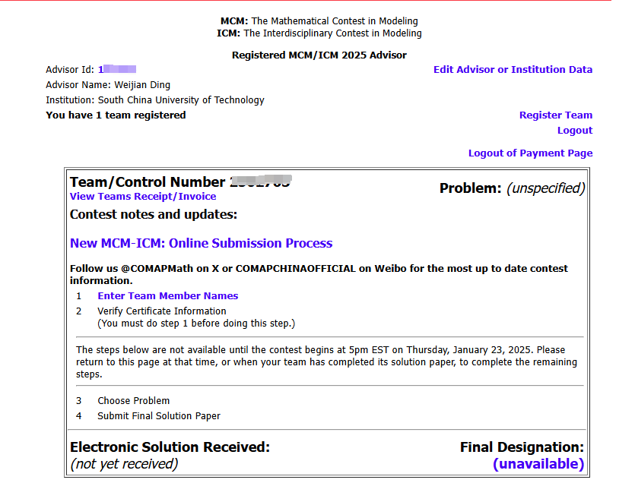
MCM/ICM Contest Rules
Contest Registration:

Slide 15
MCM/ICM Contest Rules
AI Tools in Contests:
  1. Clearly indicate the use of LLMs or other AI tools in their report, including which model was used and for what purpose. Please use inline citations and the reference section. Also append the Report on Use of AI (described below) after your 25-page solution.
  2. Verify the accuracy, validity, and appropriateness of the content and any citations generated by language models and correct any errors or inconsistencies.
  3. Provide citation and references, following guidance provided here. Double-check citations to ensure they are accurate and are properly referenced.
  4. Be conscious of the potential for plagiarism since LLMs may reproduce substantial text from other sources. Check the original sources to be sure you are not plagiarizing someone else's work.

Slide 16
MCM/ICM Contest Rules
Solution Document:
  Teams are encouraged to complete as much of the problem as they are able to do. MCM/ICM judges are primarily interested in the team's thought processes, analysis of the problem, modeling approaches, and mathematical methods.
  Teams must submit their entire solution in one Adobe PDF electronic file, consisting of written text, figures, charts, and supporting materials. Papers must be typed in English, with a readable font of at least 12-point type. Do not send additional non solution files such as data or computer programs.
  Each page of the solution must contain the team control number and the page number at the top of the page. Use a page header on each page - for example: Team # 0000000, Page 6 of 25 .

Slide 17
MCM/ICM Contest Rules
Solution Document:
  Solution report should start with the Summary Sheet followed by the team's solution. A Table of Contents is encouraged and does count toward the page limit. Reference list (or Bibliography), notes pages, and any appendices count toward the page limit and should be included after the solution pages.
  The Report on Use of AI has no page limit and will not be counted as part of the 25-page solution.
  Names of the students, advisor, and/or institution must not appear on any page of the solution. The solution file must not contain any identifying information other than the team Control Number.

Slide 18
MCM/ICM Judging Criteria
Paper Structure
  Besides the summary sheet as described each paper should contain the following sections:
    Restatement and clarification of the problem: State in your own words what you are going to do.
    Explain assumptions and rationale/justification: Emphasize the assumptions that bear on the problem. Clearly list all variables used in your model.
    Include your model design and justification for type model used or developed.
    Describe model testing and sensitivity analysis, including error analysis, etc.
    Discuss the strengths and weaknesses of your model or approach.

Slide 19
MCM/ICM Judging Criteria
  The judges will evaluate the quality of your writing in the Solution Paper:
    Conciseness and organization are extremely important.
    Key statements should present major ideas and results.
    Present a clarification or restatement of the problem, as appropriate.
    Present a clear exposition of all variables, assumptions, and hypotheses.
    Present an analysis of the problem, including the motivation or justification for the model that is used.
    Include a design of the model.
    Discuss how the model could be tested, including error analysis and stability (conditioning, sensitivity, etc.).
    Discuss any apparent strengths or weaknesses in your model or approach.

Slide 20
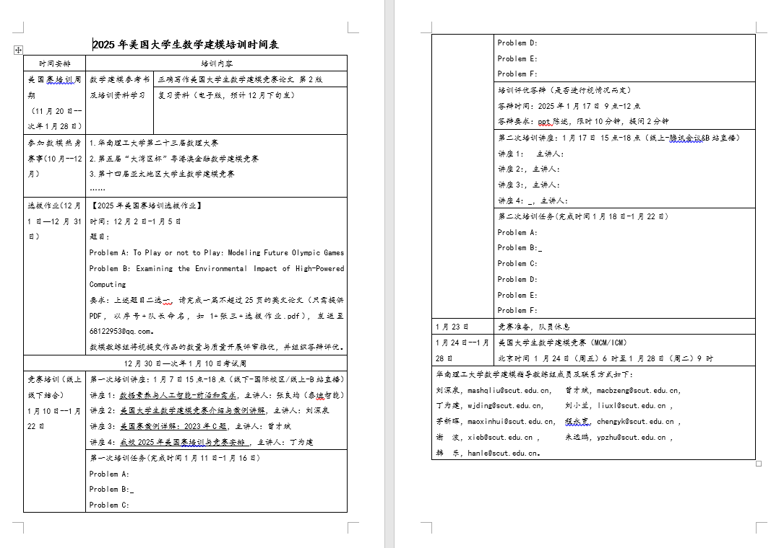
2025MCM/ICM - 培训安排表

Slide 21
2025MCM/ICM -美国赛备战
参加培训，完成两次任务
仔细研读近五年O奖论文
  英文写作（格式、语法、排版）
  模型与算法的使用
  预选题、准备论文模板
知识补充，查漏补缺
  近十年美国赛模型与算法汇总
    https://mp.weixin.qq.com/s/iNtr9WZ7oO5HI51ifwmz-w
  视频学习、慕课学习

Slide 22
竞赛纪律
2024年全国赛我校有2支队伍因相似度过高被通报
  指导教师两年内不得指导参赛队伍
  全文自建库相似度超30%的队伍有48支（17.7%）
我校参赛队伍须接受数学学院统一管理，完成资格审核、选拔等规定动作，否则参赛行为不被认可，结果不予录入“学校竞赛信息采集系统”。

Slide 23
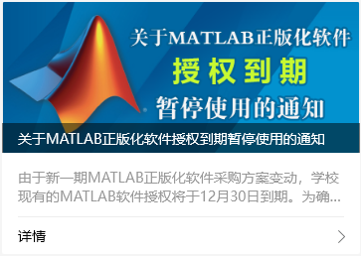
Matlab的使用许可问题
关于MATLAB正版化软件授权到期暂停使用的通知

Slide 24
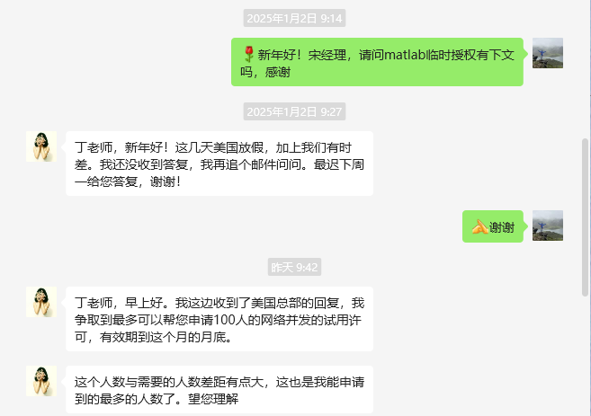
Matlab的使用许可问题
数模指导团队的努力

Slide 25
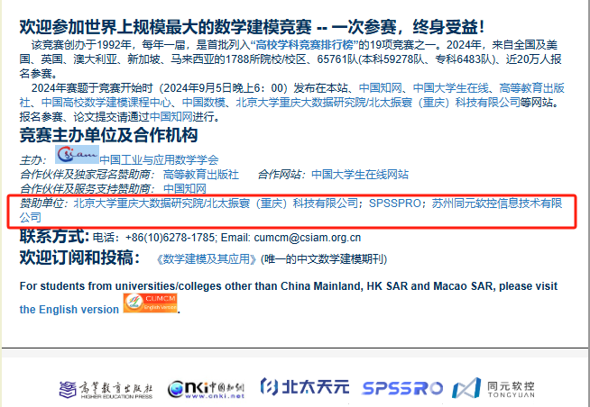
Matlab的使用许可问题
破局之策
  平替：北太天元、SPSSPRO、MWORKS …
  其他：Python、C++、绿色版 …

Slide 26
总 结
平时积累
  养成阅读英文文献的习惯，多关注、多阅读
  多看竞赛优秀论文、多做真题
重视培训
  培训的形式就是模拟竞赛，维持竞赛的强度，在不断模拟、不断仿真中快速提高
排除干扰
  时间靠挤，全身心投入
态度决定高度！

