Slide 1


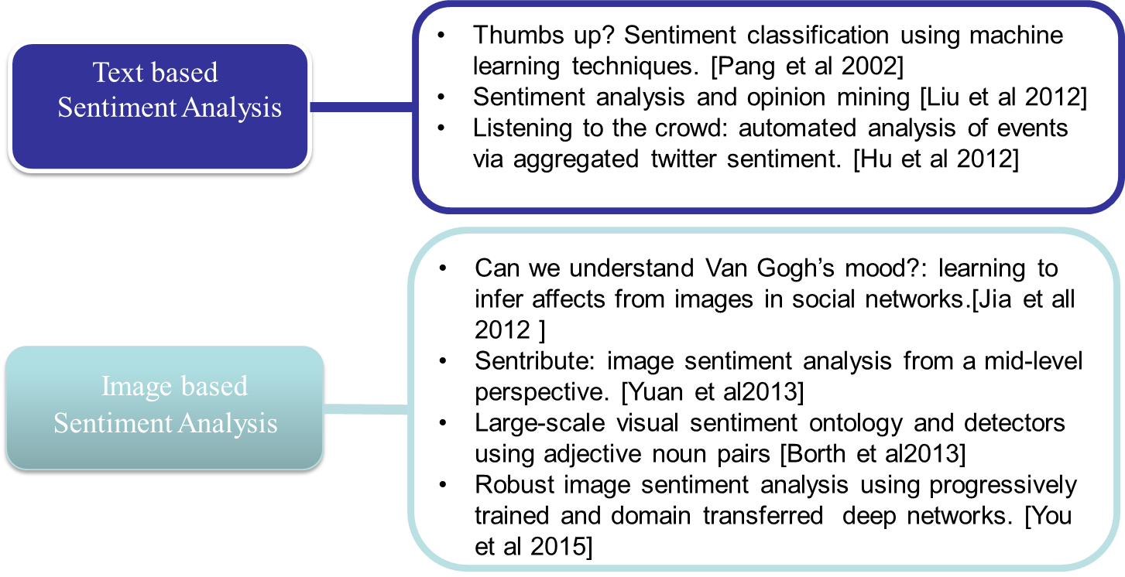
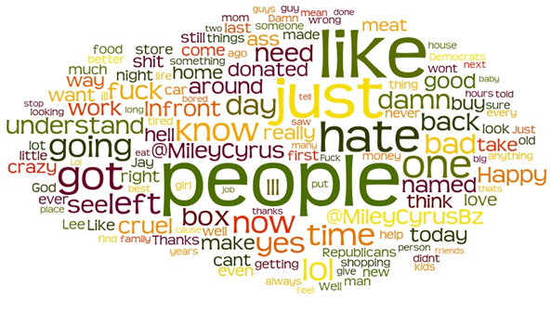
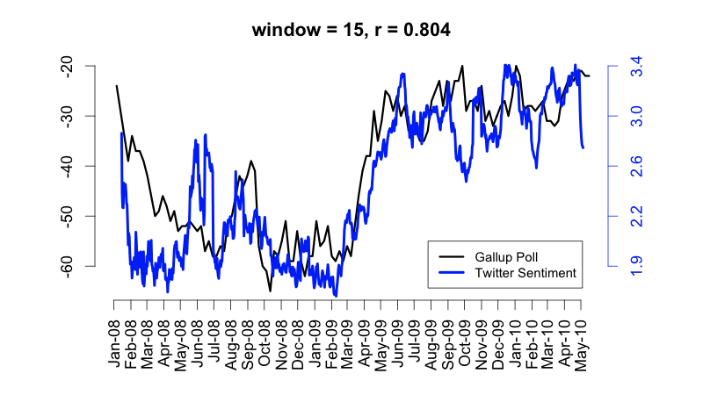
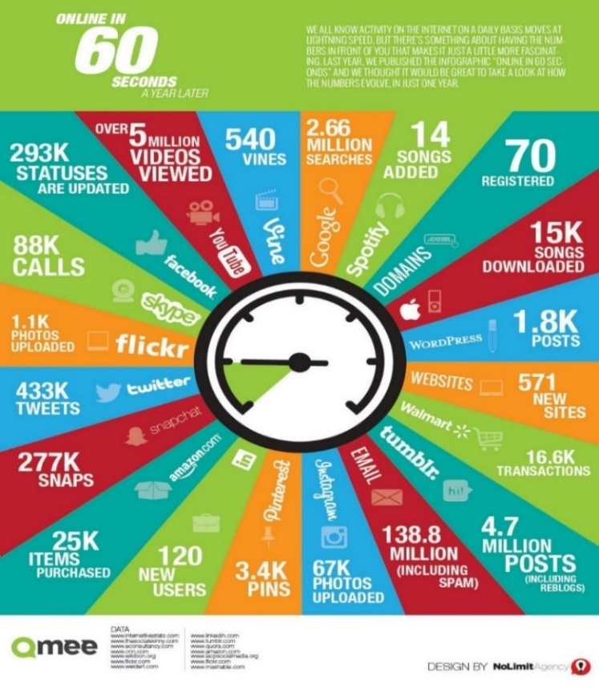
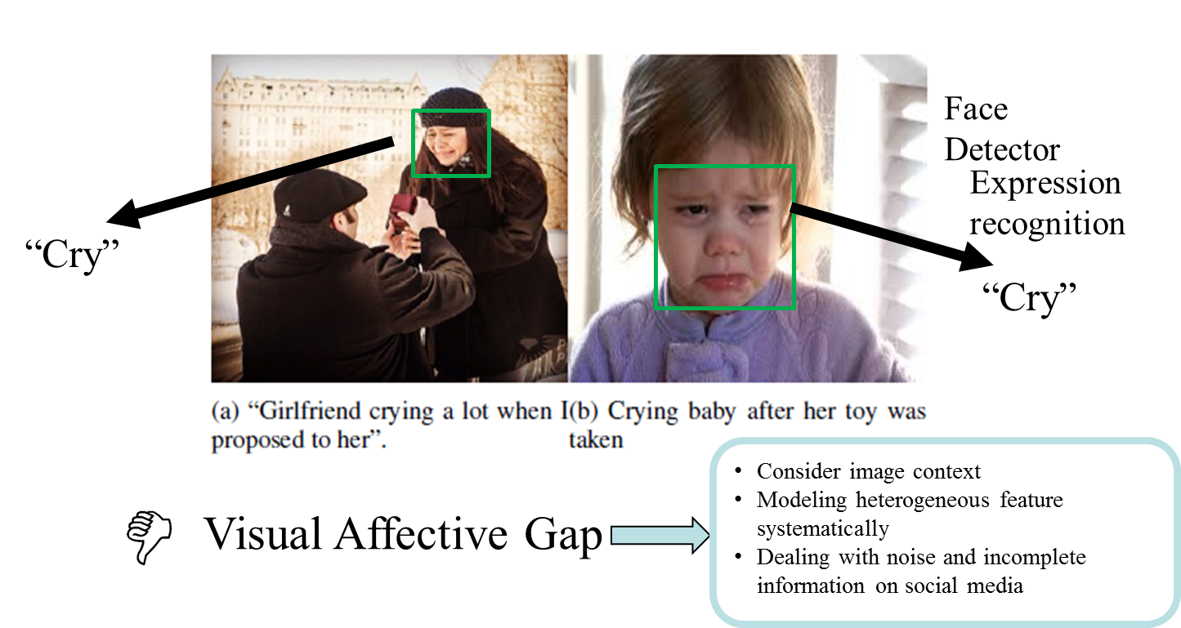
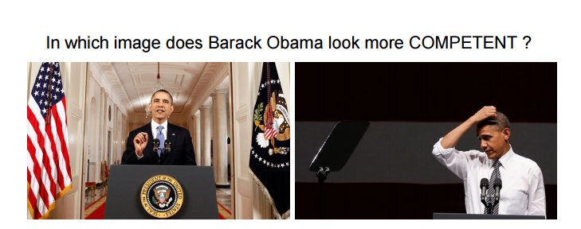
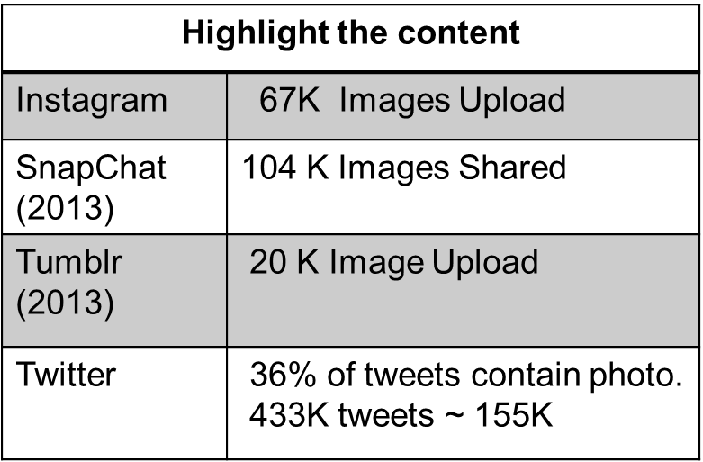
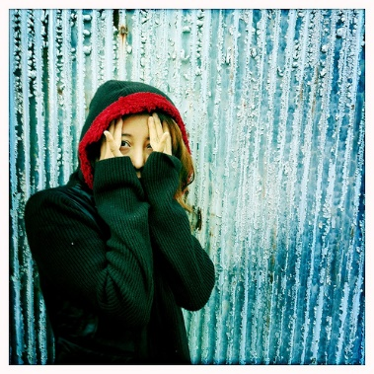

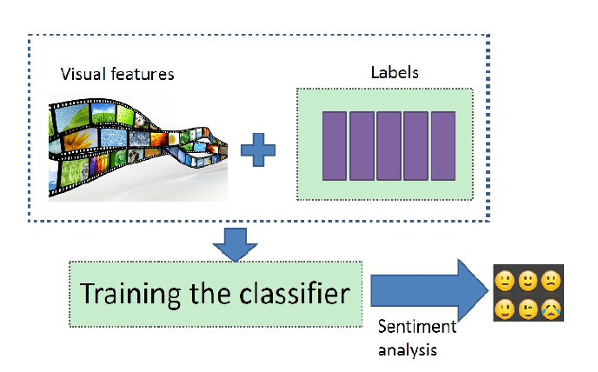
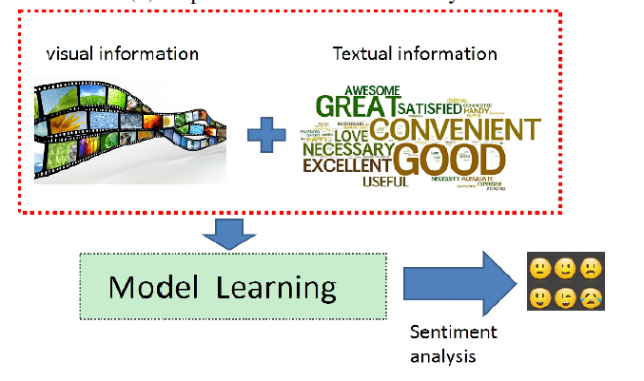
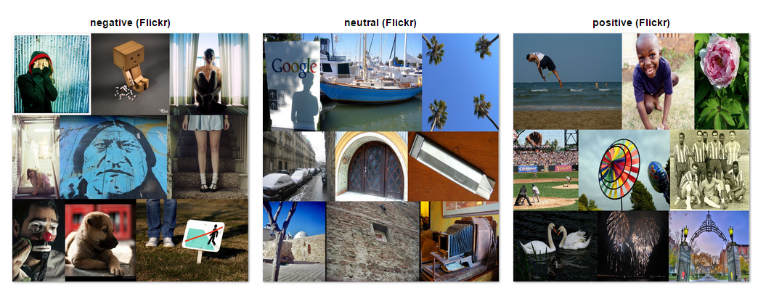
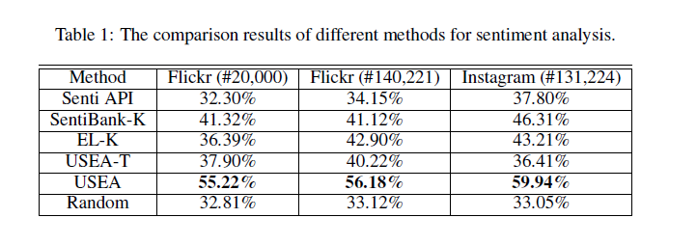

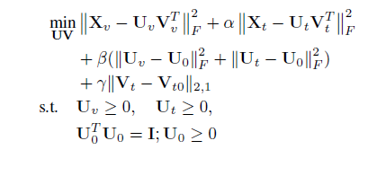
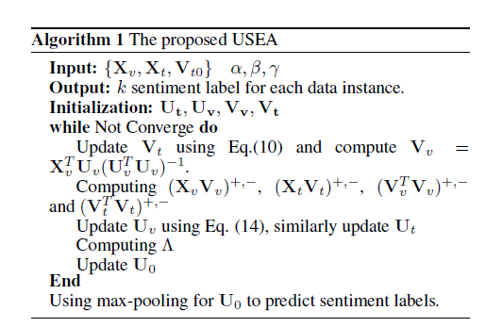
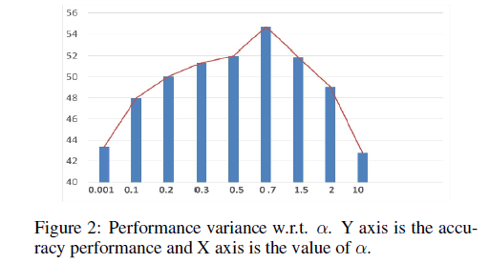
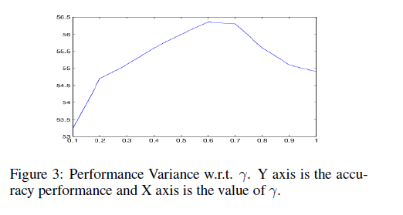
Unsupervised Sentiment Analysis for Social Media Images
Yilin Wang¹, Suhang Wang¹, Jiliang Tang² Huan Liu¹, Baoxin Li¹
¹Computer Science and Engineering, Arizona State University
²Yahoo Research, San Jose
_{MOTIVATION}
_{CHALLENGE}
Sentiment analysis is an important research area.
Product Review
supervised
Text
Sentiment VS Consumer Confidence
More desirable
Unsupervised sentiment analysis
Image
Political Campaigns
Emotional wellness ,
personalized recommendation
Unlabeled Images
_{THE PROPOSED METHOD}
_{EXPERIMENT}
(a) Supervised Sentiment Analysis
(b) Our Proposed Unsupervised Sentiment Analysis
Solution: images from social media sources are often accompanied by textual information, such information can provide much-needed additional semantic information about the underlying images, which
may be exploited to enable unsupervised sentiment analysis.
Experiment setting
Flickr: 140,221 images from 4341 users
Instagram 131,224 images from 4853 users.
Ground truth: 20000 human labeled images and the rest are
labeled with tags.
Feature extraction: Visual attribute detector and MPQA
sentiment lexicon.
Comparison: Senti Api., Sentibank-K. EL-K and USEA-T
Contributions
A principled approach to enable unsupervised sentiment analysis for social media images.
A novel unsupervised sentiment analysis framework USEA for social media images, which captures visual and textual information into a unifying model. To our best knowledge, USEA is the first unsupervised sentiment analysis framework for social media images;
Comparative studies and evaluations using datasets from real-world social media image-sharing sites, documenting the performance of USEA and leading existing methods, serving as benchmark for further exploration.
Sentiment signal
Convergence Analysis and Prior Knowledge Analysis
Acknowledgement
.
With Algorithm 1, the reconstruction error of the objective function will monotonically decrease and converge. (Theorem 1-4)
Yilin Wang and Baoxin Li are supported in part by National Science Foundation (NSF) under grant number #1135616. Suhang Wang and Huan Liu are supported by, or in part by, the National Science Foundation (NSF) under grant number #1217466 and the U.S. Army Research Office (ARO) under contract/grant number #025071. Any opinions expressed in this material are those of the authors and do not necessarily
reflect the views of the funding agencies

