Slide 1
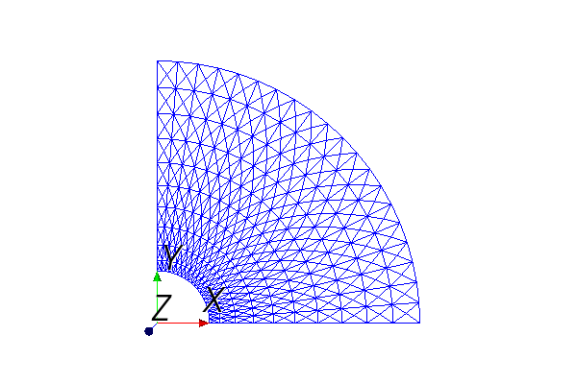
test_UserMesh-mesh.png
miCI.rmin, miCI.rmax = 1.0, 5.0 # Mesh goes from rmin to rmax in radius
miCI.nr = 10 # Number of divisions in r direction
miCI.stretch = 1.3 # Stretch parameter
# theta, starts at 0
miCI.tmax = math.pi/2 # quarter-circle
miCI.nt = 20 # Number of divisions in theta direction
# The diagonal that makes the triangular mesh
# Options: 'left, 'right', 'left/right', 'crossed'
miCI.diagonal = 'crossed'
Plot of the “mesh” object

Slide 2
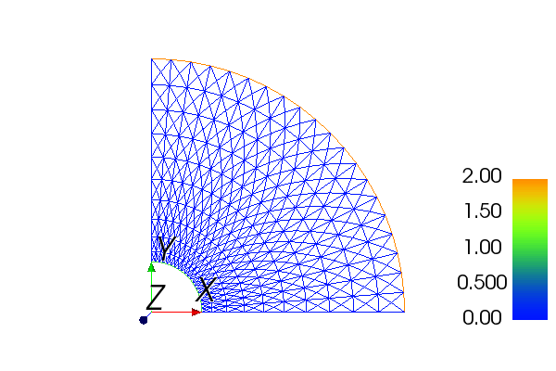
test_UserMesh-fieldBCs.png
rmin_indx = 1
rmax_indx = 2
Plot of the facet-function fieldBoundaryMarker

Slide 3
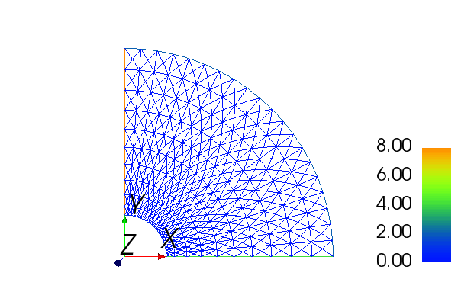
test_UserMesh-particleBCs.png
rmin_indx = 1
rmax_indx = 2
thmin_indx = 4
thmax_indx = 8
Plot of the facet-function particleBoundaryMarker

Slide 4
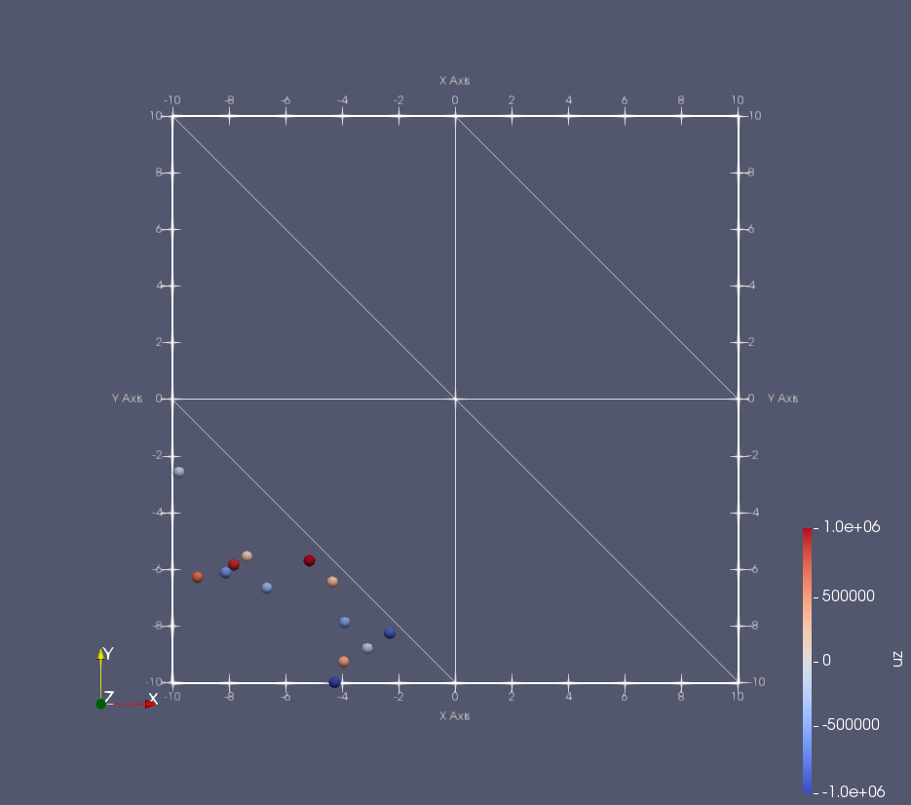
test_ParticleInitialization.png
(13 particles)

Slide 5
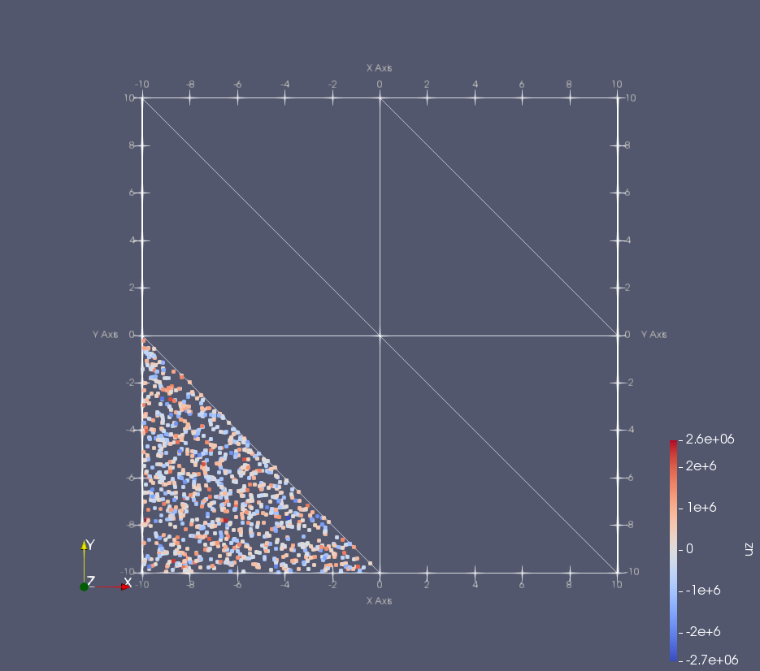
test_ParticleInitialization.png
(1000 particles)

Slide 6
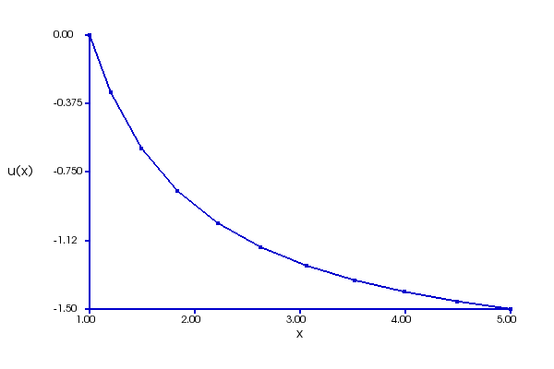
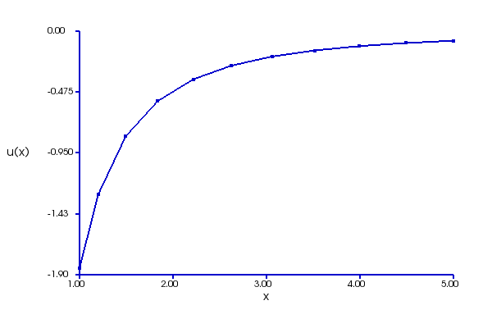
test_FieldSolve.py: test_1_1D_spherical_laplace_solver
φ(r) (V)
–E_{r}(r) (V/m)

Slide 7
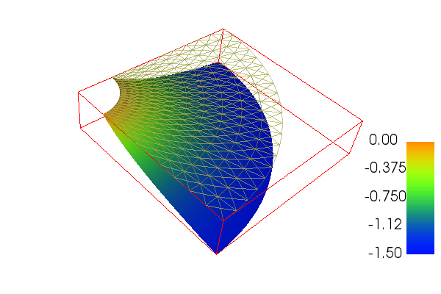
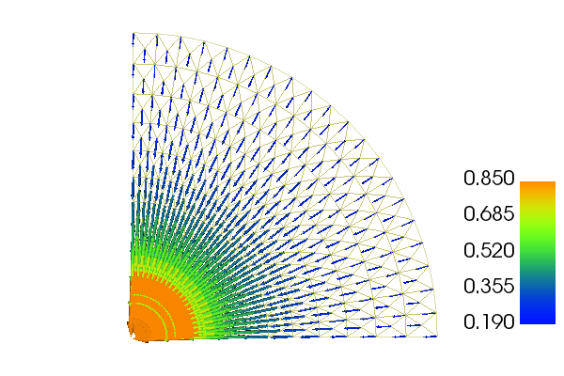
test_FieldSolve.py: test_2_2D_cyl_laplace_solver
φ(x,y) (V)
–E(x,y) (V/m)

Slide 8
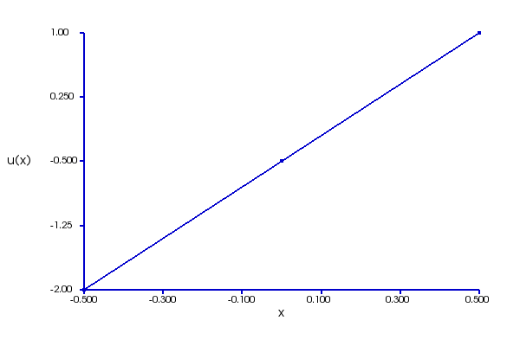
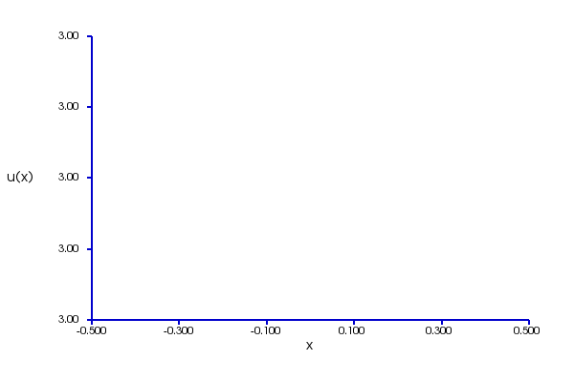
test_FieldSolve.py: test_3_1D_poisson_solver: without source term.
φ(x) (V)
–E_{x}(r) (V/m)
3 (V/m)

Slide 9
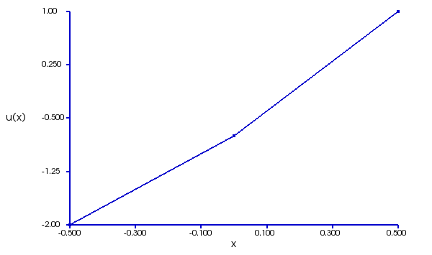
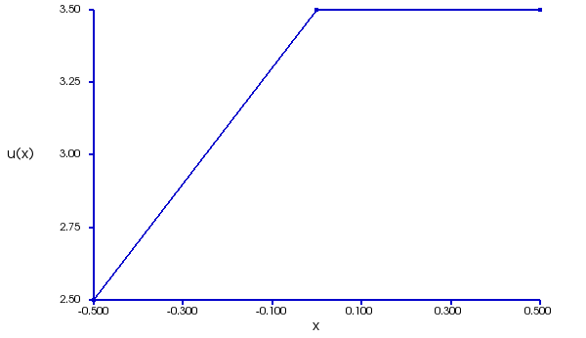
test_FieldSolve.py: test_3_1D_poisson_solver: with source term
φ(x) (V)
Source causes a jump of 1 V/m
in E_{x}.
–E_{x}(r) (V/m)
3 (V/m)

Slide 10
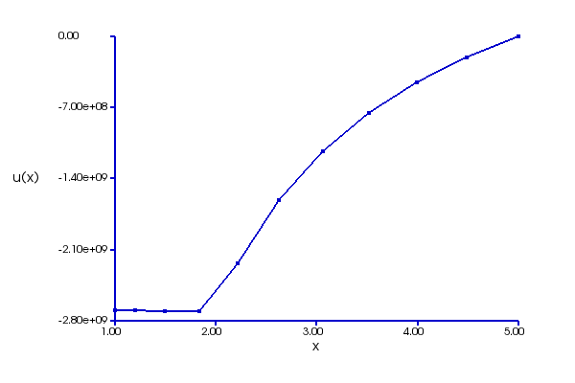
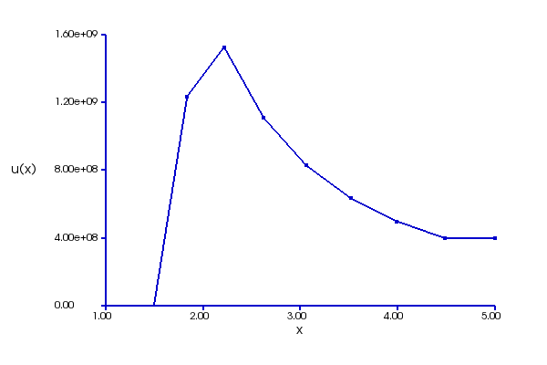
test_FieldSolve.py: test_4_1D_poisson_solver: with source term
φ(r) (V)
spherical coordinate
-1 C shell at r = 2 m
Big slope changes at the nodes where the particle contributes charge
–E_{x}(r) (V/m)

Slide 11
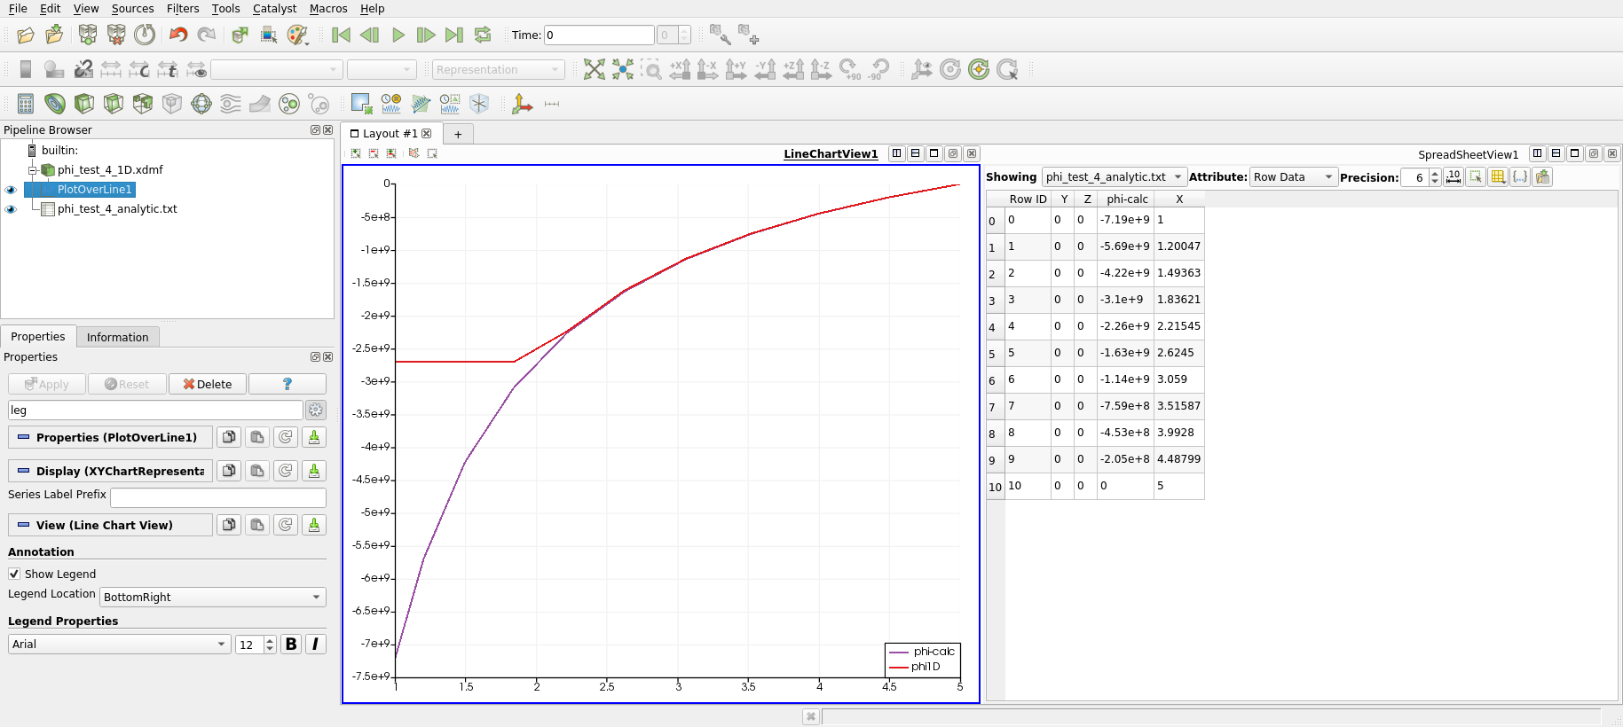
test_FieldSolve.py: test_4_1D_poisson_solver: with source term
phi_test_4_analytic.txt
X, Y, Z, phi-calc
1, 0, 0, -7.19E+009
1.20047489345091, 0, 0, -5.69E+009
1.49362709017601, 0, 0, -4.22E+009
1.83621436232314, 0, 0, -3.10E+009
2.2154524686918, 0, 0, -2.26E+009
2.62450479271247, 0, 0, -1.63E+009
3.05900128106583, 0, 0, -1.14E+009
3.51586563701379, 0, 0, -7.59E+008
3.99279503303239, 0, 0, -4.53E+008
4.48799018031015, 0, 0, -2.05E+008
5, 0, 0, 0.00E+000
1. Read using Delimited Text reader with default settings
2. Plot using X as X Array Name, phi_calc as Y.
3. See test_FieldSolver_test_4.pvsm

Slide 12
test_FieldSolve.py: test_4_1D_poisson_solver: with source term

Slide 13
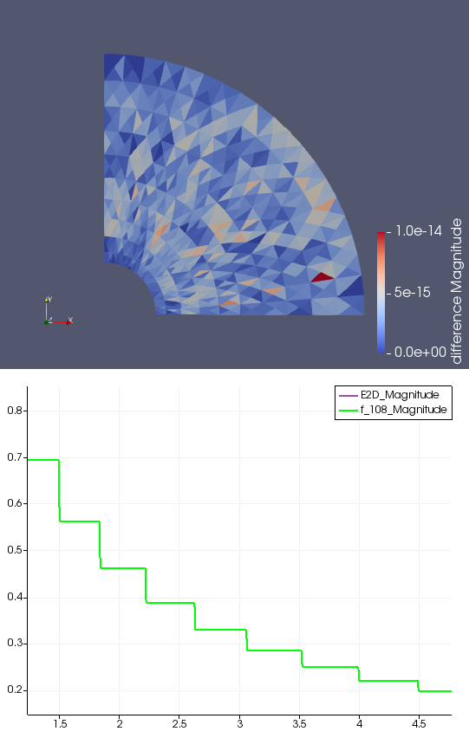
Compares newer and older E-field from quarter-circle
Almost identical, but produces much larger difference in particle orbit

Slide 14
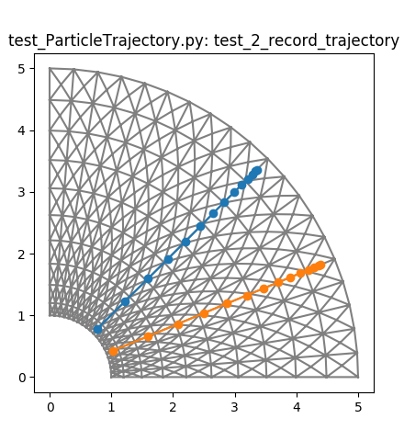

test_ParticleTrajectory.py vs. test_cpp_ParticleTrajectory.py

Slide 15
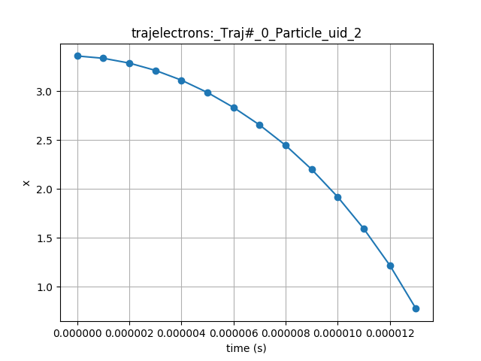
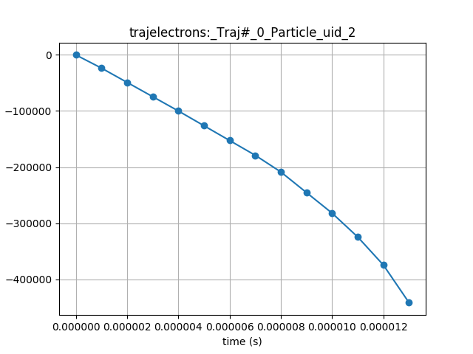
test_ParticleTrajectory.py vs. test_cpp_ParticleTrajectory.py

Slide 16


test_ParticleTrajectory.py vs. test_cpp_ParticleTrajectory.py

Slide 17
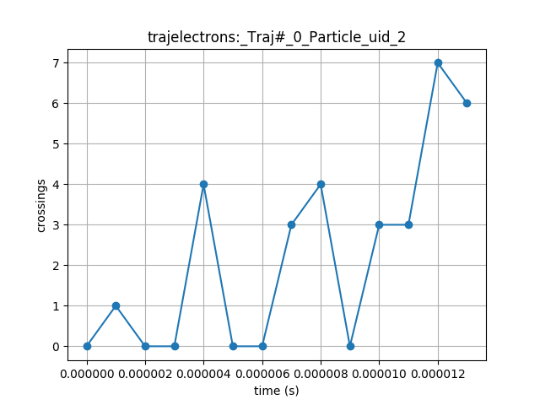
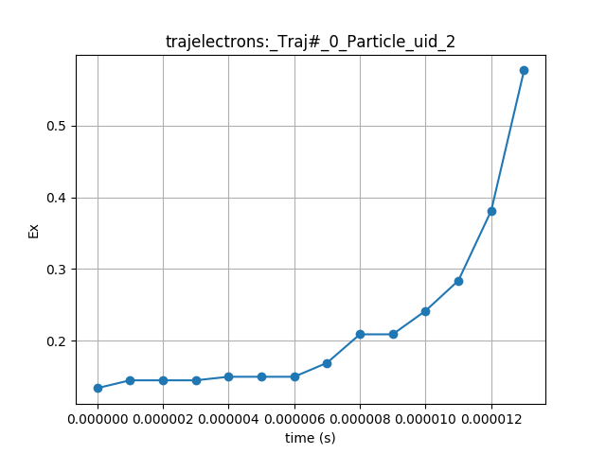
test_ParticleTrajectory.py vs. test_cpp_ParticleTrajectory.py

Slide 18
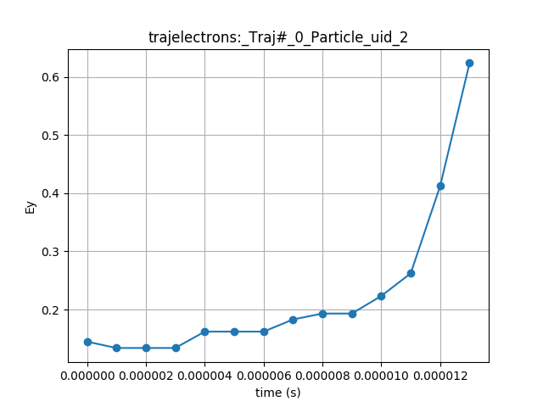
test_ParticleTrajectory.py vs. test_cpp_ParticleTrajectory.py

Slide 19
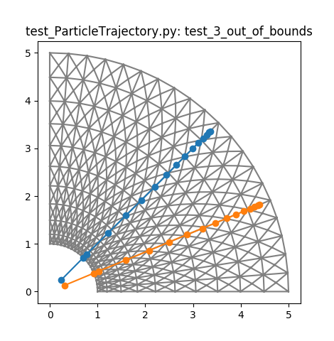
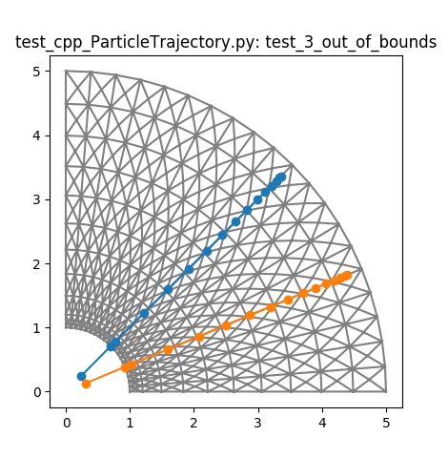
test_ParticleTrajectory.py vs. test_cpp_ParticleTrajectory.py

Slide 20
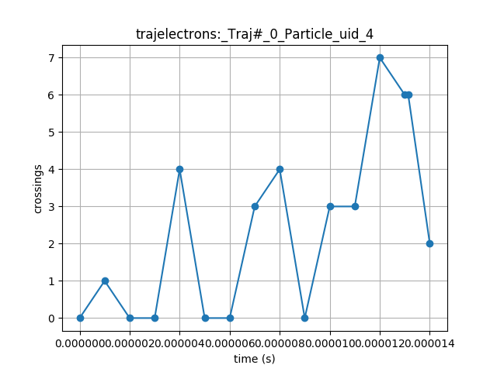
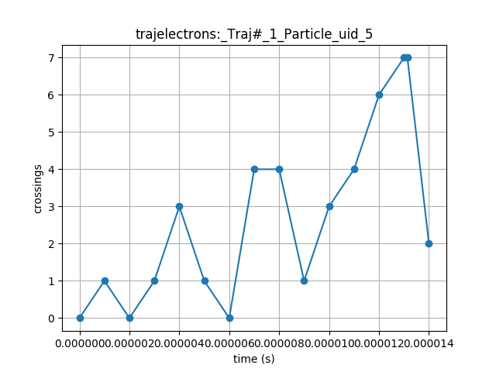
test_ParticleTrajectory.py vs. test_cpp_ParticleTrajectory.py

Slide 21
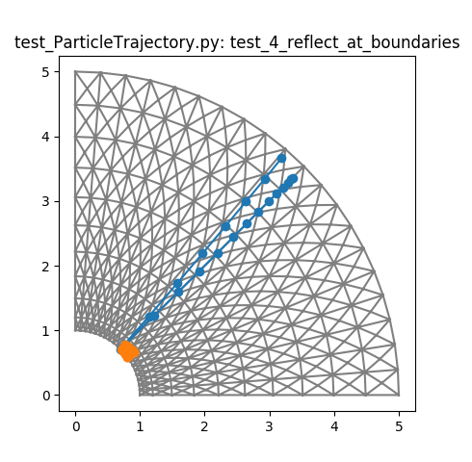

test_ParticleTrajectory.py vs. test_cpp_ParticleTrajectory.py

Slide 22
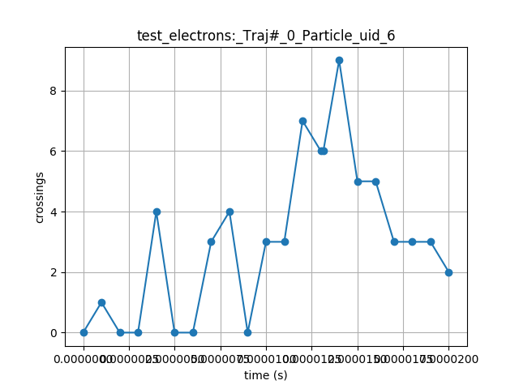
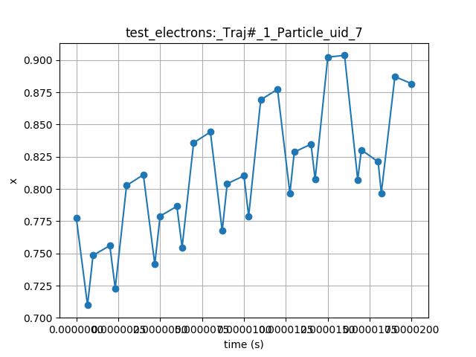
test_ParticleTrajectory.py vs. test_cpp_ParticleTrajectory.py

Slide 23
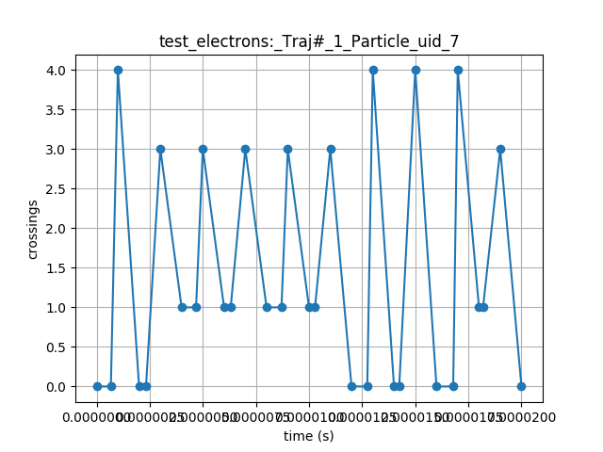
test_ParticleTrajectory.py vs. test_cpp_ParticleTrajectory.py

