Slide 1
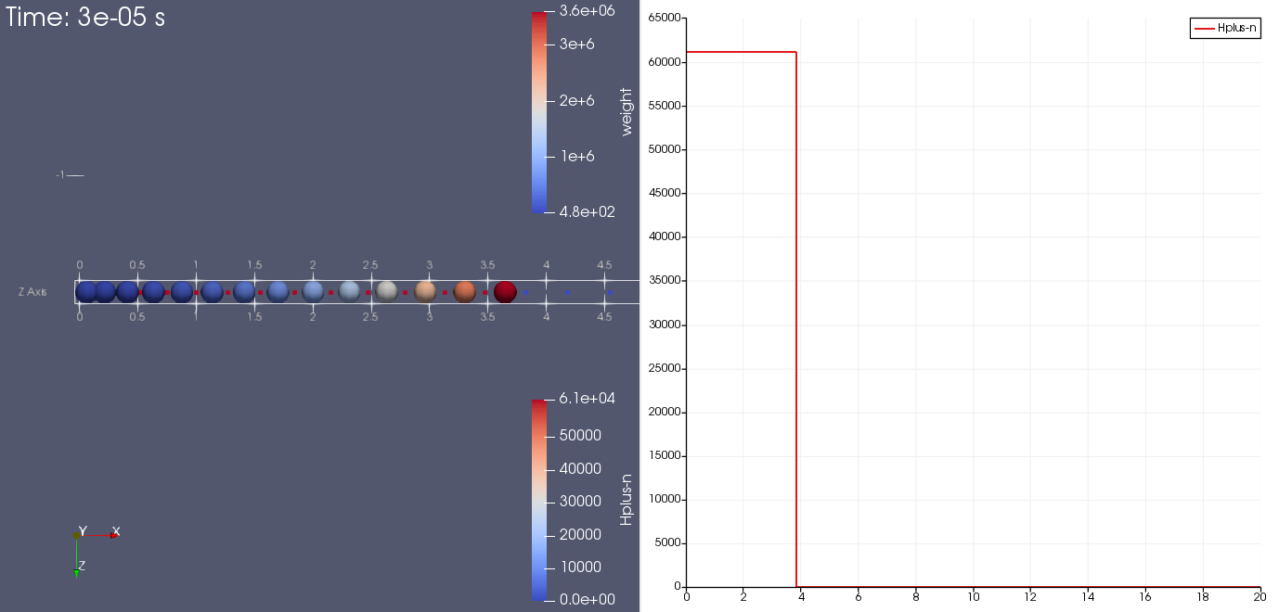
n=1 output from ion-test.py
The ions were moving out of the creation region in one step
No particles are present at n=0.
New particles were created after the push, so they haven’t moved yet.
Input specifies a density, and 1 particle/cell. So the particle ‘weight’ increases with radius.
Density should be 1.727E+06 per m3
Notes:
ion-test-Hplus.xdmf:
Axis Grid is on for the ion density
Mesh: use “Points” rep to get a dot at the cell boundaries.
ion-test.h5part:
Particles: sphere glyph, radius=0.1, colored by weight.

Slide 2
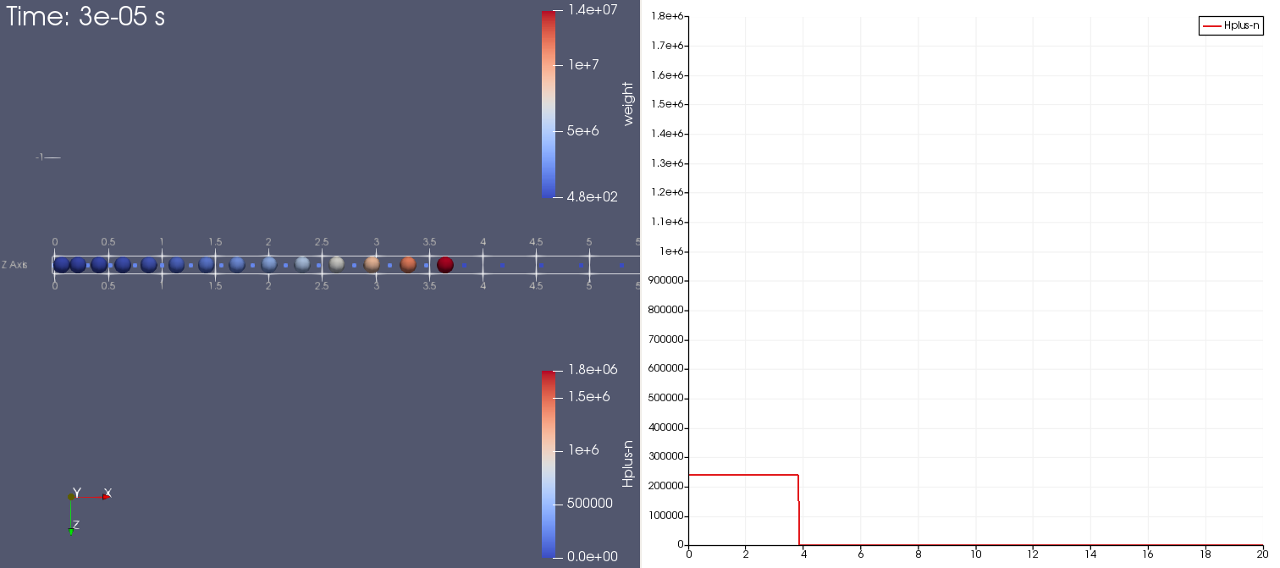
Initialization of ion-test.py: reduced ion speed by factor of 10
Now get correct density build-up.
Source rmax=3.83
(cell boundary)

Slide 3
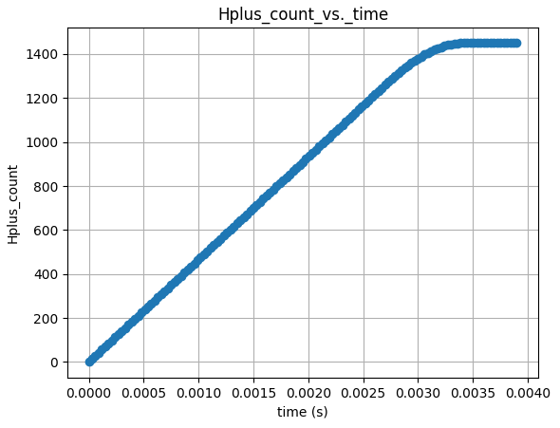
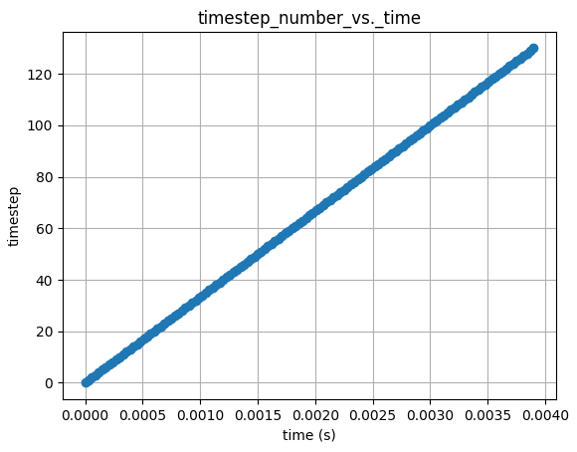
Steady-state is reached in > 100 steps
130 steps

Slide 4
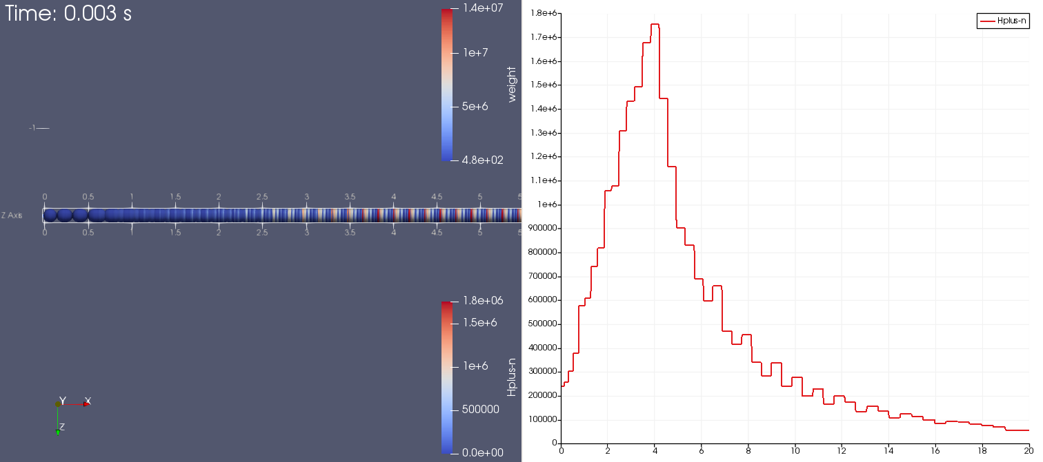
Step 130 of ion-test.py: steady state reached
Sphere1D.ods predicts peak density =1.73×10⁶

