Slide 1
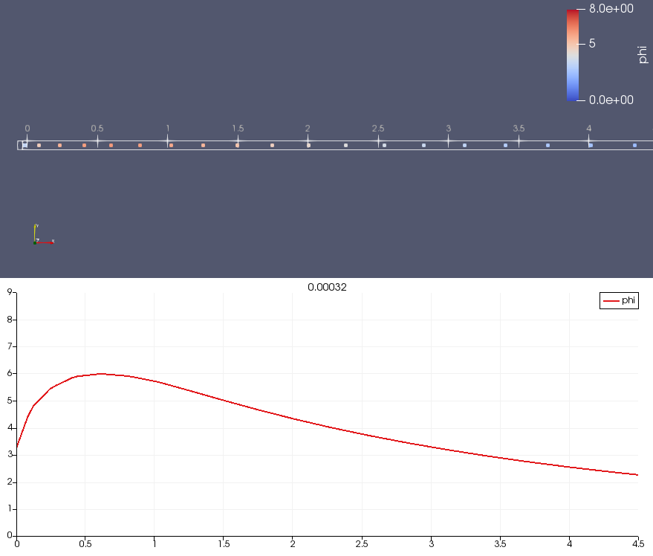
Zoom on source region
Source: 5 cells
Notes:
Source region is from 0 to 0.8 m, over 5 cells
Multiplier of ion sound speed = 10

Slide 2
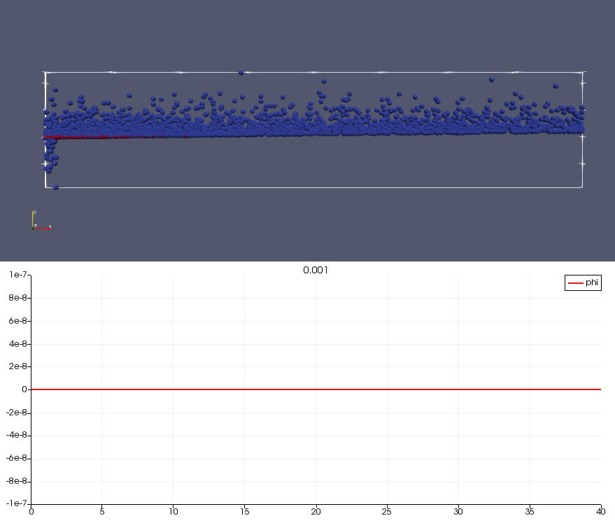
Slow electrons never get out here!
They sort themselves by speed
Notes:
I set the ion-drift-multiplier to zero. This caused the particle weights to become zero and so no electric field is generated!

Slide 3
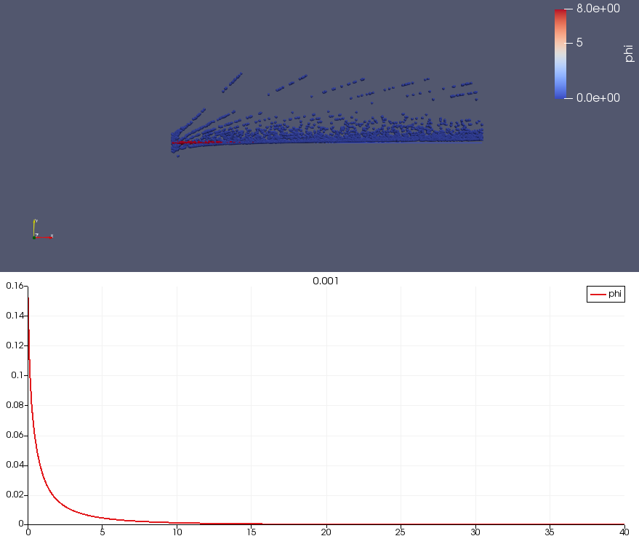
Notes:
Te = 0.01 eV. The ‘spray’ is the over-accelerated electrons

Slide 4
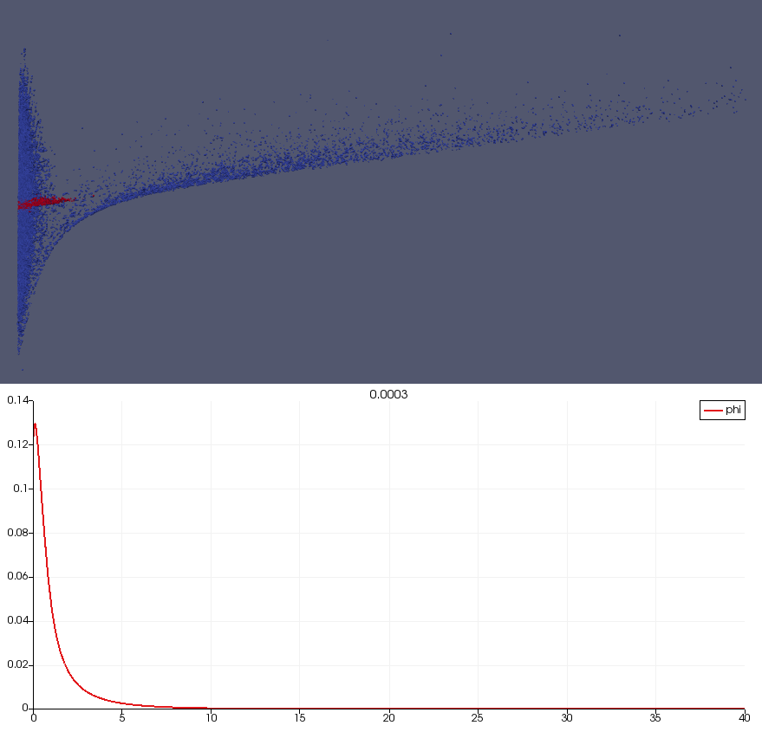
run1
N=300
Ion accumulation near r=0 accelerates electrons
Notes:
Cut timestep by 10

Slide 5
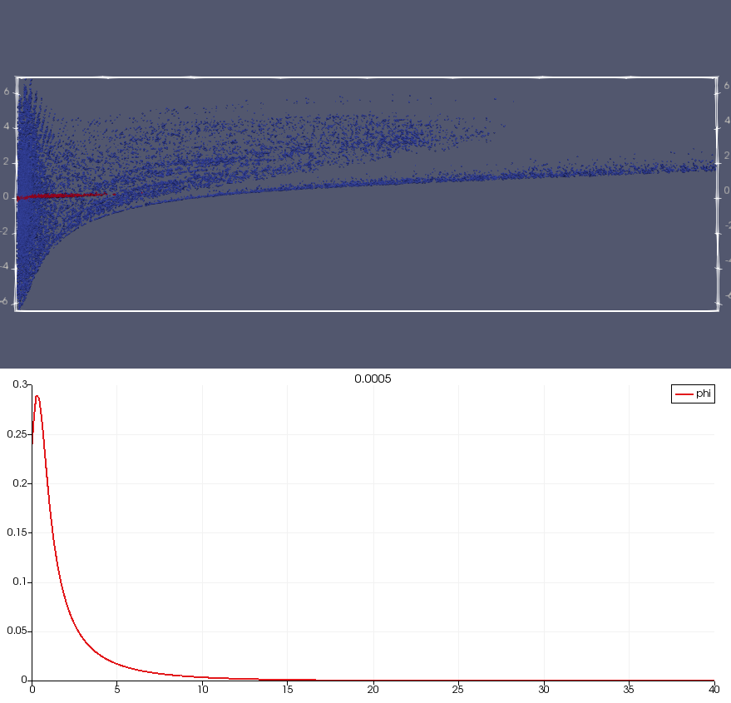
N=500

Slide 6
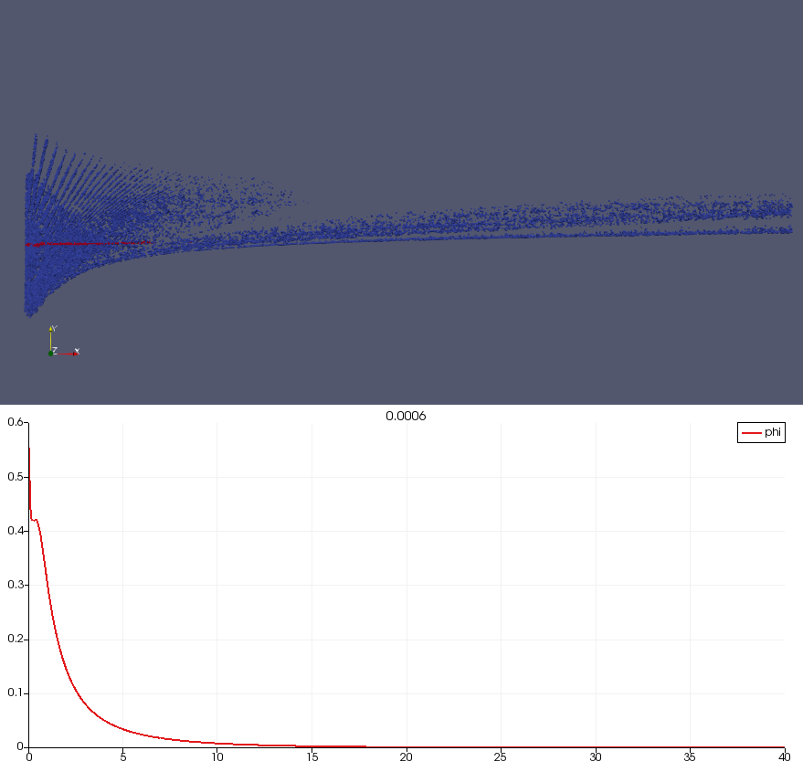
N=600
Numerical acceleration near r=0
On-axis spike has appeared; leads to above

Slide 7
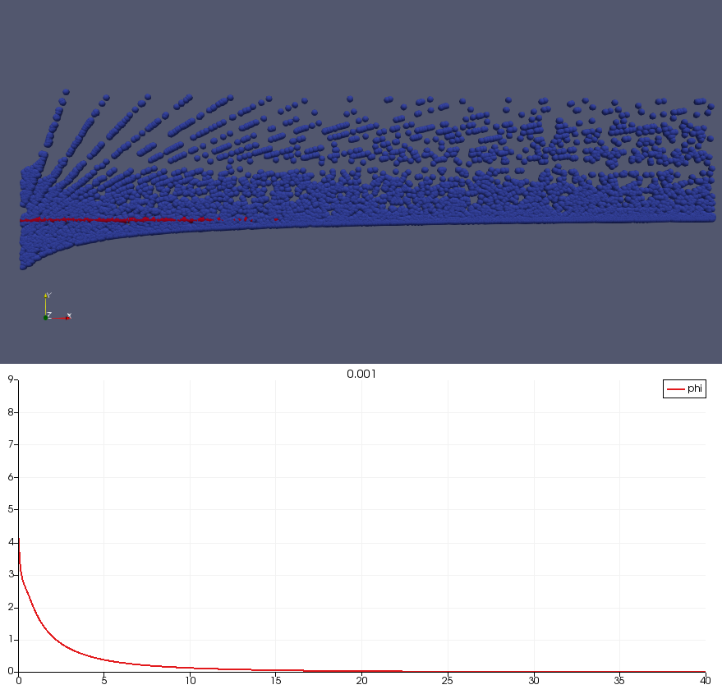
run1
N=1000
Numerical acceleration of electrons dominates
Notes:
Reduced timestep by 10. Ran to 1000 steps.

Slide 8
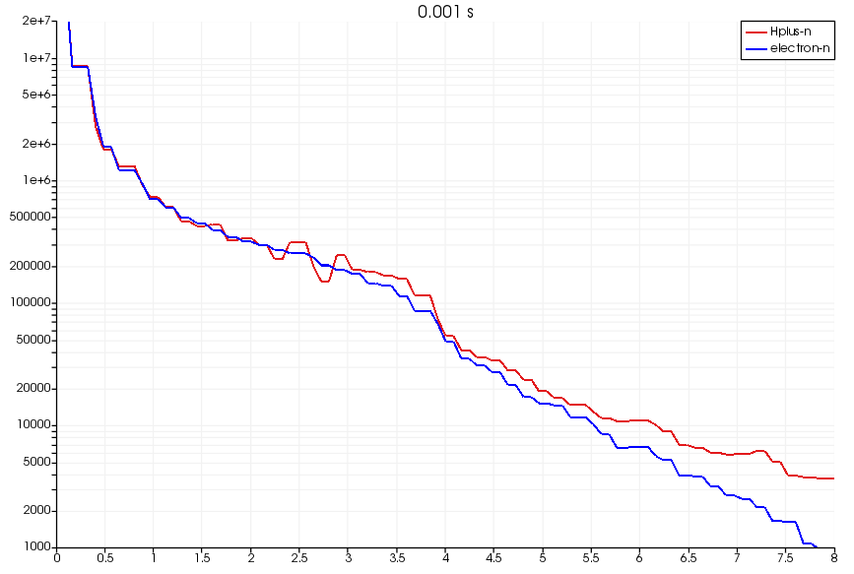
sphere1D/runs/14oct18
1000 steps; dt=1e-6 s
Density climbs in center. May be reaching equilibrium, or may need some heating.
Need a diagnostic to check the temperature & flux.
Notes:
Plot used sphere1D-ne-ni.pvsm
Input summary:
2 cell/Debye length. 25 Debye lengths in region. Uniform mesh.
timestep=1e-6 s is slightly over vstream=0.3.
Ion mass is 100 electrons.
3 electrons per cell; 1 ion per cell.
Potential is flat at r=0.
Applied random E-field is zero.

Slide 9
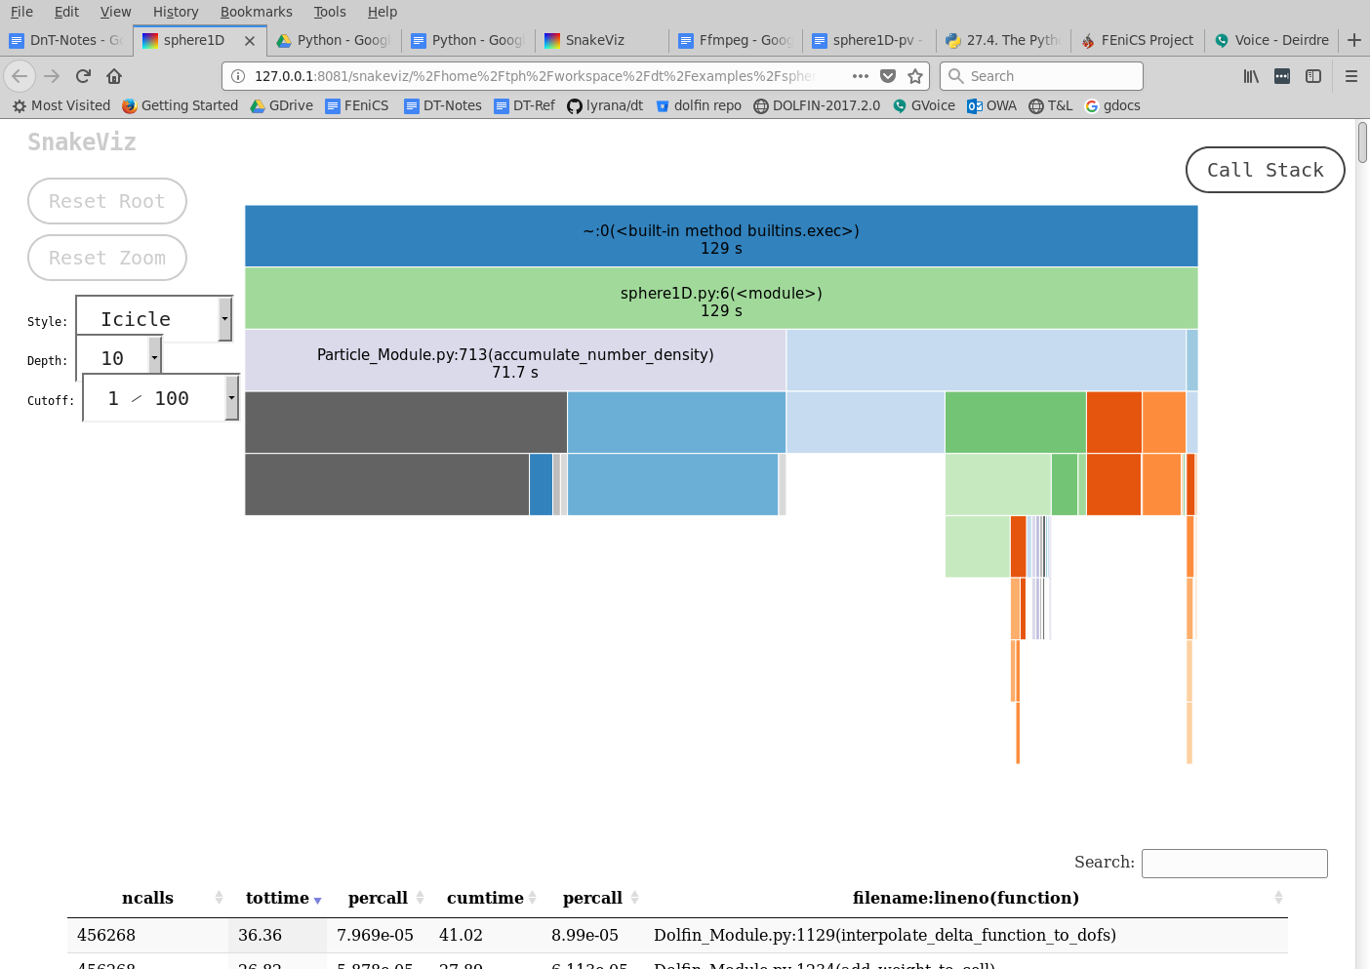
Notes:
Profile with most terminal output turned off.

Slide 10
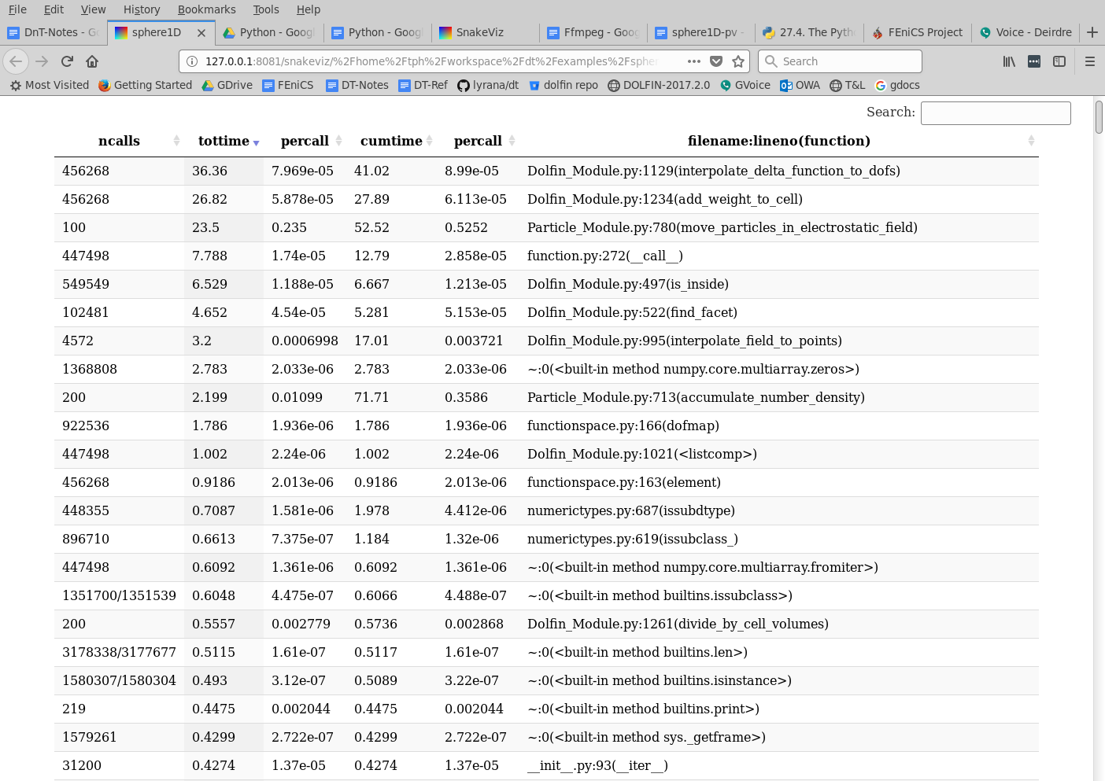
Notes:
Times for previous page plot.

Slide 11
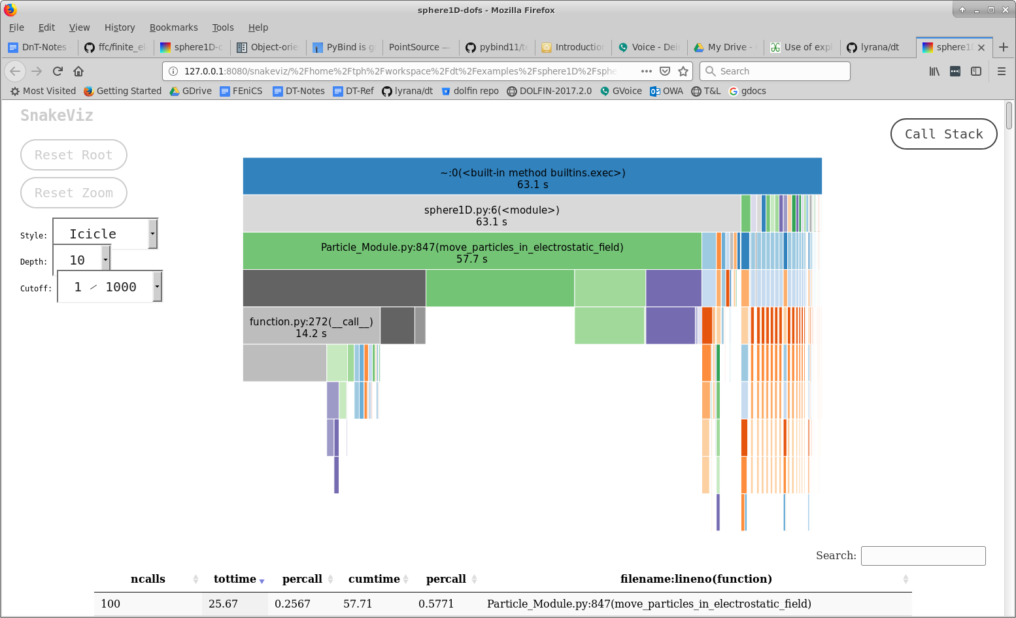
Using C++ functions, the particle density calculations are almost negligible!

Slide 12
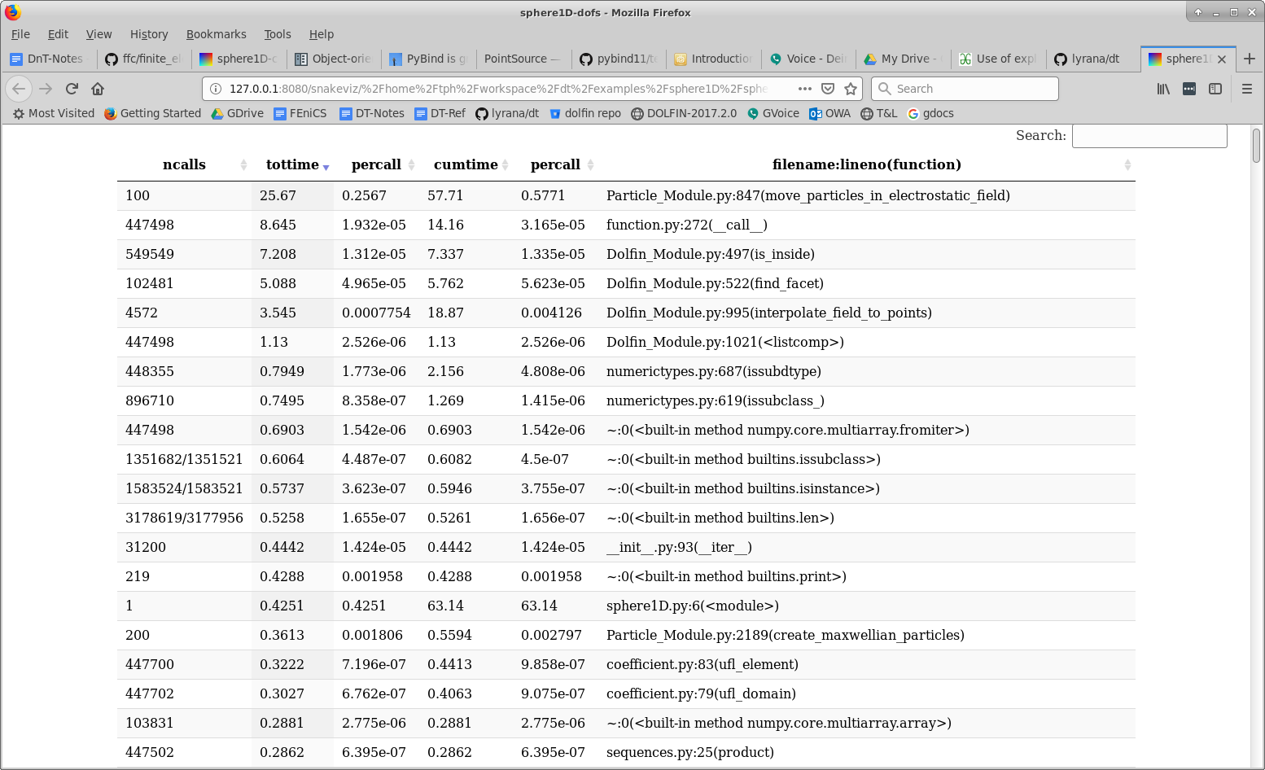
Using C++ functions, the particle density calculations are almost negligible!

