Slide 1
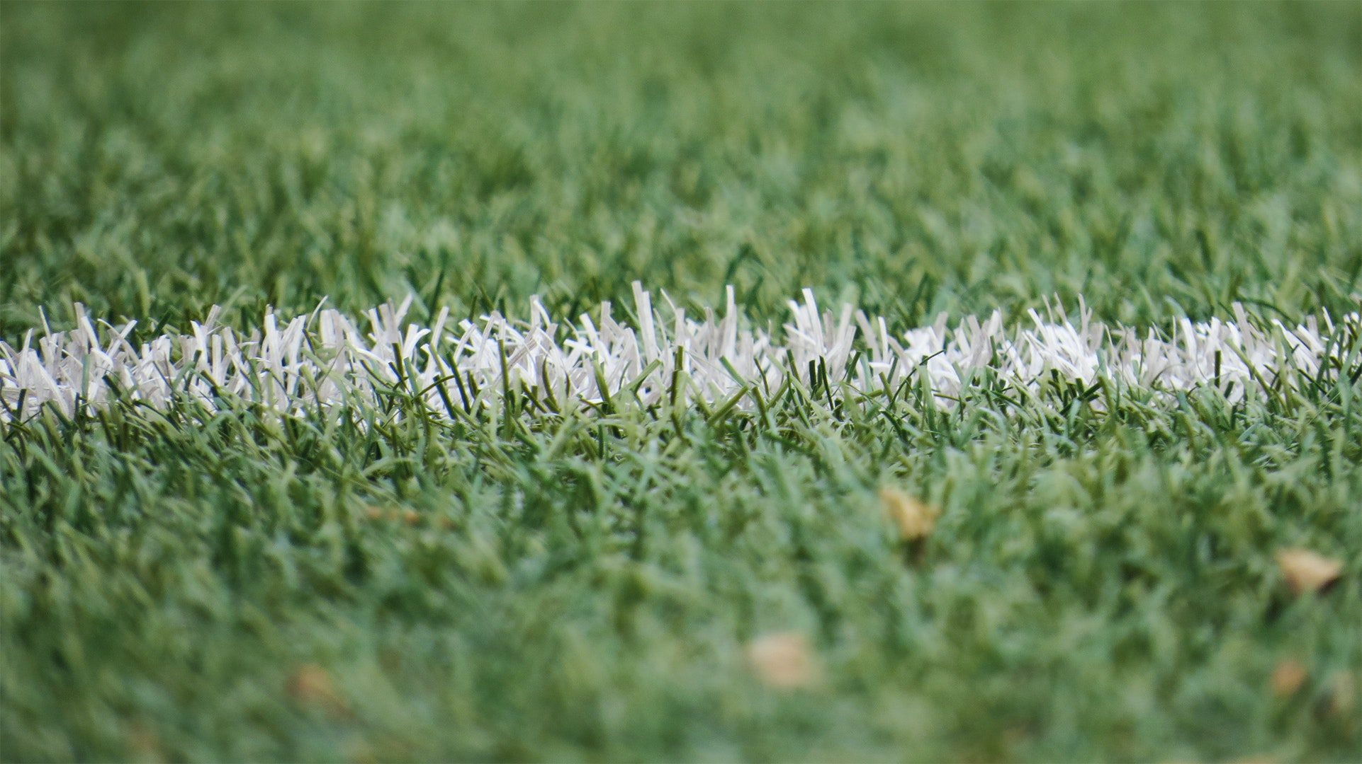
AUSTRALIAN SPORTS QUIZ

Slide 2
It is not possible to know Australia without knowing about the rich sporting culture that exists in the country.
Cricket, Soccer, Football, Rugby, Basketball.. Name the sport and Australians excel at it!
Let us go quiz you through some interesting facts about sport in Australia so that you learn more..

Slide 3
Do you know what is the national sport of Australia?

Slide 4
Australia, with its rich sporting culture does not have an official national sport, even though many consider Cricket and Australian Rules Football as games of national importance.

Slide 5
So your mate decides to be nice and buys a couple of tickets and asks you to go for a “footy game”, what sport would you be heading down to watch? (hopefully with some hotdog and a beer) ?

Slide 6
Australian Rules Football or ‘Footy’, is an Australian sport through and through..
Initially known as Melbourne or Victorian Rules football, this sport is one of the most popular and engaging sports in the country!

Slide 7
The ‘Ashes’ brings out a very competitive edge between the Australian Cricket Team and which other country?

Slide 8
After Australia had won its first Test Match on English soil in 1882, a newspaper stated that English cricket died and that their body would be cremated and the ‘ashes taken to Australia’. This is how the famous tournament got its name that we know today.

Slide 9
The ‘Wallabies’, apart from and endearingly cute species of Animals, is also the nickname given to the Australian team playing what sport?

Slide 10
The ‘Wallabies’, apart from and endearingly cute species of Animals, is also the nickname given to the Australian team playing what sport?

Slide 11
The ‘Wallabies’, apart from and endearingly cute species of Animals, is also the nickname given to the Australian team playing what sport?

Slide 12
In reference to the ‘Wallabies’, which is a marsupial that is found throughout Australia, the Australian Rugby team was given this nickname.

Slide 13
Did you know there was a city in Australia also called as the ‘Sporting Capital of the World’?

Slide 14
Melbourne, with its rich sporting culture is also known as the Sporting Capital of the world. From the MCG, the Melbourne Cup and the ALF Cup final to name a few, the sporting calendar in the city is always exciting for any sporting fans to indulge themselves in.

Slide 15
X is a sport that is conducted in various countries around the world in the calendar year and currently starts its season in Australia. Identify X.

Slide 16
Trick question, there are two answers. Formula 1 and the Australian Open are just two of the major international sporting events that use the Australian Summer to kickstart their international calendars!

Slide 17
If you are in Victoria, you would be getting a public holiday for the ‘Melbourne Cup’.
Which sport is it associated with?

Slide 18
The great ‘Melbourne Cup’ Holiday that all of us enjoy is all about enjoying annual horse racing that has been a tradition of the Melbournian culture for years now!

