Slide 1
BWMon
-- Building Extensible Mobile Applications for Monitoring Large HPC Resources
Mentor: Michael Showerman
Student: Yushuo Lin

Slide 2
Project Motivation

Slide 3
Project Goal
This project will allow users to access Blue Waters information services everywhere with their Android devices. Also the application will provide a visualization for each data feed user select.
This project will allow users to set alarm for every data feed. User will be able to provide a condition about when the application should send an alert to the user.

Slide 4
System actitecture
BWMon
Data Feeds List
Feeds Detail
User
DownloadFeedsTasks()
FeedsList
For each Feed
DownloadFeedsDetailsTask()
DataFeed

Slide 5
Implemented Features
Select data feeds and visualize the data
Set data feeds auto sync period
Set data feeds display color

Slide 6
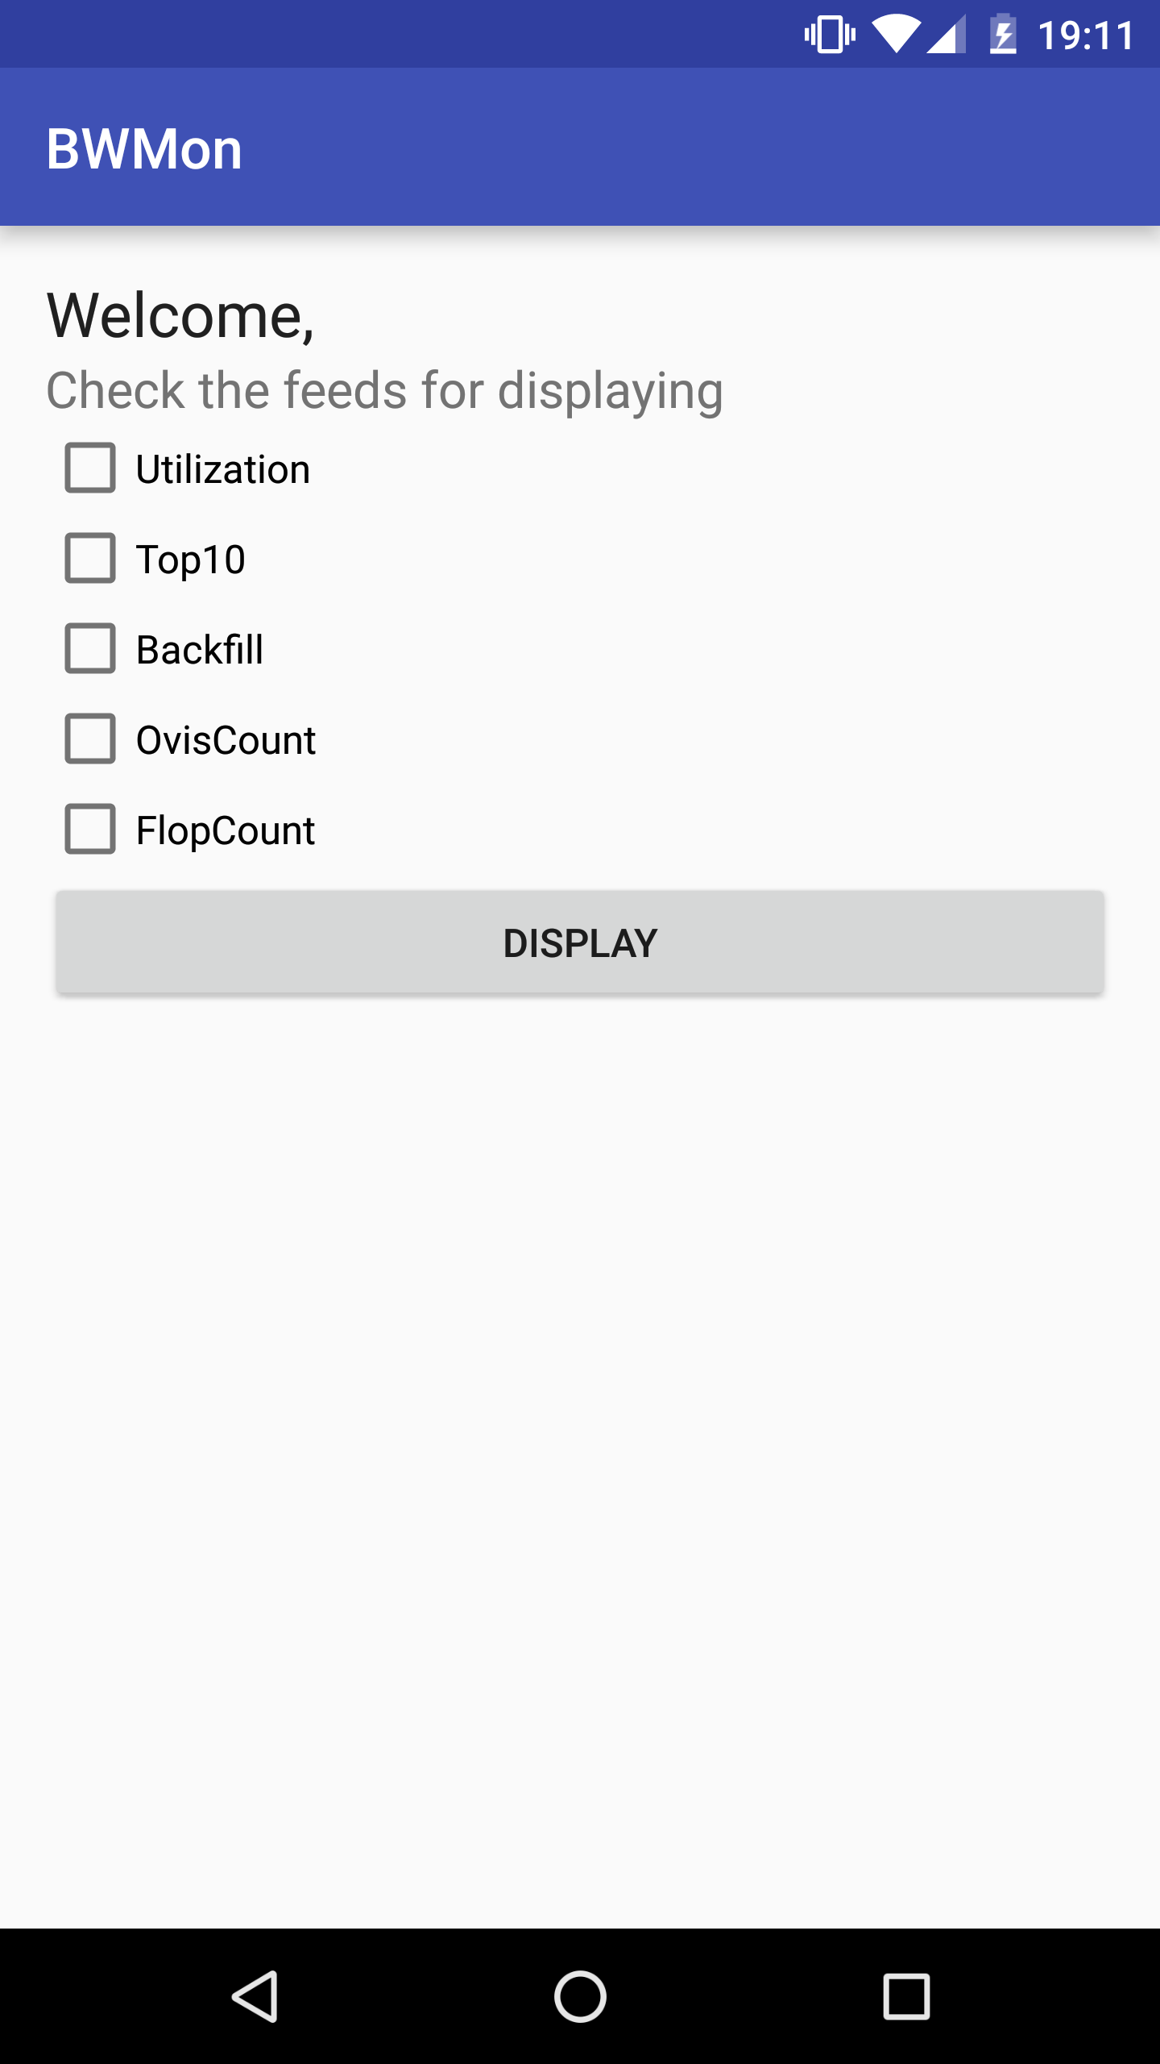
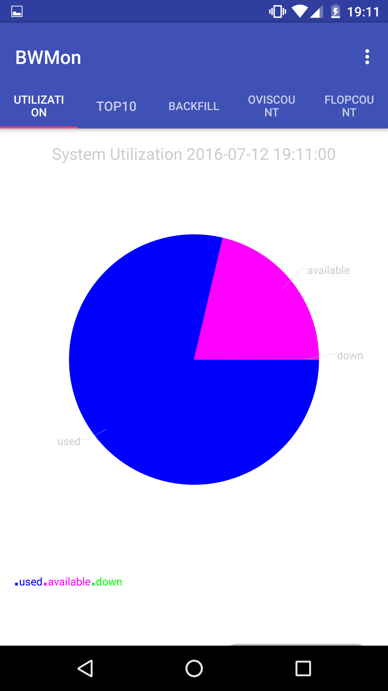
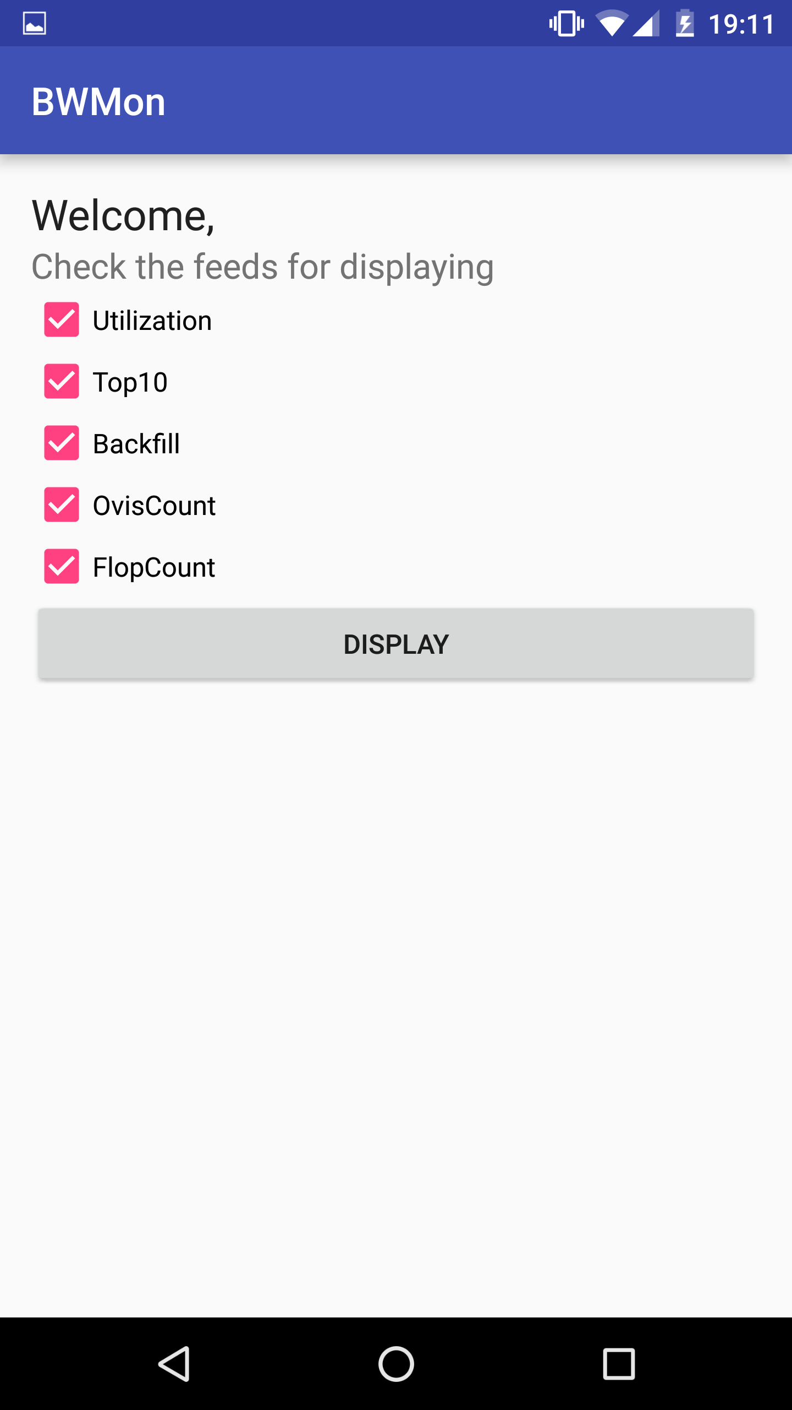
1. a) Select data feeds

Slide 7
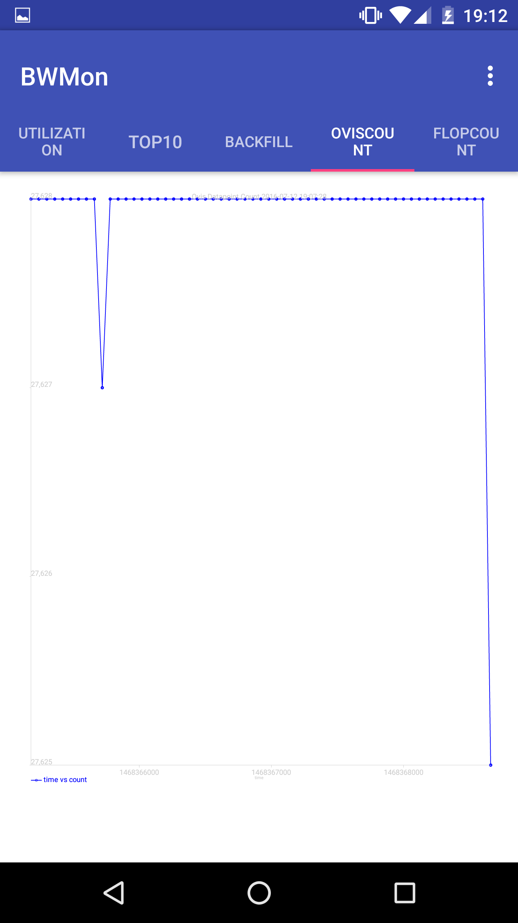
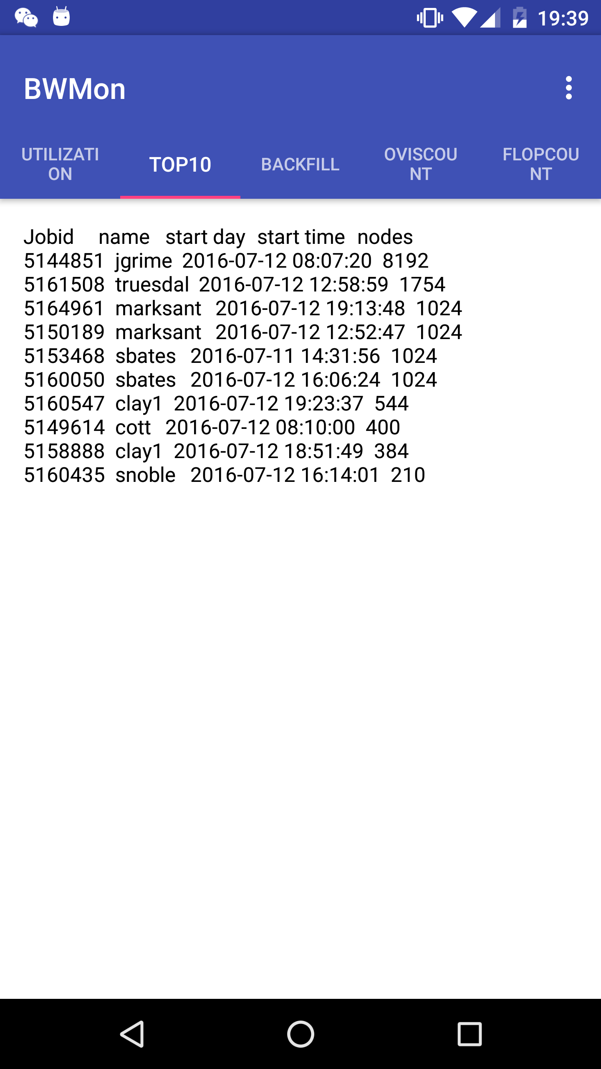
1. b) Visualize the data
Pie Chart
Line Chart
Plain Text

Slide 8
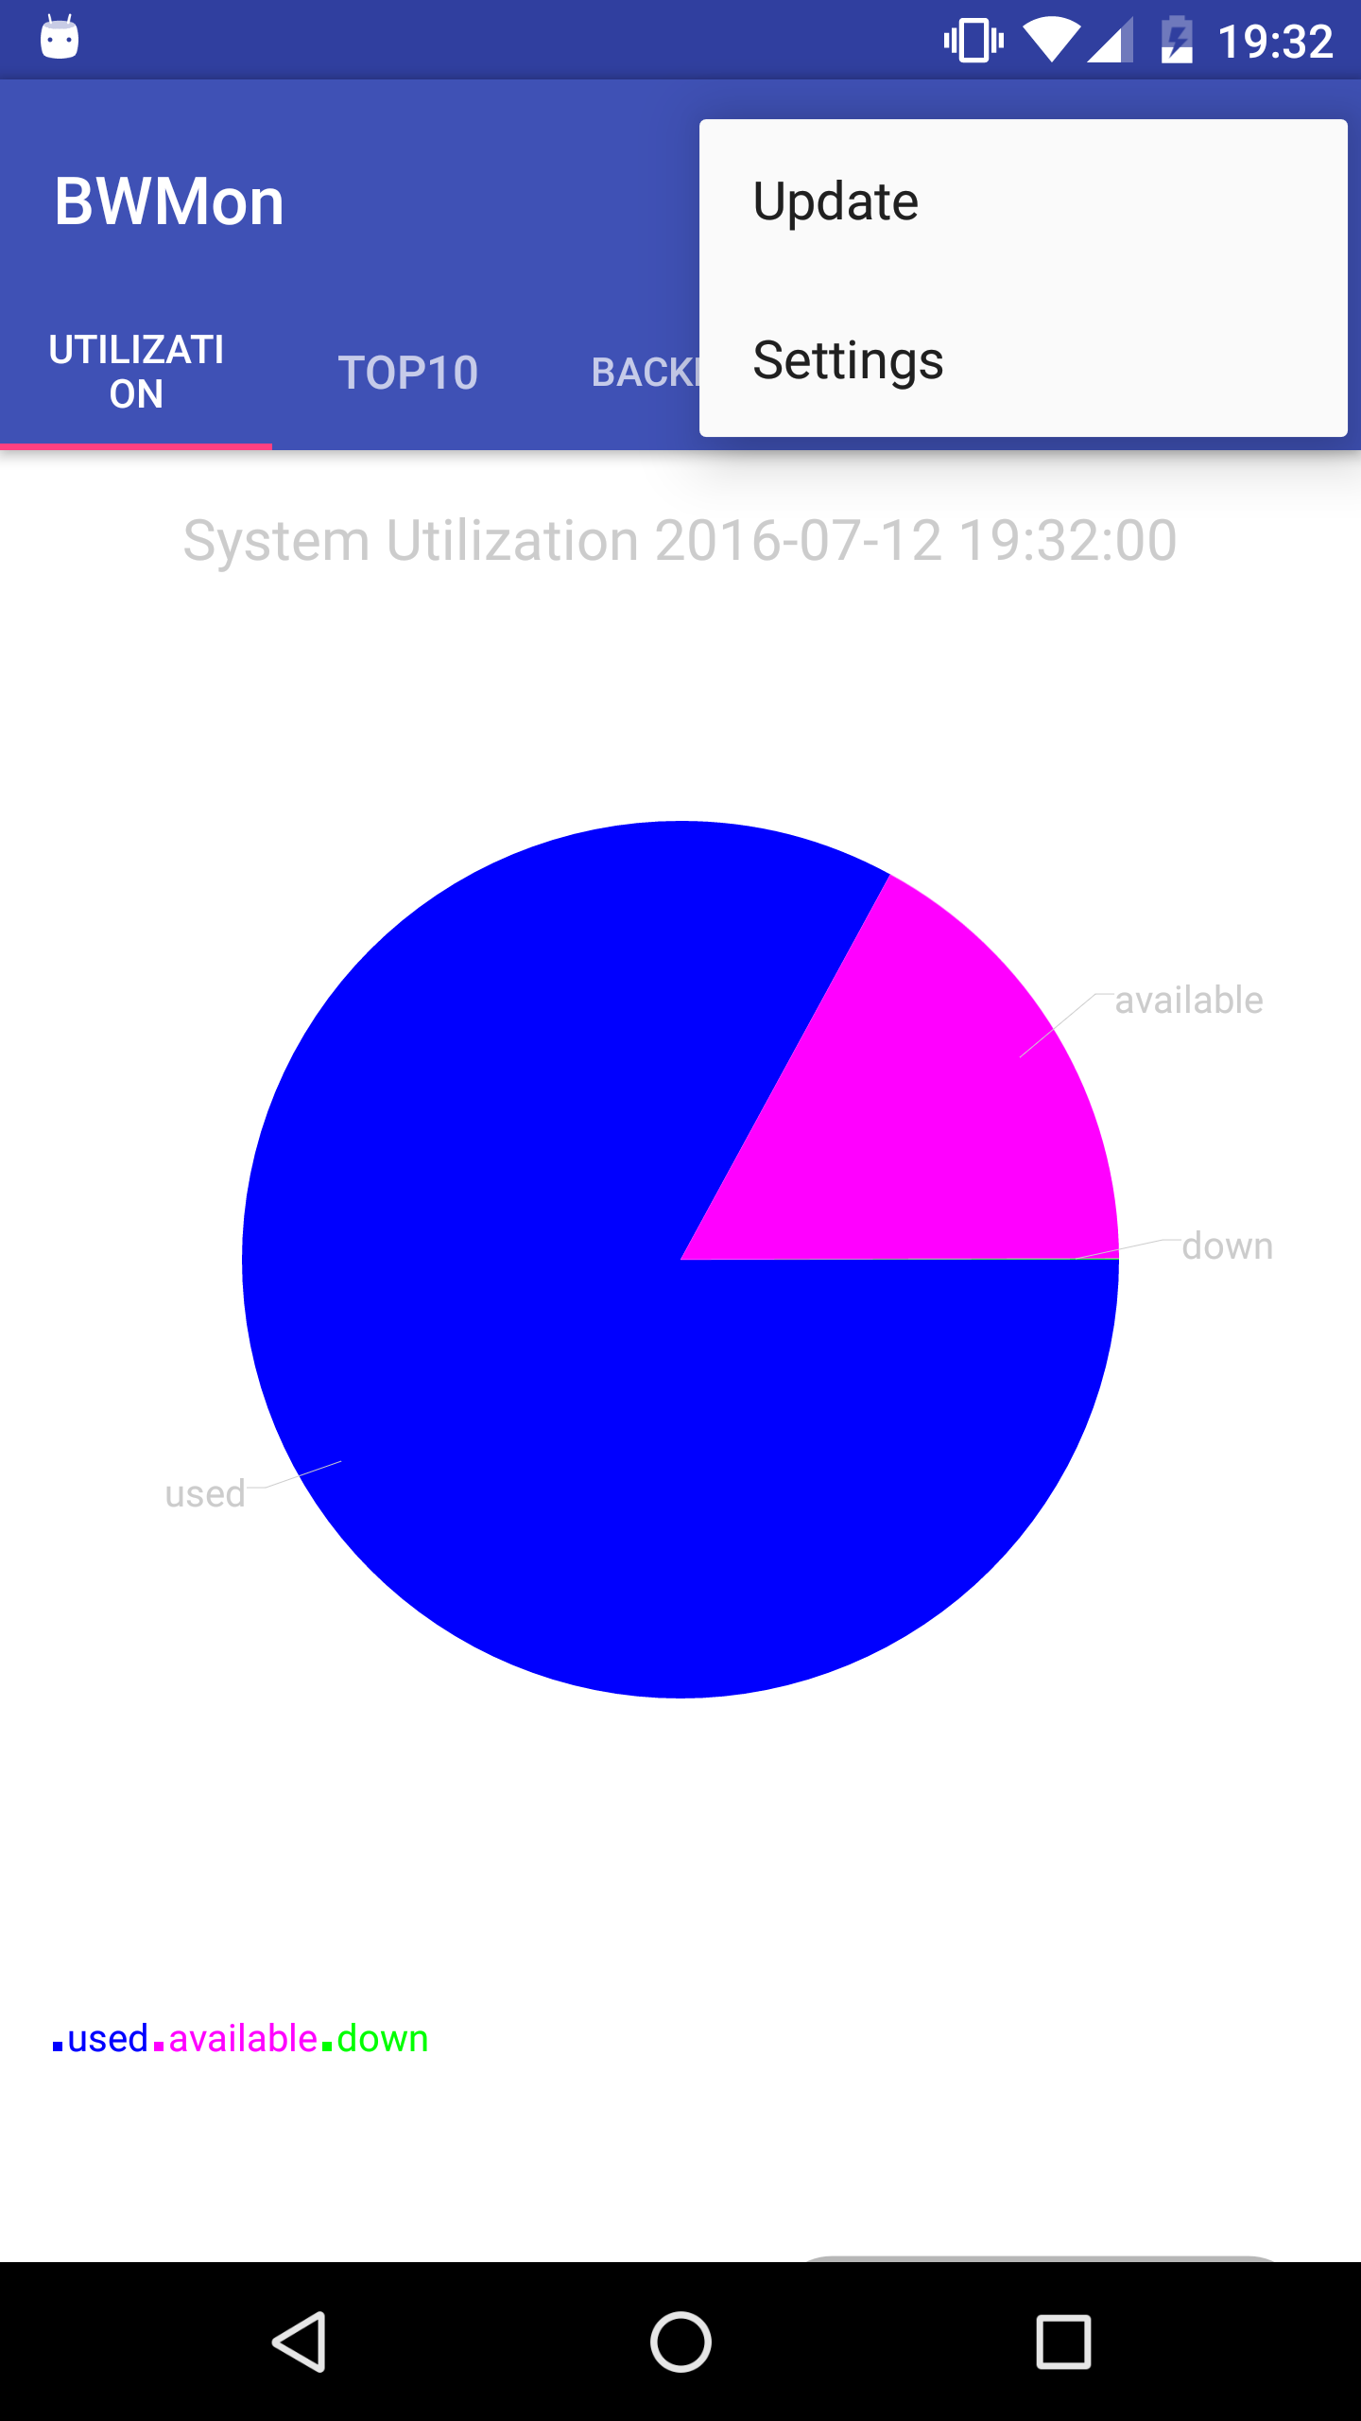
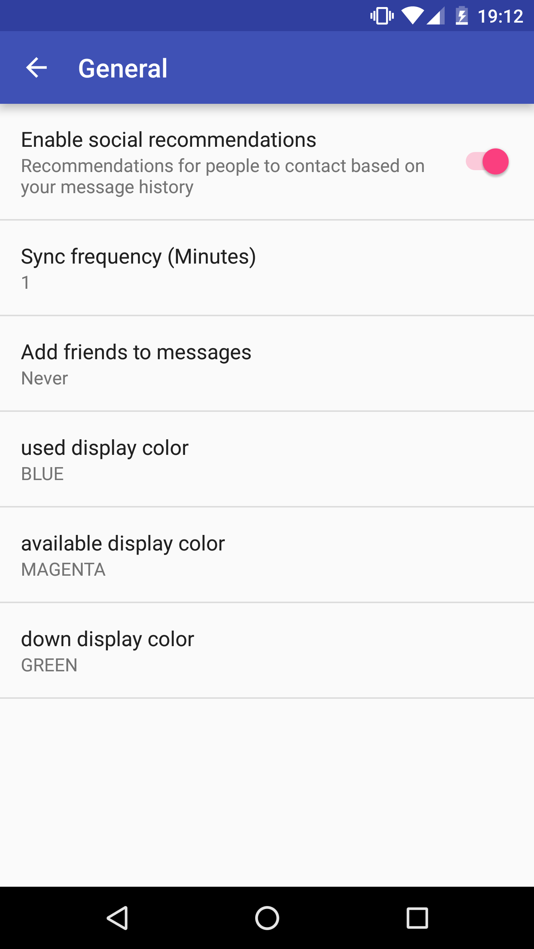
2. Set data feeds auto sync period

Slide 9
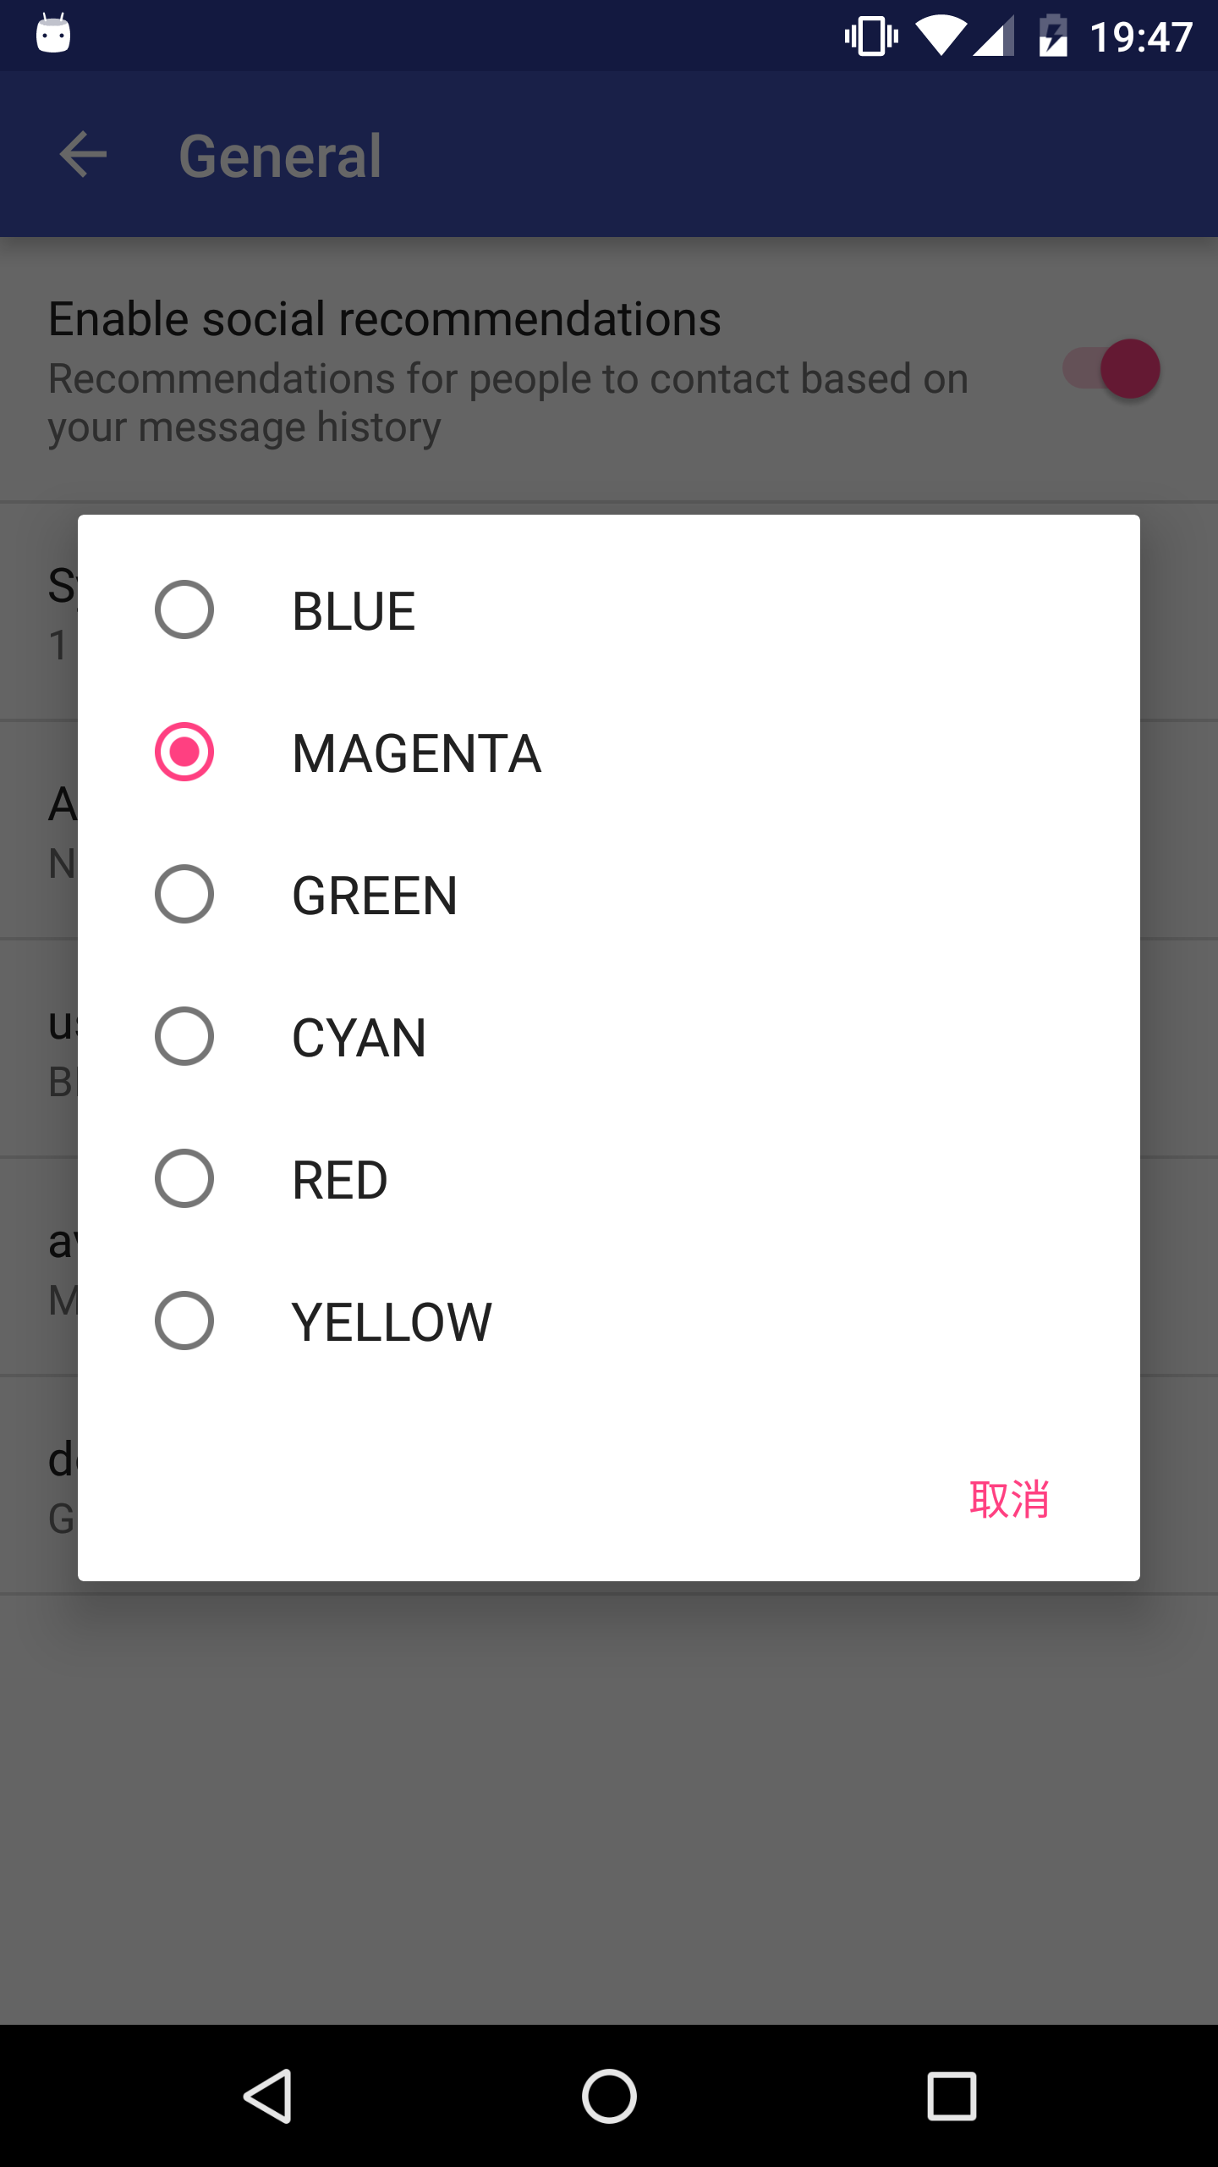
3. Set data feeds display color (1)

Slide 10
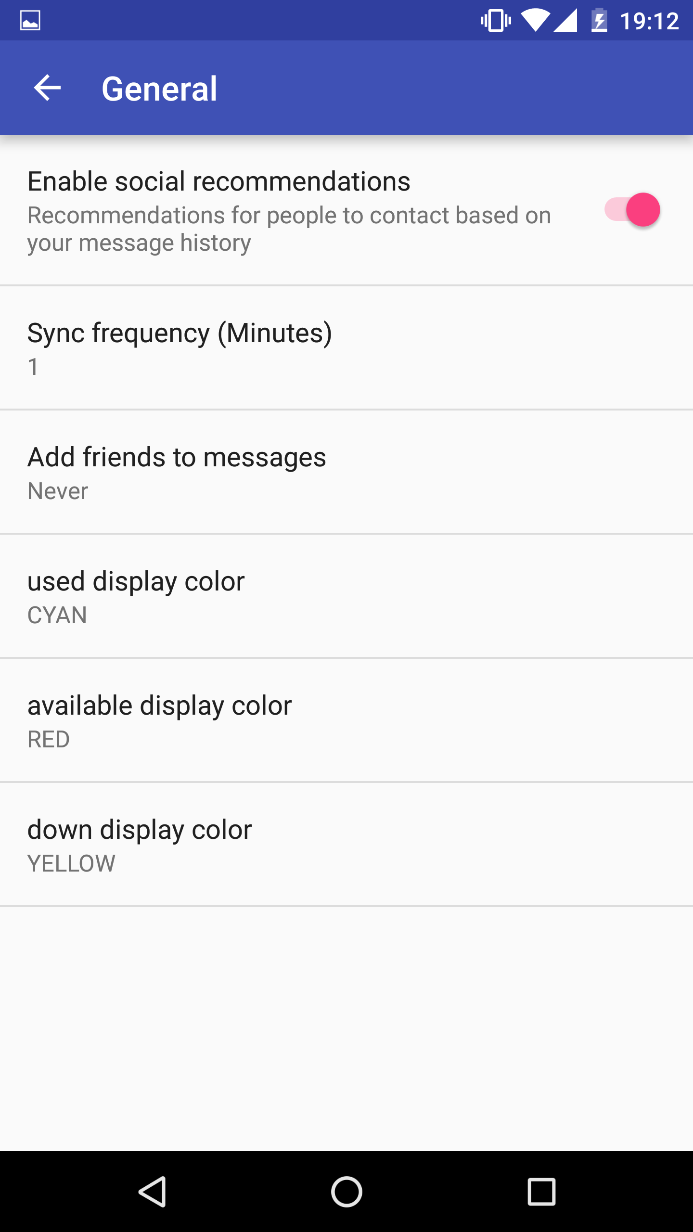
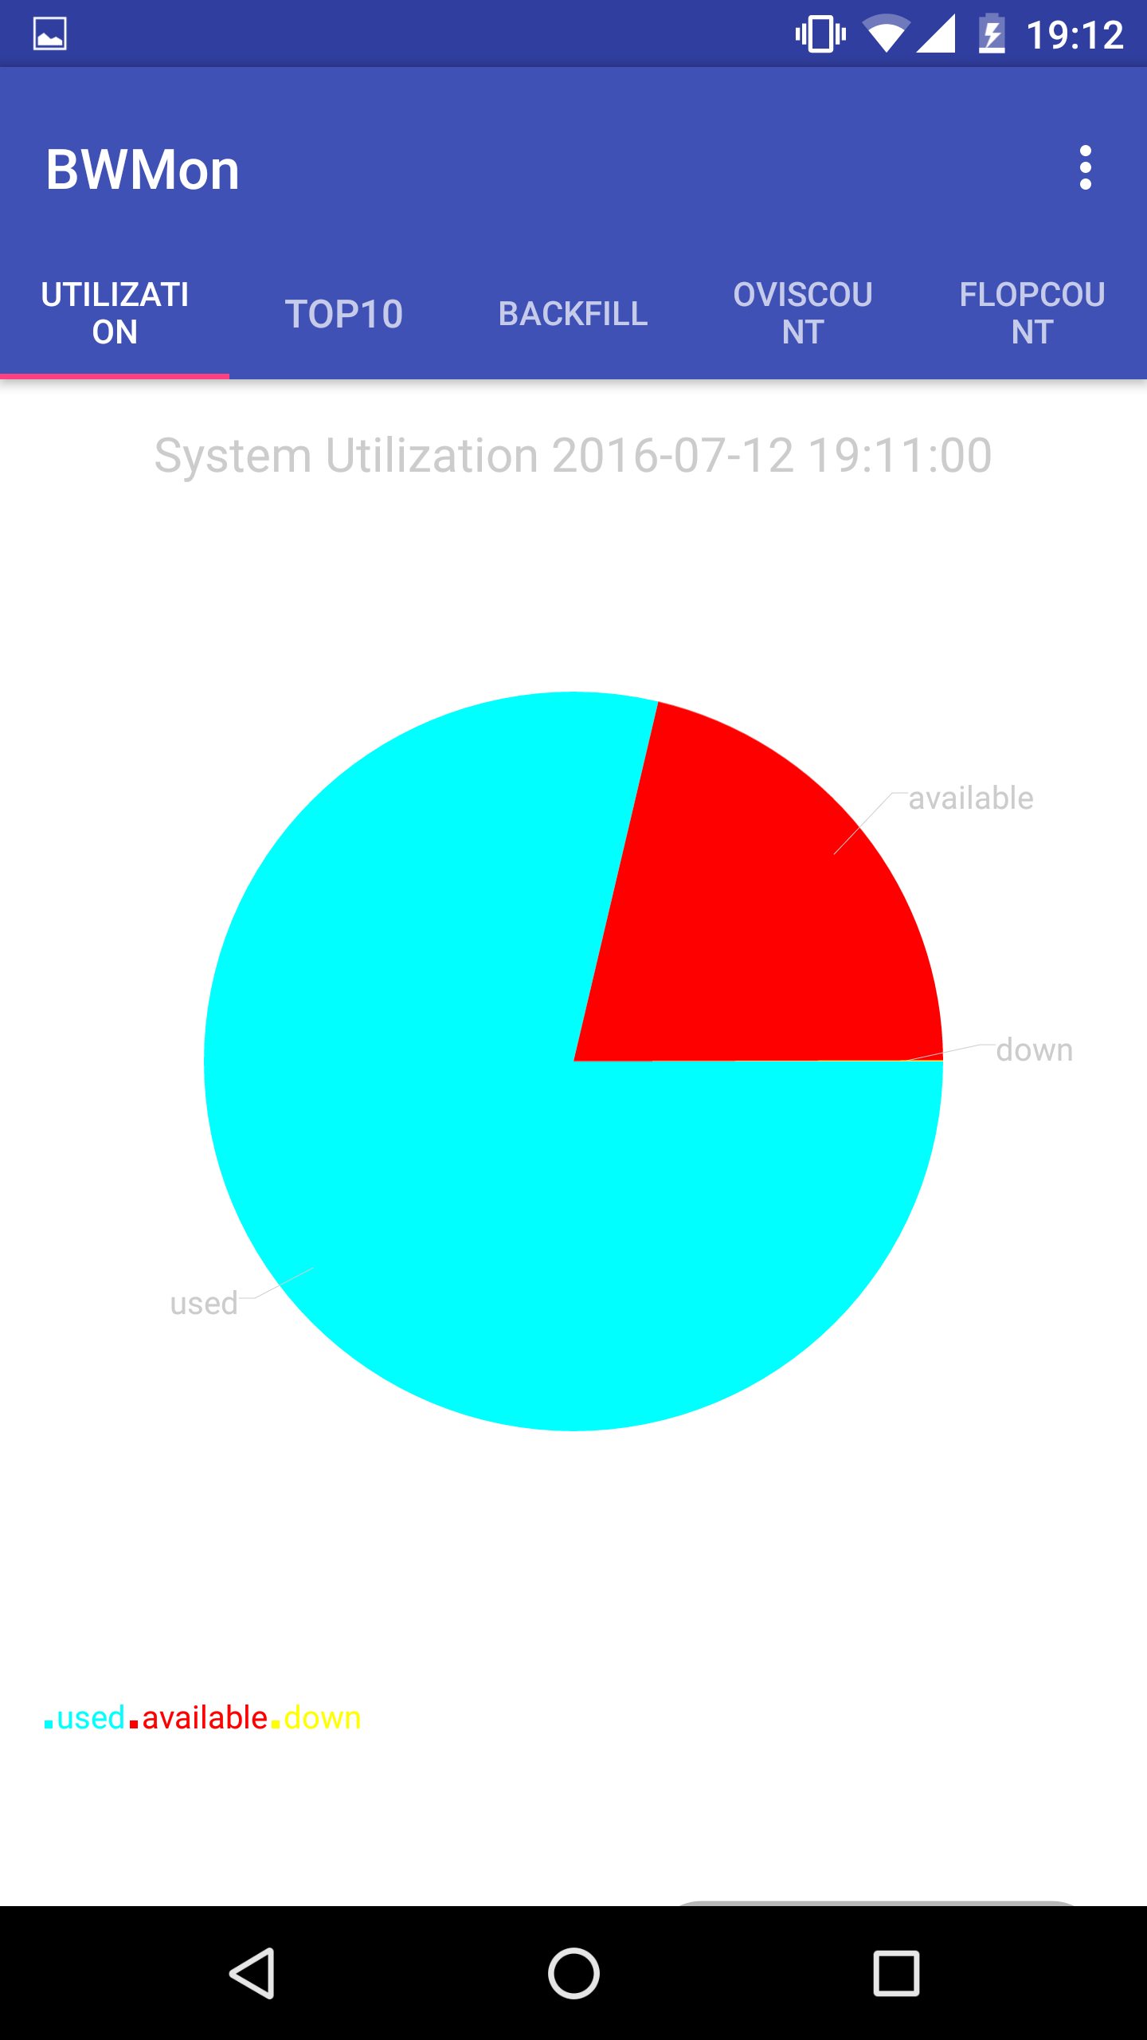
3. Set data feeds display color (2)

Slide 11
Future Plan
1. Implement alert system
2. Make the application more extensible
3. Provide tests, documention for future maintainence and re-design

Slide 12
Thanks For Watching

