Slide 1
Diabetes Risk Prediction: Deep Learning vs. Classical ML with a Bayesian Uncertainty-Aware Triage Agent
Jephthah Kimanthi David, Gideon Bamuleseyo — CS 582, Group 10
Notes:
Quick intro, one sentence on the hook -- "we don't just pick a model, we build a system that knows when to trust its own prediction."

Slide 2
The problem
• Diabetes screening at population scale needs two things at once: catch at-risk people early, don't overwhelm clinicians with false alarms
• Most work treats this as a single-model accuracy contest
• Question we ask instead: can a system know when to trust a prediction, not just what the prediction is?
Notes:
Set up the motivation before showing any numbers -- this is the "why."

Slide 3
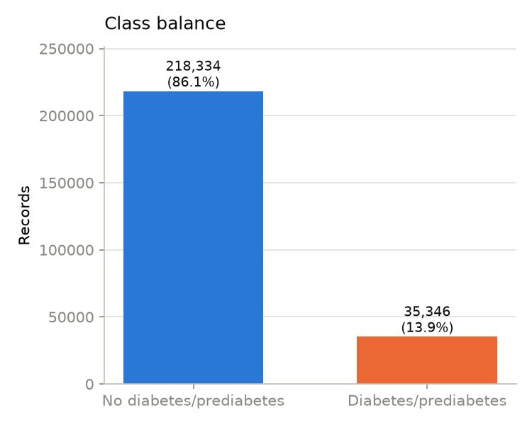
Dataset
• CDC BRFSS 2015 Diabetes Health Indicators (Kaggle), 253,680 records, 21 features
• Binary label: diabetes/prediabetes vs. none
• After de-dup (24,206 exact duplicates removed): 183,579 train / 45,895 test (80/20 stratified split)
• Class imbalance: 84.7% negative / 15.3% positive
Notes:
Flag the imbalance early -- it explains several design decisions later (class-weighting, why "auto-flag" needed care).

Slide 4
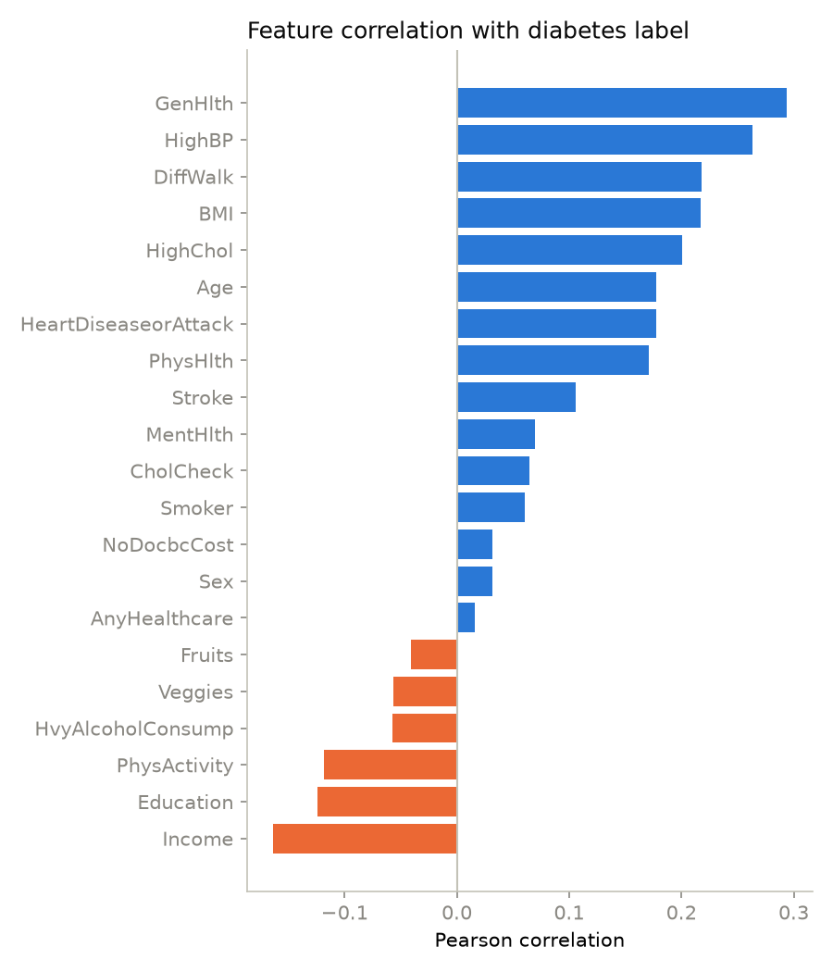
What predicts diabetes risk here?
• Strongest positive correlates: GenHlth, HighBP, DiffWalk, BMI, HighChol
• Strongest negative correlates: Income, Education, PhysActivity
Notes:
One-slide EDA summary -- don't dwell, this just grounds the feature choices made later in the Bayesian network.

Slide 5
Pipeline overview
• Step 1: train classical ML + DNN, benchmark against a published comparison (Ayoade et al., 2025)
• Step 2: layer a Bayesian Network on the best model's output for per-case uncertainty (inspired by Akram et al., 2025)
• Step 3: triage agent — auto-clear / auto-flag / escalate
• Step 4: analyze the accuracy-vs-automation tradeoff
Notes:
This is the map for the rest of the talk -- refer back to it as you move through steps 1-4.

Slide 6
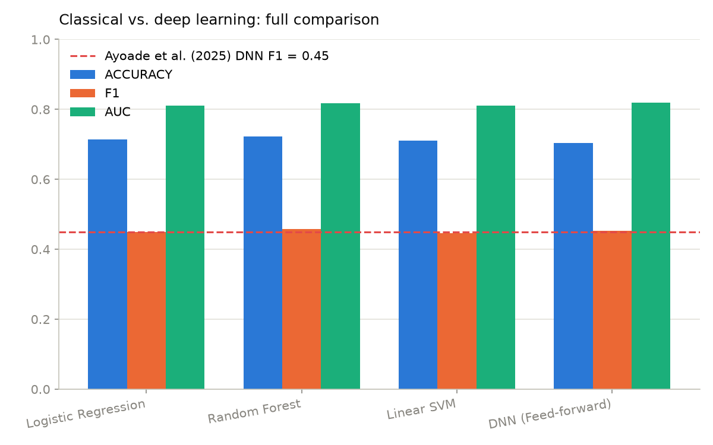
Baseline: classical ML vs. deep learning
Model | Accuracy | F1 | AUC | Train time
Logistic Regression | 0.714 | 0.449 | 0.811 | 0.1s
Random Forest | 0.723 | 0.458 | 0.817 | 3.9s
Linear SVM | 0.710 | 0.447 | 0.810 | 0.2s
DNN (feed-forward) | 0.704 | 0.452 | 0.819 | 53.4s
Notes:
Our DNN F1 (0.452) lands just above Ayoade et al.'s reported 0.45 -- confirms the baseline is faithful, not an outlier.

Slide 7
Key finding: DNN isn't a silver bullet here
• DNN edges out on AUC (0.819 vs. RF's 0.817) but has the lowest accuracy
• Costs 15–500x more to train than any classical model
• Replicates Ayoade et al. (2025): deep learning doesn't reliably beat classical ML on tabular survey data
• Decision: build the uncertainty layer on Random Forest — comparable AUC, better F1/accuracy, near-zero cost
Notes:
This is a deliberate pivot point in the talk -- "so we picked the classical model, and here's why that's the interesting part, not a letdown."

Slide 8
Adding a Bayesian uncertainty layer
• Random Forest gives one probability per case — often overconfident, no structured notion of “how sure are we, really?”
• We fit a discrete Bayesian Network (pgmpy) with 5 parents of the diabetes label: RF's prediction (binned), GenHlth, BMI category, age group, HighBP
• BayesianEstimator (BDeu prior) fits the CPDs; VariableElimination gives an exact posterior P(diabetes=1 | evidence) per test case
• Binary entropy of that posterior = per-case uncertainty score
Notes:
Emphasize this doesn't retrain or replace RF -- it's a lightweight layer on top, inspired by the retinopathy uncertainty-quantification approach in Akram et al. (2025), adapted from images to tabular data.

Slide 9
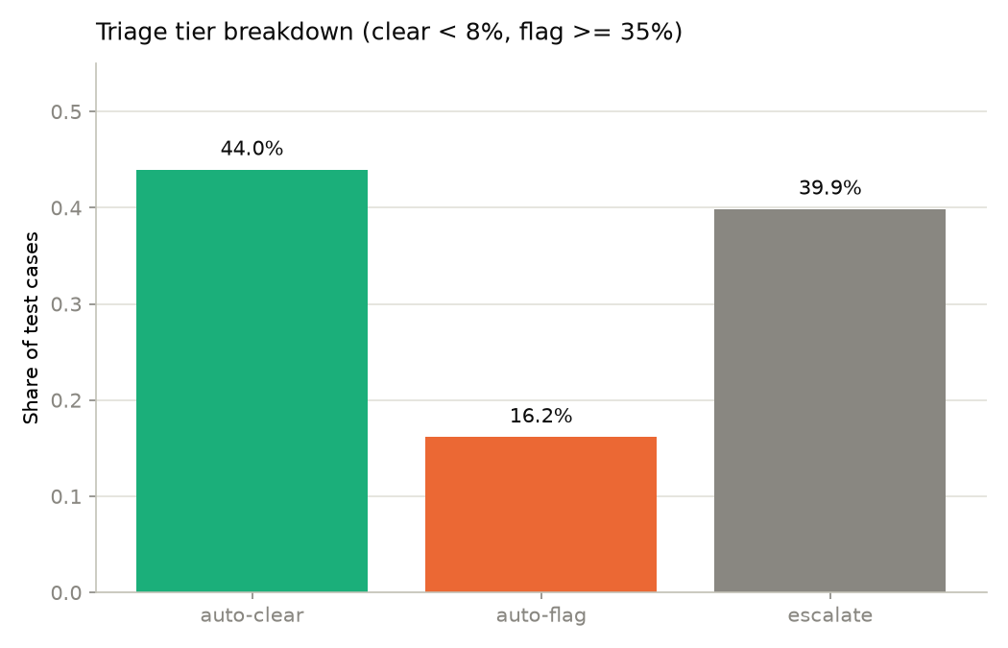
Triage agent: three tiers
Tier | Rule | Share | Outcome
Auto-clear | posterior < 8% | 44.0% | FN rate 4.3% (vs. 15.3% base rate)
Escalate | 8% ≤ posterior < 35% | 39.9% | sent to human review
Auto-flag | posterior ≥ 35% | 16.2% | 41.5% precision (2.7x base rate)
Notes:
Headline number: 60.2% of cases could bypass manual review entirely. Auto-clear cuts the miss rate to under a third of the population base rate; auto-flag concentrates true positives at ~2.7x their natural frequency.

Slide 10
Does the uncertainty score actually mean something?
• Mean entropy by tier: auto-clear 0.13 (confident) vs. auto-flag 0.97 / escalate 0.64 (uncertain)
• Negative risk can be called with much higher confidence than positive risk here — a direct consequence of the 85/15 imbalance
• Sensible bias for a screening tool: better to escalate a possible case than silently auto-clear or auto-diagnose it
Notes:
This slide answers the "why should I trust this triage split" question before showing the tradeoff curve.

Slide 11
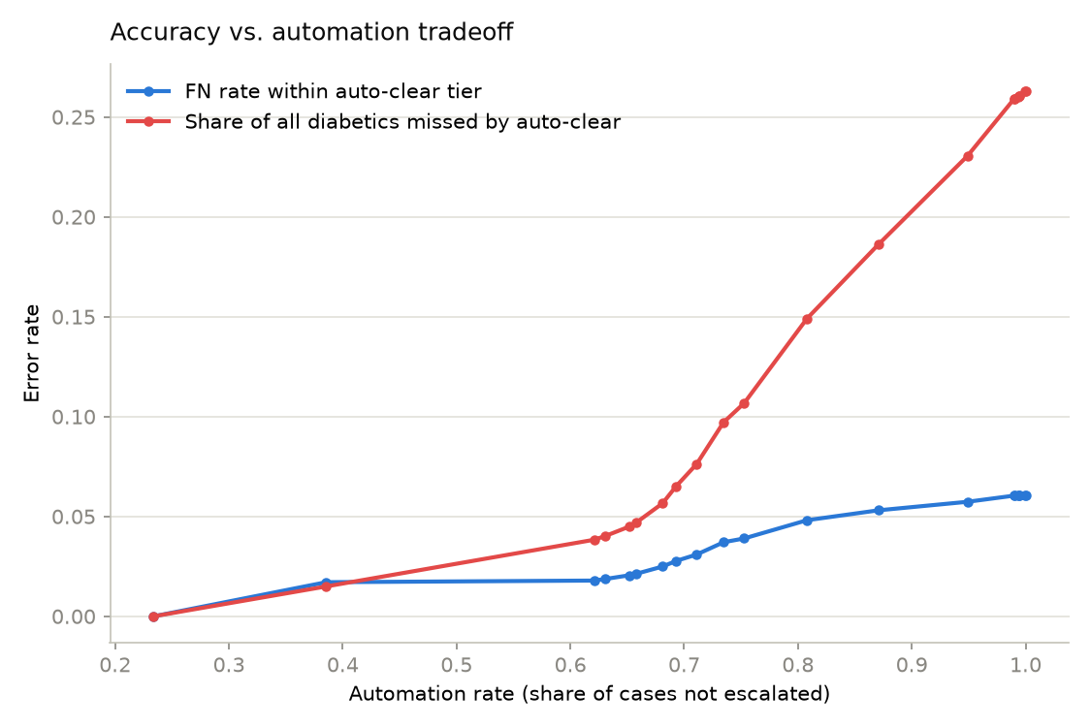
Accuracy vs. automation tradeoff
• Swept the escalation band width around the population prevalence, tracked automation rate against two error signals
• FN rate within auto-clear, and share of all diabetics missed by auto-clear
• Clear knee point around ~60–62% automation: FN rate stays flat at ~2% below it, then climbs steeply (more than doubles by ~80% automation, reaches 26% at 100%)
Notes:
This is the payoff slide -- "automating the easy 60% costs almost nothing; automating the rest would cost a lot." Pause here for questions if time allows.

Slide 12
Where's the novelty?
Not the baseline comparison — the classical-vs-DNN benchmark is a faithful replication of Ayoade et al. (2025), useful as a validated starting point, not the contribution.
Cross-domain transfer — Akram et al. (2025) quantify Bayesian uncertainty for a CNN on retinopathy images; we adapt that pattern to tabular survey data with a classical base model instead.
Hybrid evidence fusion — the Bayesian network fuses Random Forest's opaque prediction with independent clinical variables (GenHlth, BMI, age, HighBP) as co-parents — a calibration layer over a black-box model, not a replacement classifier.
The agentic contribution — the triage agent turns that uncertainty score into an autonomous action policy (auto-clear / auto-flag / escalate) with a quantified accuracy-vs-automation tradeoff: it doesn't just predict, it decides when to act versus defer to a human.
Notes:
This slide directly answers the rubric's "demonstrate some novelty" requirement -- call out explicitly that novelty lives in the architecture/agentic layer, not the base algorithms. Lead with the triage agent as the strongest claim.

Slide 13
Conclusions
• A well-tuned Random Forest matches/beats a feed-forward DNN on every practical axis on this tabular health-survey data — deep learning is not a silver bullet here
• A small Bayesian network turns RF's point estimate into a calibrated, per-case uncertainty score without retraining the base model
• That score powers a triage agent automating ~60% of the caseload at a quarter of the population's natural miss rate, concentrating review effort where it matters most
Notes:
Restate the three numbers people should remember: 0.819 AUC, 60.2% automation, 4.3% FN rate in auto-clear.

Slide 14
Future work
• Richer Bayesian network structure (more evidence variables, learned rather than fixed structure)
• Calibration comparison against simpler baselines (raw RF thresholding, conformal prediction)
• Cost-sensitive tuning of the auto-clear/auto-flag bands against a real clinical review-capacity constraint

Slide 15
Questions
• Thank you — happy to take questions.

