Slide 1
Introduction
Resort Management
1.Trinh Thiem Bao
2.Ly Thi Thuy Tien
3.Nguyen Quoc Thai
Date 08 Month 05 Year 2019

Slide 2
Content
Actual demand :
When people are too busy, there is no time to go to see a room for a vacation.
Resort Management is a website developed for online booking online. For more convenient for users
Notes:
Thế giới đang trong xu hướng công nghệ hoá, tự động hoá,các doanh nghiệp đang ngày càng cần các giải pháp công nghệ để nhằm tối ưu hoá và phát triển doanh nghiệp .Nắm bắt những nhu cầu đó nên hệ thống Resort Management được xây dung và phát triển.

Slide 3
Introduction - Actual requirements
Requirements of the project
Help users can view rooms, online booking and entertainment services
Administrators easily manage their Resort

Slide 4
Introduction -
Functionalities requirements:
1. For the website
It should contain links such as HOME,BOOKING, SERVICES, CONTACT US, REGISTER, LOGIN
2. For the User Guide website
- Register their account
- USER can Booking Room , Compare Rooms,History Booked
- USER can modified their information profile
- USER can pay for reservations, pay for services .
Notes:
Hệ thống có 2 phần chủ yếu để phục vụ nhu cầu của doanh nghiệp và khách hàng của họ

Slide 5
Requirements of the project
3. For the admin’s website :
Administrators can view the feedback received from the users.
Administrators can view the list of all services in resort , add new , update and delete some services .
Administrators can view user information, employee information and active account .
Administrators can view customer invoices, and change the status of invoices .
Administrator can scan Qrcode Customer , and see all Details Customer .
Finally , Administrator can view revenue of Resort by date .

Slide 6
Requirements of the project
4. For the Employee website :
Employee can scan QrCode Customer , and see all Details Customer .
Employee can change password of myself .
Employee can chats with Customer .
Employee can see list Rooms .
Employee can Checkin – CheckOut Date of Customer .
Finally , Employee can update status Receipt of Customer.

Slide 7
Requirements of the project
5. For the Ticket Collector website :
Ticket Collector can scan QrCode Ticket .
Ticket Collector can change password of myself .
Ticket Collector can chats with Customer .

Slide 8
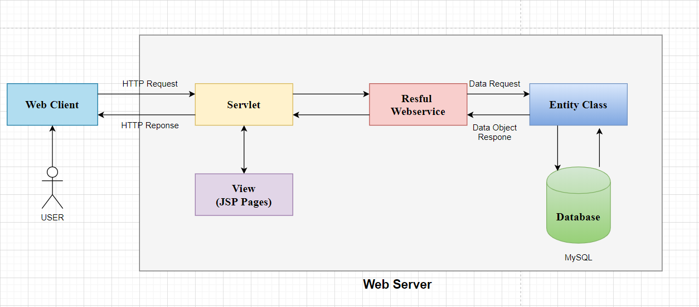
Deployment diagram
Các bước xử lý trong JSP

Slide 9
Conclusion
Advantages
Quick search
Compare
Defect
Cancel booking
see through picture
Safe
Community

Slide 10
Task List
Task | Activity Plan Prepared By:
GUEST PAGES
Home | Ms.Tien
Booking | Ms.Tien
Location | Ms.Tien
Login | Ms.Tien
Log Out | Ms.Tien
History | Ms.Tien
Register | Ms.Tien

Slide 11
Task List
Task | Activity Plan Prepared By:
II. Customer Page :
Menu Food | Mr.Bao
Menu Entertainment | Mr.Bao
Information Customer | Mr.Bao
Ticket | Mr.Bao
Your Bill | Mr.Bao
Feedback | Mr.Bao
Cart | Mr.Bao
III. Admin Page :
Revenue | Mr.Bao
QrCode | Ms.Tien
Login/ForgotPassword | Mr.Bao
Customer | Mr.Thai
Room | Mr.Thai

Slide 12
Task List
Task | Activity Plan Prepared By:
Location | Mr.Thai
Receipt | Mr.Thai
Service | Mr.Thai
Convenient | Mr.Thai
Feedback | Mr.Thai
III. Employee
Overall View | Mr.Bao
Checkin-Checkout | Mr. Tien
Check Tickets | Ms.Tien
Room List | Mr.Thai

Slide 13

Thank You

