Slide 1
Introduction
Resort Management
1.Trinh Thiem Bao
2.Ly Thi Thuy Tien
3.Nguyen Quoc Thai
Date 08 Month 05 Year 2019

Slide 2
Content
Actual demand :
When people are too busy, there is no time to go to see a room for a vacation.
Resort Management is a website developed for online booking online. For more convenient for users

Slide 3
Introduction - Actual requirements
Requirements of the project
Help users can view rooms, online booking and entertainment services
Administrators easily manage their Resort

Slide 4
Introduction -
Functionalities requirements:
1. For the website
It should contain links such as HOME,BOOKING, SERVICES, CONTACT US, REGISTER, LOGIN
2. For the User Guide website
- Register their account
- USER can Booking Room , Compare Rooms,History Booked
- USER can modified their information profile
- USER can pay for reservations, pay for services .

Slide 5
Requirements of the project
3. For the admin’s website :
Administrators can view the feedback received from the users.
Administrators can view the list of all services in resort , add new , update and delete some services .
Administrators can view user information, employee information and active account .
Administrators can view customer invoices, and change the status of invoices .
Administrator can scan Qrcode Customer , and see all Details Customer .
Finally , Administrator can view revenue of Resort by date .

Slide 6
Requirements of the project
4. For the Employee website :
Employee can scan QrCode Customer , and see all Details Customer .
Employee can change password of myself .
Employee can chats with Customer .
Employee can see list Rooms .
Employee can Checkin – CheckOut Date of Customer .
Finally , Employee can update status Receipt of Customer.

Slide 7
Requirements of the project
5. For the Ticket Collector website :
Ticket Collector can scan QrCode Ticket .
Ticket Collector can change password of myself .
Ticket Collector can chats with Customer .

Slide 8
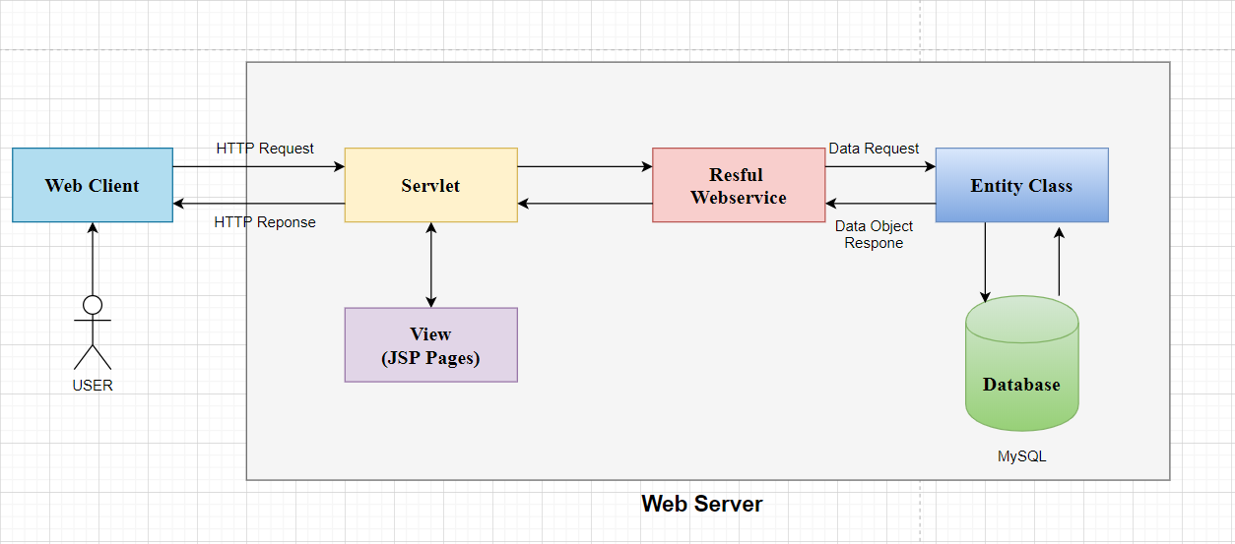
Deployment diagram
Các bước xử lý trong JSP

Slide 9
Conclusion
Advantages
Quick search
Compare
Defect
Cancel booking
see through picture
Safe
Community

Slide 10
Task List
Task | Activity Plan Prepared By:
GUEST PAGES
Home | Ms.Tien
Booking | Ms.Tien
Location | Ms.Tien
Login | Ms.Tien
Log Out | Ms.Tien
History | Ms.Tien
Register | Ms.Tien

Slide 11
Task List
Task | Activity Plan Prepared By:
II. Customer Page :
Menu Food | Mr.Bao
Menu Entertainment | Mr.Bao
Information Customer | Mr.Bao
Ticket | Mr.Bao
Your Bill | Mr.Bao
Feedback | Mr.Bao
Cart | Mr.Bao
III. Admin Page :
Revenue | Mr.Bao
QrCode | Ms.Tien
Login/ForgotPassword | Mr.Bao
Customer | Mr.Thai
Room | Mr.Thai

Slide 12
Task List
Task | Activity Plan Prepared By:
Location | Mr.Thai
Receipt | Mr.Thai
Service | Mr.Thai
Convenient | Mr.Thai
Feedback | Mr.Thai
III. Employee
Overall View | Mr.Bao
Checkin-Checkout | Mr. Tien
Check Tickets | Ms.Tien
Room List | Mr.Thai

Slide 13

Thank You

