Slide 1





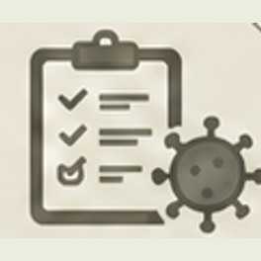

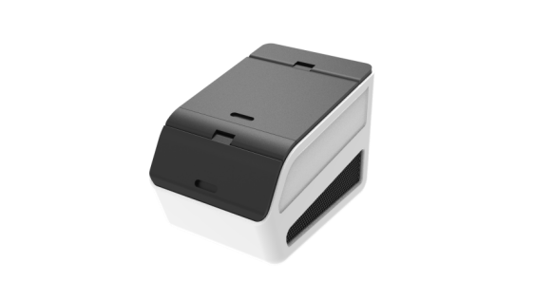










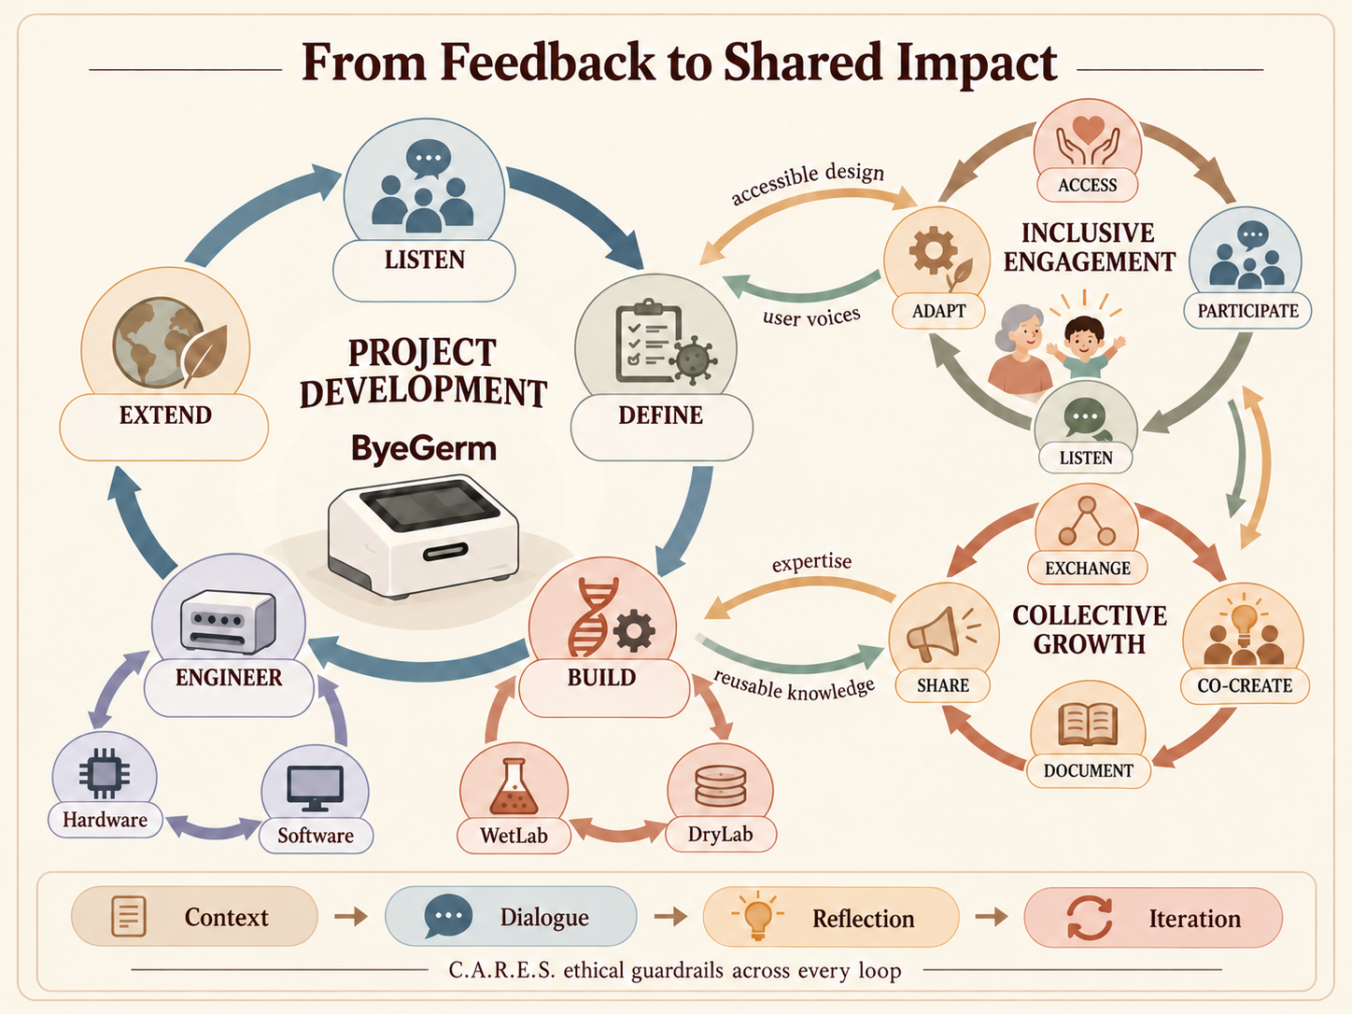
From Feedback to Shared Impact
c
e
s
s
i
b
l
e
d
e
s
i
g
n
LISTEN
a
c
ACCESS
INCLUSIVE
ENGAGEMENT
PROJECT
DEVELOPMENT
u
s
e
r
v
o
i
c
e
s
ADAPT
PARTICIPATE
EXTEND
ByeGerm
DEFINE
LISTEN
e
x
p
e
r
t
i
s
e
r
EXCHANGE
e
ENGINEER
BUILD
u
s
a
b
l
e
k
n
o
w
COLLECTIVE
GROWTH
l
Hardware
e
d
g
e
SHARE
CO-CREATE
Software
WetLab
DryLab
DOCUMENT
Context
Dialogue
Reflection
Iteration
C.A.R.E.S. ethical guardrails across every loop

Slide 2

For the Well-being of Humanity，Health Is a Right for Everyone
For a Better Future for Humanity, We Keep Going

Slide 3
Human Practices, in Numbers
20
43
770+
50+
28+
14
Fields
Professional contacts
Participants
Engagement actions
Reusable practices
Published resources
Notes:
[Sources]
https://jlu-igem-wiki-preview.pages.dev/Eagagement/iHP
Figure 1 audit: 14 separately opened on-site PDFs; 49 distinct documented engagement/work units, conservatively shown as 45+; 769 response/attendance/contact/ballot touchpoints (not unique persons); 28 selected replicable artifacts/formats; 20 analyst-defined fields; 24 distinct named expert/professional contacts.
PDFs:
Stakeholder scoring criteria: https://jlu-igem-wiki-preview.pages.dev/ihp-resources/revision-4-20261017/stakeholder-scoring-criteria.pdf
Stakeholder review & adaptation: https://jlu-igem-wiki-preview.pages.dev/ihp-resources/revision-4-20261017/stakeholder-review-and-adaptation.pdf
Nursing-home informed consent: https://jlu-igem-wiki-preview.pages.dev/ihp-resources/revision-4-20261017/nursing-home-informed-consent.pdf
Kindergarten informed consent: https://jlu-igem-wiki-preview.pages.dev/ihp-resources/revision-4-20261017/kindergarten-informed-consent.pdf
Community emergency response guide: https://jlu-igem-wiki-preview.pages.dev/ihp-resources/revision-6-20261017/community-collaborative-emergency-response-guide.pdf
ByeGerm 1.0 user manual: https://jlu-igem-wiki-preview.pages.dev/ihp-resources/revision-4-20261017/byegerm-1-user-manual.pdf
Retrospective empathy survey: https://jlu-igem-wiki-preview.pages.dev/ihp-resources/revision-4-20261017/retrospective-empathy-survey.pdf
ByeGerm 2.0 user manual: https://jlu-igem-wiki-preview.pages.dev/ihp-resources/revision-4-20261017/byegerm-2-user-manual.pdf
Respiratory card-game instructions: https://jlu-igem-wiki-preview.pages.dev/ihp-resources/revision-6-20261017/card-game-instructions.pdf
Kindergarten material safety: https://jlu-igem-wiki-preview.pages.dev/ihp-resources/revision-4-20261017/kindergarten-material-safety.pdf
Kindergarten venue/personnel safety: https://jlu-igem-wiki-preview.pages.dev/ihp-resources/revision-4-20261017/kindergarten-venue-personnel-safety.pdf
Kindergarten activity safety: https://jlu-igem-wiki-preview.pages.dev/ihp-resources/revision-4-20261017/kindergarten-activity-safety.pdf
Older-adult education resource: https://jlu-igem-wiki-preview.pages.dev/ihp-resources/revision-4-20261017/older-adult-education.pdf
Braille learning material: https://jlu-igem-wiki-preview.pages.dev/ihp-resources/revision-4-20261017/braille-learning-material.pdf
Important: surveys 385+200, 100 special-needs youth attendees, 60 elder feedback slips, 24 named contacts. 60 slips are not verified persons. Not counting unknown numbers of teachers, children, questions, international event participants.

Slide 4
