Slide 1




Slide 2
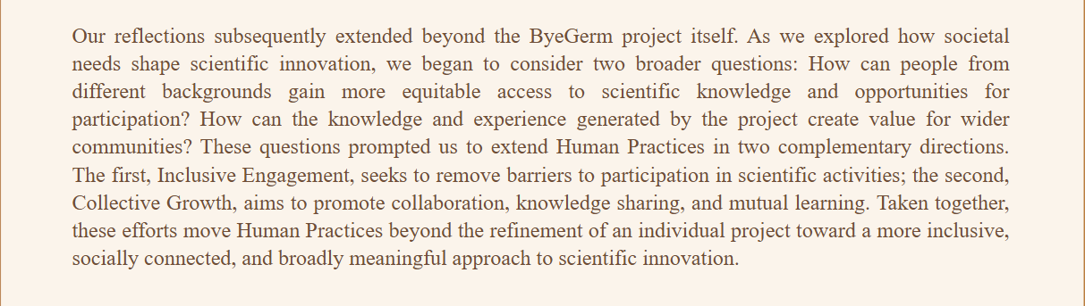


For the Well-being of Humanity，Health Is a Right for Everyone
For a Better Future for Humanity, We Keep Going

Slide 3
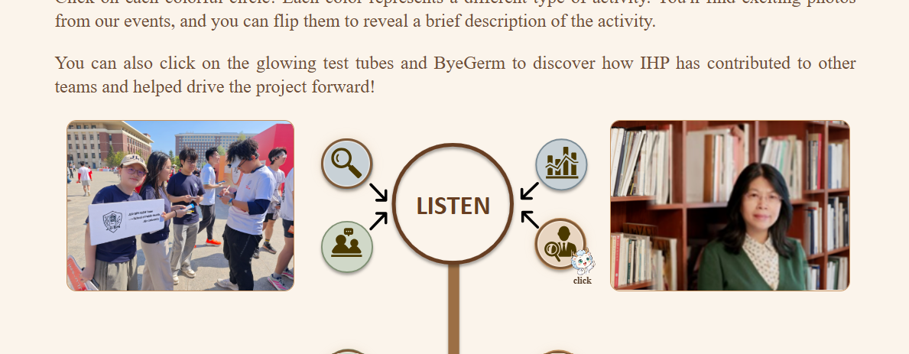

Click

Slide 4
