Slide 1
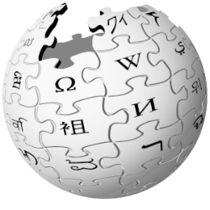


Exploring Wikipedia
with

Slide 2
Today’s Objectives
Learn just enough to build simple prototypes/POCs with Spark
Fast paced, high level overview of all major Spark components
Hands on with Spark’s programming APIs (DataFrame/SQL, RDD, Datasets)
Overview of Spark architecture: Core, Streaming, Standalone Mode, DAG
Mix of beginner + advanced topics
Not all slides/labs covered (reference & homework material)
Lots of ideas, code & datasets to play around with after class
Notes:
Note that we won’t have much time to use ML pipelines in class

Slide 3
Data
Analytics
Pageviews (March 2015) - 255 MB
Dataframes
Clickstream (Feb 2015) - 1.2 GB
Dataframes, SQL, GraphX
Pagecounts (last hour) - ~500 MB
RDD, Datasets, Dataframes
English Wikipedia (Mar 5, 2016) - 54 GB
Dataframes, SQL, ML
6 Lang Wikipedias (live streams)
Streaming, RDD, Dataframes, SQL

Slide 4




Large Scale Usage:
Largest cluster:
8000 nodes
Largest single job:
1 petabyte
Top streaming intake:
1 TB/hour
2014 on-disk 100 TB sort record:
23 mins /
207 EC2 nodes
Notes:
For the 100 TB sort, each record was 100 bytes (10 byte key and 90 byte value), randomly generated. Each EC2 node was i2.8xlarge with 32 slots (and physical CPU cores) per machine. 6,592 slots total in cluster.

Slide 5
Machine Learning

Slide 6
Algorithm coverage
Classification
Logistic regression w/ elastic net
Naive Bayes
Streaming logistic regression
Linear SVMs
Decision trees
Random forests
Gradient-boosted trees
Multilayer perceptron
One-vs-rest
Regression
Least squares w/ elastic net
Isotonic regression
Decision trees
Random forests
Gradient-boosted trees
Streaming linear methods
Recommendation
Alternating Least Squares
Frequent itemsets
FP-growth
Prefix span
Feature extraction & selection
Binarizer
Bucketizer
Chi-Squared selection
CountVectorizer
Discrete cosine transform
ElementwiseProduct
Hashing term frequency
Inverse document frequency
MinMaxScaler
Ngram
Normalizer
One-Hot Encoder
PCA
PolynomialExpansion
RFormula
SQLTransformer
Standard scaler
StopWordsRemover
StringIndexer
Tokenizer
StringIndexer
VectorAssembler
VectorIndexer
VectorSlicer
Word2Vec
Clustering
Gaussian mixture models
K-Means
Streaming K-Means
Latent Dirichlet Allocation
Power Iteration Clustering
Statistics
Pearson correlation
Spearman correlation
Online summarization
Chi-squared test
Kernel density estimation
Linear algebra
Local dense & sparse vectors & matrices
Distributed matrices
Block-partitioned matrix
Row matrix
Indexed row matrix
Coordinate matrix
Matrix decompositions
Model import/export
Pipelines
List based on Spark 1.5
Notes:
Classification: You are given data that you know belongs to a particular group (like docs belonging to politics or sports) and then infer which group the new data instances will sit in.
Regression: Try to fit a line to some data points... fitting a line is like ranking the data points.
Clustering: We have the unknown groups and need to infer which groups are actually there.
In Classification, we know the groups apriori, but not in Clustering.

Slide 7
High-level functionality
Learning tasks
Classification
Regression
Recommendation
Clustering
Frequent itemsets
Data utilities
Feature extraction & selection
Statistics
Linear algebra
Workflow utilities
Model import/export
Pipelines
DataFrames
Cross validation

Slide 8
Spark MLlib Components
spark.mllib vs. spark.ml
(package)
(package)
Original “lower-level” API
Built on top of RDDs
Will go to maintenance mode starting Spark 2.0
Newer “higher-level” API for constructing workflows
Built on top of DataFrames

Slide 9
Term Frequency – Inverse Document Frequency
An information retrieval algorithm used to rank how important
a word is to a collection of documents
TF:
If a word appears frequently in a doc, it’s important
IDF:
But if a word appears in many docs (the, and, of),
the word is not meaningful, so lower its score
Notes:
This is a common algorithm in the field of information retrieval. Variations of the tf-idf weighting scheme are often used by search engines as a central tool in scoring and ranking a web page’s relevance given a user query.

Slide 10
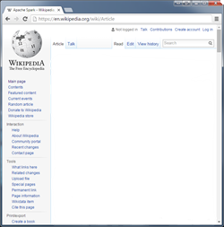
TF–IDF
the
and
and
of
olympics
the
games
politics
of
sports
congress
government
the
and
politics
the
of
congress
sports
TF:
# of times word X appears in a document
Total # of words in the document

Slide 11
TF–IDF
the
and
and
of
olympics
the
games
politics
of
sports
congress
government
the
and
politics
the
of
congress
sports
the: 2
and: 1
politics: 1
government: 1
of: 1
of: 2
congress: 2
and: 1
the: 1
politics: 1
sports: 2
the: 1
and: 1
games: 1
olympics: 1

Slide 12
TF–IDF
the
and
and
of
olympics
the
games
politics
of
sports
congress
government
the
and
politics
the
of
congress
sports
the: 2 / 6 = 0.3
and: 1 / 6 = 0.16
politics: 1 / 6 = 0.16
government: 1 / 6 = 0.16
of: 1 / 6 = 0.16
of: 2 / 7 = 0.28
congress: 2 / 7 = 0.28
and: 1 / 7 = 0.14
the: 1 / 7 = 0.14
politics: 1 / 7 = 0.14
sports: 2 / 6 = 0.3
the: 1 / 6 = 0.16
and: 1 / 6 = 0.16
games: 1 / 6 = 0.16
olympics: 1 / 6 = 0.16
Notes:
TF(t) = (Number of times term t appears in a document) / (Total number of terms in the document). While computing TF, all terms are considered equally important.

Slide 13
TF–IDF
the
and
and
of
olympics
the
games
politics
of
sports
congress
government
the
and
politics
the
of
congress
sports
the: 2 / 6 = 0.3
and: 1 / 6 = 0.16
politics: 1 / 6 = 0.16
government: 1 / 6 = 0.16
of: 1 / 6 = 0.16
of: 2 / 7 = 0.28
congress: 2 / 7 = 0.28
and: 1 / 7 = 0.14
the: 1 / 7 = 0.14
politics: 1 / 7 = 0.14
sports: 2 / 6 = 0.3
the: 1 / 6 = 0.16
and: 1 / 6 = 0.16
games: 1 / 6 = 0.16
olympics: 1 / 6 = 0.16
Notes:
While computing TF, all terms are considered equally important.
However it is known that certain terms, such as "is", "of", and "that", may appear a lot of times but have little importance. Thus we need to weigh down the frequent terms while scale up the rare ones.
In the second doc, there are 7 words so politics is weighted less than the word politics in the 1st doc with 6 words.

Slide 14
TF–IDF
the
and
and
of
olympics
the
games
politics
of
sports
congress
government
the
and
politics
the
of
congress
sports
IDF:
Total # of documents
log
# of documents with word X in it

Slide 15
TF–IDF
the
and
and
of
olympics
the
games
politics
of
sports
congress
government
the
and
politics
the
of
congress
sports
IDF:
3
log
= 0
3

Slide 16
TF–IDF
the
and
and
of
olympics
the
games
politics
of
sports
congress
government
the
and
politics
the
of
congress
sports
IDF:
3
log
= 0.18
2

Slide 17
TF–IDF
the
and
and
of
olympics
the
games
politics
of
sports
congress
government
the
and
politics
the
of
congress
sports
IDF:
3
log
= 0.48
1

Slide 18
TF–IDF
the
and
and
of
olympics
the
games
politics
of
sports
congress
government
the
and
politics
the
of
congress
sports
government: 0.16 * 0.48 = 0.08
politics: 0.16 * 0.18 = 0.03
of: 0.16 * 0.18 = 0.03
the: 0.3 * 0 = 0
and: 0.16 * 0 = 0
congress: 0.28 * 0.48 = 0.08
of: 0.28 * 0.18 = 0.05
politics: 0.14 * 0.18 = 0.03
the: 0.14 * 0 = 0
and: 0.14 * 0 = 0
sports: 0.3 * 0.48 = 0.144
olympics: 0.16 * 0.48 = 0.08
games: 0.16 * 0.48 = 0.08
the: 0.16 * 0 = 0
and: 0.16 * 0 = 0

Slide 19
TF–IDF
sports
Search
the
and
and
of
olympics
the
games
politics
of
sports
congress
government
the
and
politics
the
of
congress
sports
government: 0.16 * 0.48 = 0.08
politics: 0.16 * 0.18 = 0.03
of: 0.16 * 0.18 = 0.03
congress: 0.28 * 0.48 = 0.08
of: 0.28 * 0.18 = 0.05
politics: 0.14 * 0.18 = 0.03
sports: 0.3 * 0.48 = 0.144
olympics: 0.16 * 0.48 = 0.08
games: 0.16 * 0.48 = 0.08

Slide 20
TF–IDF
politics
Search
the
and
and
of
olympics
the
games
politics
of
sports
congress
government
the
and
politics
the
of
congress
sports
government: 0.16 * 0.48 = 0.08
politics: 0.16 * 0.18 = 0.03
of: 0.16 * 0.18 = 0.03
congress: 0.28 * 0.48 = 0.08
of: 0.28 * 0.18 = 0.05
politics: 0.14 * 0.18 = 0.03
sports: 0.3 * 0.48 = 0.144
olympics: 0.16 * 0.48 = 0.08
games: 0.16 * 0.48 = 0.08

Slide 21
K–means clustering
An unsupervised ML algorithm for classifying items into k groups.
k:
The # of pre-chosen groups
Notes:
Clustering can be considered the most important unsupervised learning problem. So, the goal of clustering is to determine the intrinsic grouping in a set of unlabeled data.
KMeans is implemented as an Estimator and generates a KMeansModel as the base model.
- - -
Source: http://home.deib.polimi.it/matteucc/Clustering/tutorial_html/

Slide 22






K–means clustering
politics
sports
Notes:
- - -
Football: http://chicagouic.estaging.intrafinity.com/common/resources/images/Cliparts/Sports/Illustration%20Of%20A%20Football.png
Soccer: https://upload.wikimedia.org/wikipedia/commons/thumb/e/ec/Soccer_ball.svg/2000px-Soccer_ball.svg.png
Basketball: http://www.sportadvisory.com/assets/images/rev-slider/basketball.png
US Flag: https://upload.wikimedia.org/wikipedia/en/archive/a/a4/20151118161037!Flag_of_the_United_States.svg
UK Flag: http://vignette1.wikia.nocookie.net/homefront/images/d/d0/Britain_flag.png/revision/latest?cb=20130227054907
India Flag: http://flaglane.com/download/indian-flag/indian-flag-graphic.png

Slide 23
K–means clustering
politics
sports
Notes:
- - -
Football: http://chicagouic.estaging.intrafinity.com/common/resources/images/Cliparts/Sports/Illustration%20Of%20A%20Football.png
Soccer: https://upload.wikimedia.org/wikipedia/commons/thumb/e/ec/Soccer_ball.svg/2000px-Soccer_ball.svg.png
Basketball: http://www.sportadvisory.com/assets/images/rev-slider/basketball.png
US Flag: https://upload.wikimedia.org/wikipedia/en/archive/a/a4/20151118161037!Flag_of_the_United_States.svg
UK Flag: http://vignette1.wikia.nocookie.net/homefront/images/d/d0/Britain_flag.png/revision/latest?cb=20130227054907
India Flag: http://flaglane.com/download/indian-flag/indian-flag-graphic.png

Slide 24
K–means clustering
5 million articles
100 clusters
Notes:
The term “k-means” was first used in 1967, but the idea goes back to 1957 (Hugo Steinhaus).
Source: https://en.wikipedia.org/wiki/K-means_clustering
- - -
Football: http://chicagouic.estaging.intrafinity.com/common/resources/images/Cliparts/Sports/Illustration%20Of%20A%20Football.png
Soccer: https://upload.wikimedia.org/wikipedia/commons/thumb/e/ec/Soccer_ball.svg/2000px-Soccer_ball.svg.png
Basketball: http://www.sportadvisory.com/assets/images/rev-slider/basketball.png
US Flag: https://upload.wikimedia.org/wikipedia/en/archive/a/a4/20151118161037!Flag_of_the_United_States.svg
UK Flag: http://vignette1.wikia.nocookie.net/homefront/images/d/d0/Britain_flag.png/revision/latest?cb=20130227054907
India Flag: http://flaglane.com/download/indian-flag/indian-flag-graphic.png

Slide 25

K–means clustering
black dots: Wikipedia Articles (items)
red lines: Cluster Partitions
blue dots: Cluster Centroids
Notes:
Figure 1. A clustered scatter plot. The black dots are data points. The red lines illustrate the partitions created by the k-means algorithm. The blue dots represent the centroids which define the partitions.
This example has just 2 features, x and y. But our Wiki example will use 20k features.
A centroid is "the center of mass of a geometric object of uniform density", though here, we'll consider mean vectors as centroids.
http://mnemstudio.org/clustering-k-means-example-1.htm
Source: http://mnemstudio.org/clustering-k-means-introduction.htm

Slide 26
K–means clustering: Initialization
Approach #1:
Randomly select centroids to start
Pro:
Does not require full iteration
Con:
If a cluster is large compared to neighbors, initial centroids will likely end up in large cluster.
Notes:
Figure 1. A clustered scatter plot. The black dots are data points. The red lines illustrate the partitions created by the k-means algorithm. The blue dots represent the centroids which define the partitions.
This example has just 2 features, x and y. But our Wiki example will use 20k features.
A centroid is "the center of mass of a geometric object of uniform density", though here, we'll consider mean vectors as centroids.
http://mnemstudio.org/clustering-k-means-example-1.htm
Source: http://mnemstudio.org/clustering-k-means-introduction.htm

Slide 27
K–means clustering: Initialization
Approach #2:
k-means++
Pro:
Avoids the poor clusterings found by standard algorithm
Con:
Needs k passes over the data, so does not scale well to large data sets
Notes:
K-means++ was first proposed in 2007. It is an algorithm for choosing the initial values (or "seeds") for the k-means clustering algorithm. It is a way of avoiding the sometimes poor clusterings found by the standard k-means algorithm.
Since the k-means++ initialization needs k passes over the data, it does not scale very well to large data sets.
https://en.wikipedia.org/wiki/K-means%2B%2B

Slide 28

K–means clustering: Initialization
Approach #3:
k-means||
Pro:
Also avoids the poor clusterings found by standard algorithm
Can select multiple candidate centroids in first iteration
Notes:
A scalable version of ++
http://theory.stanford.edu/~sergei/papers/vldb12-kmpar.pdf
Image: https://upload.wikimedia.org/wikipedia/commons/thumb/5/50/Red_Checkmark.svg/2000px-Red_Checkmark.svg.png

Slide 29
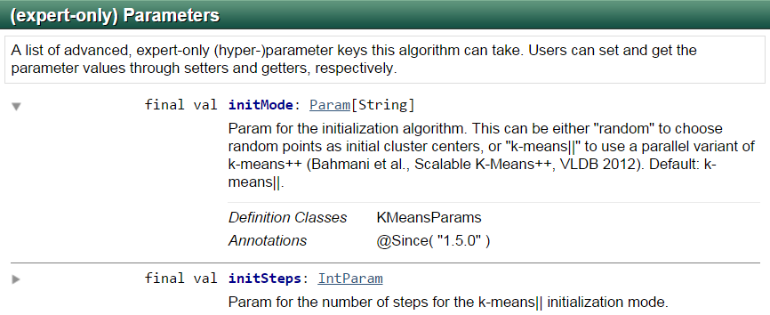
K–means clustering: Initialization
Source: https://spark.apache.org/docs/1.6.0/api/scala/index.html#org.apache.spark.ml.clustering.KMeans
Notes:
You can set this using: setInitMode

Slide 30
K–means clustering
k:
2
Article | Word X | Word Y
A | 1.0 | 1.0
B | 1.5 | 2.0
C | 3.0 | 4.0
D | 5.0 | 7.0
E | 3.5 | 5.0
F | 4.5 | 5.0
G | 3.5 | 4.5
Source: http://mnemstudio.org
Notes:
This is one full iteration in initialization stage, not k-means iteration
Consider the following data set consisting of the scores of 2 variables/words/features for 7 articles.
Find the two articles furthest apart… using the Euclidean distance measure
Source: http://mnemstudio.org/clustering-k-means-example-1.htm
Source: http://mnemstudio.org/clustering-k-means-introduction.htm

Slide 31
K–means clustering
k:
2
 | Article | Mean Vector (centroid)
Group 1 | A | (1.0, 1.0)
Group 2 | D | (5.0, 7.0)
Notes:
First, this data set is to be grouped into two clusters. As a first step in finding a sensible initial partition, let the A & B values of the two individuals furthest apart (using the Euclidean distance measure), define the initial cluster means, giving:
Source: http://mnemstudio.org/clustering-k-means-example-1.htm
Source: http://mnemstudio.org/clustering-k-means-introduction.htm

Slide 32
K–means clustering
k:
2
 | Article | Mean Vector (centroid)
Cluster 1 | A, B, C | (1.8, 2.3)
Cluster 2 | D, E, F, G | (4.1, 5.4)
Notes:
Now the initial partition has changed, and the two clusters at this stage having the following characteristics:
But we cannot yet be sure that each individual has been assigned to the right cluster….
Source: http://mnemstudio.org/clustering-k-means-example-1.htm
Source: http://mnemstudio.org/clustering-k-means-introduction.htm

Slide 33
K–means clustering
k:
2
Article | Distance to mean (centroid) of Cluster 1 | Distance to mean (centroid) of Cluster 2
A | 1.5 | 5.4
B | 0.4 | 4.3
C | 2.1 | 1.8
D | 5.7 | 1.8
E | 3.2 | 0.7
F | 3.8 | 0.6
G | 2.8 | 1.1
Cluster 1
Cluster 2
Notes:
But we cannot yet be sure that each individual has been assigned to the right cluster. So, we compare each individual’s distance to its own cluster mean and to that of the opposite cluster. And we find:
Only individual 3 is nearer to the mean of the opposite cluster (Cluster 2) than its own (Cluster 1). In other words, each individual's distance to its own cluster mean should be smaller that the distance to the other cluster's mean (which is not the case with individual 3).
Thus, individual 3 is relocated to Cluster 2 resulting in the new partition:
Each iteration is a new spark job, inside it multiple stages
Source: http://mnemstudio.org/clustering-k-means-example-1.htm
Source: http://mnemstudio.org/clustering-k-means-introduction.htm

Slide 34
K–means clustering
k:
2
 | Article | Mean Vector (centroid)
Cluster 1 | A, B | (1.3, 1.5)
Cluster 2 | C, D, E, F, G | (3.9, 5.1)
Notes:
Only individual 3 is nearer to the mean of the opposite cluster (Cluster 2) than its own (Cluster 1). In other words, each individual's distance to its own cluster mean should be smaller that the distance to the other cluster's mean (which is not the case with individual 3).
Thus, individual 3 is relocated to Cluster 2 resulting in the new partition:
The iterative relocation would now continue from this new partition until no more relocations occur. However, in this example each individual is now nearer its own cluster mean than that of the other cluster and the iteration stops, choosing the latest partitioning as the final cluster solution.
Also, it is possible that the k-means algorithm won't find a final solution. In this case it would be a good idea to consider stopping the algorithm after a pre-chosen maximum of iterations.
Source: http://mnemstudio.org/clustering-k-means-example-1.htm
Source: http://mnemstudio.org/clustering-k-means-introduction.htm

Slide 35
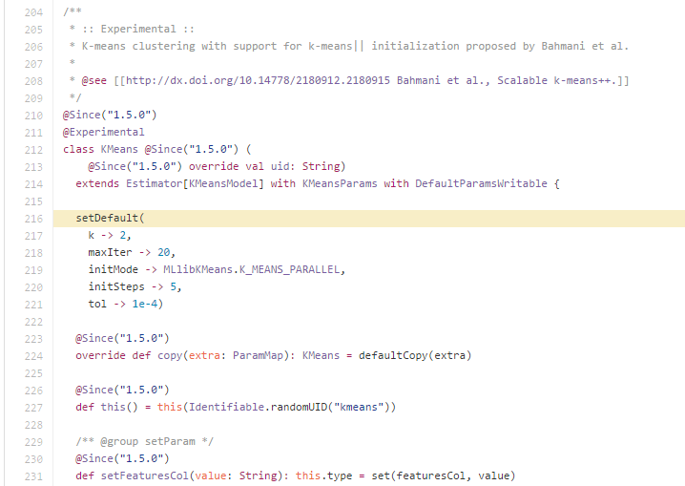
K–means clustering
Source: https://github.com/apache/spark/blob/master/mllib/src/main/scala/org/apache/spark/ml/clustering/KMeans.scala#L216
Notes:
This shows the default # of max iterations that k-means will do. Generally only 10-20 iterations are required to converge.

Slide 36
Spark ML Pipelines
DataFrame: uses DF from Spark SQL as a ML dataset. Different columns can store
text, feature vectors, true labels and predictions
Transformer: an algorithm which can transform one DataFrame into another DataFrame
(example: ML model is a transformer that transforms a DF with features into a DF
with predictions)
Estimator: an algorithm which can be fit on a DF to produce a Model
(example: a learning algorithm is an Estimator which trains on a DF and
produces a model)
Pipeline: chains multiple Transformers and Estimators together to specify a ML workflow
Notes:
The pipeline concept is mostly inspired by the scikit-learn project.
The new pipeline API lives under a new package named “spark.ml”. A pipeline consists of a sequence of stages. There are two basic types of pipeline stages: Transformer and Estimator. A Transformer takes a dataset as input and produces an augmented dataset as output. E.g., a tokenizer is a Transformer that transforms a dataset with text into an dataset with tokenized words. An Estimator must be first fit on the input dataset to produce a model, which is a Transformer that transforms the input dataset. E.g., logistic regression is an Estimator that trains on a dataset with labels and features and produces a logistic regression model.
A practical ML pipeline often involves a sequence of data pre-processing, feature extraction, model fitting, and validation stages. For example, classifying text documents might involve text segmentation and cleaning, extracting features, and training a classification model with cross-validation.
The new pipeline API lives under a new package named “spark.ml”. A pipeline consists of a sequence of stages. There are two basic types of pipeline stages: Transformer and Estimator. A Transformer takes a dataset as input and produces an augmented dataset as output. E.g., a tokenizer is a Transformer that transforms a dataset with text into an dataset with tokenized words. An Estimator must be first fit on the input dataset to produce a model, which is a Transformer that transforms the input dataset. E.g., logistic regression is an Estimator that trains on a dataset with labels and features and produces a logistic regression model.
For Transformer, an ML model is a Transformer which transforms DataFrame with features into a DataFrame with predictions.

Slide 37
DataFrame
Spark ML Pipeline
Tokenizer()
DF
StopWordsRemover()
DF
hashingTF()
DF
IDF()
DF
normalizer()
DF
kmeans()
DataFrame

Slide 38
DataFrame
Spark ML Pipeline
T
lowerText
Tokenizer()
words
DF
T
words
StopWordsRemover()
noStopWords
DF
T
noStopWords
hashingTF()
hashingTF
(20k features)
DF
E
hashingTF
IDF()
idf
DF
T
idf
normalizer()
features
DF
E
features
kmeans()
prediction
DataFrame
Notes:
Transformers: Tokenizer, stopWordsRemover, hashingTF, normalizer (takes a vector and normalizes it, sum of each vector is equal to one)
- You apply a functions and you get some output
Estimators: IDF (estimates frequencies of words and then weighs the words by frequencies), K-means
You take all the data and then figure out something, in kmean, figure out centroids then take any other dataset and apply this model.
Builds a model that you can build
Normalizer: it’s b/c some articles are small, others are large. If you don’t do normalizer, then if the word Congress appears 100 times, then it’ll be a complete outlier compared to others. Ohh, then k-means will see that as it’s own cluster off on it’s own.

Slide 39
Spark Streaming

Slide 40
Motivation
Stability condition for any streaming app
Receive data only as fast as the system can process it
Stability condition for Spark Streaming’s “micro-batch” model
Finish processing previous batch before next one arrives

Slide 41
Stable micro-batch operation
Spark Streaming runs micro-batches at fixed batch intervals
0s
2s
4s
6s
8s
time
1s
1s
1s
1s
batch processing time <=
batch interval
Previous batch is processed before next one arrives => stable

Slide 42
Unstable micro-batch operation
Spark Streaming runs micro-batches at fixed batch intervals
0s
2s
4s
6s
8s
time
2.1s
2.1s
2.1s
2.1s
batch processing time > batch interval
scheduling delay builds up
Batches continuously gets delayed and backlogged => unstable

Slide 43

6 Edit Streams:
English : en
52.89.53.194:9002
German : de
54.68.10.240:9003
French : fr
54.68.10.240:9004
Russian : ru
54.68.10.240:9005
Italian : it
54.68.10.240:9006
Spanish : es
54.68.10.240:9007

Slide 44

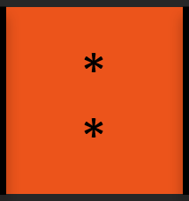
Batch Interval: 600 ms
200 ms
200 ms
200 ms
“Batch Ready for processing!”
200 ms
200 ms
200 ms
“Batch Ready for processing!”
200 ms
:9002
English Edits
RDD
S
R
S
S
JVM
Notes:
To-do, color code this so that Red Receiver makes a red RDD and Green Receiver makes a green RDD.
Notes:
spark.streaming.blockInterval: The number of tasks per receiver per batch will be approximately (batch interval / block interval). For example, block interval of 200 ms will create 10 tasks per 2 second batches. Too low the number of tasks (that is, less than the number of cores per machine), then it will be inefficient as all available cores will not be used to process the data. To increase the number of tasks for a given batch interval, reduce the block interval. However, the recommended minimum value of block interval is about 50 ms, below which the task launching overheads may be a problem.
By default, the input data received through Receivers is stored in the executors’ memory with StorageLevel.MEMORY_AND_DISK_SER_2. This serialization obviously has overheads – the receiver must deserialize the received data and re-serialize it using Spark’s serialization format.
Most input Dstream (except file stream or 1.3 Kafka direct stream) are associated with a Receiver object which receives the data from a source.
For each input source, Spark Streaming launches receivers, which are tasks running within the application’s executors that collect data from the input source and save it as RDDs. These receive the input data and replicate it (by default) to another executor for fault tolerance.
Note that, unlike RDDs, the default persistence level of DStreams keeps the data serialized in memory.
Spark Streaming offers the same fault tolerance properties for DStreams as Spark has for RDDs: as long as a copy of the input data is still available, it can recompute any state derived from it using the lineage of the RDDs (i.e., by rerunning the operations used to process it).
From the block, the partition can spill to disk if needed
The 2nd Executor for replication is chosen randomly

Slide 45

DStreams:
Batch Interval: 0.6 seconds
0.6 sec
0.6 sec
0.6 sec
. . .
Block #1
Block #2
Block #3
editsDStream
. . .
Part #1
Part #2
Part #3
filter()
filteredDStream
. . .
Part #1
Part #2
Part #3
Notes:
Ask TD: Is that first conversion from Blocks to Partitions called a transformation?
Any operation applied on a DStream translates to operations on the underlying RDDs.
These underlying RDD transformations are computed by the Spark engine. The DStream operations hide most of these details and provide the developer with higher-level API for convenience.

Slide 46
Batch Interval: 3 sec
English Edits
“English Batch Ready for processing!”
“Spanish Batch Ready for processing!”
RDD
T
S
R
R
Spanish Edits
S
T
JVM

Slide 47
Transformations on DStreams:
reduce()
filter()
map()
repartition()
flatMap()
updateStateByKey()
countByValue()
join()
union()
count()
transform()
reduceByKey()
cogroup()
Notes:
Map: Return a new DStream by passing each element of the source DStream through a function func.
flatMap: Similar to map, but each input item can be mapped to 0 or more output items.
CountByValue: When called on a DStream of elements of type K, return a new DStream of (K, Long) pairs where the value of each key is its frequency in each RDD of the source DStream.
Tranform: Return a new DStream by applying a RDD-to-RDD function to every RDD of the source DStream. This can be used to do arbitrary RDD operations on the DStream.
trackStateByKey… like updateStateByKey: Return a new "state" DStream where the state for each key is updated by applying the given function on the previous state of the key and the new values for the key. This can be used to maintain arbitrary state data for each key. Say you want to maintain a running count of each word seen in a text data stream. H
Source:
https://spark.apache.org/docs/latest/streaming-programming-guide.html

Slide 48
Kafka:
Approach 1: Receiver-based Approach
This approach uses a Receiver to receive the data.
Approach 2: Direct Approach (No Receivers)
New receiver-less “direct” approach since Spark 1.3
Periodically queries Kafka for the latest offsets in each topic + partition
and accordingly defines the offset ranges to process in each batch
val directKafkaStream = KafkaUtils.createDirectStream[
[key class], [value class], [key decoder class], [value decoder class] ](
streamingContext, [map of Kafka parameters], [set of topics to consume])

Slide 49

MLlib Operations on DStreams:
Streaming Linear Regression
Streaming Logistic Regression
Streaming KMeans
Online hypothesis testing (A/B testing)
Notes:
Streaming Linear Regression: When data arrive in a streaming fashion, it is useful to fit regression models online, updating the parameters of the model as new data arrives. MLlib currently supports streaming linear regression using ordinary least squares. The fitting is similar to that performed offline, except fitting occurs on each batch of data, so that the model continually updates to reflect the data from the stream.
Streaming KMeans: When data arrive in a stream, we may want to estimate clusters dynamically, updating them as new data arrive. MLlib provides support for streaming k-means clustering, with parameters to control the decay (or “forgetfulness”) of the estimates. The algorithm uses a generalization of the mini-batch k-means update rule. For each batch of data, we assign all points to their nearest cluster, compute new cluster centers, then update each cluster
Online testing: Online testing is widely used to compare online models. We can implement A/B testing in MLlib and integrate it with Spark Streaming. For example, we have a PairDStream[String, Double], whose keys are model ids and values are observations (click or not, or revenue associated with the event). With A/B testing, we can tell whether one model is significantly better than another at a certain time.

Slide 50
Streaming DataFrames
Umbrella ticket to track what's needed to make streaming DataFrame a reality:
https://issues.apache.org/jira/browse/SPARK-8360
Notes:
Pass a physical plan generated by Catalyst into Streaming

Slide 51
Streaming DataFrames
Easier-to-use APIs (batch, streaming, and interactive)
And optimizations:
- Tungsten backends
- native support for out-of-order data
- data sources and sinks
val stream = read.kafka("...")
stream.window(5 mins, 10 secs)
.agg(sum("sales"))
.write.jdbc("mysql://...")

Slide 52
Spark 1.3
Static DataFrames
Spark 2.0
Continuous DataFrames
Single API !

Slide 53
Closing Remarks
+

Slide 54

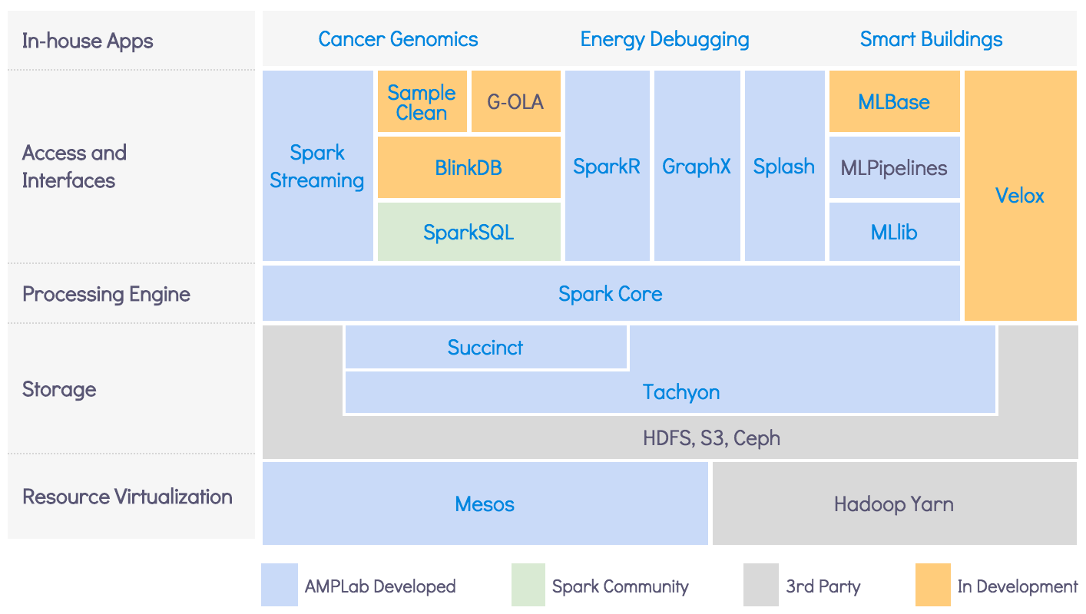
BDAS: Berkeley Data Analytics Stack
Notes:
“BDAS, the Berkeley Data Analytics Stack, is an open source software stack that integrates software components being built by the AMPLab to make sense of Big Data.
BDAS consists of the components shown below.
Components shown in Blue or Green are available for download now.”
- - -
Source:
Image from:
https://amplab.cs.berkeley.edu/software/

Slide 55
Hardware Trends
 | 2010 | 2015
Storage | 50+MB/s (HDD) | 500+MB/s (SSD) | 10X
Network | 1Gbps | 10Gbps | 10X
CPU | ~3GHz | ~3GHz | ☹

Slide 56
Project Tungsten
Substantially speed up execution by optimizing CPU efficiency, via:
Runtime code generation
Exploiting cache locality
Off-heap memory management

Slide 57
Challenge: Data Representation
Java objects often many times larger than underlying fields
class User(name: String, friends: Array[Int])
User(“Bobby”, Array(1, 2))
User
0x…
0x…
int[]
3
1
2
String
0
5
0x…
char[]
5
B
o
b
b
y
Notes:
Here’s a 2nd problem with RDDs… this is more of a VM problem that’s hard to make work well for Java and Python.
You also end up with data structures with a lots of pointers floating around.
This user class has a name and list of friends. And we have a user, Bobby, and 2 friends.
Here we’re looking at the Java objects that get created in the JVM. The only Data is just the string Bobby and the two integers. But 3 or 4 times more space is used up by the structures around them… each object has a header that points to its class has other stuff like letting you lock it. The user object also has a point to an int array, that has it’s own header with a length and all that stuff. The String Bobby also points to an array of characters.

Slide 58
Tungsten’s Compact Encoding
(123, “data”, “bricks”)
Offset to data
0x0
123
32L
48L
4
“data”
6
“bricks”
Offset to data
Field lengths
Null bitmap
Notes:
This is the first phase of Tungsten, and it’s already in Spark.
This slide shows encoding rows of data in binary form.
This is much more efficient than all of the mess of Java objects with pointers between them.
So we have a row with an integer and 2 strings. We basically just stick this into one big array of bytes that is all together. It’s similar to what you may have in a database.
It has a bitmap to say what’s null. It has the integer, the binary data for strings and some pointers to where each string is beginning.
This is all a self-contained object, you can move it around just by itself. It is also a lot smaller than the corresponding Java objects.

Slide 59
From DataFrame to Tungsten
Python
DF
Java/Scala
DF
R
DF
Logical Plan
Initial phase in Spark 1.5
More work coming in 2016
Tungsten
Execution

Slide 60
Unified API, One Engine, Automatically Optimized
language
frontend
SQL
Python
Java/Scala
R
…
DataFrame
Logical Plan
Tungsten
backend
JVM
LLVM
SIMD
3D XPoint
…

Slide 61
You will have access to Databricks and these datasets via Community Edition after class…
Good luck!

