Slide 1



Spark Architecture &
Resource Managers

Slide 2
Slides
https://github.com/lyubent/swedbank/slides

Slide 3





Ways to Run Spark
Local
Static Allocation
Standalone Scheduler
YARN
Dynamic Allocation
Mesos
Notes:
Static vs. Dynamic doesn’t refer to RDD partitioning here…
In cluster mode Spark depends on a cluster manager to launch executors and, in certain cases, to launch the driver. The cluster manager is a pluggable component in Spark.
Each one of these resource managers has different pros and cons. One nice thing about running Spark in YARN, for example, is that you can dynamically resize the # of Executors in the application. This feature is not yet possible in Standalone mode.
Static Partitioning: With this approach, each application is given a maximum amount of resources it can use, and holds onto them for its whole duration.
Mesos: In “fine-grained” mode (default), each Spark task runs as a separate Mesos task. This allows multiple instances of Spark (and other frameworks) to share machines at a very fine granularity, where each application gets more or fewer machines as it ramps up and down, but it comes with an additional overhead in launching each task. This mode may be inappropriate for low-latency requirements like interactive queries or serving web requests.
In Standalone and Mesos course-grained, you can control the maximum number of resources Spark will acquire. By default, it will acquire all cores in the cluster (that get offered by Mesos), which only makes sense if you run just one application at a time. You can cap the max # of cores using conf.set("spark.cores.max", "10") (for example).
Standalone mode: By default, applications submitted to the standalone mode cluster will run in FIFO (first-in-first-out) order, and each application will try to use all available nodes. You can limit the number of nodes an application uses by setting the spark.cores.maxconfiguration property in it, or change the default for applications that don’t set this setting through spark.deploy.defaultCores. Finally, in addition to controlling cores, each application’s spark.executor.memory setting controls its memory use.
YARN: The --num-executors option to the Spark YARN client controls how many executors it will allocate on the cluster, while --executor-memory and --executor-cores control the resources per executor.
The “coarse-grained” mode will instead launch only one long-running Spark task on each Mesos machine, and dynamically schedule its own “mini-tasks” within it. The benefit is much lower startup overhead, but at the cost of reserving the Mesos resources for the complete duration of the application

Slide 4
Local Mode

Slide 5



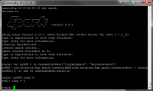
Local Mode
> ./bin/spark-shell --master local[12]
CPUs:
3 options: local, local[N], local[*]
JVM: Ex + Driver
> ./bin/spark-submit --name "MyFirstApp"
--master local[12] myApp.jar
RDD, P1
Task
Task
RDD, P1
Task
Task
RDD, P2
Task
Task
val conf = new SparkConf()
.setMaster("local[12]")
.setAppName(“MyFirstApp")
.set("spark.executor.memory", “3g")
val sc = new SparkContext(conf)
RDD, P2
Task
Task
RDD, P3
Task
Task
Task
Task
Internal Threads
Worker Machine
Disk
Notes:
Local – run spark with one worker thread
Local[N] – run spark with N worker threads
Local[*] – run Spark with as many worker threads as logical cores on your machine
Note, that in local mode a shuffle is not costly! Not good for real performance testing.
Spark can efficiently support tasks as short as 200 ms
- - - -
There are a lot of internal threads (I think shuffle servers alone have 8 threads?), but most of them are just idle and don't do much so I wouldn't worry about the overhead.
You can launch a spark shell on a single node and then run jstack to see what all the threads are doing.
- - -Ask Reynold: In local mode, can students still change the % of memory allocated to tasks vs shuffle vs user code? A) Yes, same thing.

Slide 6
Standalone Mode

Slide 7




Spark Standalone
different spark-env.sh
SPARK_WORKER_CORES
W
W
W
W
Ex
Ex
Ex
Ex
RDD,P1
T
T
RDD,P4
T
T
RDD,P5
T
T
RDD,P7
T
T
RDD,P2
T
T
RDD,P6
T
T
RDD,P3
T
T
RDD,P8
T
T
RDD,P1
T
T
RDD,P1
T
T
RDD,P2
T
T
RDD,P2
T
T
T
T
Internal Threads
T
T
Internal Threads
Internal Threads
Internal Threads
Driver
Spark Master
OS Disk
SSD
SSD
OS Disk
SSD
SSD
OS Disk
SSD
SSD
OS Disk
SSD
SSD
SSD
SSD
SSD
SSD
SSD
SSD
SSD
SSD
> ./bin/spark-submit --name “SecondApp"
--master spark://host4:port1
myApp.jar
vs.
spark-env.sh
SPARK_LOCAL_DIRS
Notes:
Mention how much RAM to give each JVM
Mention that OOMs can happen in the driver or execyutor
There will be 3 masters and the workers… when they start up, they ask ZK where the active master is.
How to separate RDD caches on disk from shuffle data? A) It is not possible right now
Spark_local_dirs: (SSDs) Directory to use for "scratch" space in Spark, including map output files and RDDs that get stored on disk. This should be on a fast, local disk in your system. It can also be a comma-separated list of multiple directories on different disks. NOTE: In Spark 1.0 and later this will be overriden by SPARK_LOCAL_DIRS (Standalone, Mesos) or LOCAL_DIRS (YARN) environment variables set by the cluster manager
- -
On the 2nd machine, we have SPARK_WORKER_CORES set to 10, instead of 6 like all the other machines.
Note, there’s no way to tell a worker that has SPARK_WORKER_CORES set to 15 to just launch Executors with only 10 cores. However, you can start an entire Spark application and say that you only want ‘x’ cores and then some workers will launch Executors, but other workers will not. This could lead to a bit of unbalanced cluster.
- - - -
ZooKeeper:
Utilizing ZooKeeper to provide leader election and some state storage, you can launch multiple Masters in your cluster connected to the same ZooKeeper instance. One will be elected “leader” and the others will remain in standby mode. If the current leader dies, another Master will be elected, recover the old Master’s state, and then resume scheduling. The entire recovery process (from the time the first leader goes down) should take between 1 and 2 minutes. Note that this delay only affects scheduling new applications – applications that were already running during Master failover are unaffected.
After you have a ZooKeeper cluster set up, enabling high availability is straightforward. Simply start multiple Master processes on different nodes with the same ZooKeeper configuration (ZooKeeper URL and directory). Masters can be added and removed at any time.
In order to schedule new applications or add Workers to the cluster, they need to know the IP address of the current leader. This can be accomplished by simply passing in a list of Masters where you used to pass in a single one. For example, you might start your SparkContext pointing to spark://host1:port1,host2:port2. This would cause your SparkContext to try registering with both Masters – if host1 goes down, this configuration would still be correct as we’d find the new leader, host2.
There’s an important distinction to be made between “registering with a Master” and normal operation. When starting up, an application or Worker needs to be able to find and register with the current lead Master. Once it successfully registers, though, it is “in the system” (i.e., stored in ZooKeeper). If failover occurs, the new leader will contact all previously registered applications and Workers to inform them of the change in leadership, so they need not even have known of the existence of the new Master at startup.
Due to this property, new Masters can be created at any time, and the only thing you need to worry about is that new applications and Workers can find it to register with in case it becomes the leader. Once registered, you’re taken care of.

Slide 8
Spark Standalone
different spark-env.sh
SPARK_WORKER_CORES
W
W
W
W
Ex
Ex
Ex
Ex
RDD,P1
T
T
RDD,P4
T
T
RDD,P5
T
T
RDD,P7
T
T
RDD,P2
T
T
RDD,P6
T
T
RDD,P3
T
T
RDD,P8
T
T
RDD,P1
T
T
RDD,P1
T
T
RDD,P2
T
T
RDD,P2
T
T
T
T
Internal Threads
T
T
Internal Threads
Internal Threads
Internal Threads
I’m HA via ZooKeeper
More Masters can be added live
Driver
Spark Master
Spark Master
Spark Master
OS Disk
SSD
SSD
OS Disk
SSD
SSD
OS Disk
SSD
SSD
OS Disk
SSD
SSD
SSD
SSD
SSD
SSD
SSD
SSD
SSD
SSD
> ./bin/spark-submit --name “SecondApp"
--master spark://host1:port1,host2:port2
myApp.jar
vs.
spark-env.sh
SPARK_LOCAL_DIRS
Notes:
Note: In the DataStax distribution, the Spark Master is HA via the C* system table.
There will be 3 masters and the workers… when they start up, they ask ZK where the active master is.
How to separate RDD caches on disk from shuffle data? A) It is not possible right now
Spark_local_dirs: (SSDs) Directory to use for "scratch" space in Spark, including map output files and RDDs that get stored on disk. This should be on a fast, local disk in your system. It can also be a comma-separated list of multiple directories on different disks. NOTE: In Spark 1.0 and later this will be overriden by SPARK_LOCAL_DIRS (Standalone, Mesos) or LOCAL_DIRS (YARN) environment variables set by the cluster manager
- -
On the 2nd machine, we have SPARK_WORKER_CORES set to 10, instead of 6 like all the other machines.
Note, there’s no way to tell a worker that has SPARK_WORKER_CORES set to 15 to just launch Executors with only 10 cores. However, you can start an entire Spark application and say that you only want ‘x’ cores and then some workers will launch Executors, but other workers will not. This could lead to a bit of unbalanced cluster.
- - - -
ZooKeeper:
Utilizing ZooKeeper to provide leader election and some state storage, you can launch multiple Masters in your cluster connected to the same ZooKeeper instance. One will be elected “leader” and the others will remain in standby mode. If the current leader dies, another Master will be elected, recover the old Master’s state, and then resume scheduling. The entire recovery process (from the time the first leader goes down) should take between 1 and 2 minutes. Note that this delay only affects scheduling new applications – applications that were already running during Master failover are unaffected.
After you have a ZooKeeper cluster set up, enabling high availability is straightforward. Simply start multiple Master processes on different nodes with the same ZooKeeper configuration (ZooKeeper URL and directory). Masters can be added and removed at any time.
In order to schedule new applications or add Workers to the cluster, they need to know the IP address of the current leader. This can be accomplished by simply passing in a list of Masters where you used to pass in a single one. For example, you might start your SparkContext pointing to spark://host1:port1,host2:port2. This would cause your SparkContext to try registering with both Masters – if host1 goes down, this configuration would still be correct as we’d find the new leader, host2.
There’s an important distinction to be made between “registering with a Master” and normal operation. When starting up, an application or Worker needs to be able to find and register with the current lead Master. Once it successfully registers, though, it is “in the system” (i.e., stored in ZooKeeper). If failover occurs, the new leader will contact all previously registered applications and Workers to inform them of the change in leadership, so they need not even have known of the existence of the new Master at startup.
Due to this property, new Masters can be created at any time, and the only thing you need to worry about is that new applications and Workers can find it to register with in case it becomes the leader. Once registered, you’re taken care of.

Slide 9
Spark Standalone (multiple apps)
W
W
W
W
Ex
Ex
Ex
Ex
Ex
Ex
Ex
Ex
Driver
Driver
Spark Master
OS Disk
SSD
OS Disk
SSD
OS Disk
SSD
OS Disk
SSD

Slide 10
Spark Standalone (single app)
W
W
W
W
W
W
W
W
Ex
Ex
Ex
Ex
Ex
Ex
Ex
Ex
Driver
Spark Master
OS Disk
SSD
OS Disk
SSD
OS Disk
SSD
OS Disk
SSD
conf/spark-env.sh
SPARK_WORKER_INSTANCES: [default: 1] # of worker instances to run on each machine
SPARK_WORKER_CORES: [default: ALL] # of cores to allow Spark applications to use on the machine
SPARK_WORKER_MEMORY: [default: TOTAL RAM – 1 GB] Total memory to allow Spark applications to use on the machine
SPARK_DAEMON_MEMORY: [default: 512 MB] Memory to allocate to the Spark master and worker daemons themselves
Notes:
You can configure the cluster by setting environment variables in conf/spark-env.sh. Create this file by starting with theconf/spark-env.sh.template, and copy it to all your worker machines for the settings to take effect.
Regarding SPARK_WORKER_INSTANCES:
You can make this more than 1 if you have very large machines and would like multiple Spark worker processes. If you do set this, make sure to also set SPARK_WORKER_CORES explicitly to limit the cores per worker, or else each worker will try to use all the cores.
About SPARK_WORKER_MEMORY:
…note that each application's individual memory is configured using its spark.executor.memory property.

Slide 11
Standalone Settings
Apps submitted will run in FIFO mode by default
spark.cores.max: maximum amount of CPU cores to request for the application from across the cluster
spark.executor.memory: Memory for each executor
Notes:
You cannot say how many executors you want in Standalone mode…

Slide 12
YARN Mode

Slide 13
YARN Benefits
Allows for multiple data processing engines against HDFS or HBase
Dynamically allocates cluster resources and improves utilization over static MR-v
Better scalability in the future (>5,000 node clusters)
Can run multiple Executors on each node for a single Spark App w/ just one NodeManager
Solid Kerberos integration
Allow applications to request specific nodes for scheduling tasks

Slide 14
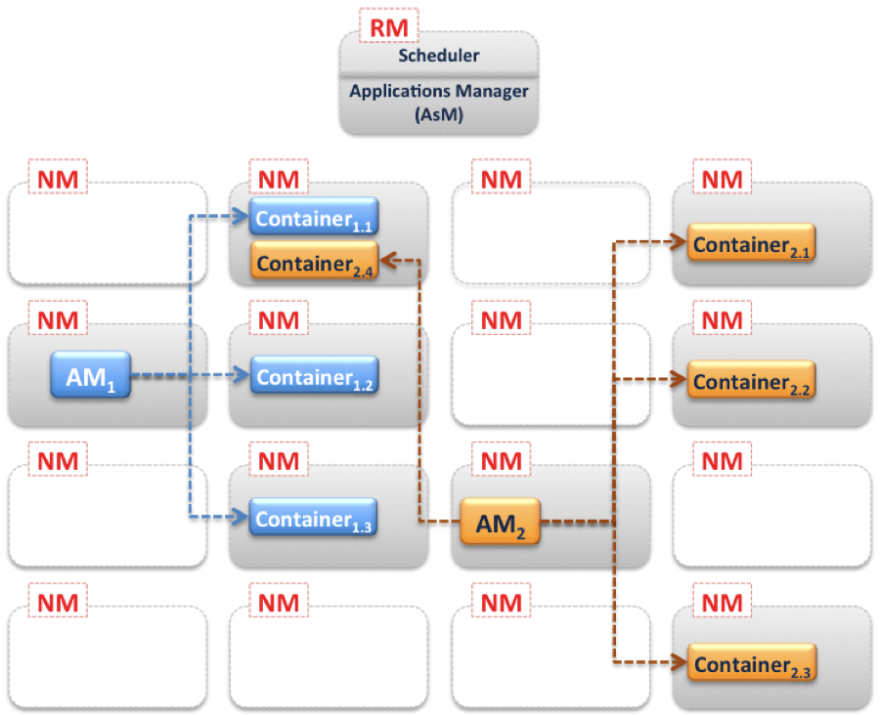
YARN
Source: Cloudera Blog

Slide 15
YARN Settings
http://spark.apache.org/docs/latest/running-on-yarn.html

Slide 16
Spark YARN
Resource
Manager
1
Client #1
2
3
4
5
8
NodeManager
NodeManager
NodeManager
6
6
App Master
Container
Container
7
7
Notes:
The NodeManagers are heartbeating with the Resource Manager and always sharing live resources information.
1) A client program submits the application, including the necessary specifications to launch the application-specific ApplicationMaster itself.
2) The ResourceManager assumes the responsibility to negotiate a specified container in which to start the ApplicationMaster and then launches the ApplicationMaster. Per Andrew: Technically the RM negotiates with the NM to launch a generic container, within which the AppMaster code is instantiated.
3) The ApplicationMaster, on boot-up, registers with the ResourceManager – the registration allows the client program to query the ResourceManager for details, which allow it to directly communicate with its own ApplicationMaster.
4+5) During normal operation the ApplicationMaster negotiates appropriate resource containers via the resource-request protocol.
6) On successful container allocations, the ApplicationMaster launches the container by providing the container launch specification to the NodeManager. The launch specification, typically, includes the necessary information to allow the container to communicate with the ApplicationMaster itself.
7) The application code executing within the container then provides necessary information (progress, status etc.) to its ApplicationMaster via an application-specific protocol.
8) During the application execution, the client that submitted the program communicates directly with the ApplicationMaster to get status, progress updates etc. via an application-specific protocol.
9) Once the application is complete, and all necessary work has been finished, the ApplicationMaster deregisters with the ResourceManager and shuts down, allowing its own container to be repurposed.

Slide 17
Spark YARN
Client #1
Resource
Manager
I’m HA via ZooKeeper
Scheduler
Client #2
Apps Master
NodeManager
NodeManager
NodeManager
App Master
App Master
Container
Container
Container
Container
Notes:
Application: This may be a single job, a sequence of jobs, a long-running service issuing new commands as needed or an interactive exploration session.
Spark Driver: The Spark driver is the process running the spark context (which represents the application session). This driver is responsible for converting the application to a directed graph of individual steps to execute on the cluster. There is one driver per application.
Spark Application Master: The Spark Application Master is responsible for negotiating resource requests made by the driver with YARN and finding a suitable set of hosts/containers in which to run the Spark applications. There is one Application Master per application.
Spark Executor: A single JVM instance on a node that serves a single Spark application. An executor runs multiple tasks over its lifetime, and multiple tasks concurrently. A node may have several Spark executors and there are many nodes running Spark Executors for each client application.
Spark Task: A Spark Task represents a unit of work on a partition of a distributed dataset.

Slide 18

Spark YARN (client mode)
Client #1
Resource
Manager
Driver
NodeManager
NodeManager
NodeManager
Container
App Master
Container
Executor
Executor
RDD
T
RDD
T
Notes:
In client mode (the default), the driver runs on the machine where you executed spark-submit , as part of the spark-submit command.
In yarn-client mode, the driver runs in the client process, and the application master is only used for requesting resources from YARN.
This means that you can directly see the output of your driver program, or send input
to it (e.g. for an interactive shell), but it requires that the machine where you submitted from has fast connectivity to the workers and stays available for the duration of your application. In contrast, in cluster mode, the driver is launched within the standalone cluster, as another process on one of the worker nodes, and then it connects back to request executors. This makes spark-submit more “fire-and-forget”, in that you can close your laptop while the application is running.

Slide 19
Spark YARN (cluster mode)
Resource
Manager
Does not support Spark Shells
Client #1
NodeManager
NodeManager
NodeManager
Container
App Master
Container
Executor
Executor
RDD
T
RDD
T
Container
Driver
Executor
RDD
T
Notes:
When running Spark on YARN, each Spark executor runs as a YARN container. Where MapReduce schedules a container and fires up a JVM for each task, Spark hosts multiple tasks within the same container. This approach enables several orders of magnitude faster task startup time.
Broadly, yarn-cluster mode makes sense for production jobs, while yarn-client mode makes sense for interactive and debugging uses where you want to see your application’s output immediately.
In yarn-cluster mode, the driver runs in the Application Master. This means that the same process is responsible for both driving the application and requesting resources from YARN, and this process runs inside a YARN container. The client that starts the app doesn’t need to stick around for its entire lifetime.
Understanding the difference requires an understanding of YARN’s Application Master concept. In YARN, each application instance has an Application Master process, which is the first container started for that application. The application is responsible for requesting resources from the ResourceManager, and, when allocated them, telling NodeManagers to start containers on its behalf. Application Masters obviate the need for an active client — the process starting the application can go away and coordination continues from a process managed by YARN running on the cluster.

Slide 20
YARN Settings
--num-executors: controls how many executors will be allocated
--executor-memory: RAM for each executor
--executor-cores: CPU cores for each executor
Dynamic Allocation:
spark.dynamicAllocation.enabled
spark.dynamicAllocation.minExecutors
spark.dynamicAllocation.maxExecutors
spark.dynamicAllocation.sustainedSchedulerBacklogTimeout (N)
spark.dynamicAllocation.schedulerBacklogTimeout (M)
spark.dynamicAllocation.executorIdleTimeout (K)
https://github.com/apache/spark/blob/master/core/src/main/scala/org/apache/spark/ExecutorAllocationManager.scala
Notes:
In Mesos and Standalone mode, Spark will greedily acquire as many cores and executors as are offered by the scheduler. However, both Mesos and Stand‐alone mode support setting spark.cores.max to limit the total number of cores across
all executors for an application.

Slide 21
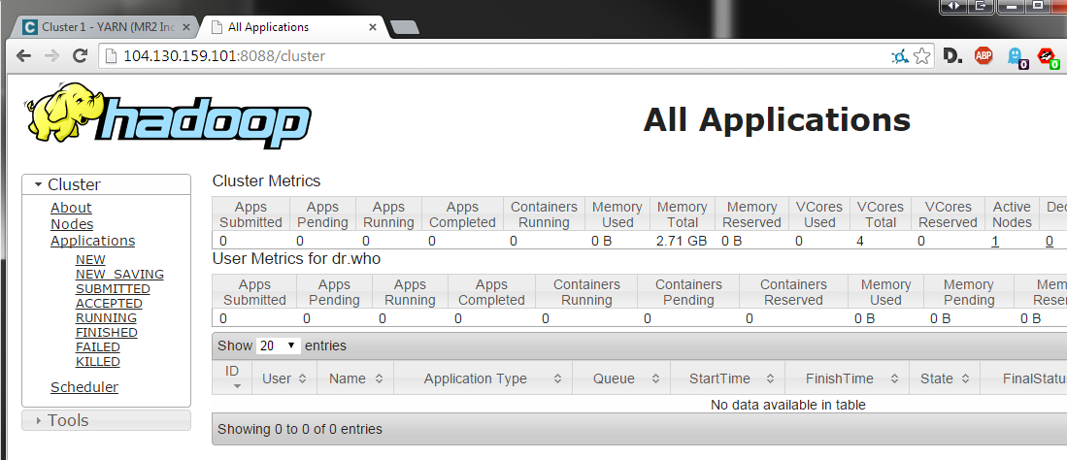
YARN Resource Manager UI
No apps running
http://<ip address>:8088

Slide 22
Starting in “client” mode
[ec2-user@ip-10-0-72-36 ~]$ spark-submit
--class org.apache.spark.examples.SparkPi
--deploy-mode client
--master yarn
/opt/cloudera/parcels/CDH-5.2.1-1.cdh5.2.1.p0.12/jars/spark-examples-1.1.0-cdh5.2.1-hadoop2.5.0-cdh5.2.1.jar
10
Notes:
Note that in client mode, the output from the Spark app is sent directly back to the cmd-line.

Slide 23
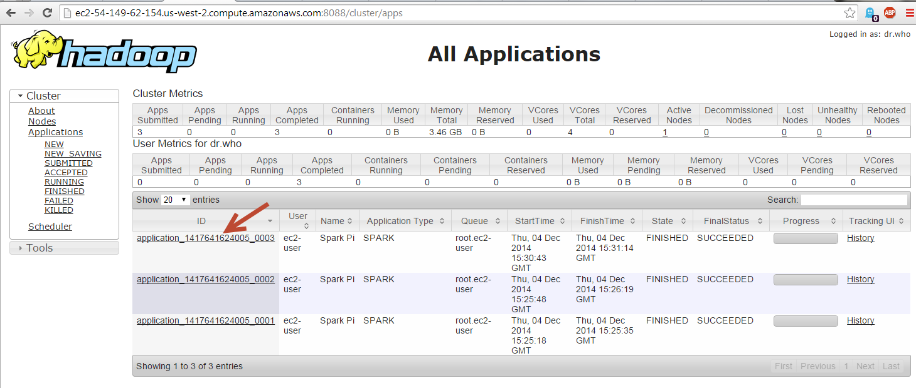
YARN Resource Manager UI
App running in client mode
Notes:
Let’s click on an app to see the details…

Slide 24
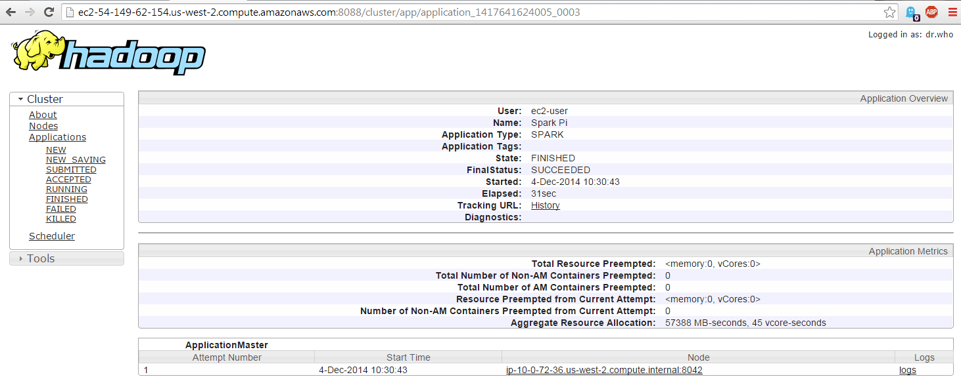
YARN Resource Manager UI
App running in client mode

Slide 25
Starting in “cluster” mode
[ec2-user@ip-10-0-72-36 ~]$ spark-submit
--class org.apache.spark.examples.SparkPi
--deploy-mode cluster
--master yarn
/opt/cloudera/parcels/CDH-5.2.1-1.cdh5.2.1.p0.12/jars/spark-examples-1.1.0-cdh5.2.1-hadoop2.5.0-cdh5.2.1.jar
10
Notes:
Notice that this time, the output is not shown on the cmd line. The output will be printed to the stdout log file for the application.

Slide 26
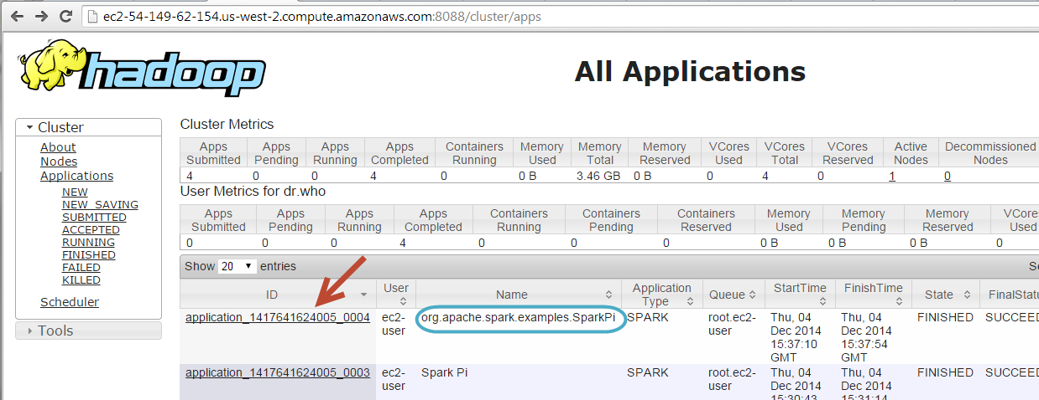
YARN Resource Manager UI
App running in cluster mode

Slide 27
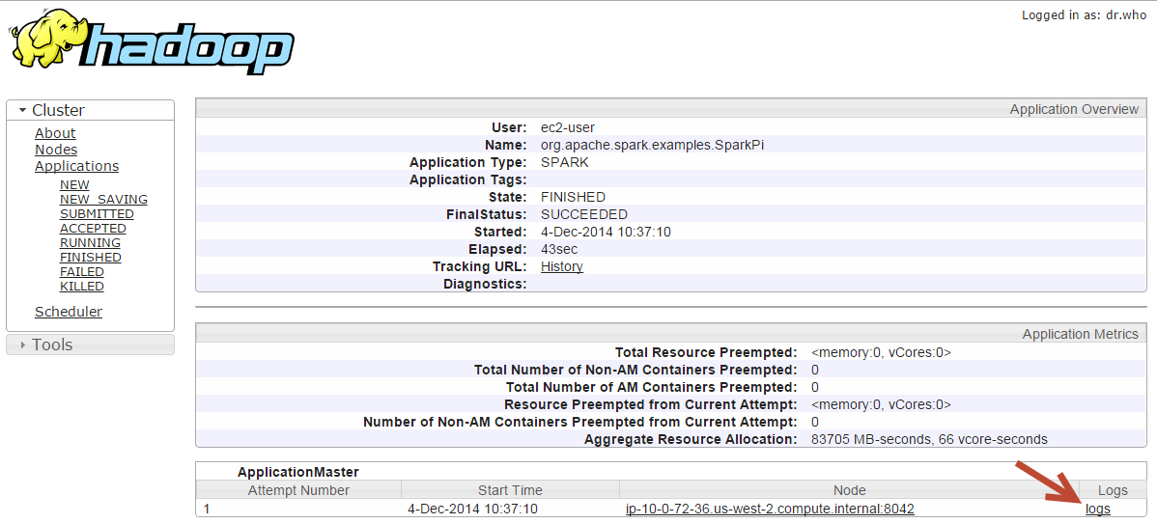
YARN Resource Manager UI
App running in cluster mode

Slide 28
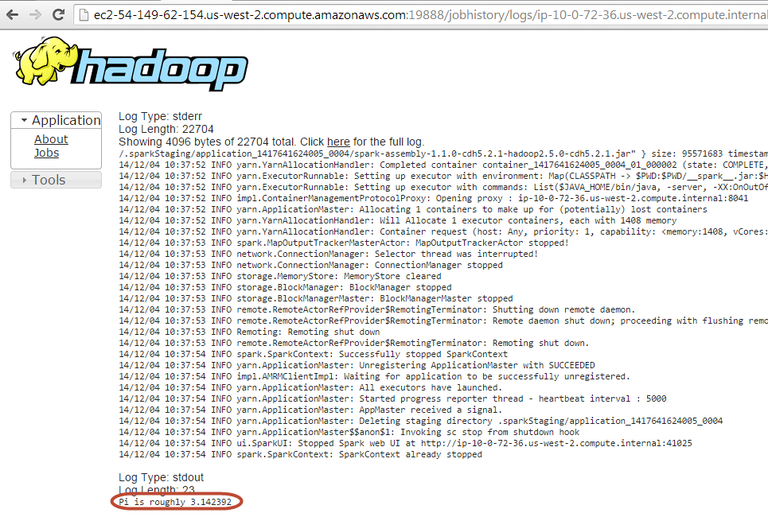
YARN Resource Manager UI
App running in cluster mode

Slide 29
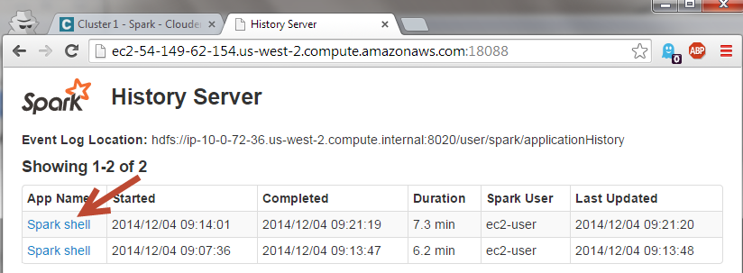
History Server
Notes:
History Server is another Spark JVM that by defaults takes 512 MB of RAM.
Spark’s Standalone Mode cluster manager also has its own web UI. If an application has logged events over the course of its lifetime, then the Standalone master’s web UI will automatically re-render the application’s UI after the application has finished.
If Spark is run on Mesos or YARN, it is still possible to reconstruct the UI of a finished application through Spark’s history server, provided that the application’s event logs exist. You can start the history server by executing:
./sbin/start-history-server.sh

Slide 30
Pluggable Resource Management
 | Spark Central Master | Who starts Executors? | Tasks run in
Local | [none] | Human being | Executor
Standalone | Standalone Master | Worker JVM | Executor
YARN | YARN App Master | Node Manager | Executor
Mesos | Mesos Master | Mesos Slave | Executor

Slide 31
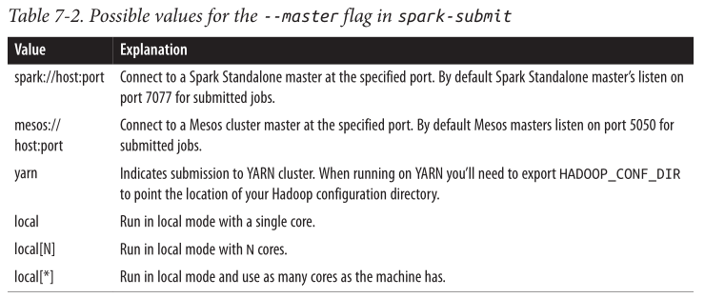

Deploying an App to the Cluster
spark-submit provides a uniform interface for submitting jobs across all cluster managers
bin/spark-submit --master spark://host:7077
--executor-memory 10g
my_script.py
Source: Learning Spark

Slide 32
Summary
To summarize the concepts in this section, let’s walk through the exact steps that occur when you run a Spark application on a cluster.
The user submits an application using spark-submit.
spark-submit launches the driver program and invokes the main method specified by the user.
The driver program contacts the cluster manager to ask for resources to launch executors.
The cluster manager launches executors on behalf of the driver program.
The driver process runs through the user application. Based on the RDD actions and transformations in the program, it sends work to executors in the form of tasks.
Tasks are run on executor processes to compute and save results.
Source: Learning Spark

Slide 33
Dynamic Resource Allocation
Each Spark application scales the number of executors up and down based on workload
If executors are idle, remove them
If we need more executors, request them

Slide 34
Execution Model In
Job 1
Task 1
Task 7
Task 2
Task 4
Task 8
Task 3
Task 5
Task 9
Executor 1
Executor 2
Executor 3
In Spark, each executor is long-running and runs many small tasks
Notes:
Spark = granular pipelined tasks

Slide 35

Execution Model is Different
Hadoop MapReduce
Reduce Task 1
Map Task 2
Reduce Task 2
Container 4
Container 2
Container 5
In MapReduce, each container is short-lived and runs one large task
Notes:
MR = heaviy Map or Reduce tasks

Slide 36
Static Resource Allocation
Resource
(CPU / Mem)
Allocated
Used
Time
More resources allocated than used…

Slide 37
Static Resource Allocation
Resource
(CPU / Mem)
Allocated
Used
Time
More resources allocated than used

Slide 38
Dynamic Resource Allocation
Resource
(CPU / Mem)
Allocated
Used
Time
More efficient utilization of cluster resources
Notes:
Spark is fast because it reuses cluster resources
Spark holds onto resources for a long time
Dynamic allocation allows you to benefit from the former without suffering the latter

Slide 39
Dynamic Allocation
spark.dynamicAllocation.enabled
spark.dynamicAllocation.minExecutors
spark.dynamicAllocation.maxExecutors
spark.dynamicAllocation.sustainedSchedulerBacklogTimeout (N)
spark.dynamicAllocation.schedulerBacklogTimeout (M)
spark.dynamicAllocation.executorIdleTimeout (K)
https://github.com/apache/spark/blob/master/core/src/main/scala/org/apache/spark/ExecutorAllocationManager.scala
Notes:
In Mesos and Standalone mode, Spark will greedily acquire as many cores and executors as are offered by the scheduler. However, both Mesos and Stand‐alone mode support setting spark.cores.max to limit the total number of cores across
all executors for an application.

Slide 40
Dynamic Allocation Use Cases
Long-running ETL jobs
e.g. Parsing JSON into Parquet in S3
Interactive applications / server
e.g. Spark shell, Ooyala job server
Any application with large shuffles

Slide 41










Who is Using Dynamic Allocation?

Slide 42
External Shuffle Service
Must turn this on for dynamic allocation in YARN
Worker JVM serves files
Node Manager serves files
Notes:
External shuffle service.
If you want to use dynamic allocation in YARN, you have to turn this on also.
The Executors will still write out the files after the map runs.
But what if an Executor dies or gets terminated?
You need another process to serve the shuffle files to the Reducers.
In Standalone Mode, Worker JVM is used to serve the files. In YARN, the NodeManager JVM is used (via an auxiliary service)
To enable this service in Standalone mode, set spark.shuffle.service.enabled to true. In YARN, this external shuffle service is implemented in org.apache.spark.yarn.network.YarnShuffleService that runs in each NodeManager in your cluster.

Slide 43
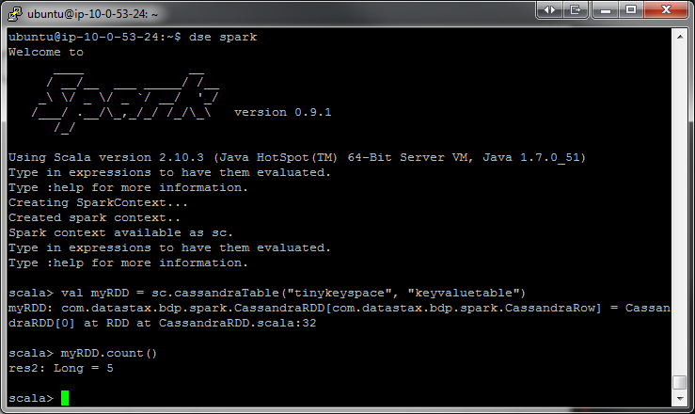
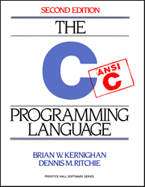

PySpark at a Glance
Write Spark jobs in Python
Run interactive jobs in the shell
Supports C extensions

Slide 44
PySpark to Java API
41 files
8,100 loc
6,300 comments
Spark Core Engine
(Scala)
PySpark
Java API
Local
Standalone Scheduler
YARN
Mesos
Notes:
Built on top of the Java API. It’s a very thin layer that sits on top of Scala and Java Spark.
It provides a way to get data in and out of python and it reuses a lot of the Spark Scala functionality.

Slide 45
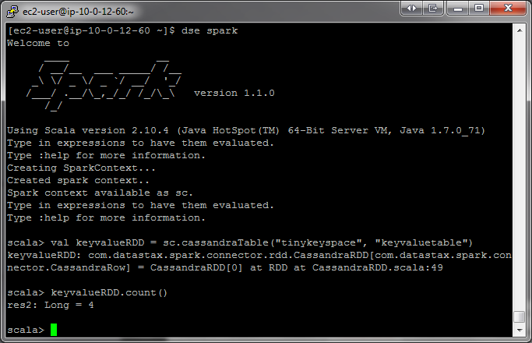
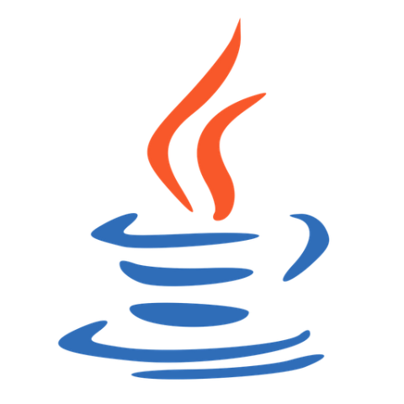

PySpark Architecture
daemon.py
RDD
Pipe
F(x)
RDD
Spark Context
Controller
Py4j
Spark Context
F(x)
Socket
MLlib, SQL, shuffle
Executor JVM
F(x)
Driver JVM
daemon.py
RDD
Pipe
F(x)
Local Disk
MLlib, SQL, shuffle
F(x)
Executor JVM
RDD
Driver Machine
Worker Machine
Notes:
TO-DO: Ask josh about UDFs… running in JVM< or Python PID
Py4J enables Python programs running in a Python interpreter to dynamically access Java objects in a Java Virtual Machine. Essentially, you just call Java methods from your python code as if they were python methods.
These are executor JVMs where num_cores = 2
In the Executor JVM, Pyrolite is used to unpickle the data or to pickle it. “This library allows your Java or .NET program to interface very easily with the Python world. It uses the Pyro protocol to call methods on remote objects. (See https://github.com/irmen/Pyro4). Pyrolite contains and uses a feature complete pickle protocol implementation to exchange data with Pyro/Python. “
Why does the local disk get used on the driver machine? Py4J is very inefficient for transferring large data b/c it uses a text based protocol.. It has to encode in base 64 so really slow. A collect or broadcast may be huge, so Py4j writes one file to the local FS. The final unpickling happens in the Python process on the Driver Machine.
Python functions and closures (with dependencies) are serialized using PiCloud’s CloudPickle module
You could also use Py4J. There is an example on the frontpage and lots of documentation, but essentially, you just call Java methods from your python code as if they were python methods:
You first write a java program where you create a class and run that java program in a JVM. Then you write a Python program that can access that java object via a network socket.
Here is what happens behind the scenes.
On my local machine, I have the Spark Context object… top level entry point for Spark.. Used to create RDDs. SC runs in the Python process.
When a SC is made, behind the scenes it creates a Java Spark context, running on top of regular Spark. Py4J is used to talk (copy data) between a JVM and python using reflection so you can call a java method just as if it was a native python method. It’s pretty cool.
So the python Spark Context is controlling the Java Spark Context. A local file system is also used for communication through multiple files for doing things like collecting results.
The integration with Py4J and Python is fine for like control point stuff, but you don’t want to transfer a whole lot of data through it because reflection is just too expensive.
When you submit a job to the cluster, your job (the Python transformations and stuff) gets mapped down to just a few transformations on this special Python RDD object. Behind the scenes when these objects are shipped to the Spark executor, they actually spin up a bunch of actual python processes. And the Spark Executors communicate with the Python code over pipes using a special format to pass the functions that the user is writing.
SO The executor will pipe all the data into the python processes, get all the results back and serialize it and transfer it.
Naturally, there is some serialization involved
there is one Python process per executor thread (we need this due to Python’s GIL so that CPU-bound tasks can benefit from multiple cores). In older versions of PySpark, we’d end up launching a new Python worker process per task. In newer versions (1.2.0+), executors launch Python processes as needed, keep them around in a pool, and terminate them if they’re idle for too long (1 minute by default); see https://github.com/apache/spark/pull/2259 and the followup patches for more details. The actual subprocess architecture is a little bit complicated because we use a separate process for managing the Python worker processes in order to work around some fork() performance issues in the JVM. This may mean that you’ll see up to 5 Python processes on an executor with 4 threads: one Python process per core, plus the daemon.py middle layer; see https://github.com/apache/spark/pull/1680 for some additional context.
Python UDFs are executed in regular Python interpreters, so things like sc.map(lambda x: some_arbitrary_python_code(x)) are run in Python interpreters, not through anything like Jython. Spark SQL and MLlib may actually end up executing code that runs in the JVM for doing heavy number-crunching and I expect that we’ll see more in-JVM execution of certain operations in future versions of Spark.
See also: the (woefully out-of-date) PySpark internals page on the Spark wiki: https://cwiki.apache.org/confluence/display/SPARK/PySpark+Internals. I really ought to update this page to reflect some of these recent developments.

Slide 46

Reading from HDFS
HadoopRDD
MappedRDD
PythonRDD

Slide 47

Choose Your Python Implementation
CPython
(default python)
Spark Context
pypy
JIT, so faster
less memory
CFFI support
Worker Machine
Driver Machine
$ PYSPARK_DRIVER_PYTHON=pypy PYSPARK_PYTHON=pypy ./bin/pyspark
OR
$ PYSPARK_DRIVER_PYTHON=pypy PYSPARK_PYTHON=pypy ./bin/spark-submit wordcount.py
Notes:
CPython is the original Python implementation. It is the implementation you download from Python.org. CPython compiles your python code into bytecode (transparently) and interprets that bytecode in a evaluation loop. So CPython does not translate your Python code to C by itself. It instead runs a interpreter loop. There is a project that does translate Python-ish code to C, and that is called Cython.
Pypy uses just in time compilation (JIT) or dynamic translation, so it runs faster. This means that compilation is done during the execution of the program (at run time) rather than just prior to execution.
- - -
CFFI: C Foreign Function Interface for Python. The goal is to provide a convenient and reliable way to call compiled C code from Python using interface declarations written in C.
- - -
Pypy uses just in time compilation (JIT) or dynamic translation, so it runs faster. This means that compilation is done during the execution of the program (at run time) rather than just prior to execution.
A JIT compiler is a program that turns Java bytecode (instructions that must be interpreted) into instructions that can be sent directly to the processor.
After you've written a Java program, the source language statements are compiled by the Java compiler into bytecode rather than into code that contains instructions that match a particular hardware platform's processor (for example, an Intel Pentium microprocessor or an IBM System/390 processor). The bytecode is platform-independent code that can be sent to any platform and run on that platform.
In the past, most programs written in any language have had to be recompiled, and sometimes, rewritten for each computer platform. One of the biggest advantages of Java is that you only have to write and compile a program once. The Java on any platform will interpret the compiled bytecode into instructions understandable by the particular processor. However, the virtual machine handles one bytecode instruction at a time. Using the Java just-in-time compiler (really a second compiler) at the particular system platform compiles the bytecode into the particular system code (as though the program had been compiled initially on that platform). Once the code has been (re-)compiled by the JIT compiler, it will usually run more quickly in the computer.
- - -
Good explanation of JIT:
A JIT compiler runs after the program has started and compiles the code (usually bytecode or some kind of VM instructions) on the fly (or just-in-time, as it's called) into a form that's usually faster, typically the host CPU's native instruction set. A JIT has access to dynamic runtime information whereas a standard compiler doesn't and can make better optimizations like inlining functions that are used frequently.
This is in contrast to a traditional compiler that compiles all the code to machine language before the program is first run.
To paraphrase, conventional compilers build the whole program as an EXE file BEFORE the first time you run it. For newer style programs, an assembly is generated with pseudocode (p-code). Only AFTER you execute the program on the OS (e.g., by double-clicking on its icon) will the (JIT) compiler kick in and generate machine code (m-code) that the Intel-based processor or whatever will understand.
- - - - -
Research: https://github.com/apache/spark/blob/master/bin/pyspark#L54
https://github.com/apache/spark/pull/2144

Slide 48
Python Benchmarks
The performance speed up will depend on work load (from 20% to 3000%).
Here are some benchmarks:
Job | CPython 2.7 | PyPy 2.3.1 | Speed up
Word Count | 41 s | 15 s | 2.7 x
Sort | 46 s | 44 s | 1.05 x
Stats | 174 s | 3.6 s | 48 x
Here is the code used for benchmark:
rdd = sc.textFile("text")
def wordcount():
rdd.flatMap(lambda x:x.split('/'))\
.map(lambda x:(x,1)).reduceByKey(lambda x,y:x+y).collectAsMap()
def sort():
rdd.sortBy(lambda x:x, 1).count()
def stats():
sc.parallelize(range(1024), 20).flatMap(lambda x: xrange(5024)).stats()
https://github.com/apache/spark/pull/2144

Slide 49
Default Python Worker process size

