Slide 1
Book Search Application
COS 2021A Course Project

Slide 2
Purpose of Course Project
My course project is designed to help the customers of the Readers’ Society bookstore in Blagoevgrad find the perfect book
My project is a console application that lists the five best books for the user, given their specific input
The books are chosen with the help of a polymorphic function - Search(), which considers the preferences of the user (age, gender, interests), and uses them to evaluate how appropriate a given book is

Slide 3
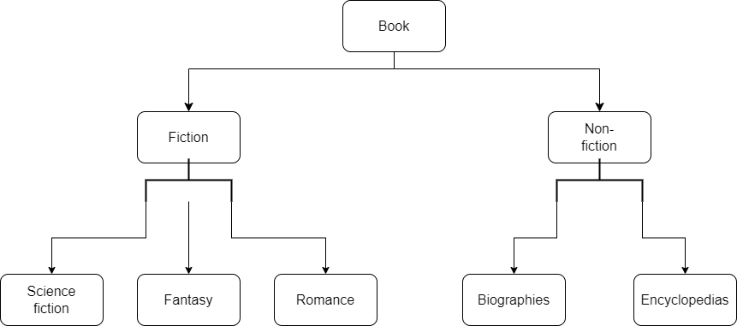
Classification of Books
The books offered at the bookstore are classified by genre
There are five genres:
Science Fiction
Fantasy
Romance
Biographies
Encyclopedias
Hierarchy of the genres (classes)

Slide 4
Search() Function - Input
int Search(SearchCriteria s)
It takes as input the following struct, which represents the user’s preferences:
struct SearchCriteria {
int age; // Age of the reader //
double maxPrice; // Maximum price the user is willing to pay for a book //
Gender g; // enum (male, female, other) //
Context c; // enum (school, vacation, home, work, gift) //
PersonalInterests p; // enum (sport, science, technology, celebrities, history, mythology) //
};

Slide 5
Search() Function - Output
The function outputs a “grade” for each book
The grade is a numerical estimation of how likely the user is to enjoy a given book
Axiom:
0 <= grade <= 100

Slide 6
Search() – Sample Implementation
class ScienceFiction : public Fiction {
private:
int scientificAccuracy; // 0-100 based on how scientifically accurate the book is
int actionLevel; // 0-100 based on how much action takes place in the book
public:
virtual int Search(SearchCriteria s2) {
if (price > s2.maxPrice) { // if book is too expensive, it immediately receives a zero
return 0;
}
double weightAge = 0.1, weightGender = 0.1, weightContext = 0.2, weightInterests = 0.4, weightAccuracy = 0.1, weightAction = 0.1;
int ageR, genderR, contextR, interestR; // age relevance, gender relevance, etc.
int grade;
// These variables will be used to calculate the grade. grade = weightAge*ageR + weightGender*genderR + ...

Slide 7
Sample Implementation (Cont.)
{
return 80 + weightAccuracy * scientificAccuracy + weightAction * actionLevel;
}
// Calculating age relevance
if (s2.age < 13) { ageR = 0; }
else if (13 <= s2.age && s2.age <= 25) { ageR = 100; }
else if (25 < s2.age && s2.age <= 40) { ageR = 60; }
else { ageR = 50; }
// A child that is no more than 12 years old and doesn't have any interest in science or technology would not enjoy sci-fi books
if (s2.age < 13 && s2.p != science && s2.p != technology) {
return 0;
}
// A person above the age of 13 with an interest in science/technology who is searching for a book to read at home/on vacation is very likely to enjoy sci-fi books
if (s2.age > 13 && (s2.p == science || s2.p == technology) && (s2.c == home || s2.c == vacation))

Slide 8
Sample Implementation (Cont.)
// Calculating gender relevance
if (s2.g == male) { genderR = 60; }
else if (s2.g == female) { genderR = 40; }
else { genderR = 50; }
//Calculating context relevance
switch (s2.c) {
case school:
contextR = 0;
break;
case work:
contextR = 0;
break;
case home:
contextR = 100;
break;
case vacation:
contextR = 80;
break;
case gift:
contextR = 50;
break;
// no default case needed since context is guaranteed to match one of these cases by stringToEnumC()
}

Slide 9
Sample Implementation (Cont.)
switch (s2.p) {
case sport:
interestR = 0;
break;
case celebrities:
interestR = 0;
break;
case history:
interestR = 20;
break;
case technology:
interestR = 80;
break;
case science:
interestR = 100;
break;
case mythology:
interestR = 20;
break;
} // no default case needed as above
grade = weightAge * ageR + weightGender * genderR + weightContext * contextR + weightInterests * interestR + weightAccuracy * scientificAccuracy + weightAction * actionLevel;
return grade;
}

Slide 10
Algorithms Used
When all books are graded, they are sorted by their grade
The sorting algorithm used is called Introsort
Introsort – a hybrid between Quicksort, Heapsort, and Insertion Sort
Best, average, and worst-case performance of O(NlogN)
Introsort is so efficient because it begins with Quicksort and if the recursion depth exceeds 2logN, it switches to Heapsort. This avoids Quicksort’s O(n^2) worst-case complexity
Implemented through std::sort() function

Slide 11
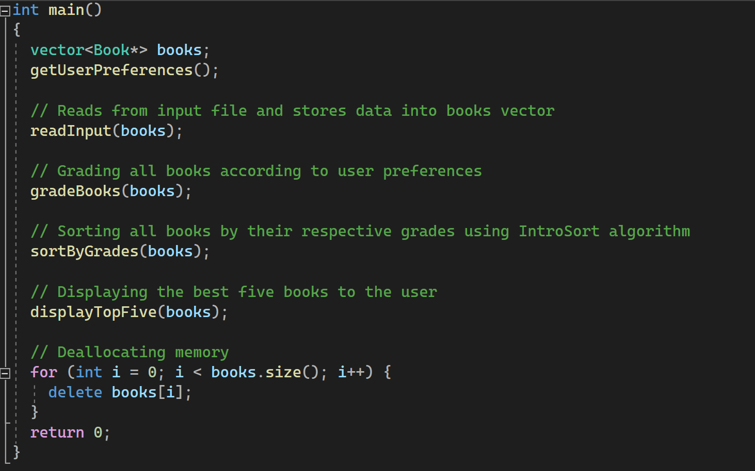
Main function of the program

Slide 12
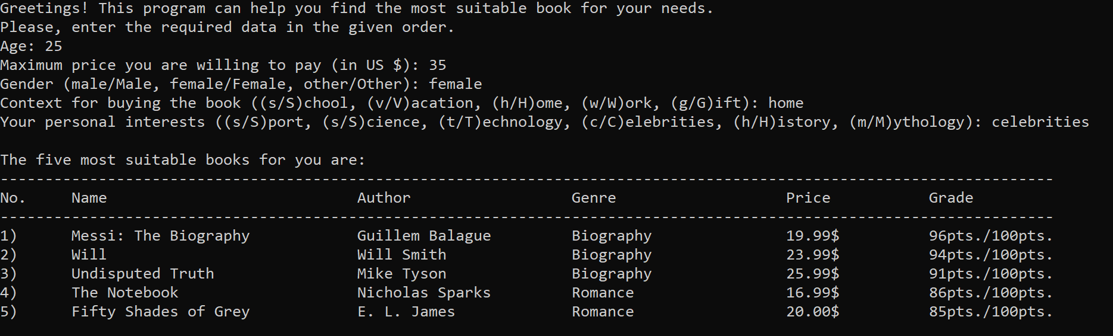
Sample Output of the Program

Slide 13
Thank you for your attention!
Presentation and project by:
Lyuboslav Gigov

