Slide 1
Memory Allocation
Device Memory
Host Memory
CSR vertices
10G/8G/6G
(reallocate every time)
cudaMalloc
1
5
CSR offsets
|V| + 1
cudaMalloc
4
Source Vertices
# Max source
cudaMallocHost
2
C1, C2
cudaMalloc
4
C Host
cudaMallocManaged
3
Temp space
1.4G + 1.4G = ~2.8G
cudaMalloc
Leave 100 MB for other variables
TODO: divide memory into half-half

Slide 2
0 | 2 | 4 | 7 | 7 | 7 | 7
Host Memory
0
1
0 | 2 | 4 | 7 | 10 | 12 | 14
1 | 2 | 0 | 2 | 0 | 1 | 3 | 2 | 4 | 5 | 3 | 5 | 3 | 4
2
BIN ID
3
0 | 0 | 0 | 1 | 1 | 1
4
5
Pinned Memory Pages on CPU

Slide 3
Main thread
0
Released Queue
Assigned Queue

Slide 4


Materializing
Released Queue
Producer
0
Assigned Queue

Slide 5
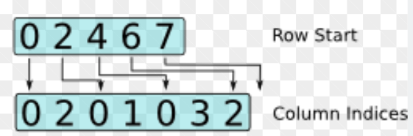
Waiting to pop
Producer
Released Queue
0
Assigned Queue
BIN 0
Pinned Memory Page on CPU

Slide 6

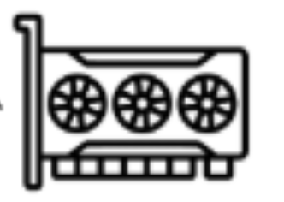
Waiting to pop
Producer
Released Queue
Assigned Queue
0
Consumer
Transferring
GPU

Slide 7
Waiting to pop
0
Producer
Released Queue
Assigned Queue
Consumer
Computing
GPU

