Slide 1
Shared Note
Upload, View, Edit, Annotate
Team48
Ziyi Yan, Zhengyu Sun, Lyuliang Liu

Slide 2
Part One
Sprint 2 Goals

Slide 3
Sprint Goals
1 Display different styles of Badges based on file type
2 Modify the dropdown menu for user
3 Display different styles of Badges based on file type
New Features
Upload and display, Annotate on PDF
Annotate and Save annotated PDF
Create File Online which supports html formartting
Download File and Student Portal

Slide 4
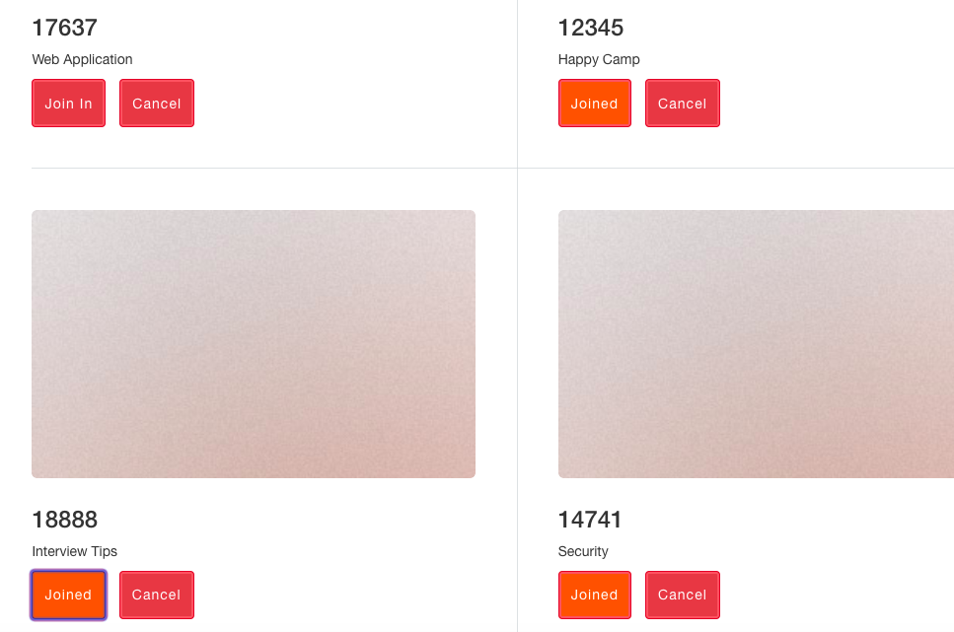
Student Portal
Join in and cancel
Courses
Save Choices By
Clicking Save Button

Slide 5
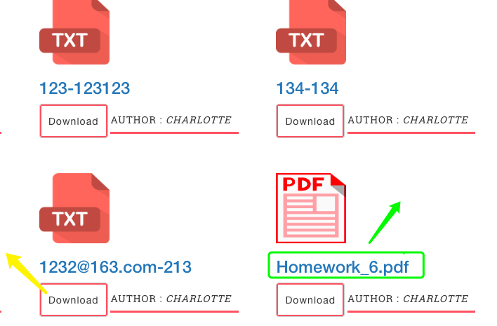
PDF-related Functions
View Note
Click Filename
to view the content
- Download The Note

Slide 6
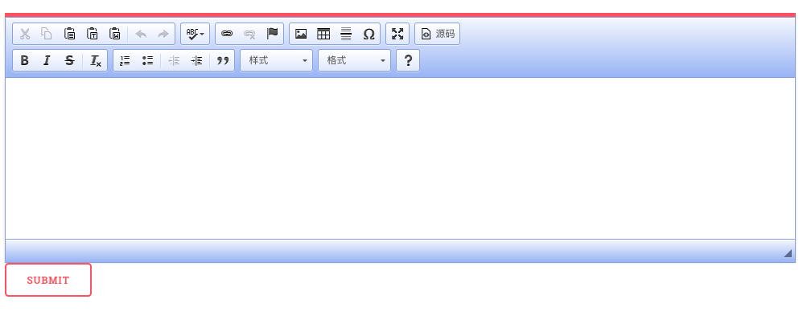
Text -related Functions
Type In Text
Support Different Formarts

Slide 7
Part Two
Problems and Solutions

Slide 8
PDF Display
Save Annotated PDF
It’s hard to deal with .pdf than with .txt
Using pdf.js to display PDF and other plugins to finish Annotation Functions
First We try to save All Annotations as JSON, but parsing annotation from and to JSON is hard
Finally we choose to save
annotation with PDF

Slide 9
Part Three
Further Goals for Sprint 3

Slide 10
In-Mail
Advanced Annotation
Professor Can send announcements to all students
All uses can send one-to-one message
Send and Accept Friend Request
Highlight Text
Comment with Picture
Delete Annotation

Slide 11
Thanks!
Presented by Zoey

