Slide 1
Travel Evidence Pack
USDA Rural Development — Centralized Training Site Analysis
Real captured quotes: flights (ITA Matrix) & hotels (us.trip.com)
Training dates Nov 29 – Dec 1, 2026 | Trip Nov 28 – Dec 2 (4 nights) | 24 attendees
All quotes queried 2026-10-24 (UTC), in USD. Links to conference_budget.xlsx (Options/Sources).

Slide 2
How these screenshots were captured
Provenance & limitations — read before relying on figures
• Flights — ITA Matrix (matrix.itasoftware.com): round trip DCA↔destination, depart 2026-11-28, return 2026-12-02, 1 adult. Fares are total incl. taxes/carrier fees per ticket; cheapest may be Basic Economy.
• Hotels — us.trip.com: destination city list, check-in 2026-11-28 / check-out 2026-12-02 (4 nights), 1 room / 1 adult, currency USD. Nightly figure excludes taxes & fees; 'Total price' includes them.
• Screening standard applied to hotels: guest rating ≥ 8.0/10, ≥ 50 reviews, breakfast included or separately budgeted, and nightly rate at/below the FY2027 GSA lodging cap on every night.
• These are single-seat / single-room PUBLIC quotes captured on one date. They are NOT bookings, NOT held inventory, and NOT group rates. Group airfare inventory and a 24-room block at the quoted rate remain TO VERIFY (see approval_register.csv R-02, R-03).
• No price table in this deck is self-made: every figure shown is inside an actual platform screenshot. Derived event totals live in conference_budget.xlsx (Options sheet) and are reconciled there, not fabricated here.
• Other travel sites (Kayak, Booking.com, Marriott/IHG, Google Hotels) blocked automation or forced non-USD currency from this network, so ITA Matrix + trip.com were used as the consistent USD sources.

Slide 3
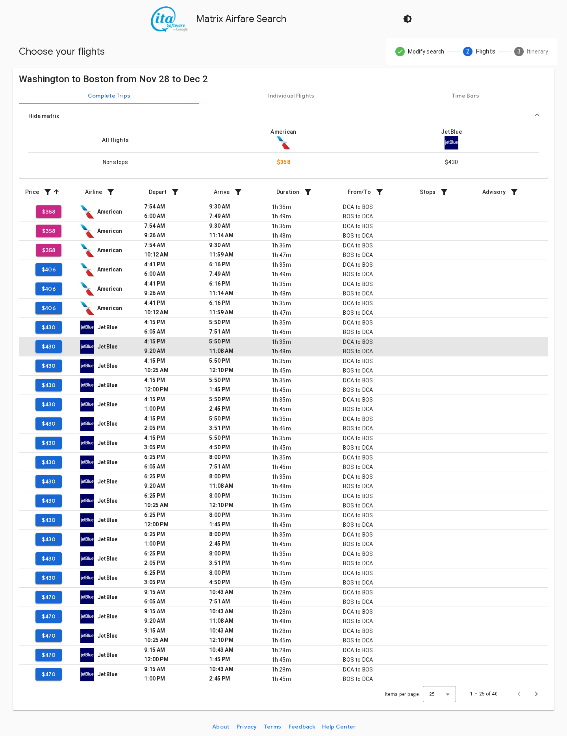
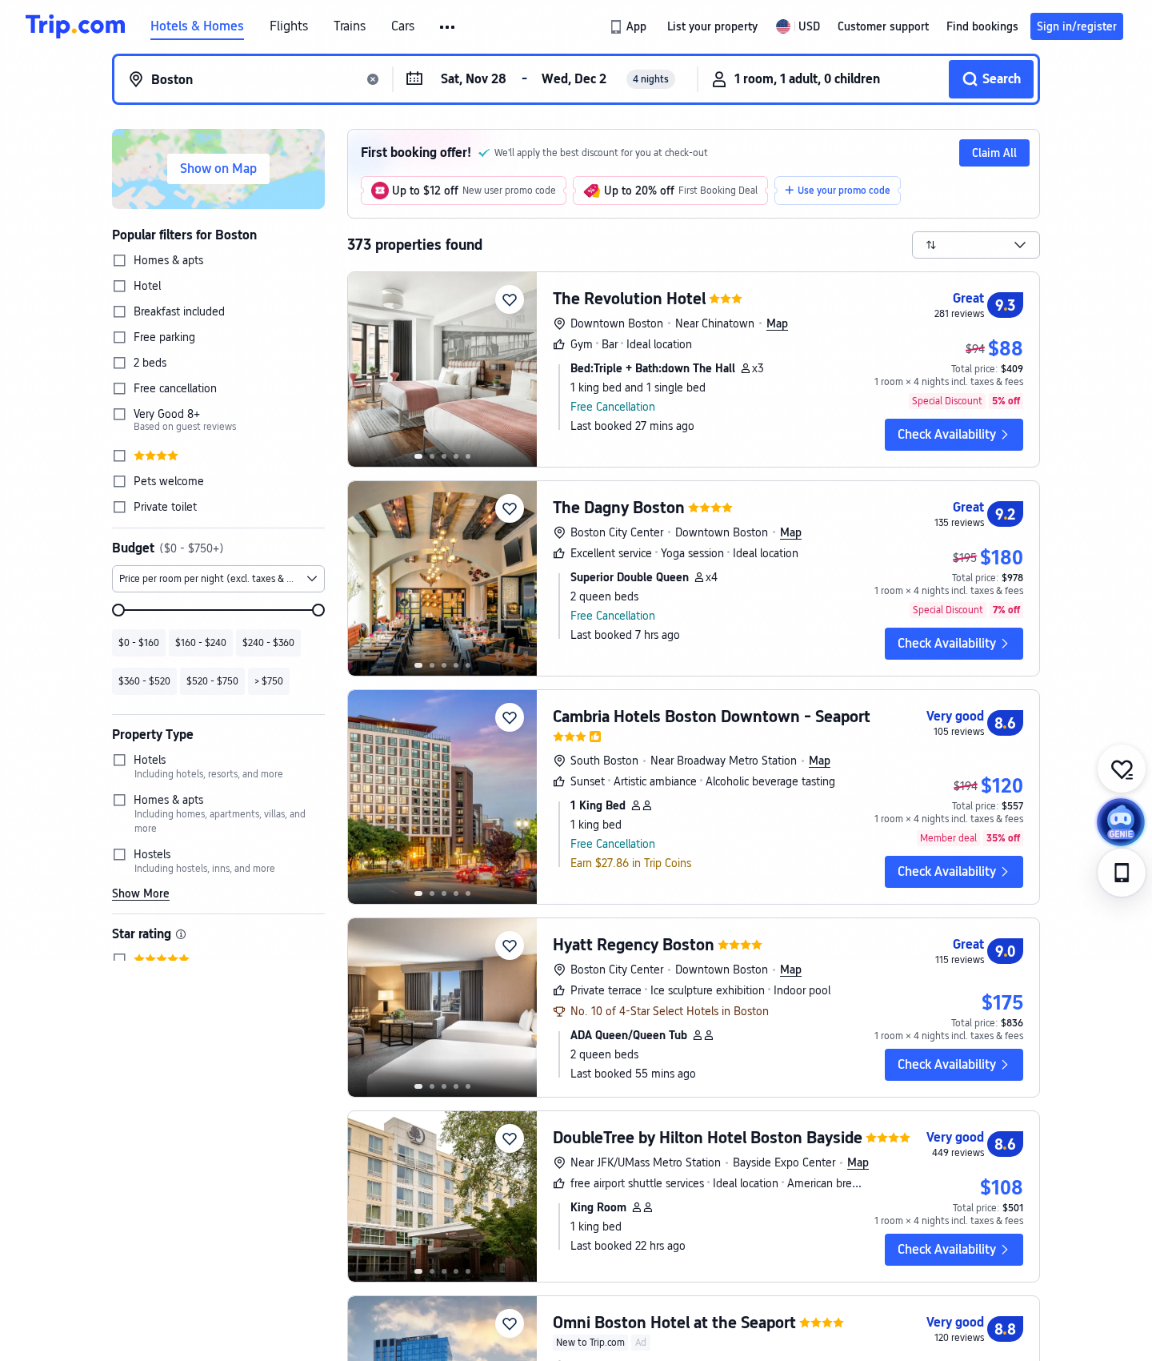
Boston, MA — RECOMMENDED
Flights & hotel evidence · queried 2026-10-24 · USD · RECOMMENDED OPTION
Flight — ITA Matrix
DCA⇄BOS · American/JetBlue nonstop · ~$358 RT
Hotel — us.trip.com
DoubleTree by Hilton Boston Bayside · ~$108/night · 8.6/10 (449 reviews) · breakfast incl. · free airport shuttle
Sources: matrix.itasoftware.com (DCA↔BOS, RT 11/28–12/2, 1 adult) | us.trip.com/hotels/list?cityId=26848 (11/28–12/2, 1 room, USD) · queried 2026-10-24 · figures feed conference_budget.xlsx → Options/Sources

Slide 4
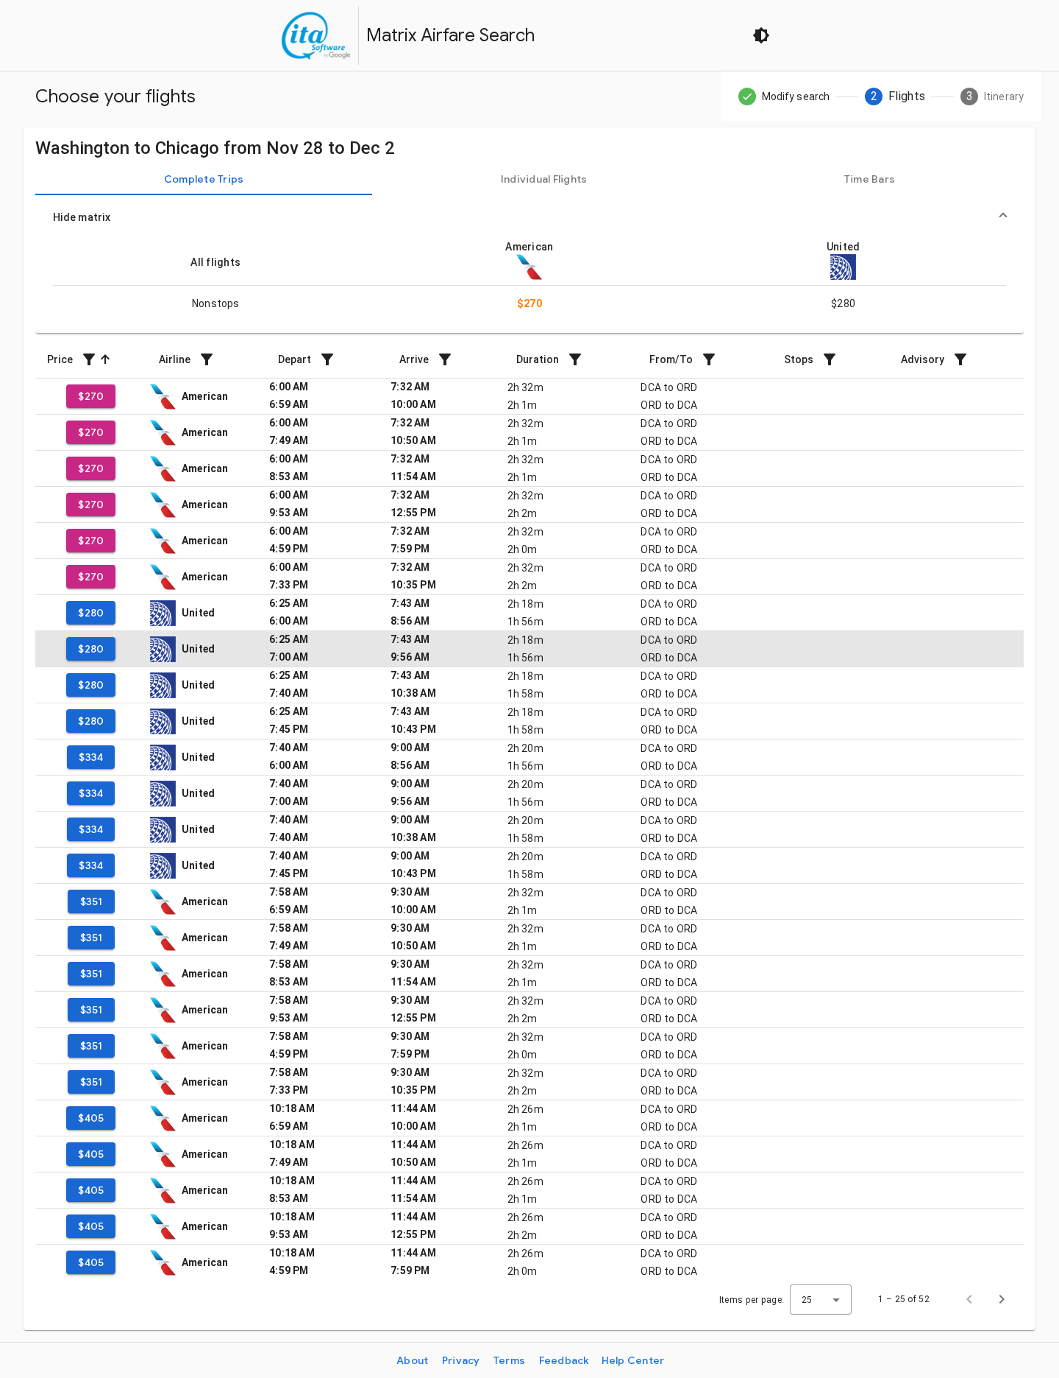
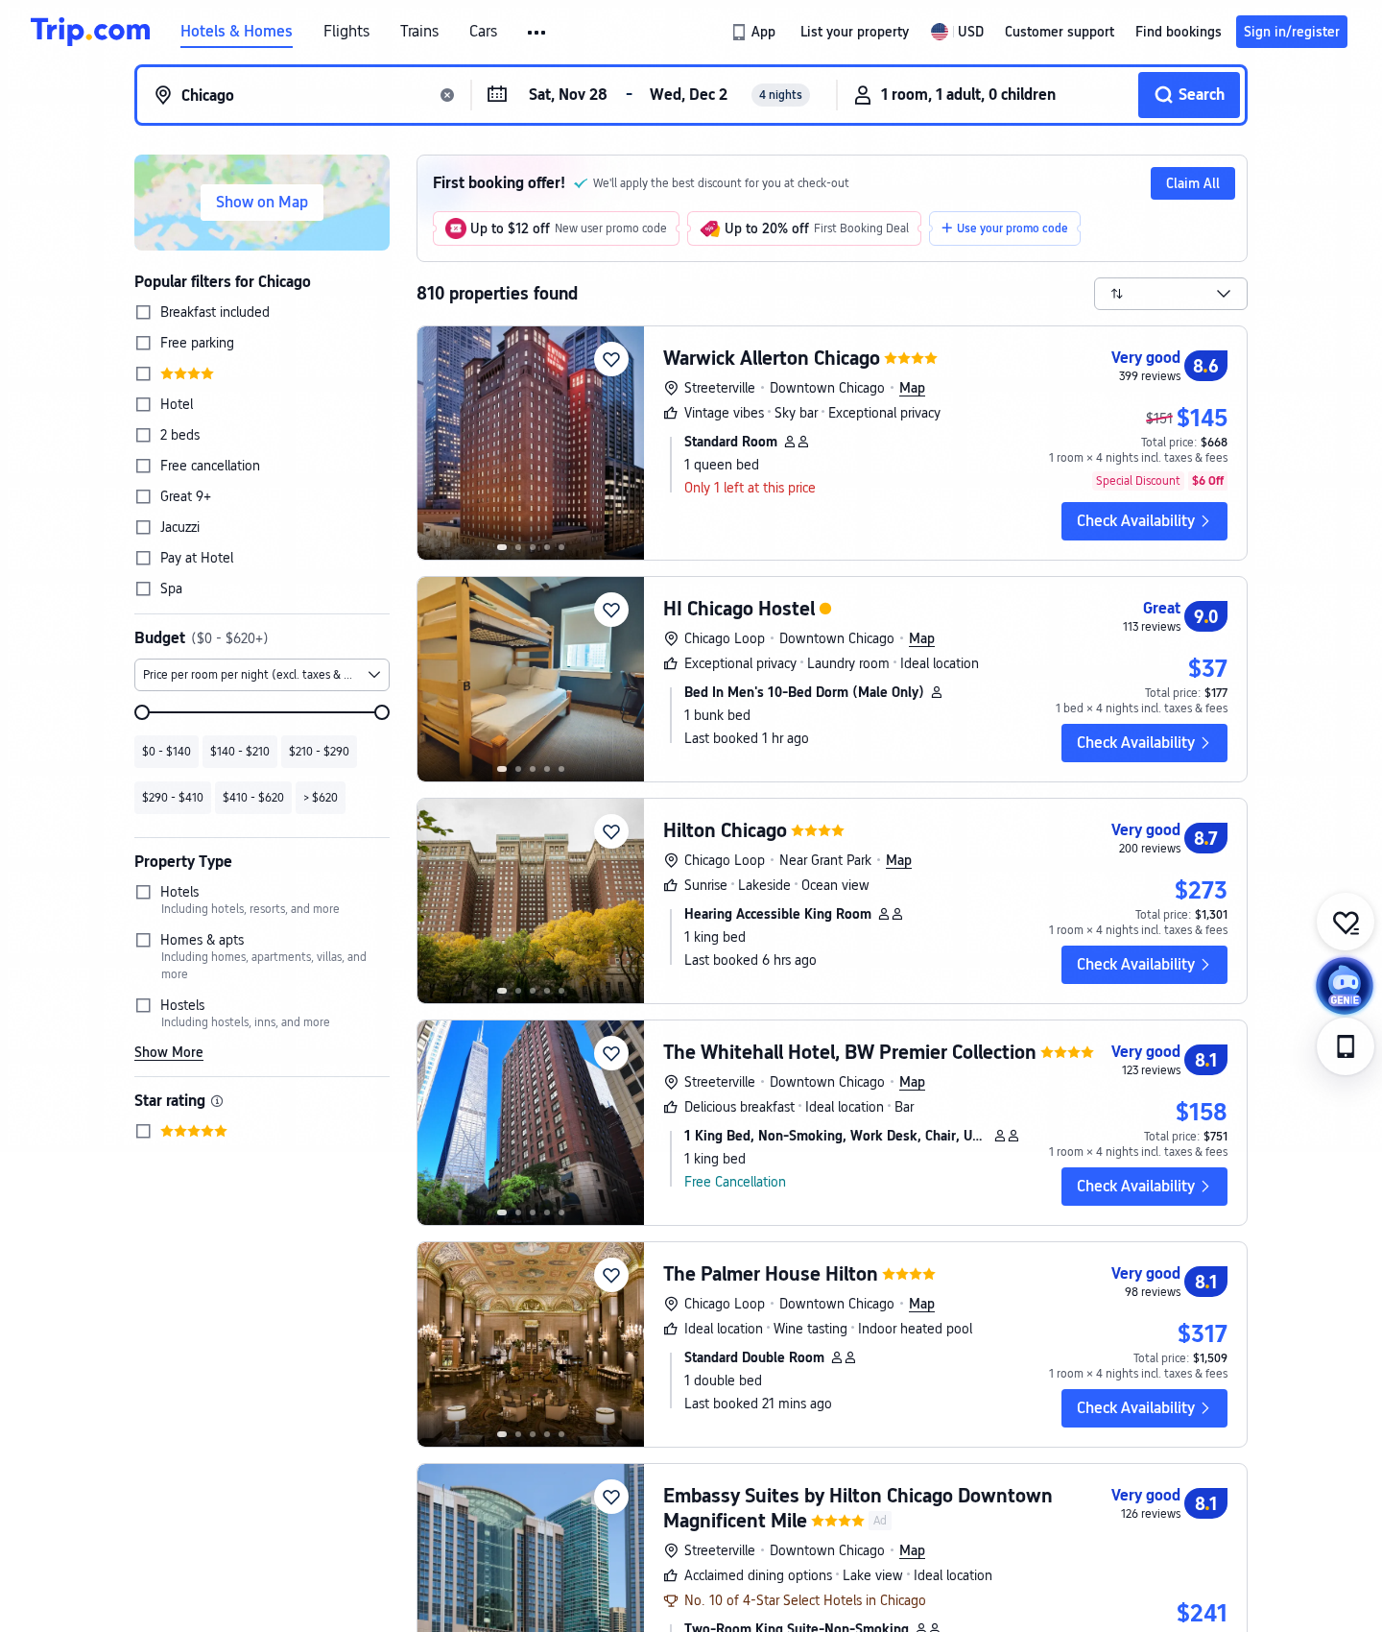
Chicago, IL — nearest alternative
Flights & hotel evidence · queried 2026-10-24 · USD
Flight — ITA Matrix
DCA⇄ORD · American nonstop · ~$270 RT
Hotel — us.trip.com
Warwick Allerton (and alt) · ~$145/night · 8.6/10 (399 reviews)
Sources: matrix.itasoftware.com (DCA↔ORD, RT 11/28–12/2, 1 adult) | us.trip.com/hotels/list?cityId=549 (11/28–12/2, 1 room, USD) · queried 2026-10-24 · figures feed conference_budget.xlsx → Options/Sources

Slide 5
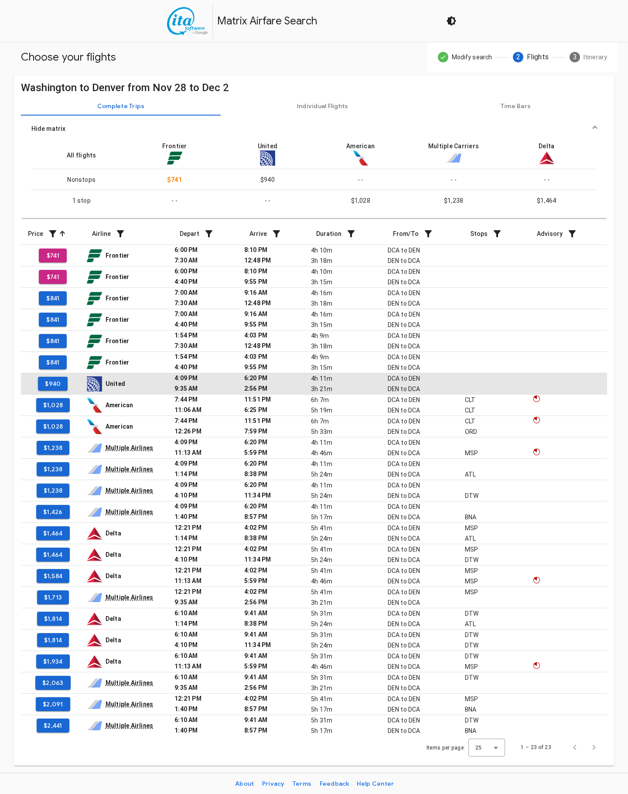
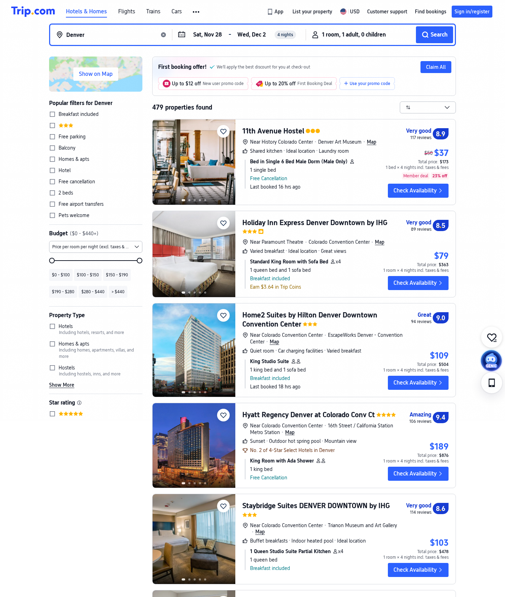
Denver, CO
Flights & hotel evidence · queried 2026-10-24 · USD
Flight — ITA Matrix
DCA⇄DEN · Frontier ~$741 / United ~$940 RT
Hotel — us.trip.com
Home2 Suites by Hilton Denver Downtown · ~$109/night · 9.0/10 (94 reviews) · breakfast incl.
Sources: matrix.itasoftware.com (DCA↔DEN, RT 11/28–12/2, 1 adult) | us.trip.com/hotels/list?cityId=20099 (11/28–12/2, 1 room, USD) · queried 2026-10-24 · figures feed conference_budget.xlsx → Options/Sources

Slide 6
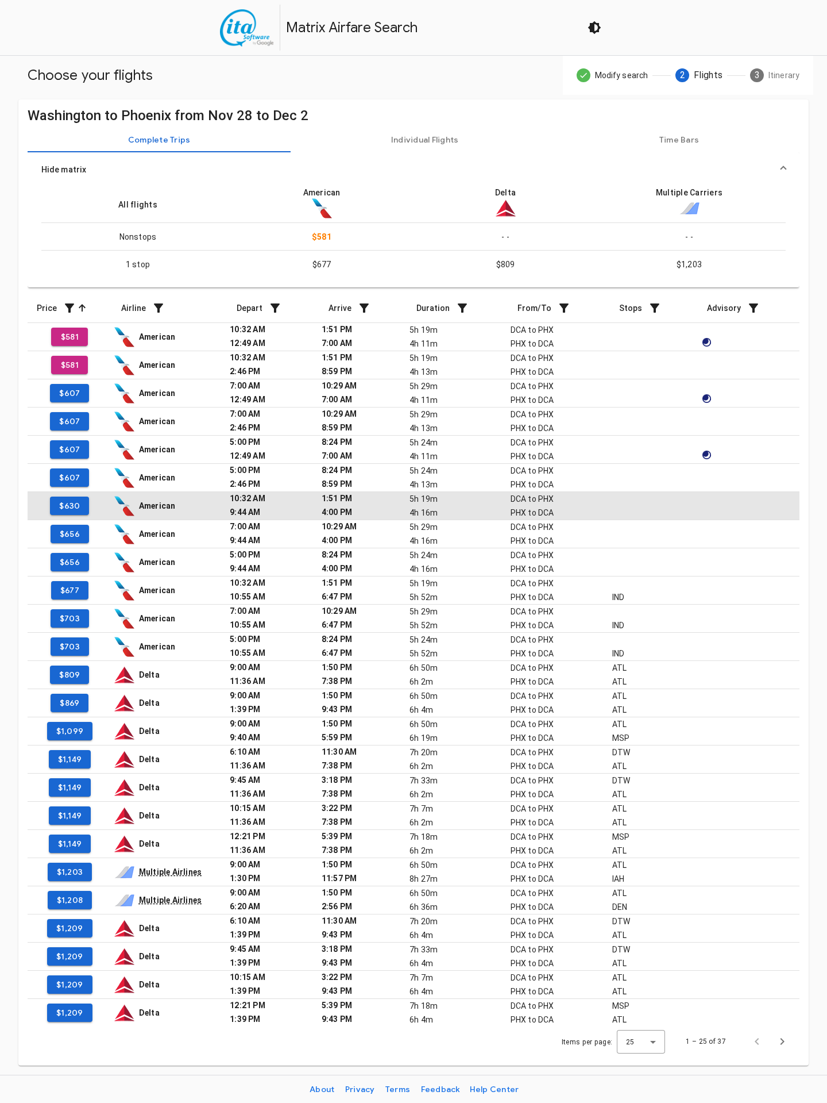
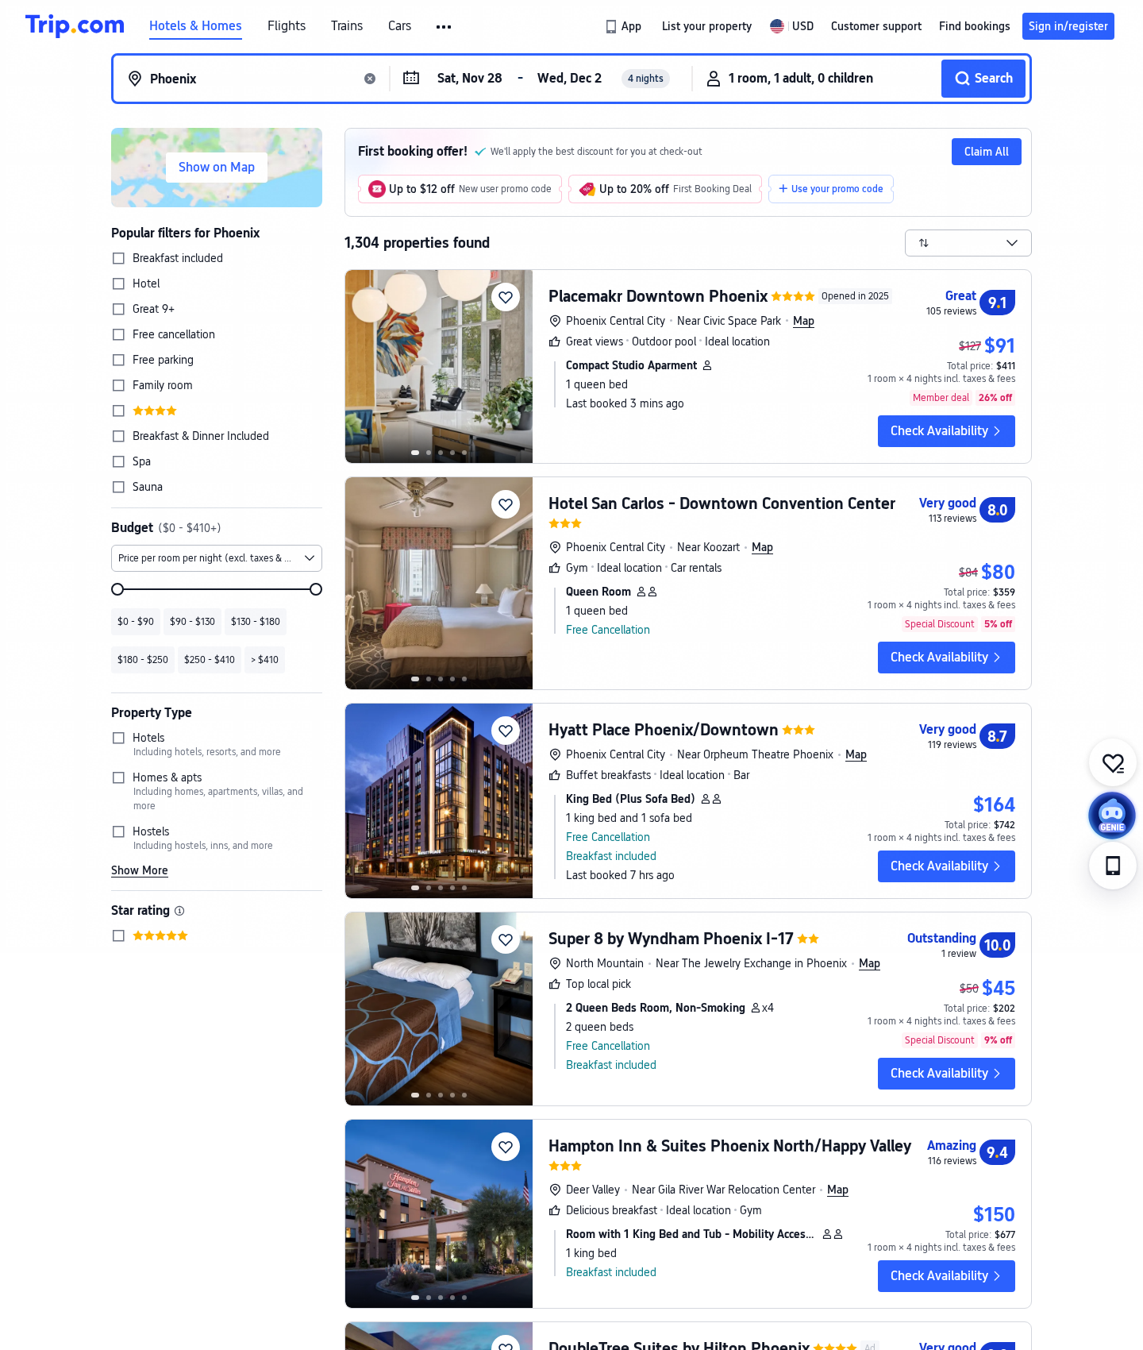
Phoenix, AZ
Flights & hotel evidence · queried 2026-10-24 · USD
Flight — ITA Matrix
DCA⇄PHX · American nonstop · ~$581 RT
Hotel — us.trip.com
Hampton Inn & Suites · ~$150/night · 9.4/10 (116 reviews) · breakfast incl.
Sources: matrix.itasoftware.com (DCA↔PHX, RT 11/28–12/2, 1 adult) | us.trip.com/hotels/list?cityId=25938 (11/28–12/2, 1 room, USD) · queried 2026-10-24 · figures feed conference_budget.xlsx → Options/Sources

Slide 7
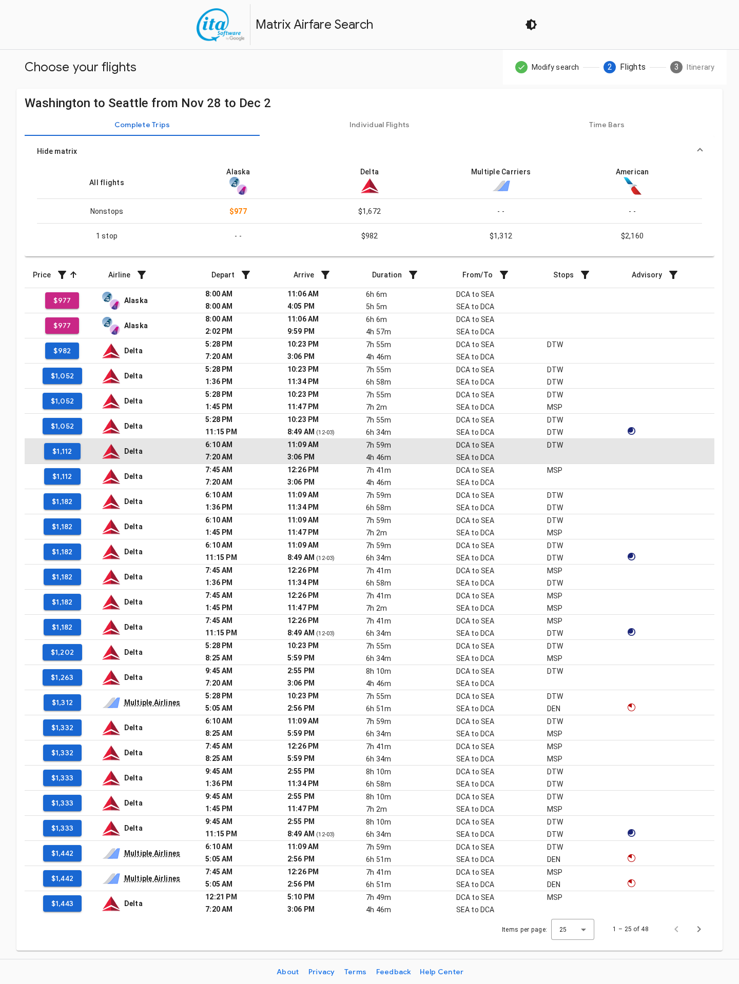
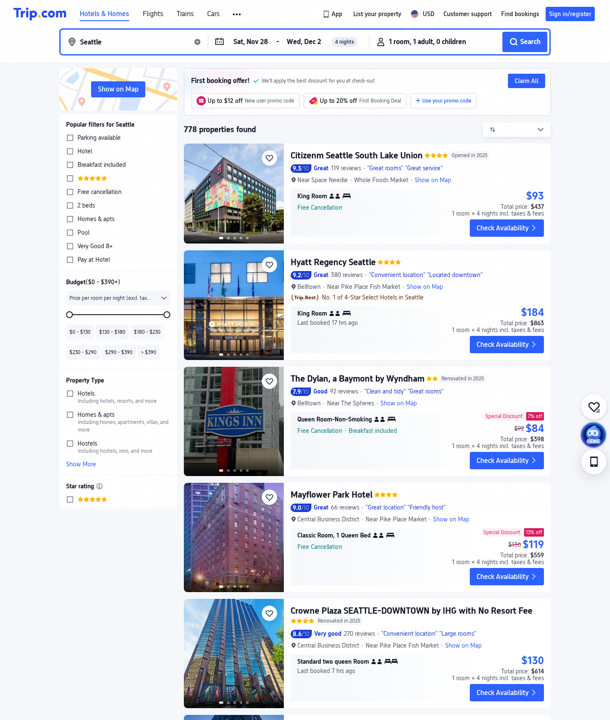
Seattle, WA
Flights & hotel evidence · queried 2026-10-24 · USD
Flight — ITA Matrix
DCA⇄SEA · nonstop ~$977 / 1-stop ~$982 RT
Hotel — us.trip.com
Belltown (breakfast-incl.) · ~$103/night · 8.6/10 (114 reviews) · breakfast incl.
Sources: matrix.itasoftware.com (DCA↔SEA, RT 11/28–12/2, 1 adult) | us.trip.com/hotels/list?cityId=511 (11/28–12/2, 1 room, USD) · queried 2026-10-24 · figures feed conference_budget.xlsx → Options/Sources

Slide 8
From screenshots to the budget
How these real quotes map into conference_budget.xlsx
• Each airfare above is entered once per city in the workbook's CityData sheet; the Options sheet multiplies by headcount (24/18) and applies the airfare factor (base ×1.0 and +20% stress).
• Each hotel nightly rate is multiplied by 4 nights and an internal 12% lodging-tax estimate (a planning placeholder — NOT the statutory Suffolk County rate; replace at booking, Register R-10).
• Registration $180/person (incl. 3 working lunches), agency-provided meals (Nov 28 dinner, Dec 1 dinner, Dec 2 lunch), light refreshments, and ground transport are added in Daily/Options.
• Recommended: Boston, 24 attendees — grand total $34,242.77 (base $32,612.16 + 5% reserve $1,630.61), ~$18,757 under the $53,000 ceiling.
• Decision rule: fit ceiling → maximize attendees → lowest total-with-reserve → alphabetical. Boston wins on breakfast-included $108 hotel + free shuttle despite higher airfare than Chicago.
• Still TO VERIFY before approval (not fabricated here): group air inventory, 24-room block at quoted rate, venue address/capacity/quote, FEMA fire-safe hotel status, funds availability, roster justification. See approval_register.csv.

