Slide 1
Travel Evidence Pack
USDA Rural Development - training site analysis
Existing real captures, reviewed and corrected
Training Nov 29-Dec 1, 2026 | travel Nov 28-Dec 2 | 18 / 24 people
No fully quality-admitted recommendation yet. Boston 24 is a cost-priority completion candidate, not an approved booking.

Slide 2
Evidence status and use - read before relying on prices
Flights: archived Google Flights captures, one passenger, round trip, economy incl. Basic, USD. Booking is unavailable from the capture region; authorized purchasing channel and group seats remain unverified.
Hotels: archived Trip.com and Google Hotels captures. A displayed 2-guest offer is not proof of a one-adult price; room type, breakfast and cancellation are provider-specific.
Quality: platform-specific score screens plus sufficient reviews are only preliminary. Recent cleanliness, night-noise and maintenance evidence is required; a missing review is not a clean bill of health.
All quoted fares/rooms are snapshots, not reservations or held inventory. Venue, catering, procurement, funds and actual individual transport remain conditional.
The workbook distinguishes known/estimated costs from separate unquoted base-cost parameters. Do not treat those missing costs as free.

Slide 3
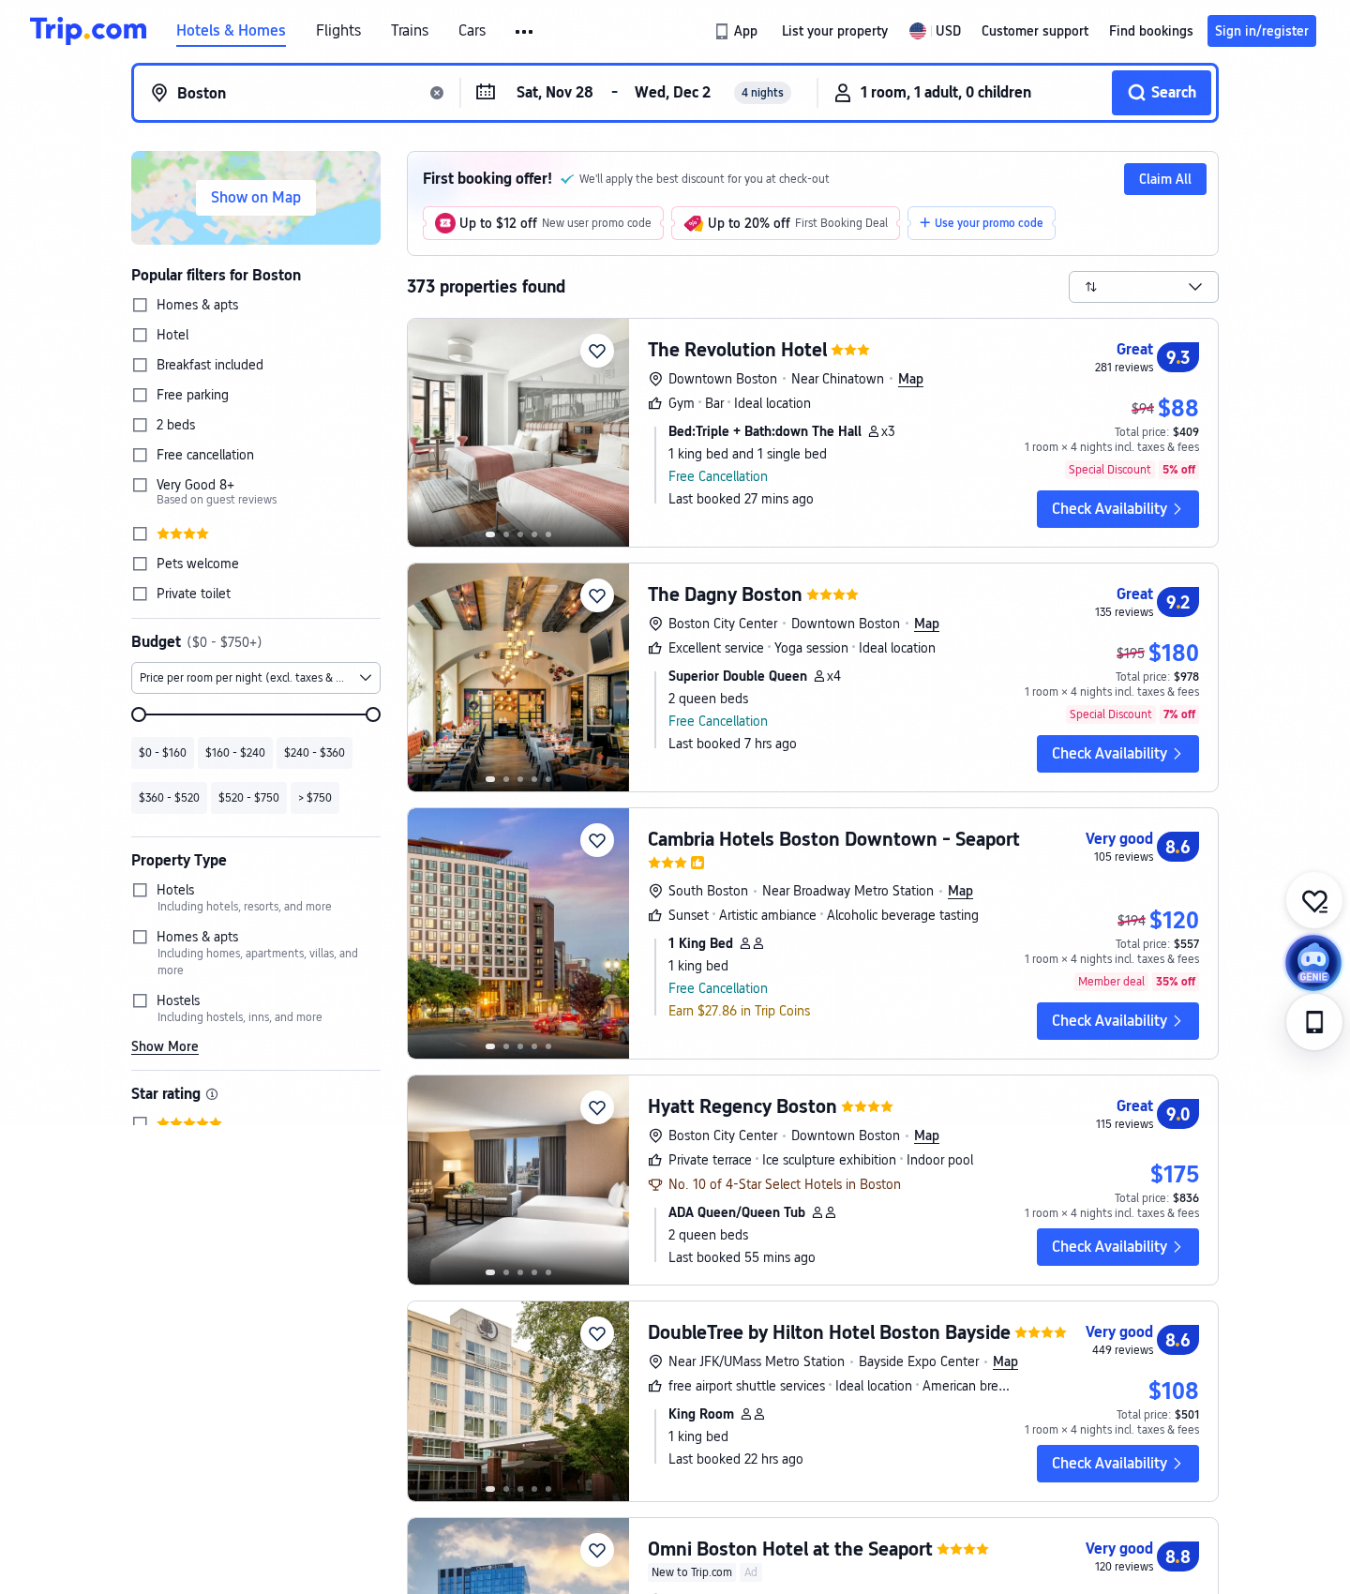
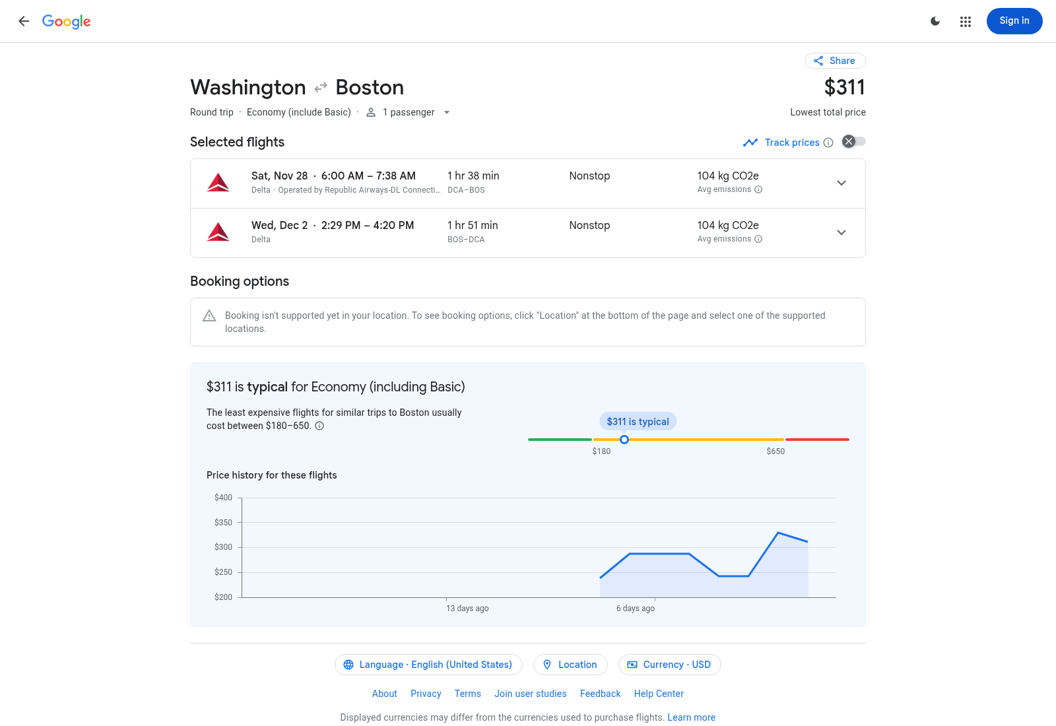
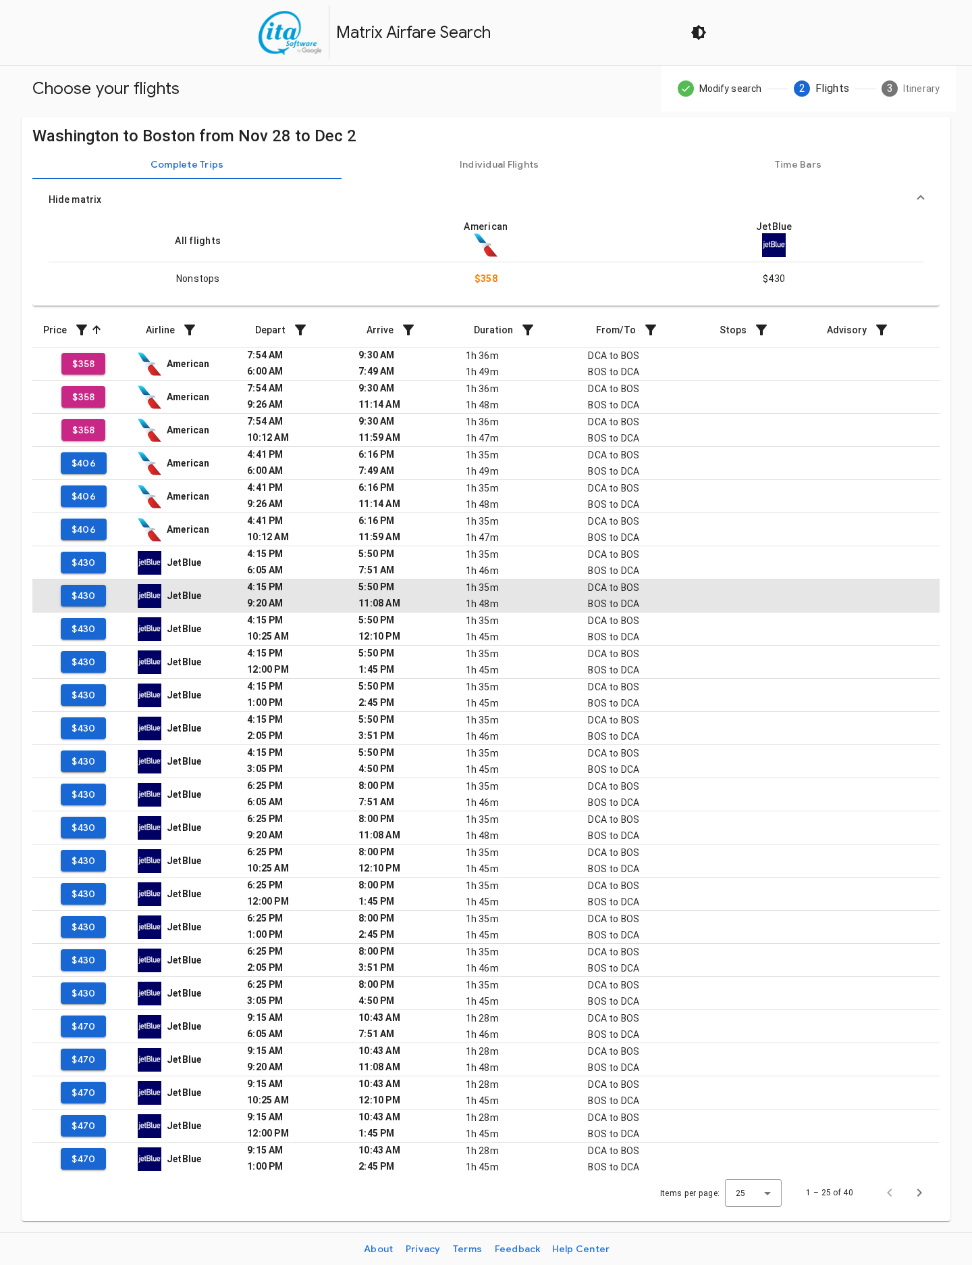
Boston - costed candidate; QUALITY PENDING
Flight - Google Flights
DCA-BOS | Delta | $311.00 round trip
11/28 06:00-07:38; 12/2 14:29-16:20 (local times)
Hotel - $108.00/room/night indicative
Trip.com 8.6/10 | 449 reviews; applicability and quality PENDING.
Original captures 2026-10-24 UTC. Budget: conference_budget.xlsx CityData / Options / Sources. No booking or group stock confirmed.

Slide 4
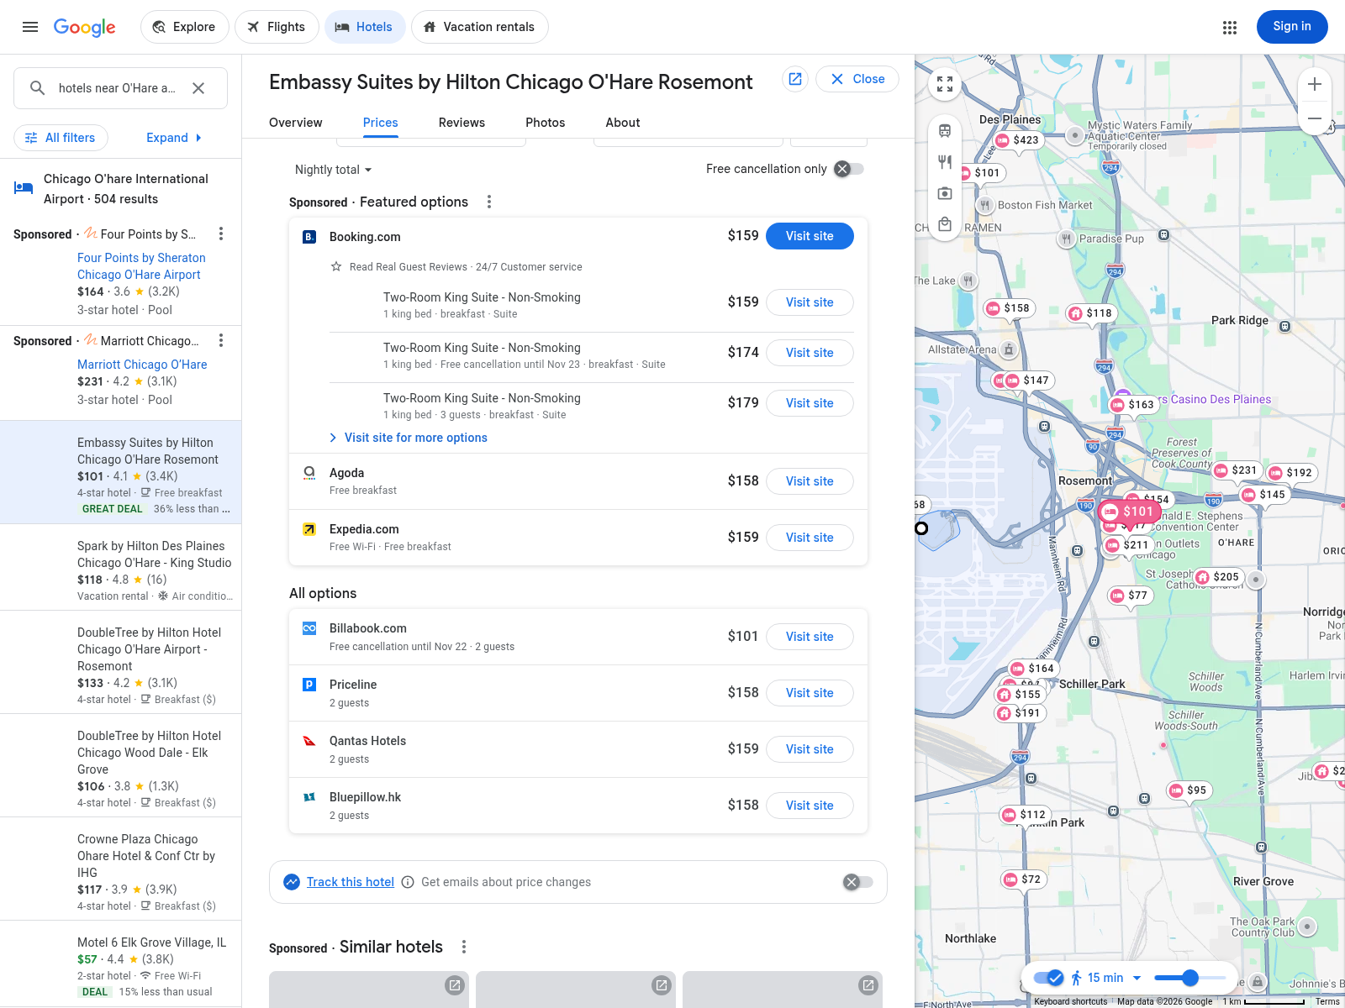
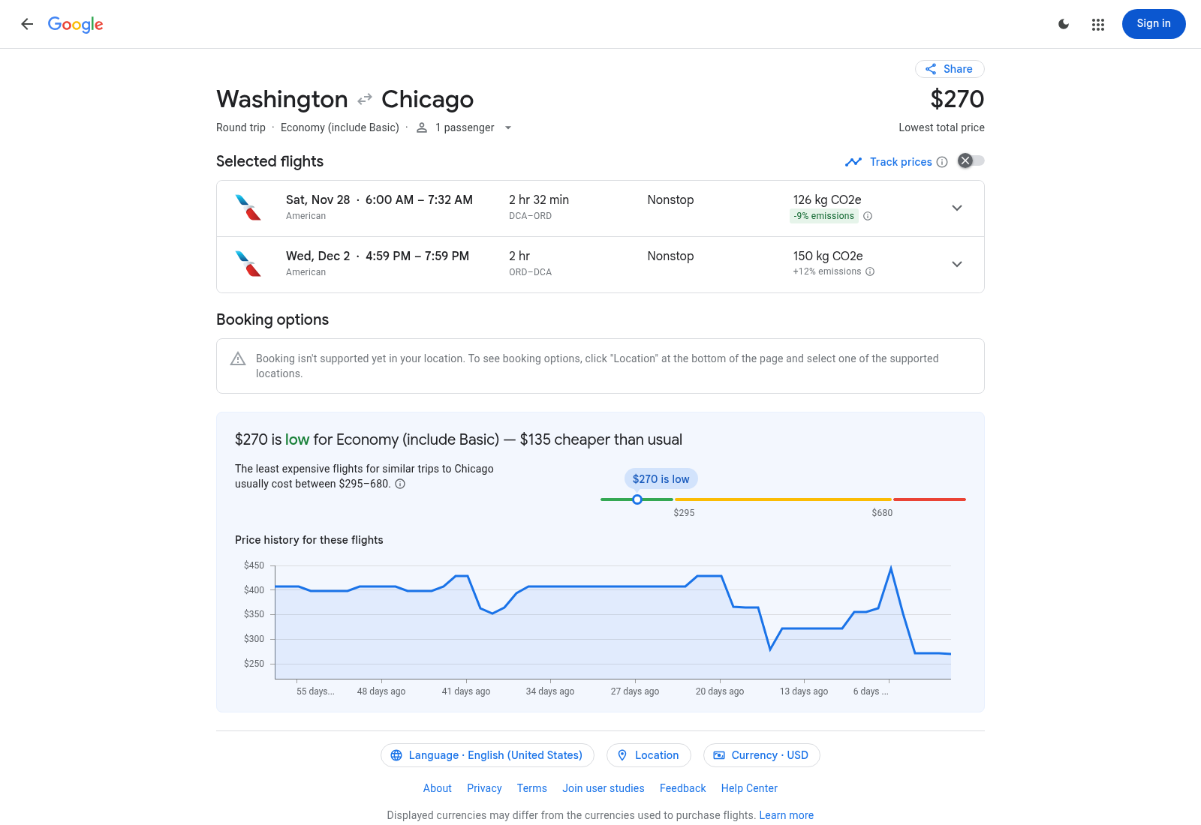
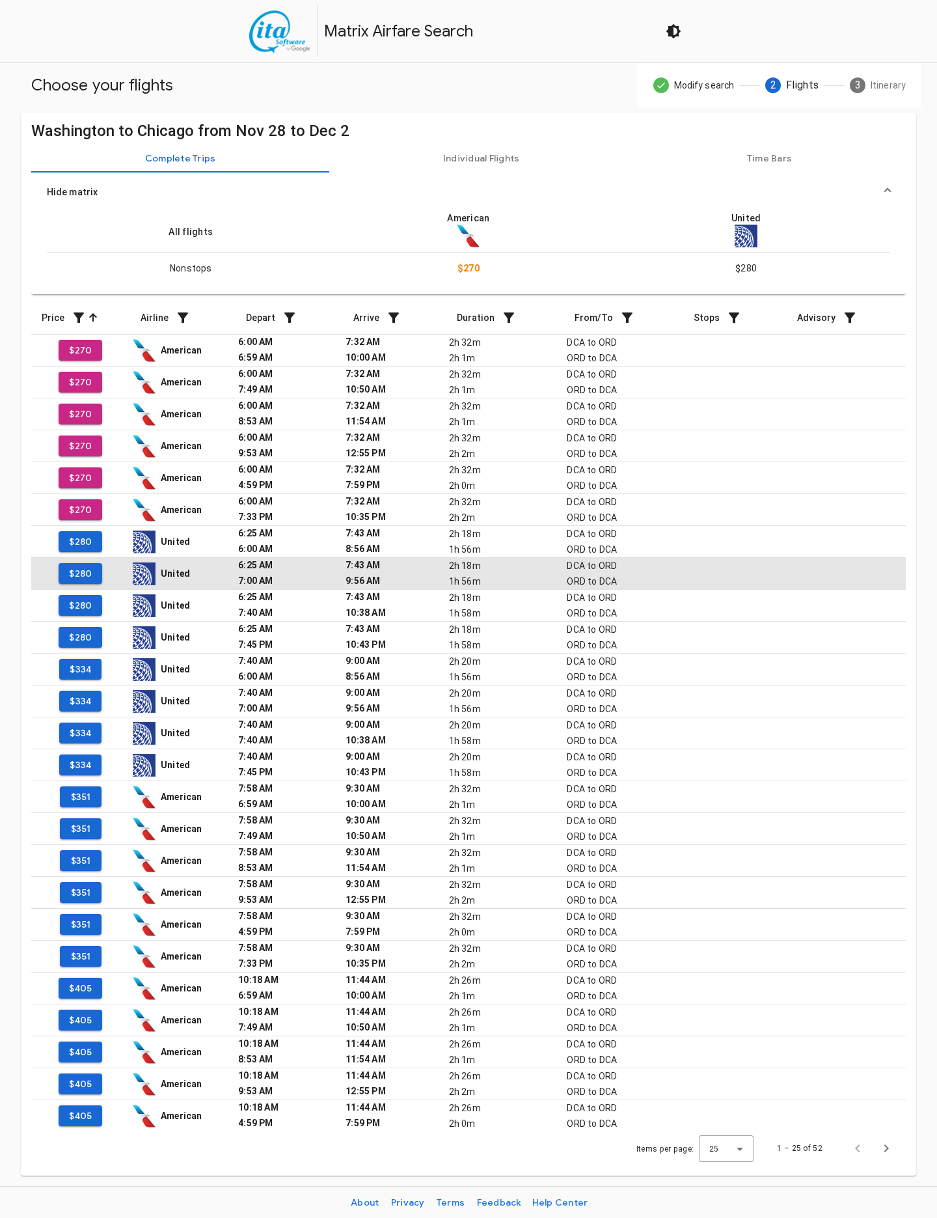
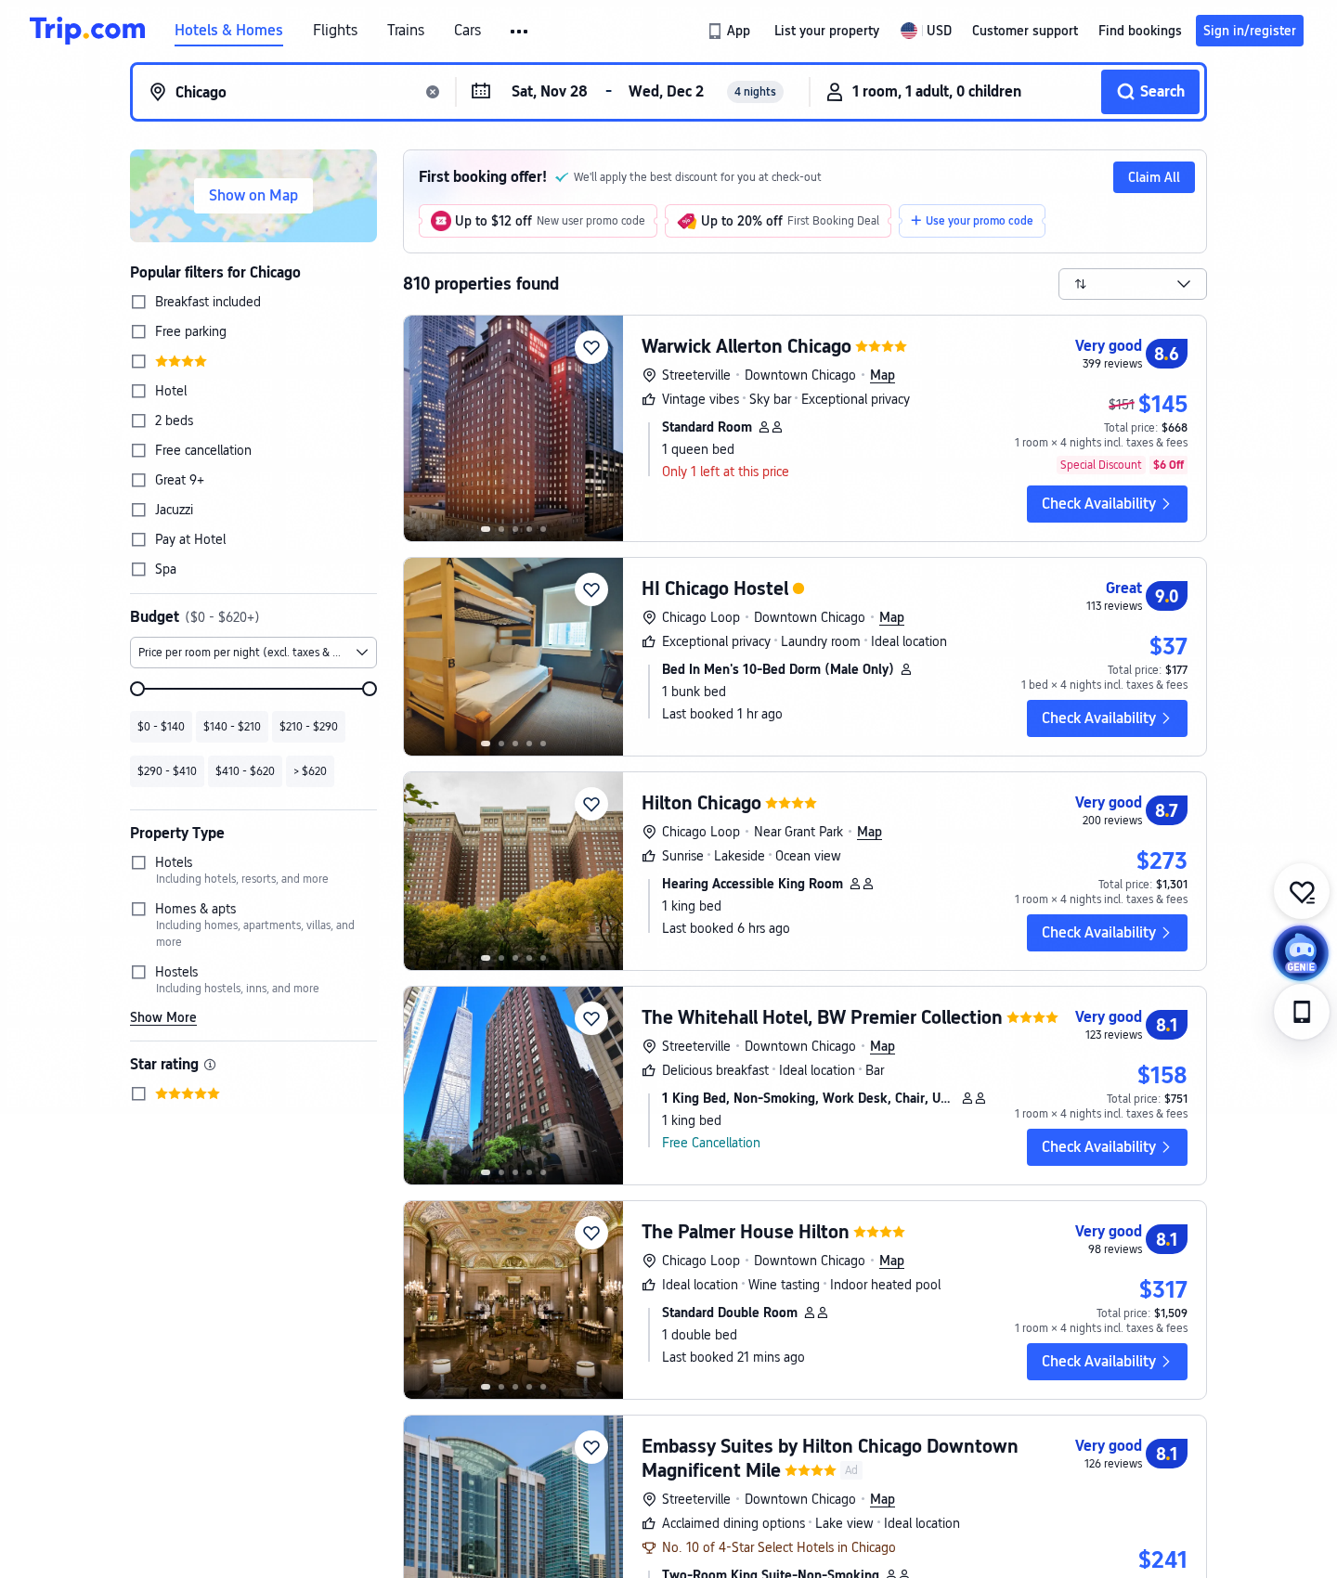
Chicago - corrected breakfast offer EXCLUDED
Flight - Google Flights
DCA-ORD | American | $270.00 round trip
11/28 06:00-07:32; 12/2 16:59-19:59 (local times)
Hotel - Agoda $158/night with free breakfast
Booking suite $159 with breakfast: both exceed Dec $148 cap.
Original captures 2026-10-24 UTC. Budget: conference_budget.xlsx CityData / Options / Sources. No booking or group stock confirmed.

Slide 5
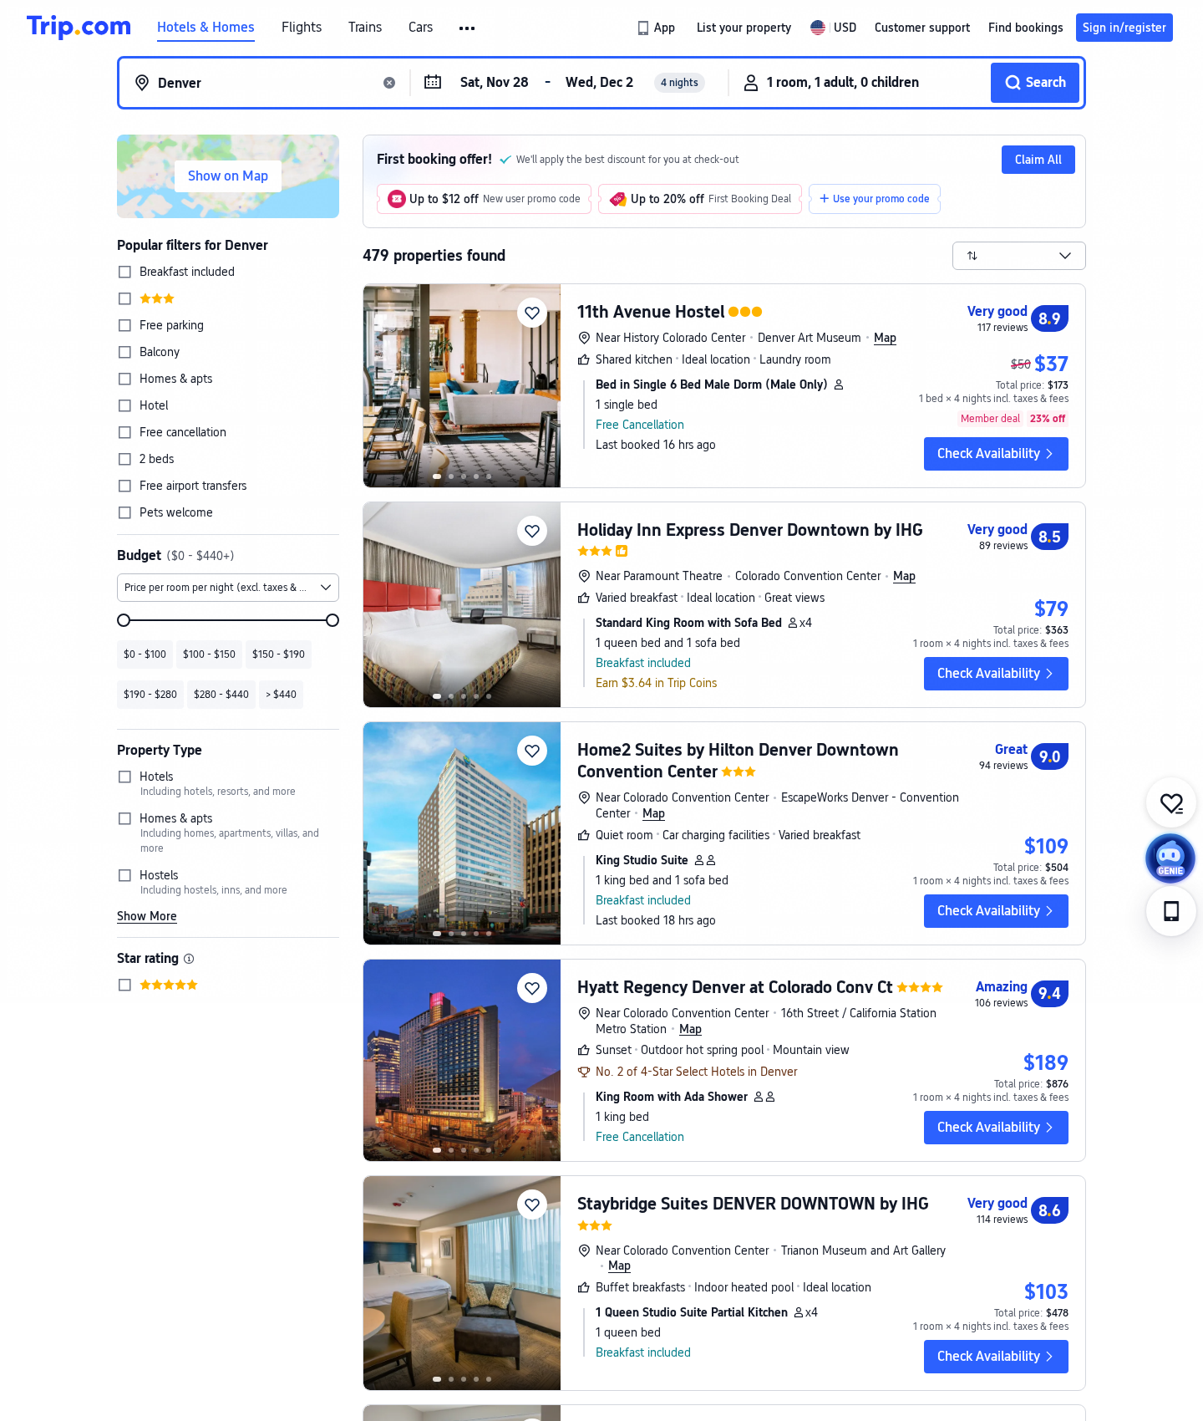
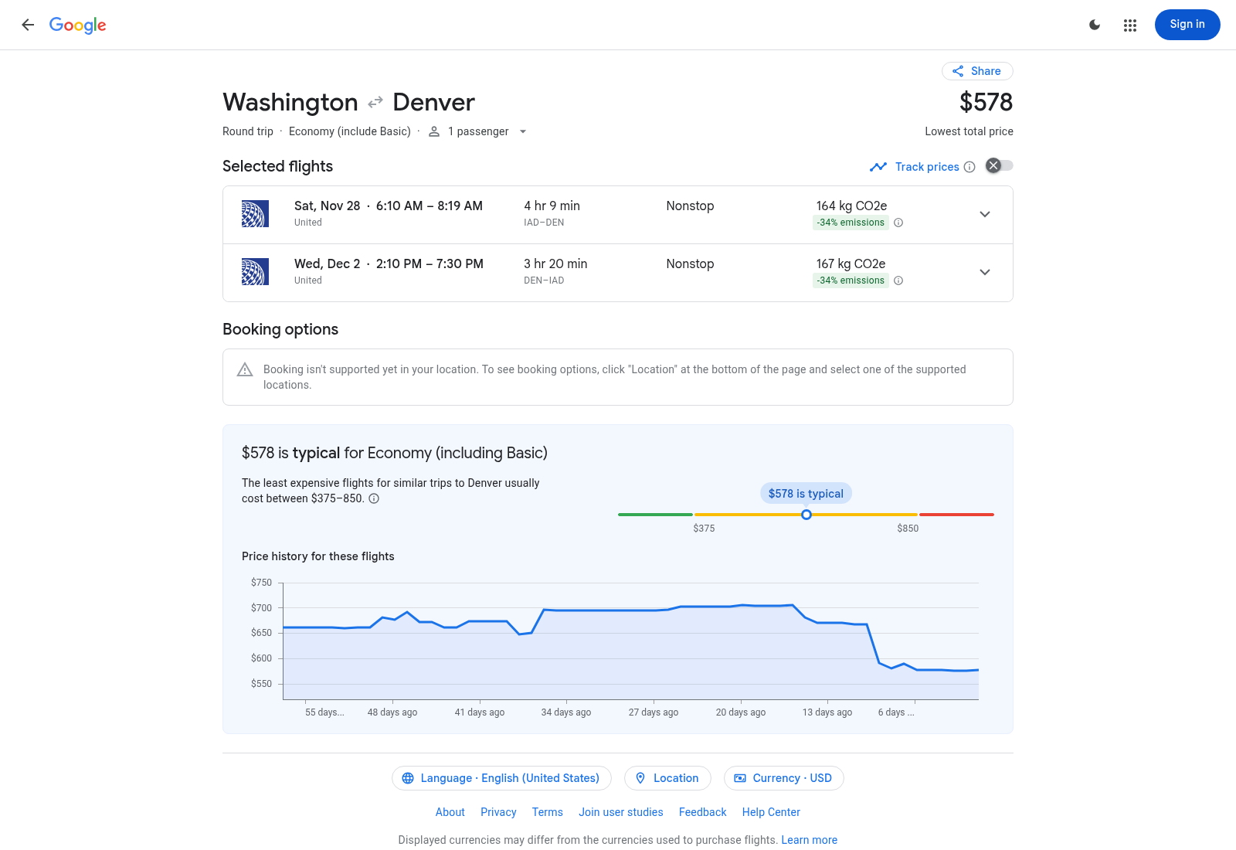
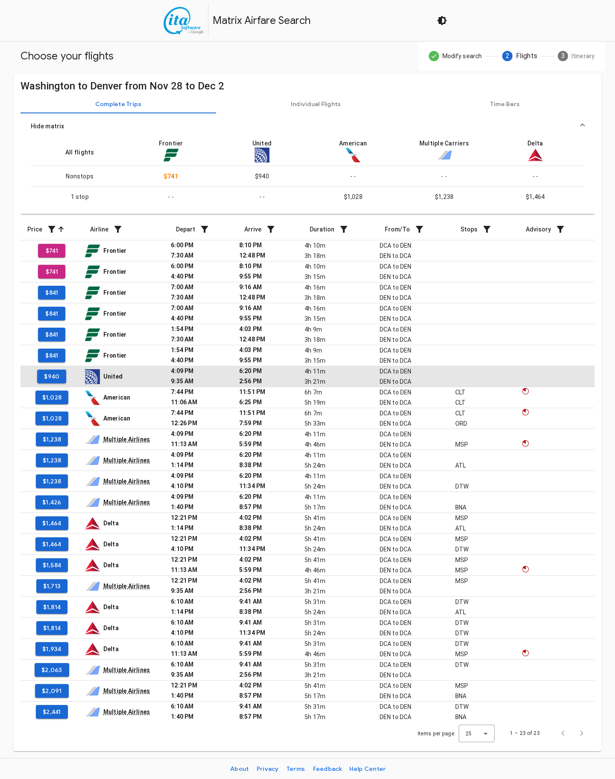
Denver - costed candidate; QUALITY PENDING
Flight - Google Flights
IAD-DEN | United | $578.00 round trip
11/28 06:10-08:19; 12/2 14:10-17:30 (local times)
Hotel - $109.00/room/night indicative
Trip.com 9.0/10 | 94 reviews; applicability and quality PENDING.
Original captures 2026-10-24 UTC. Budget: conference_budget.xlsx CityData / Options / Sources. No booking or group stock confirmed.

Slide 6
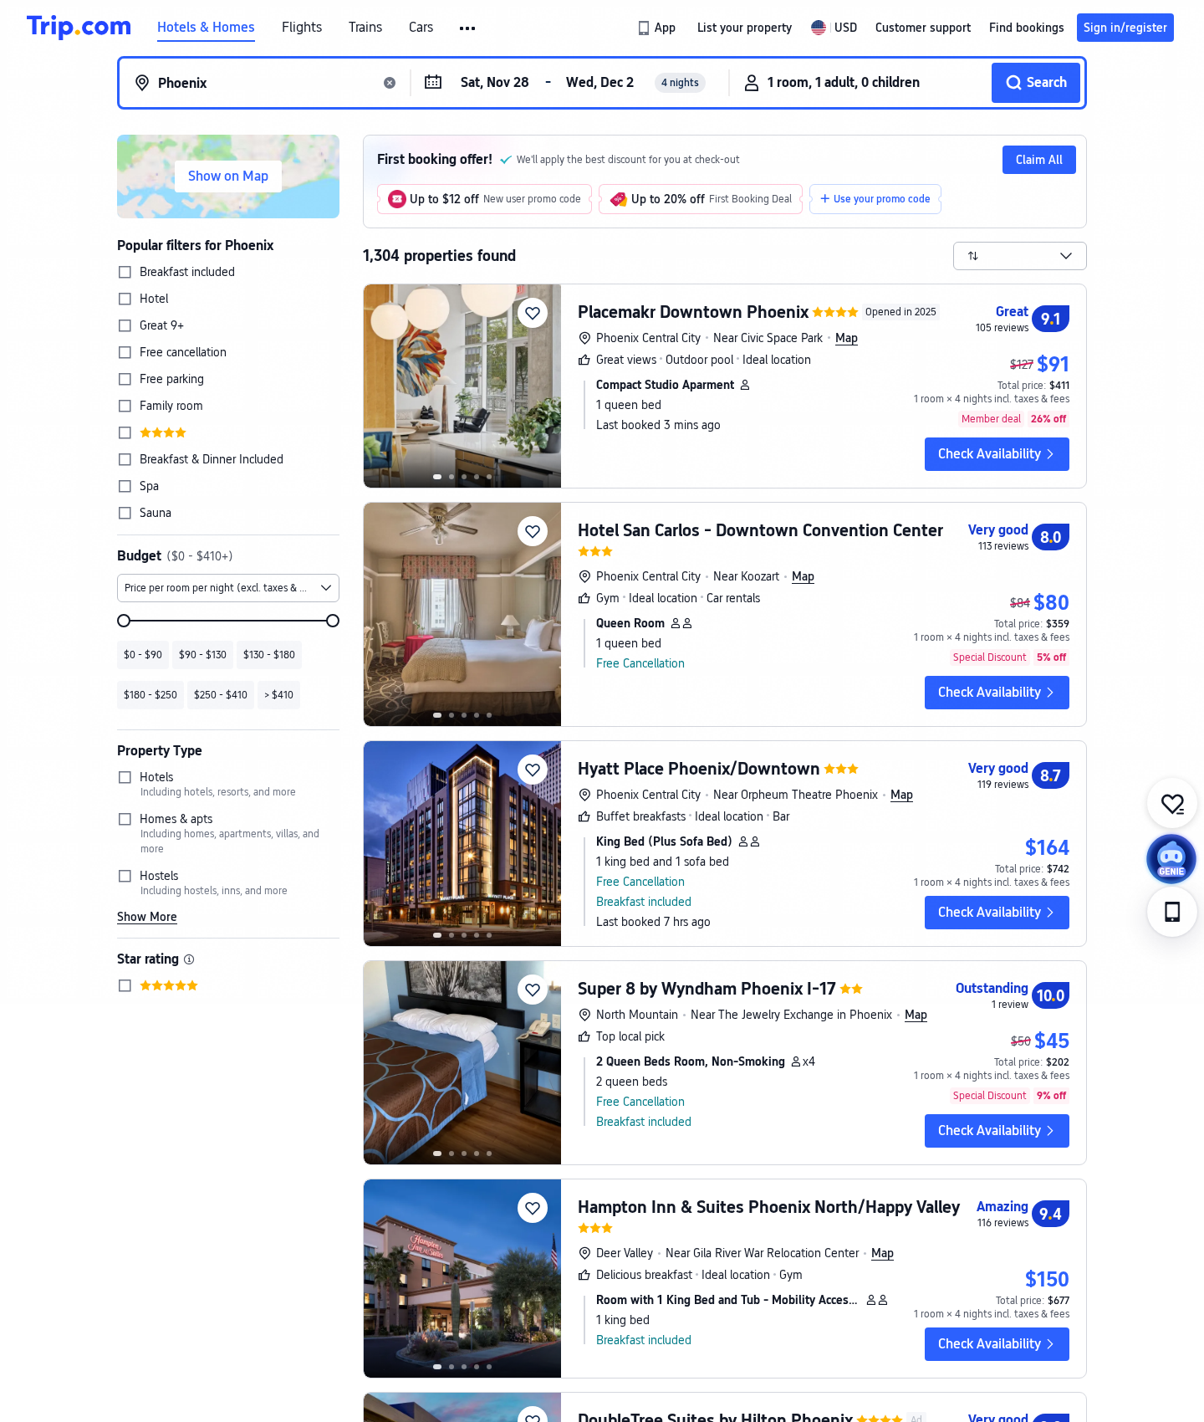
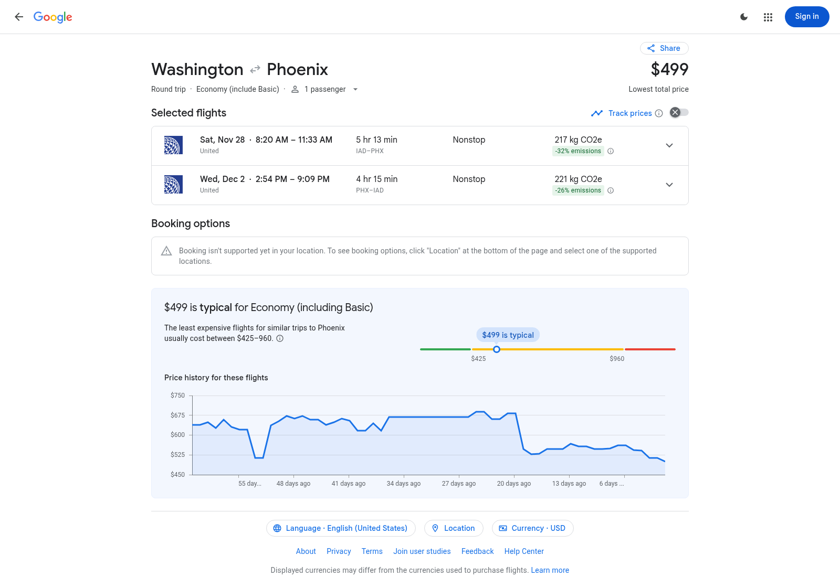
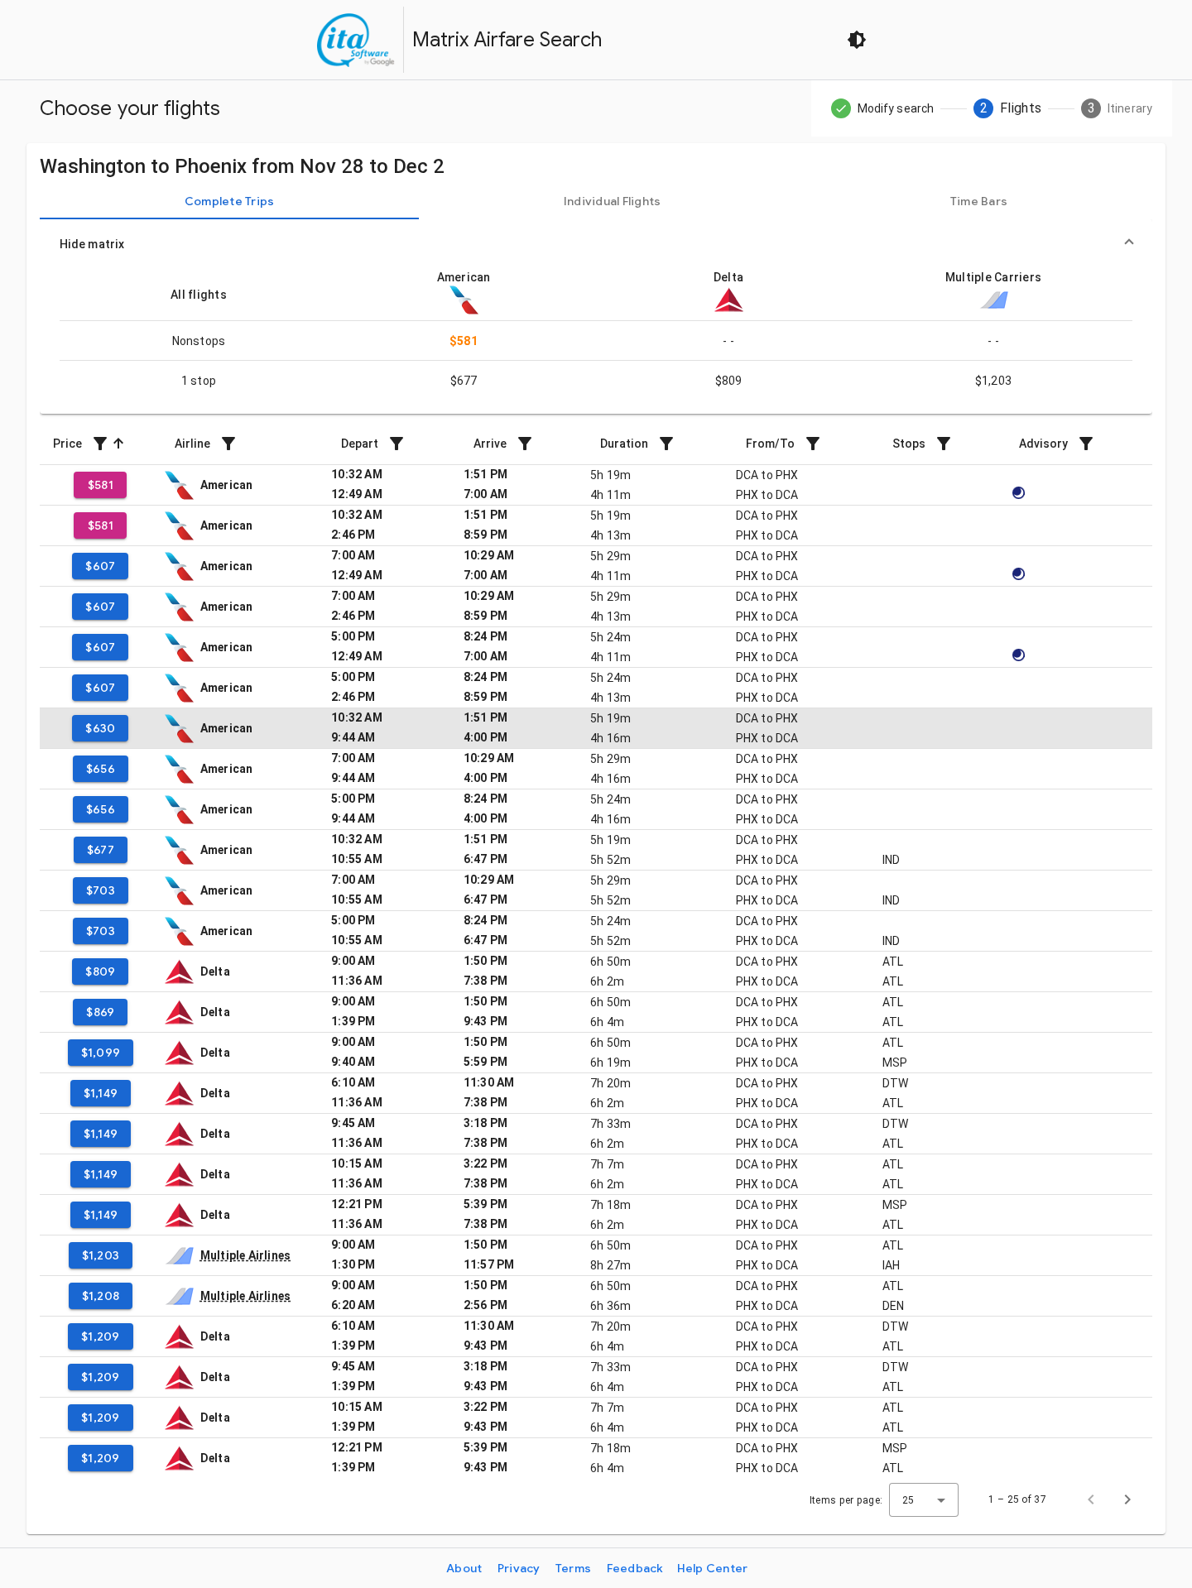
Phoenix - costed candidate; QUALITY PENDING
Flight - Google Flights
IAD-PHX | United | $499.00 round trip
11/28 08:20-11:33; 12/2 14:54-19:09 (local times)
Hotel - $150.00/room/night indicative
Trip.com 9.4/10 | 116 reviews; applicability and quality PENDING.
Original captures 2026-10-24 UTC. Budget: conference_budget.xlsx CityData / Options / Sources. No booking or group stock confirmed.

Slide 7
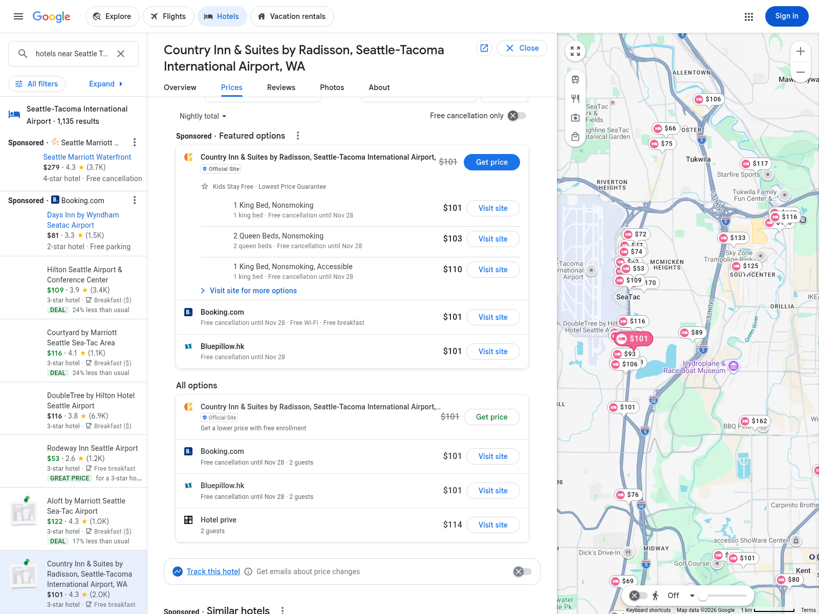
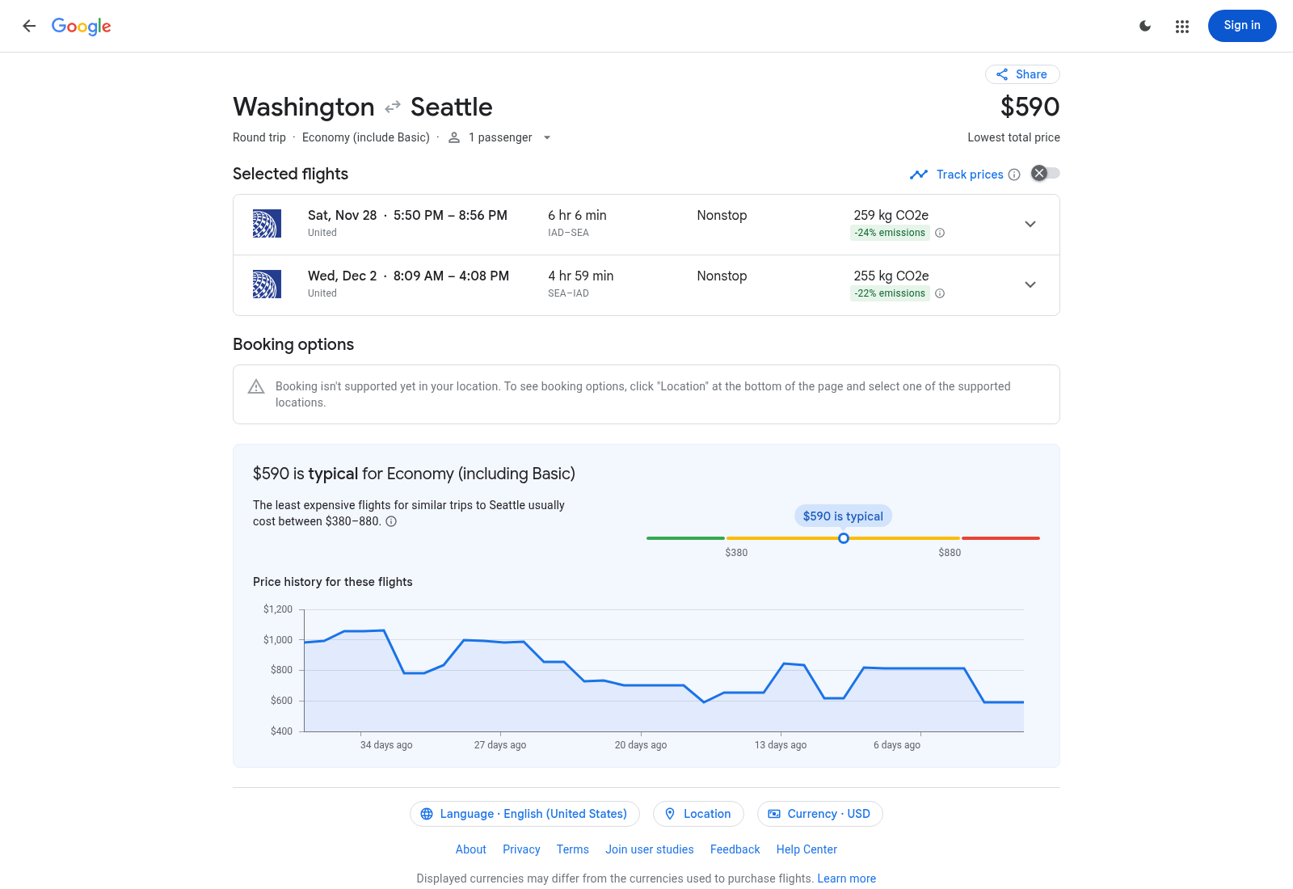
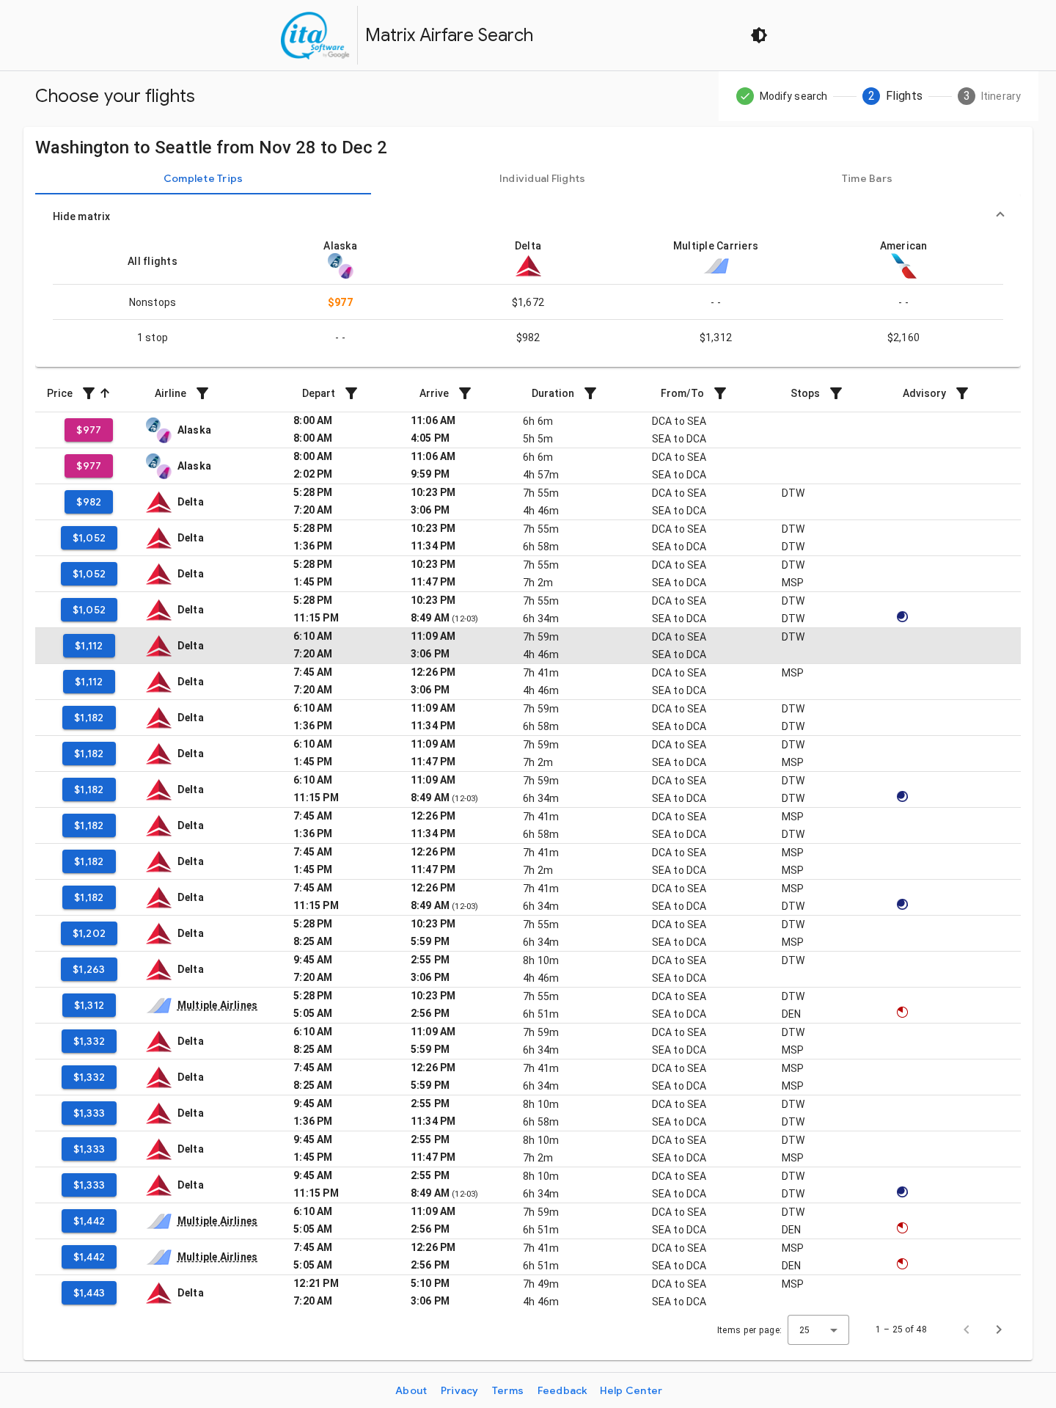
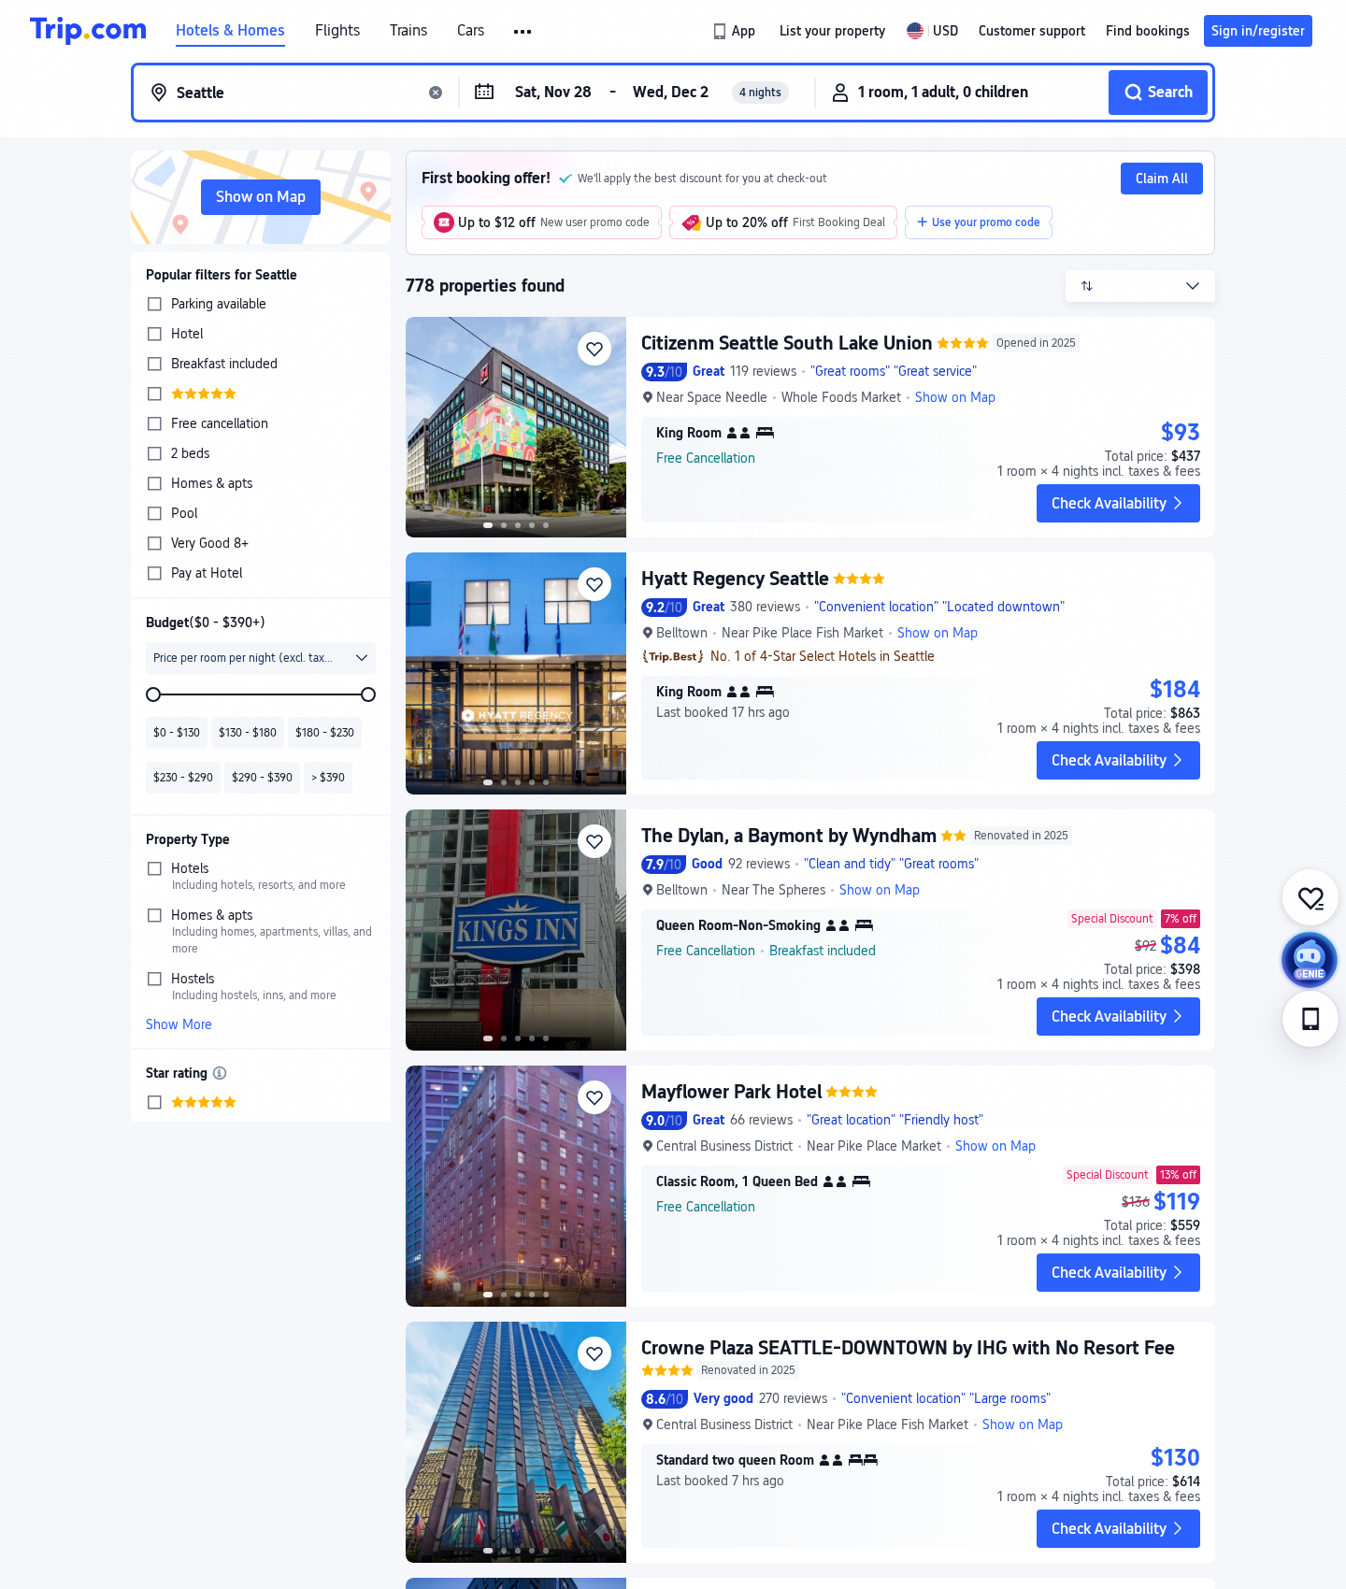
Seattle - costed candidate; QUALITY PENDING
Flight - Google Flights
IAD-SEA | United | $590.00 round trip
11/28 17:50-20:56; 12/2 08:09-16:08 (local times)
Hotel - $101.00/room/night indicative
Google 4.3/5 | 2,018 reviews; applicability and quality PENDING.
Original captures 2026-10-24 UTC. Budget: conference_budget.xlsx CityData / Options / Sources. No booking or group stock confirmed.

Slide 8
Decision snapshot and approval gates
No candidate is represented as fully quality-admitted or approved. Boston 24 is now the cost-priority completion candidate; its breakfast inclusion remains unverified. Chicago $101 is archival only, while breakfast-linked $158/$159 Embassy rates exceed the Dec-1 cap and are excluded. Chicago DoubleTree $133 is a separate pending breakfast-cost alternative, not a confirmed package.
Traveler net M&IE is inside the $53,000 budget, separately from agency catering. Reserve is 5% of the full base, including unquoted U when known.
Before approval: match one-adult hotel and breakfast terms, complete topic-specific reviews and inventory, venue/catering quotes, mission/headcount/remote evidence, procurement and funding. Old template thresholds remain subject to policy verification.
All static documents must be re-exported after parameters change.

Slide 9
Boston | actual selected round-trip flight $311.00
Captured 2026-10-24 UTC | travel 2026-11-28 to 2026-12-02 | USD
Delta; DCA-BOS; Nov 28 06:00-07:38 / Dec 2 14:29-16:20, local times. One passenger; economy incl. Basic. Taxes are in the displayed total; bags, seat choice, refund/change entitlement and government purchasing eligibility require confirmation.
https://www.google.com/travel/flights?q=Flights%20from%20DCA%20to%20BOS%20on%202026-11-28%20returning%202026-12-02&hl=en&curr=USD

Slide 10
Chicago | actual selected round-trip flight $270.00
Captured 2026-10-24 UTC | travel 2026-11-28 to 2026-12-02 | USD
American; DCA-ORD; Nov 28 06:00-07:32 / Dec 2 16:59-19:59, local times. One passenger; economy incl. Basic. Taxes are in the displayed total; bags, seat choice, refund/change entitlement and government purchasing eligibility require confirmation.
https://www.google.com/travel/flights?q=Flights%20from%20DCA%20to%20ORD%20on%202026-11-28%20returning%202026-12-02&hl=en&curr=USD

Slide 11
Denver | actual selected round-trip flight $578.00
Captured 2026-10-24 UTC | travel 2026-11-28 to 2026-12-02 | USD
United; IAD-DEN; Nov 28 06:10-08:19 / Dec 2 14:10-17:30, local times. One passenger; economy incl. Basic. Taxes are in the displayed total; bags, seat choice, refund/change entitlement and government purchasing eligibility require confirmation.
https://www.google.com/travel/flights?q=Flights%20from%20IAD%20to%20DEN%20on%202026-11-28%20returning%202026-12-02&hl=en&curr=USD

Slide 12
Phoenix | actual selected round-trip flight $499.00
Captured 2026-10-24 UTC | travel 2026-11-28 to 2026-12-02 | USD
United; IAD-PHX; Nov 28 08:20-11:33 / Dec 2 14:54-19:09, local times. One passenger; economy incl. Basic. Taxes are in the displayed total; bags, seat choice, refund/change entitlement and government purchasing eligibility require confirmation.
https://www.google.com/travel/flights?q=Flights%20from%20IAD%20to%20PHX%20on%202026-11-28%20returning%202026-12-02&hl=en&curr=USD

Slide 13
Seattle | actual selected round-trip flight $590.00
Captured 2026-10-24 UTC | travel 2026-11-28 to 2026-12-02 | USD
United; IAD-SEA; Nov 28 17:50-20:56 / Dec 2 08:09-16:08, local times. One passenger; economy incl. Basic. Taxes are in the displayed total; bags, seat choice, refund/change entitlement and government purchasing eligibility require confirmation.
https://www.google.com/travel/flights?q=Flights%20from%20IAD%20to%20SEA%20on%202026-11-28%20returning%202026-12-02&hl=en&curr=USD

Slide 14
Boston | adopted cost anchor - not a cleared booking
Captured 2026-10-24 UTC | travel 2026-11-28 to 2026-12-02 | USD
DoubleTree by Hilton Hotel Boston Bayside
$108.00/room/night; Trip.com 8.6/10 | 449 reviews.
King Room; breakfast not displayed; recent reviews missing.
4-night indicative room extension = $432.00; 12% internal tax allowance = $51.84. Group inventory, exact one-adult terms and final tax/fees remain unverified. Quality admission: PENDING.
Trip.com city search (1 room / 1 adult) or Google Hotels dated panel | original 2026-10-24 capture; see Sources for full URL and provider limits.

Slide 15
Chicago | breakfast-linked offers exceed lodging cap
Captured 2026-10-24 UTC | travel 2026-11-28 to 2026-12-02 | USD
Embassy Suites O’Hare Rosemont: Agoda $158/night expressly includes free breakfast; Booking.com suite $159 also includes breakfast. Both exceed the FY2027 Dec-1 lodging cap of $148 without actual-expense authorization and are excluded from compliant ranking, not truncated to the cap.
Billabook $101 is a 2-guest row without room-specific breakfast proof; it is archived as a lower bound only, not an eligible breakfast-included offer. Room/single-occupant applicability and inventory remain open.
Trip.com city search (1 room / 1 adult) or Google Hotels dated panel | original 2026-10-24 capture; see Sources for full URL and provider limits.

Slide 16
Denver | adopted cost anchor - not a cleared booking
Captured 2026-10-24 UTC | travel 2026-11-28 to 2026-12-02 | USD
Home2 Suites Denver Downtown Convention Center
$109.00/room/night; Trip.com 9.0/10 | 94 reviews.
King Studio Suite; breakfast shown. $79 Holiday Inn Express Downtown is a recorded alternative.
4-night indicative room extension = $436.00; 12% internal tax allowance = $52.32. Group inventory, exact one-adult terms and final tax/fees remain unverified. Quality admission: PENDING.
Trip.com city search (1 room / 1 adult) or Google Hotels dated panel | original 2026-10-24 capture; see Sources for full URL and provider limits.

Slide 17
Phoenix | adopted cost anchor - not a cleared booking
Captured 2026-10-24 UTC | travel 2026-11-28 to 2026-12-02 | USD
Hampton Inn & Suites Phoenix North/Happy Valley
$150.00/room/night; Trip.com 9.4/10 | 116 reviews.
King-bed mobility-accessible room; breakfast shown. Deer Valley location; venue access open.
4-night indicative room extension = $600.00; 12% internal tax allowance = $72.00. Group inventory, exact one-adult terms and final tax/fees remain unverified. Quality admission: PENDING.
Trip.com city search (1 room / 1 adult) or Google Hotels dated panel | original 2026-10-24 capture; see Sources for full URL and provider limits.

Slide 18
Seattle | adopted cost anchor - not a cleared booking
Captured 2026-10-24 UTC | travel 2026-11-28 to 2026-12-02 | USD
Country Inn & Suites Seattle-Tacoma Airport
$101.00/room/night; Google 4.3/5 | 2,018 reviews.
Booking.com $101 explicitly includes free breakfast but the quote shows 2 guests. One-adult applicability and recent noise review remain open.
4-night indicative room extension = $404.00; 12% internal tax allowance = $48.48. Group inventory, exact one-adult terms and final tax/fees remain unverified. Quality admission: PENDING.
Trip.com city search (1 room / 1 adult) or Google Hotels dated panel | original 2026-10-24 capture; see Sources for full URL and provider limits.

Slide 19
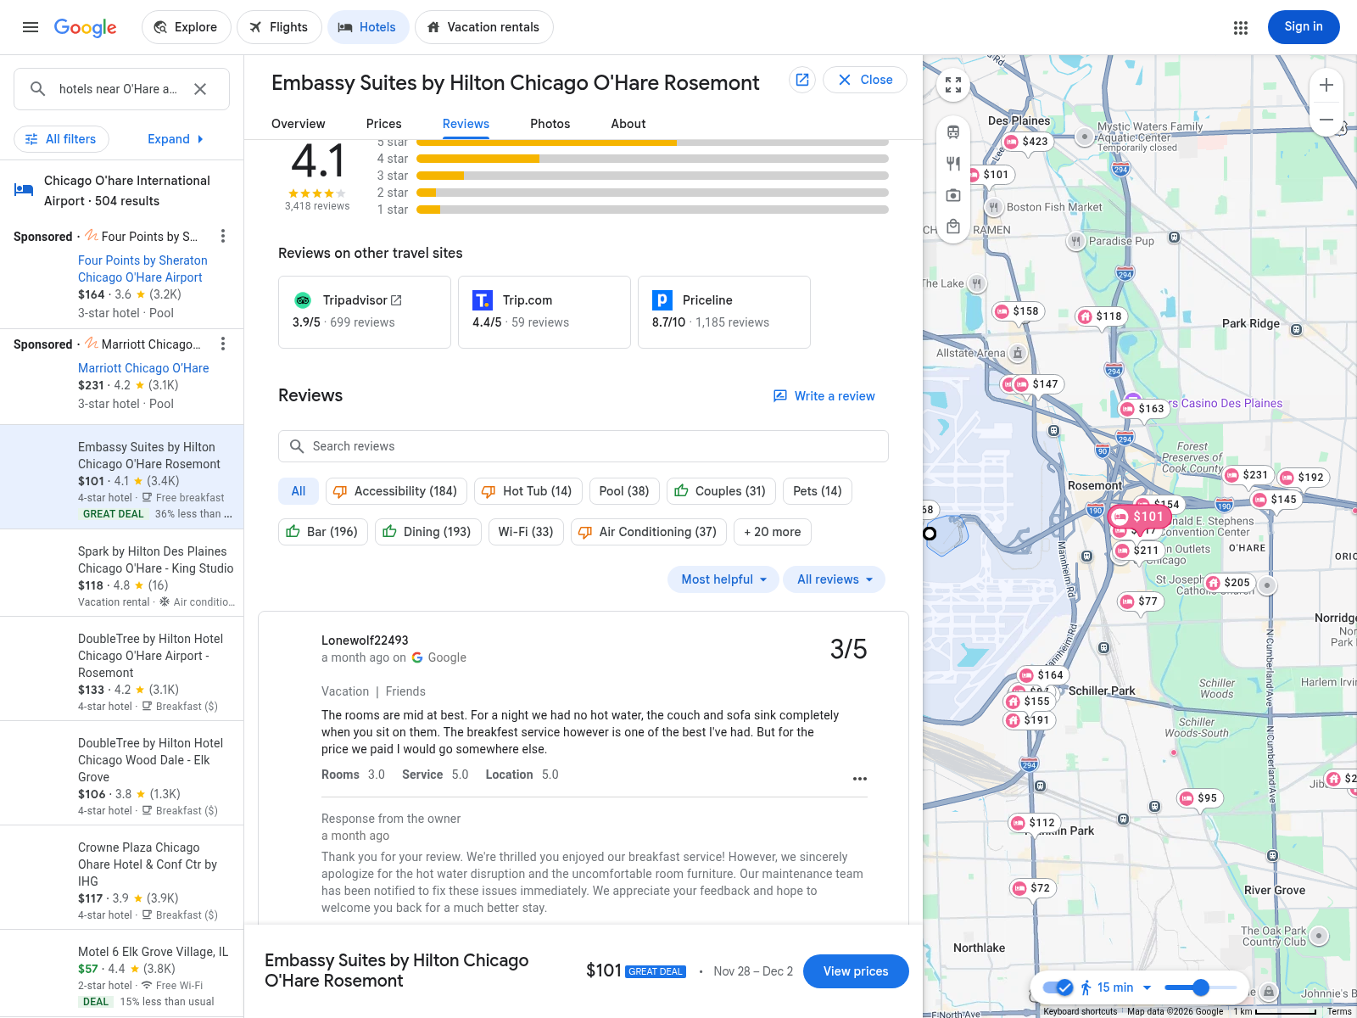
Chicago | actual review evidence
Captured 2026-10-24 UTC | travel 2026-11-28 to 2026-12-02 | USD
Google 4.1/5; 3,418 reviews. One month-old 3/5 account reports no hot water and badly worn couch/sofa. Owner acknowledges and says maintenance was notified, without repair-completion evidence. A single report does not prove a repeated pattern; it does require follow-up before admission.
https://www.google.com/travel/hotels | archived 2026-10-24 UTC; these are guest allegations/opinions, not independently established defects.

Slide 20
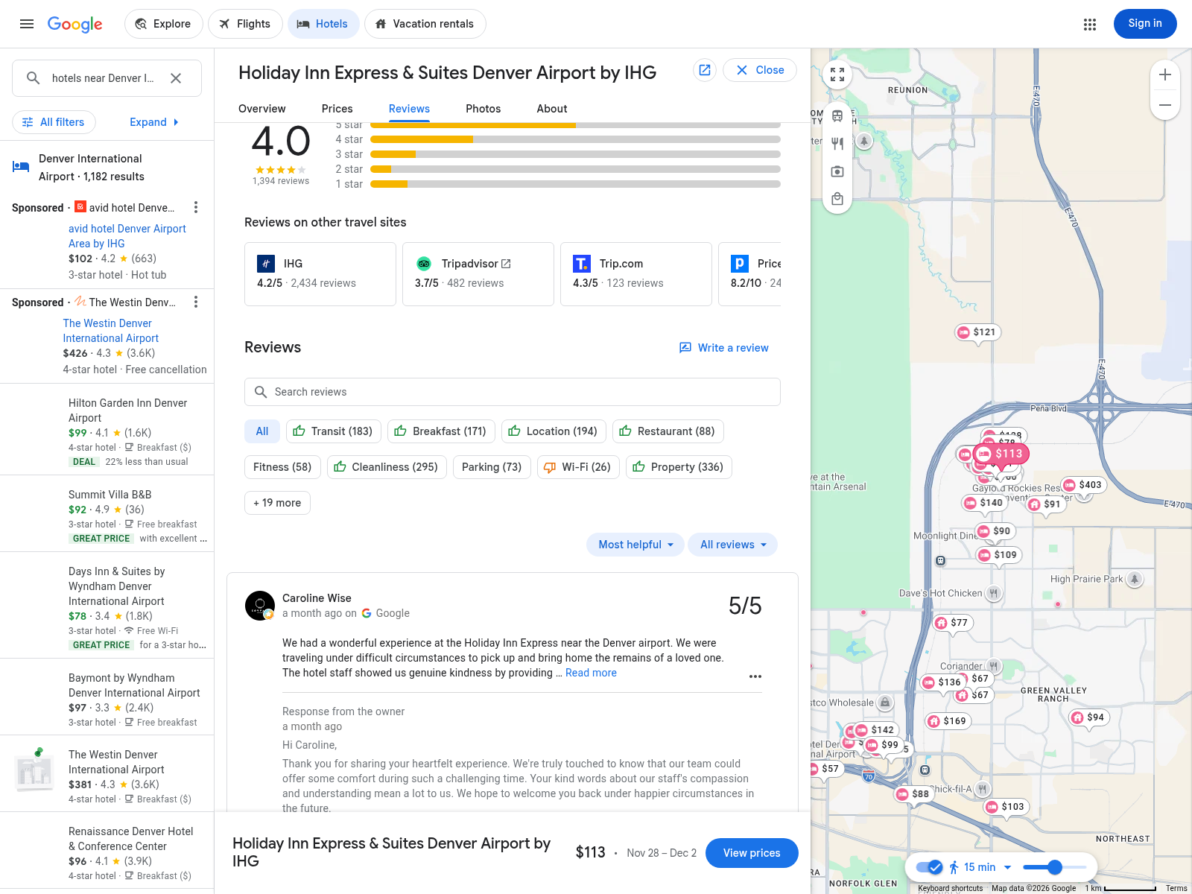
Denver alternative | actual review evidence
Captured 2026-10-24 UTC | travel 2026-11-28 to 2026-12-02 | USD
Holiday Inn Express & Suites Denver Airport: 4.0/5; 1,394 reviews. Visible month-old 5/5 account praises compassionate service. It does not establish cleanliness, night-noise and maintenance coverage; no blanket quality clearance is inferred.
https://www.google.com/travel/hotels | archived 2026-10-24 UTC; these are guest allegations/opinions, not independently established defects.

Slide 21
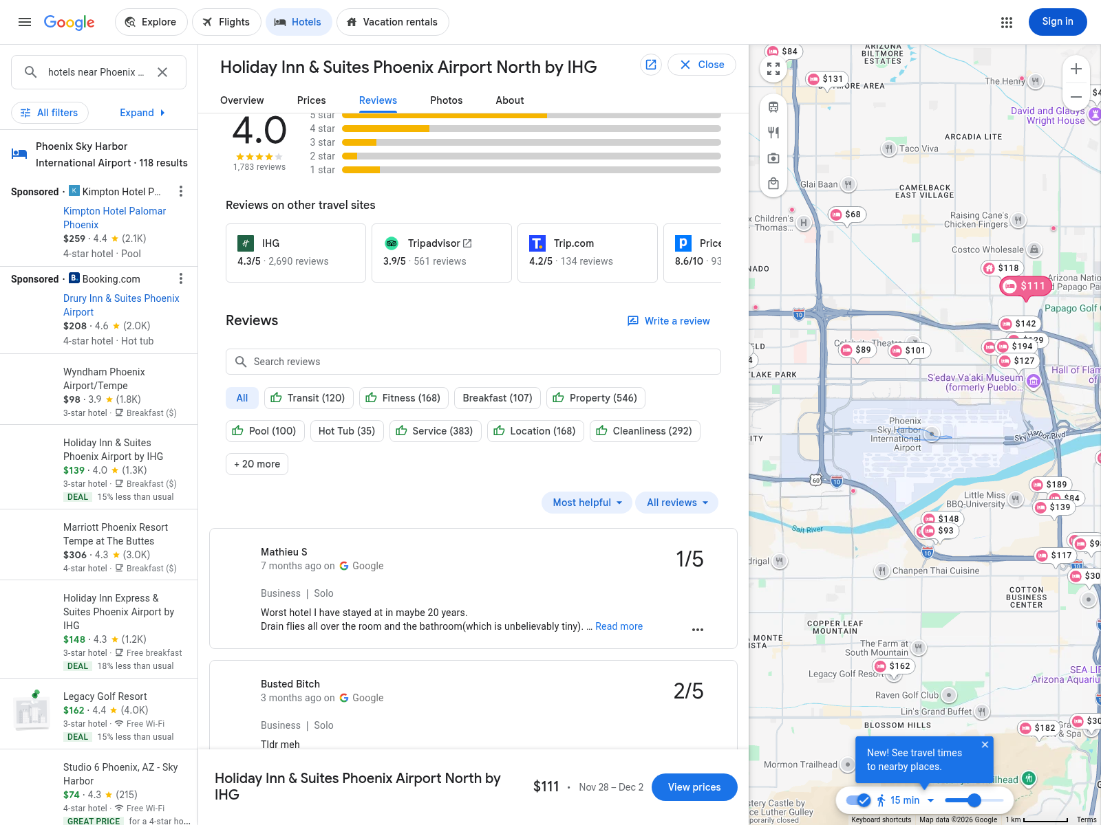
Phoenix alternative | actual review evidence
Captured 2026-10-24 UTC | travel 2026-11-28 to 2026-12-02 | USD
Holiday Inn & Suites Phoenix Airport North: 4.0/5; 1,783 reviews. Visible 7-month-old 1/5 report alleges drain flies; another 3-month-old 2/5 entry is visible but its full text is not. Request a recent topic-specific review sample and response/remediation evidence.
https://www.google.com/travel/hotels | archived 2026-10-24 UTC; these are guest allegations/opinions, not independently established defects.

Slide 22
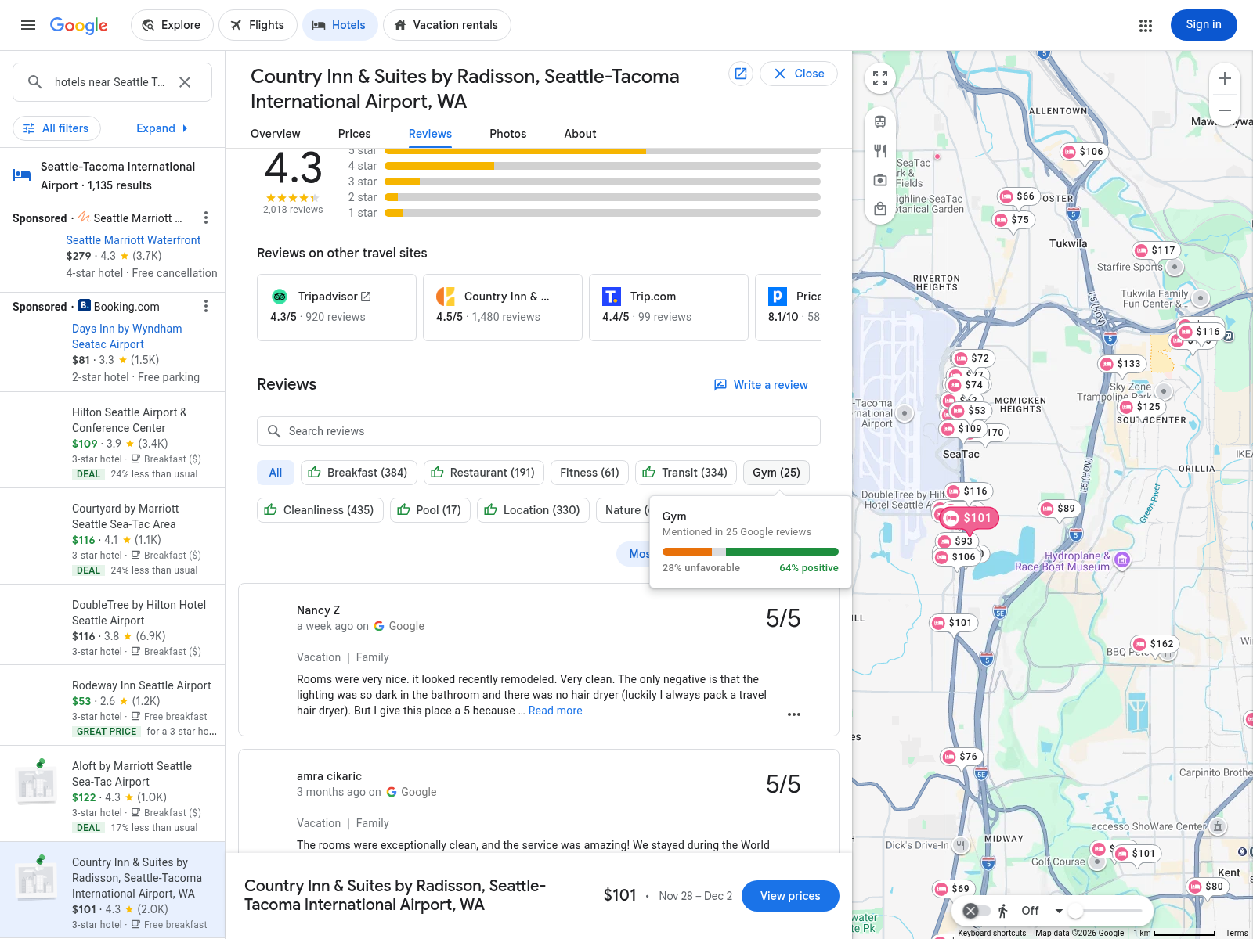
Seattle | actual review evidence
Captured 2026-10-24 UTC | travel 2026-11-28 to 2026-12-02 | USD
Country Inn: 4.3/5; 2,018 reviews. Week-old 5/5 report describes renovated clean rooms but dark lighting and no hair dryer; a second older fragment praises cleanliness. This sample does not prove an absence of noise or maintenance problems.
https://www.google.com/travel/hotels | archived 2026-10-24 UTC; these are guest allegations/opinions, not independently established defects.

Slide 23
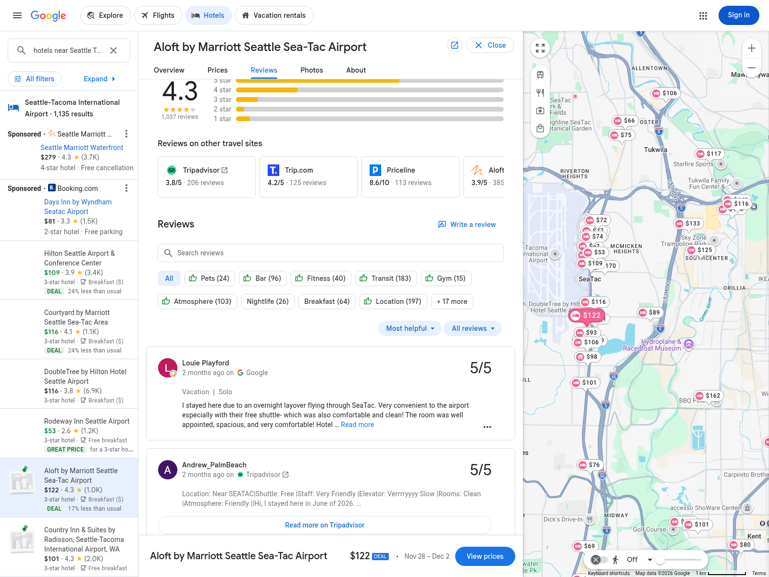
Seattle alternative - correction | actual review evidence
Captured 2026-10-24 UTC | travel 2026-11-28 to 2026-12-02 | USD
Aloft: 4.3/5; 1,037 reviews. The two visible two-month-old reviews are 5/5 and positive about convenience/shuttle and room cleanliness; one mentions a slow elevator. Earlier aircraft/monorail-noise exclusion is unsupported by this screenshot and has been withdrawn.
https://www.google.com/travel/hotels | archived 2026-10-24 UTC; these are guest allegations/opinions, not independently established defects.

Slide 24
Boston | specific competing hotel
Captured 2026-10-24 UTC | travel 2026-11-28 to 2026-12-02 | USD
Cambria Boston Downtown-Seaport: $120/night, 8.6/10 (105). King Bed; breakfast not displayed. $108 DoubleTree remains the lower room anchor; both lack recent topic-specific reviews.
Original dated platform screenshot; screening uses score scale, count, recent issue evidence and room/breakfast/transport conditions together.

Slide 25
Chicago | specific competing hotel
Captured 2026-10-24 UTC | travel 2026-11-28 to 2026-12-02 | USD
Warwick Allerton: $145/night, 8.6/10 (399), Standard Room/queen bed; one left at price. Breakfast and reviews unresolved. Compared with Embassy $101, different location may alter venue transport; group rooms are not secured.
Original dated platform screenshot; screening uses score scale, count, recent issue evidence and room/breakfast/transport conditions together.

Slide 26
Denver | specific competing hotel
Captured 2026-10-24 UTC | travel 2026-11-28 to 2026-12-02 | USD
Holiday Inn Express Denver Downtown: $79/night, 8.5/10 (89), Standard King Room with Sofa Bed, breakfast included. Lower than Home2 $109. Both require recent reviews and dated inventory; it remains a live competitor, not an omitted option.
Original dated platform screenshot; screening uses score scale, count, recent issue evidence and room/breakfast/transport conditions together.

Slide 27
Phoenix | specific competing hotel
Captured 2026-10-24 UTC | travel 2026-11-28 to 2026-12-02 | USD
Hyatt Place Phoenix/Downtown: $164/night, 8.7/10 (119), King Bed plus Sofa Bed, breakfast and free cancellation shown. Within $165 cap but little margin; downtown venue access may favor it over Hampton North/Happy Valley.
Original dated platform screenshot; screening uses score scale, count, recent issue evidence and room/breakfast/transport conditions together.

Slide 28
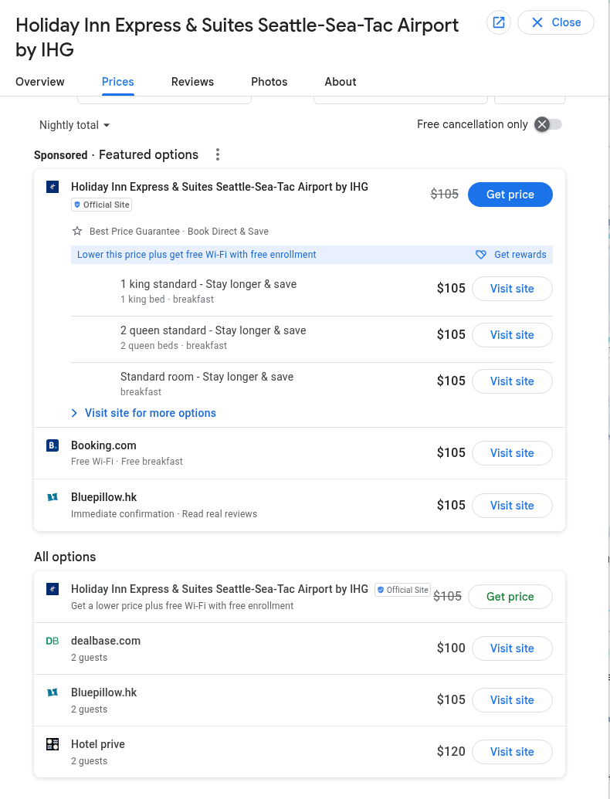
Seattle | specific competing hotel
Captured 2026-10-24 UTC | travel 2026-11-28 to 2026-12-02 | USD
Holiday Inn Express & Suites Seattle-Sea-Tac: $100 dealbase / $105 official, 4.1/5 (1,525). Screenshot offers 2 guests; breakfast/provider and exact one-adult terms remain unresolved. Do not equate a lower headline price with a cleared alternative.
Original dated platform screenshot; screening uses score scale, count, recent issue evidence and room/breakfast/transport conditions together.

Slide 29
What the evidence currently supports
Captured 2026-10-24 UTC | travel 2026-11-28 to 2026-12-02 | USD
No fully qualified recommendation is established yet. This follows actual documented gaps, not a blanket refusal to research: Boston lacks adopted breakfast/recent-review proof; Chicago has unresolved one-adult applicability and a maintenance complaint; Denver and Phoenix adopted cards lack recent topic evidence; Seattle still needs one-adult/provider matching and a noise review.
Complete the low-cost candidate first, while keeping all five cities and their specific hotel alternatives in the conditional model. Inventory, venue address/capacity, airport/venue travel, supplier eligibility and funds are execution gates, not facts already confirmed.
A quote date change requires new pricing; a 2-guest row is not established single-occupancy pricing. No screenshot was fabricated or redrawn, and the original captures are retained in the revised presentation.
Policy checked: https://www.rd.usda.gov/media/file/download/2036a.pdf - 2036.74 | approval_register.csv records specific evidence requests.

Slide 30
Repaired budget snapshot | conditional totals, USD
Captured 2026-10-24 UTC | travel 2026-11-28 to 2026-12-02 | USD
City / people | Partial base | Partial total | +20% total | U max base | U max +20%
Boston / 24 | 35,420.16 | 37,191.17 | 38,758.61 | 15,056.03 | 13,563.23
Boston / 18 | 26,565.12 | 27,893.38 | 29,068.96 | 23,911.07 | 22,791.47
Chicago / 24 | 39,812.16 | 41,802.77 | 43,163.57 | 10,664.03 | 9,368.03
Chicago / 18 | 29,859.12 | 31,352.08 | 32,372.68 | 20,617.07 | 19,645.07
Denver / 24 | 44,335.68 | 46,552.46 | 49,465.58 | 6,140.51 | 3,366.11
Denver / 18 | 33,251.76 | 34,914.35 | 37,099.19 | 17,224.43 | 15,143.63
Phoenix / 24 | 46,176.00 | 48,484.80 | 50,999.76 | 4,300.19 | 1,904.99
Phoenix / 18 | 34,632.00 | 36,363.60 | 38,249.82 | 15,844.19 | 14,047.79
Seattle / 24 | 43,763.52 | 45,951.70 | 48,925.30 | 6,712.67 | 3,880.67
Seattle / 18 | 32,822.64 | 34,463.77 | 36,693.97 | 17,653.55 | 15,529.55
Derived partial estimates, not supplier commitments. Chicago rows use breakfast-linked $158, which exceeds the Dec-1 $148 cap and is EXCLUDED. Billabook $101 is archival only. Each row has separate unresolved U(city,people); unknown costs and single-occupant applicability are not assumed away.
Snapshot source: conference_budget.xlsx Options / Thresholds. Trip 11/28-12/2; M&IE inside budget; internal lodging-tax estimate 12%.

Slide 31
Corrected quote selection and decision status
Captured 2026-10-24 UTC | travel 2026-11-28 to 2026-12-02 | USD
No fully qualified recommendation is established. Boston 24 is now the first evidence-completion priority: partial base $35,420.16; reserve $1,771.01; partial total $37,191.17 + 1.05 U_Boston_24. At +20% airfare: $38,758.61 + 1.05 U_Boston_24. The DoubleTree $108 card does not show breakfast inclusion; a breakfast quote or matching breakfast-inclusive rate is required.
Chicago Embassy: the $101 Billabook 2-guest row is NOT a breakfast-matched compliant price. Agoda $158 free-breakfast and Booking $159 breakfast suite are linked offers, but both exceed the $148 Dec-1 cap without authorization. The $158 anchor gives $41,802.77 + 1.05 U_Chicago_24 and is excluded from compliant ranking. Do not clamp the rate.
Nearest recorded cost backup A19: Boston 24 with American $358 round-trip airfare and the same $108 DoubleTree room. Partial base $36,548.16; total $38,375.57 + 1.05 U_A19; +20% total $40,179.89 + 1.05 U_A19. Its base and stress unquoted-cost ceilings are $13,928.03 and $12,209.63. Both Boston combinations still require breakfast/quality/room evidence. Chicago DoubleTree $133 also remains pending breakfast cost and one-adult terms; a different city is not automatically the nearest backup.
Seattle Booking.com $101 expressly includes free breakfast, but its 2-guest quote is not established as a one-adult offer. Only verified eligible candidates enter ranking: maximize headcount, then lowest total, then city name; move to 18 only after all eligible 24-person choices fail. All unquoted cost conditions remain candidate-specific.
Re-export this PPT / Word / CSV / approval PDF after any workbook parameter change. Current partial estimates are not a complete procurement authorization.

Slide 32
Boston A19 | original American $358 round-trip alternative
Existing ITA Matrix capture, 2026-10-24 UTC, DCA-BOS Nov28-Dec2. American $358 rows show 07:54-09:30 outbound and return alternatives 06:00-07:49, 09:26-11:14 or 10:12-11:59 local time. Exact chosen return and access to the Dec2 furnished lunch require confirmation; no group seats held.
https://matrix.itasoftware.com | original Claude source screenshot retained; this is an unresolved candidate, not an approved booking.

